Slide 1
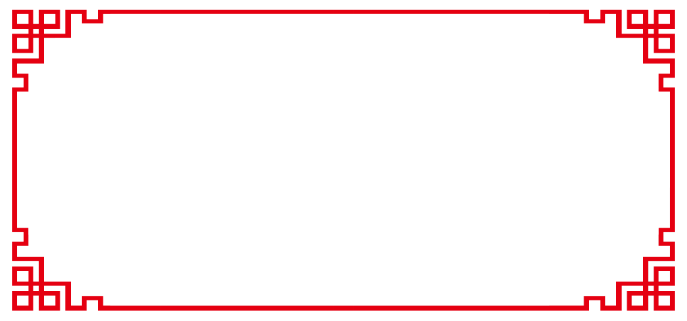
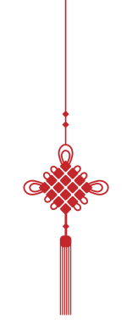
Chinese
Knots
Chen Zilan
Landy

Slide 2
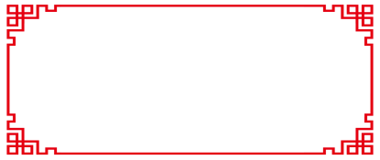
Contents
1. History of Chinese Knots
2. Types and Styles of Chinese Knots
3. Craftsmanship of Chinese Knots
4. Modern Applications of Chinese Knots
5. Chinese Knots and Other Cultures

Slide 3
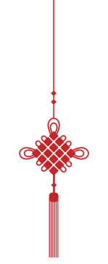
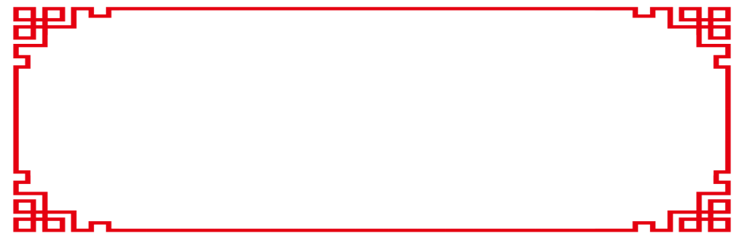
01 History of Chinese Knots

Slide 4
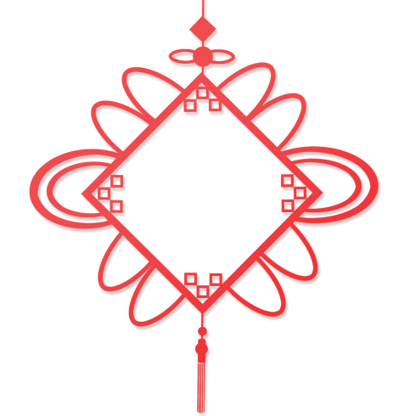
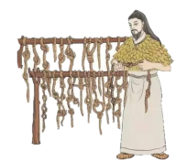
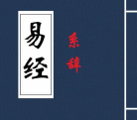
The Chinese knot is a unique Chinese folk hand-knotted ornament, which was originally used in the Paleolithic era for sewing and tying knots.
The knots began in the ancient ancestors of the rope to remember things - there was no writing in the ancient times, and the rope was knotted to remember things.
origin
据《易·系辞》载：“上古结绳而治，后世圣人易之以书目契。”
Later, it was extended to the Han Dynasty‘s ritual notation.
东汉郑玄在《周易注》中道：“结绳为约，事大，大结其绳；事小，小结其绳。”

Slide 5
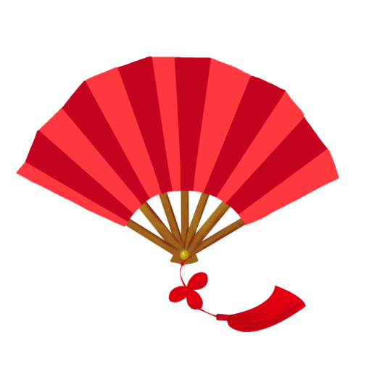
Decoration
In the Tang and Song dynasties (618 – 1279): period of the beginning
In the Ming and Qing dynasties (1368 – 1911): flourishing period
Modern times: inheritance, innovation, and dissemination

Slide 6
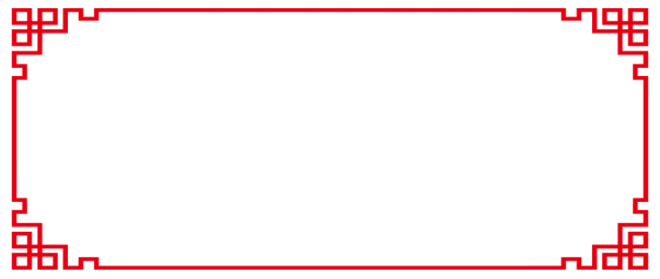
02 Types and Styles

Slide 7
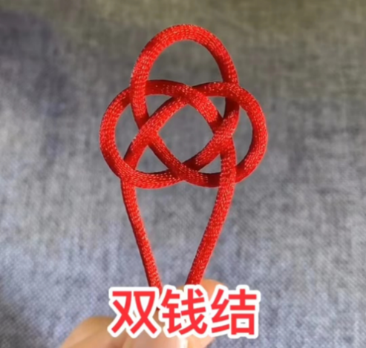
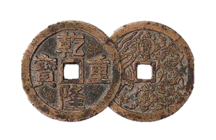
just like two copper cash
Symbolizing “good things come in pairs”.
In ancient times, “钱” was also called “泉”, which is the same sound as “全”, and can symbolize “Double Perfection”.

Slide 8
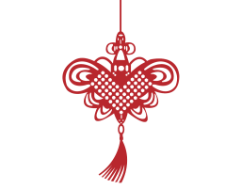
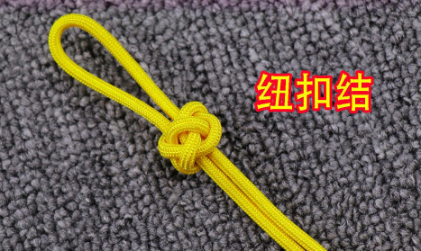
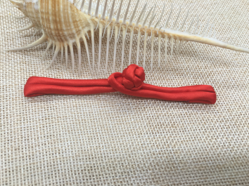
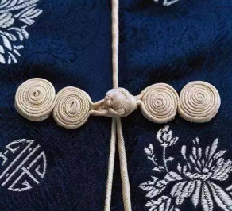
It is often used as a button for clothing. Button knot is not only used on clothes, but also as a decorative knot.

Slide 9
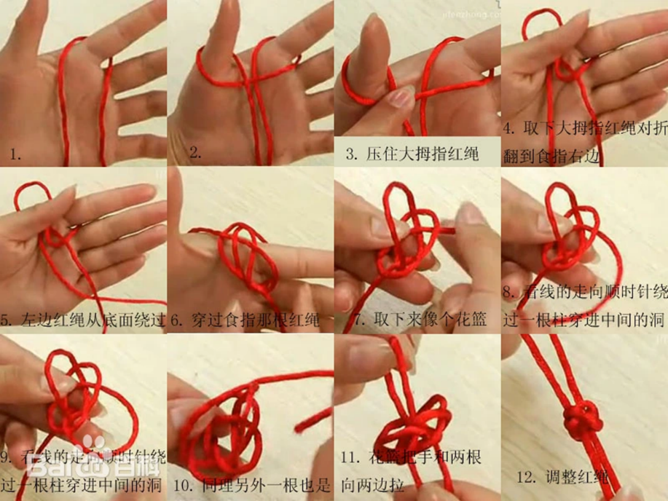

Slide 10
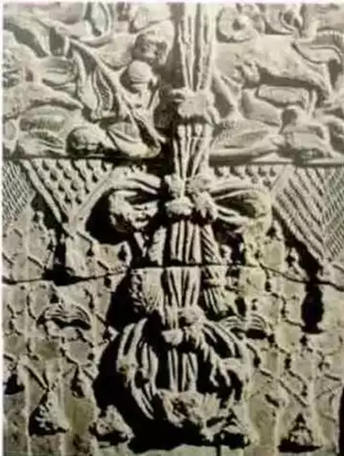

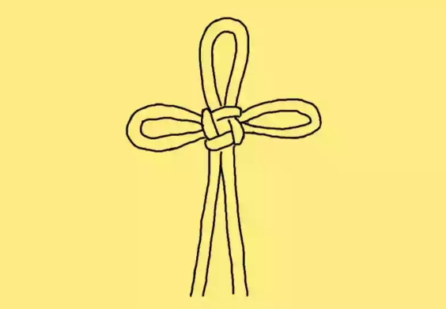
万字结
“卍”
It symbolizes the best of luck and longevity.
——安阳修定寺塔基残砖上的万字结

Slide 11
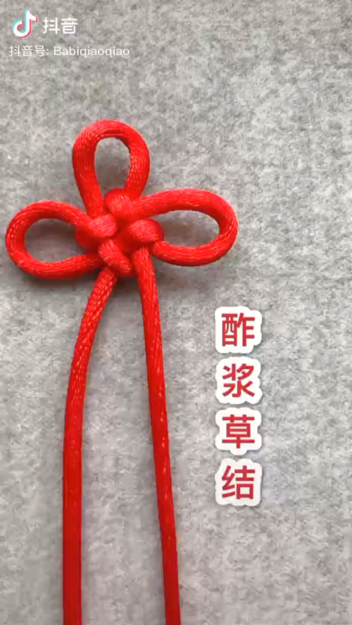
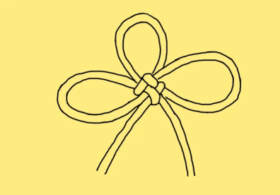
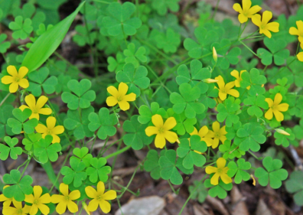
酢浆草结
The sorrel knot, which is named for its shape that resembles sorrel, is also known as the Chinese bow. The edelweiss is a three-leafed herb and is considered a lucky plant.
So the knot is also called a lucky knot, which means good luck.

Slide 12
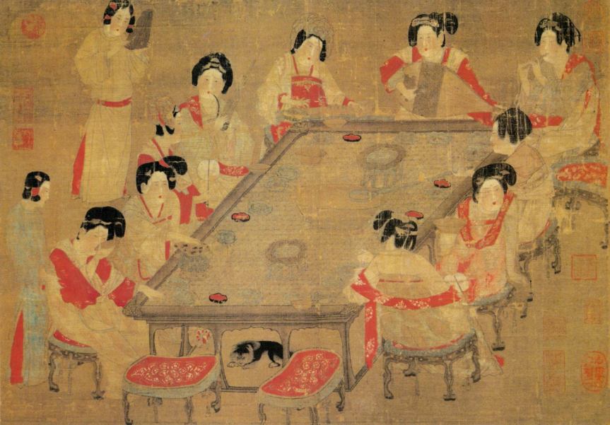
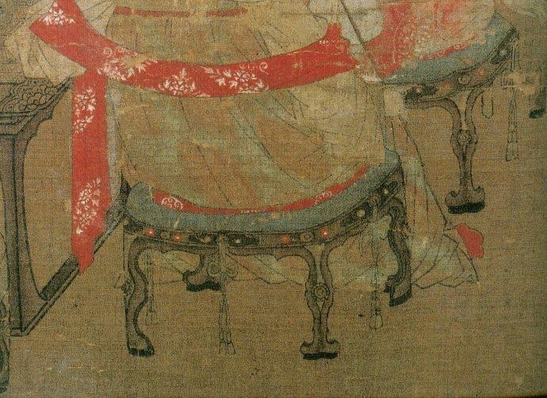
《宫乐图》

Slide 13
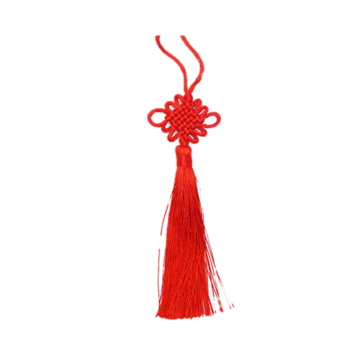
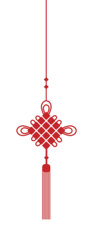
盘长结
It symbolizes the origin of all things.
It is easy to be favored by the general public in terms of sense and vision.
the main knot of many variations
tight and symmetrical

Slide 14
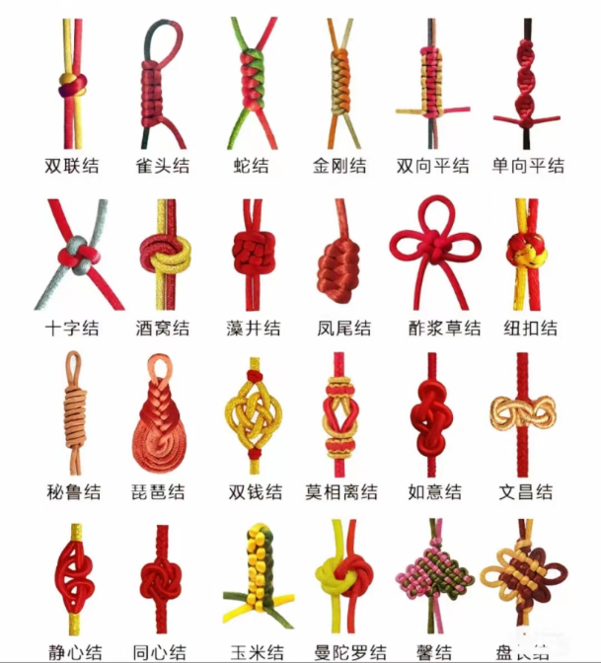

Slide 15
03 Craftsmanship

Slide 16
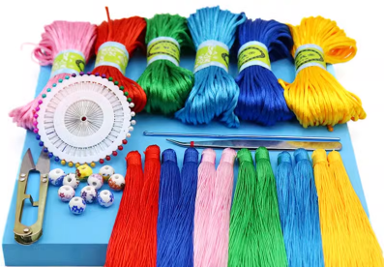
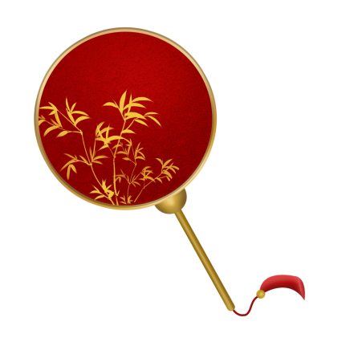

Tools:
cord, beads, needles, tweezes, scissors, pins
Skills:
Pulling, wrapping, weaving, tying, threading, adjusting

Slide 17
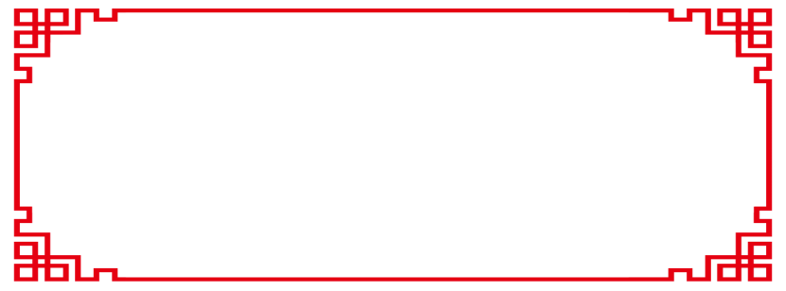
04 Modern Applications

Slide 18

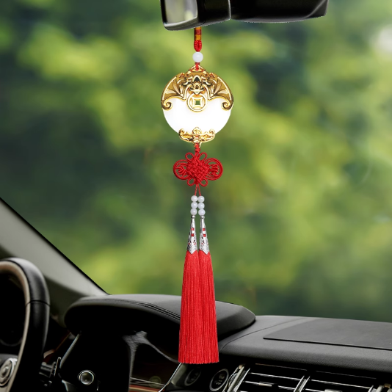
Home decoration

Slide 19
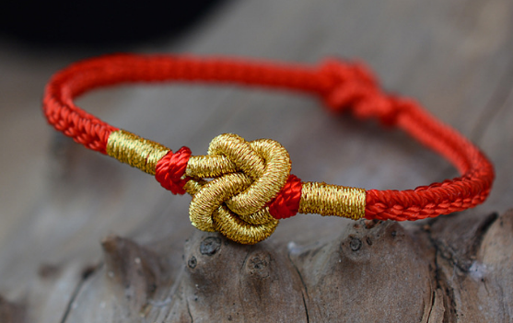
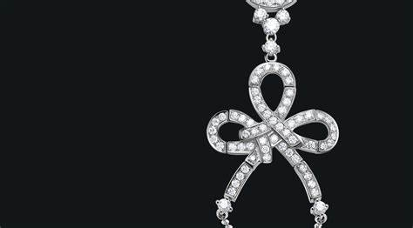
Fashion jewelry

Slide 20
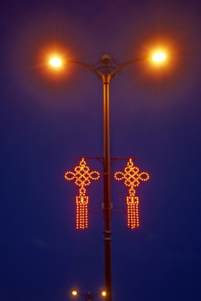
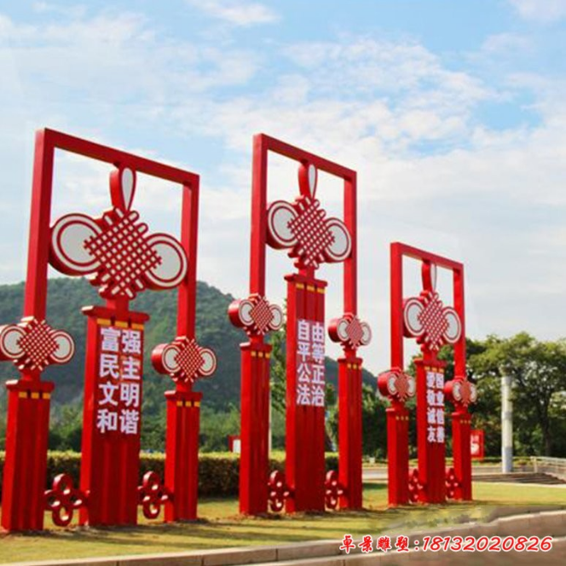
Artistic work

Slide 21
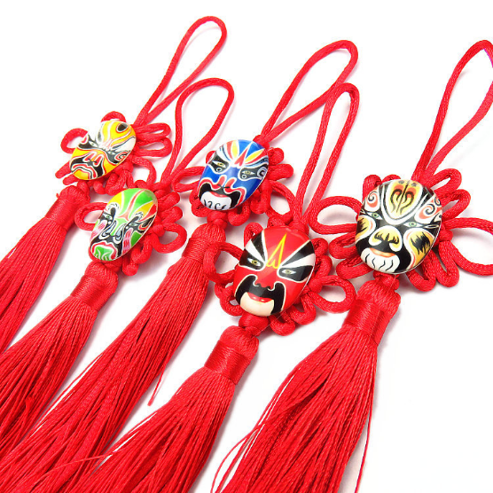
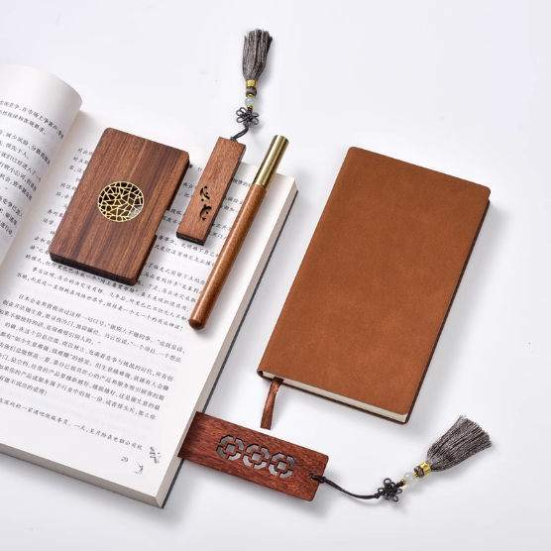
Gifts and souvenirs

Slide 22
05 Chinese Knots and Other Cultures

Slide 23
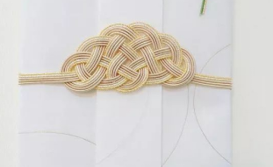
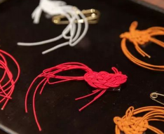
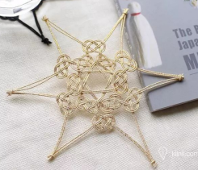
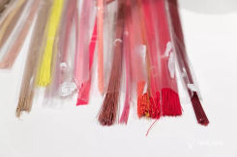
The traditional Japanese knotting craft, which originated from the Chinese knot, was brought back to Japan by diplomats to the Tang Dynasty during the Muromachi period(室町时代)
日本水引
みずひき

Slide 24
Thanks

