Slide 1
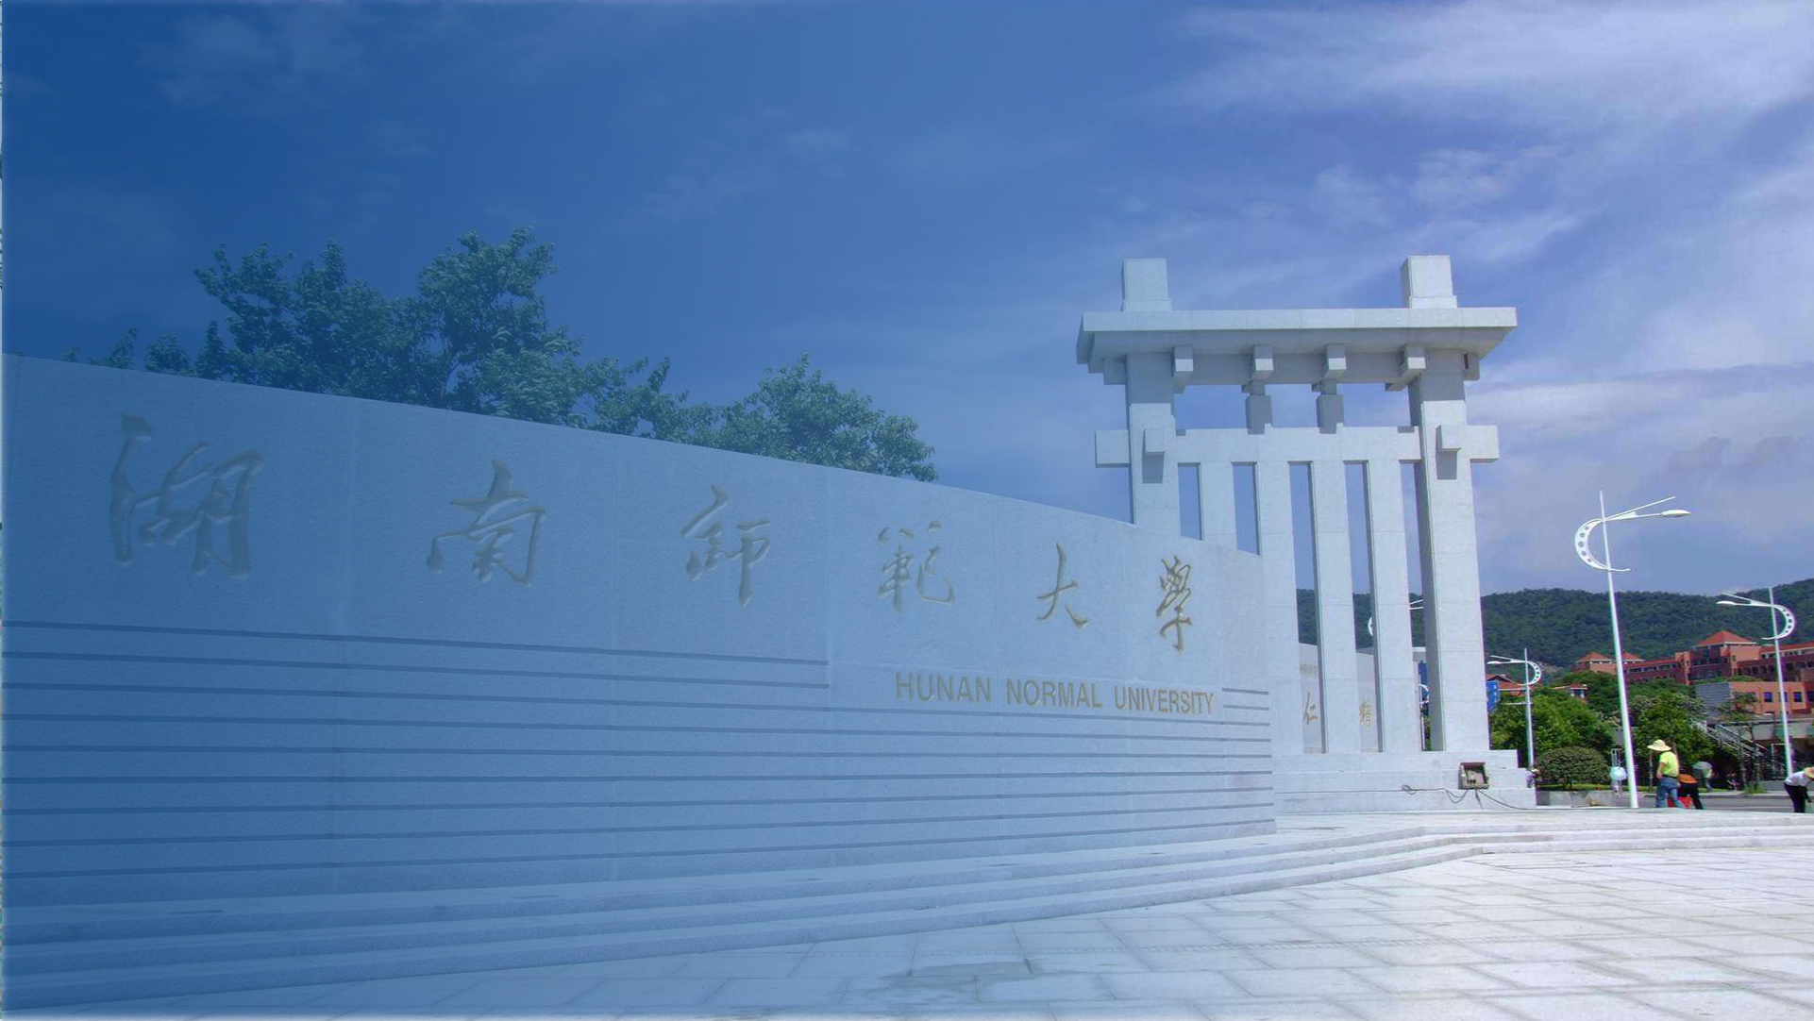

Rhetorics in China
HUNAN NORMAL UNIVERSITY THESIS DEFENSE PPT
Speaker：Qi Yixin
Major：Written Translation in English

Slide 2
Contents
1
Background of Rhetorics
What is Rhetorics
2
Examples and Quiz
3

Slide 3
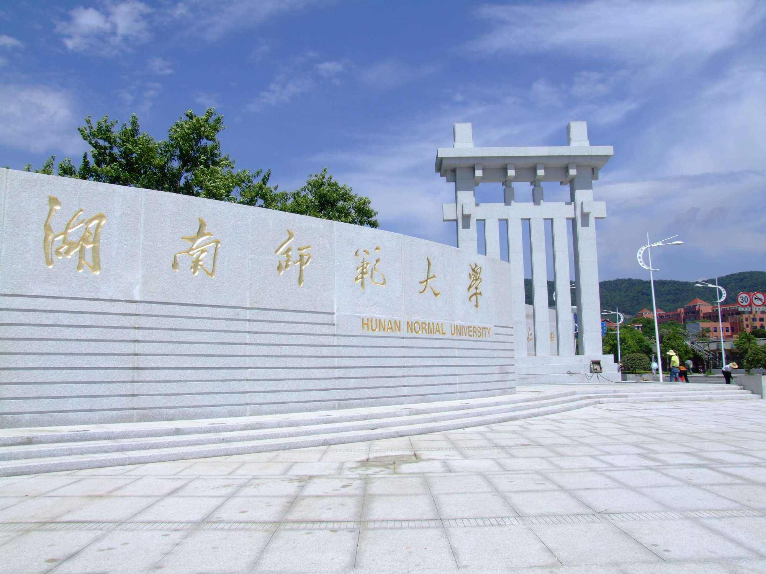

1
Background of Rhetorics

Slide 4
Background of Rhetorics
Han Dynasty
discussion about The Book of Songs《诗经》
赋Fu, 比Bi and兴 Xing
After Wei and Jin Dynasties
many books written on rhetoric, and literary theory
representative work : Literary Mind and Carving of Dragons in the Southern Dynasty by Liu Xie

Slide 5
Background of Rhetorics
After the May 4th Movement
beginning to study rhetoric
b. compiling ancient people's views-- Chinese Rhetoric Research Method 《中国修辞学研究法》
a. mainly imitating western rhetoric-- Rhetorical Patterns《修辞格》 by Tang Yue in 1923

Slide 6
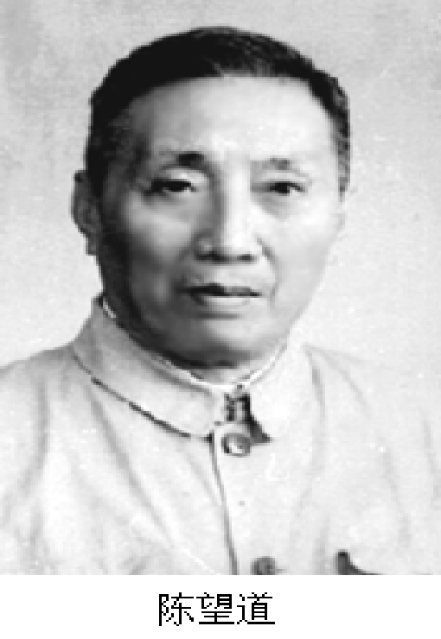
Background of Rhetorics
Chen Wangdao
--China's most important rhetorician
The Origin of Rhetoric（or Fa Fan ） 《修辞学发凡》in 1932
a. creating the first scientific rhetoric system in China;
b. establishing of modern Chinese rhetoric.

Slide 7
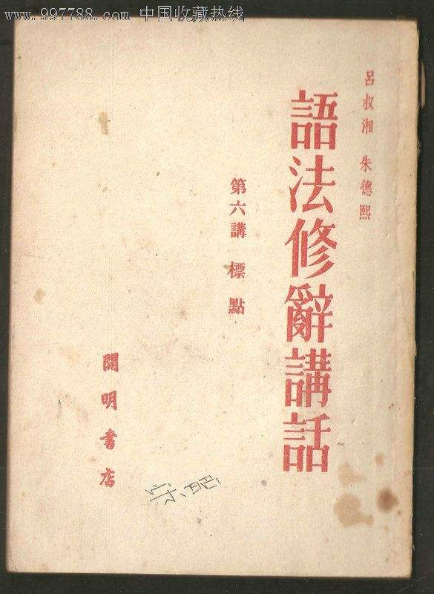
Background of Rhetorics
吕叔湘、朱德熙两位先生合写的《语法修辞讲话》
Address on Grammar and Rhetoric jointly written by Lu Shuxiang and Zhu Dexi in 1951

Slide 8
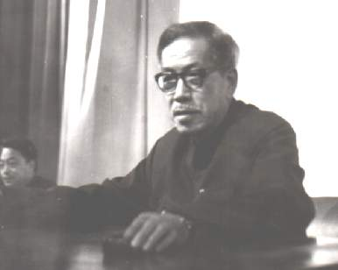
Background of Rhetorics
Rhetoric Summary by Zhang Zhigong
张志公先生的《修辞概要》
Mr. Zhang gave a lecture at Guizhou Radio And TV University

Slide 9
2
What is Rhetorics

Slide 10
What is Rhetorics
two usages
noun
verb
rhetoric (methods, skills, or law)
。
rhetorical activity (people's understanding and description of something)
xiu ci

Slide 11
What is Rhetorics
Rhetoric:
improving the effect of language expression
expressing the same meaning in language in many different ways
For example:
She is very beautiful.(beautiful/handsome/good-looking/pretty/gorgeous)

Slide 12
What is Rhetorics
Differentiation of three different concepts
rhetoric activities
rhetoric
Rhetorics
an activity to express thoughts and feelings with language;
specific, complex and changeable.
rules: common and stable;
not being changed by the subjective will of individuals.
a language science, an independent discipline;
improving the effect of language expression, is a part of linguistics.

Slide 13
What is Rhetorics
The Object of Research:
studying linguistic problems in communication activities；
improving the expression effect.
The Task of Research:
seeking something regular from the phenomena of language;
increasing the effect of language expression;
establishing a system of regular rules.

Slide 14
What is Rhetorics
The scope of rhetoric research:
bringing the whole process of speaking and writing into rhetoric (the title, materials, strategies and chapters of articles,)；
understanding rhetoric as merely beautifying language.

Slide 15
3
Examples and Quiz

Slide 16
Examples and Quiz
Parallelism
Repetition
5
Questioning
4
6
Personification
3
7
Borrowing 借代
Examples
Exaggeration
2
8
Rhetorical questioning
反问
Metaphor
1
9
Sense通感

Slide 17
Examples and Quiz
拈连
Contrast
15
Loopback
14
16
Intertextuality
回文
13
17
Transfer 移就
Examples
Rhetorical questioning
Top Truth 顶真
12
18
11
19
对偶
Puns

Slide 18
Examples and Quiz
Quiz
Rhetorical questioning
1. Don't you think we should stay focused in the class Chinese Culture?
2. A good book is a nice friend.
3. Such travelling is harder than scaling the blue sky.
4. The valley echoes, he just left, he just left, he just left.
5. Where is spring? Spring is in the children's eyes.
metaphor
Exaggeration
Repetition
Questioning

Slide 19
Examples and Quiz
Borrowing
6. The red scarf is coming towards us.
7.When the breeze passes by, it sends a wisp of fragrance, like a song on a distant tower.
8. 大考小考，快把我烤(考)糊(kao hu)了. (The tests, formal or informal, roast me.)
9. Two people were picking roses in the rose garden. One saw the thorns under the roses, and the other saw the red roses in the garden.
Sense
Puns
Contrast

Slide 20
Examples and Quiz
Intertextuality
10. Qin Shi Ming Yue Han Shi Guan.
11. His boiling words inspired me.
12. When Newton was hit by an apple, he discovered gravity; When Columbus sailed around the world, he discovered the new continent; When you look in the mirror, wow, you find a primitive man!
13. In the morning, the mountains yawned.
Transfer
Parallelism
Personification

Slide 21
References
[1] Barabantseva E. From the Language of Class to the Rhetoric of Development: discourses of ‘nationality’ and ‘ethnicity’ in China[J]. Journal of Contemporary China, 2008, 17(56): 565-589.
[2] Dobson W A C H. The language of the Book of Songs[M]//The Language of the Book of Songs. University of Toronto Press, 2017.
[3] Kirkpatrick A, Xu Z. Chinese rhetoric and writing: An introduction for language teachers[M]. Parlor Press LLC, 2012.
[4] Li C. La retórica china: Historia y cultura[J]. Rétor, 2017, 7(1): 21-39.
[5] Lloyd G. La retórica en la antigüedad griega y china[J]. Revista Iberoamericana de Argumentación, 2010 (1).
[6] Martin W. Chinese Language and Culture [C]. European University Press, 2022.
[7] The Obscure Object of Rhetoric[J]. Philosophy & Rhetoric,2021,54(2).
[8] Wagner Nathan R.. The Obscure Object of Rhetoric[J]. Philosophy & Rhetoric,2021,54(2).
姜平: 中西修辞学发展初探[J], 四川教育学院学报, 1998(1), 48-50.
许红菊: 汉语修辞与发展[D], 湖北: 华中科技大学, 2012.

Slide 22
[9] 顶针修辞手法例句, URL:https://www.yuwenmi.com/baike/940649. html? from =singlemessage/<17 Oct. 2022>.
[10] 一语双关的句子,一语双关的经典句子?, URL: https://www.chinansn.com/article-1-b20220625010621e489zu-0.html/<17 Oct. 2022>.
[11] 金双平.现代修辞学的奠基之作——评《修辞学发凡》[J].语文建设,2021(15):82.DOI:10.16412/j.cnki.1001-8476.2021.15.024.
[12] 林少阳.“五四”新学之修辞学:语言思想之现代嬗变[J].济南大学学报(社会科学版),2021,31(01):55-76+158.
[13] 马晓红. 陈望道对中国语法修辞研究的历史贡献[D].复旦大学,2005.
[14] 李行健.《语法修辞讲话》写作的前前后后——访著名语言学家吕叔湘[J].咬文嚼字,2015(09):51-54.
[15] 许贝.大学语文常用修辞手法的教学与思考[J].科教导刊,2022(20):113-115.DOI:10.16400/j.cnki.kjdk.2022.20.037.
[16] 周会会.陈望道与中国修辞学[J].兰台世界,2008(17):63.DOI:10.16565/j.cnki.1006-7744.2008.17.016.

Slide 23
THANK YOU FOR LISTENING

