Slide 1
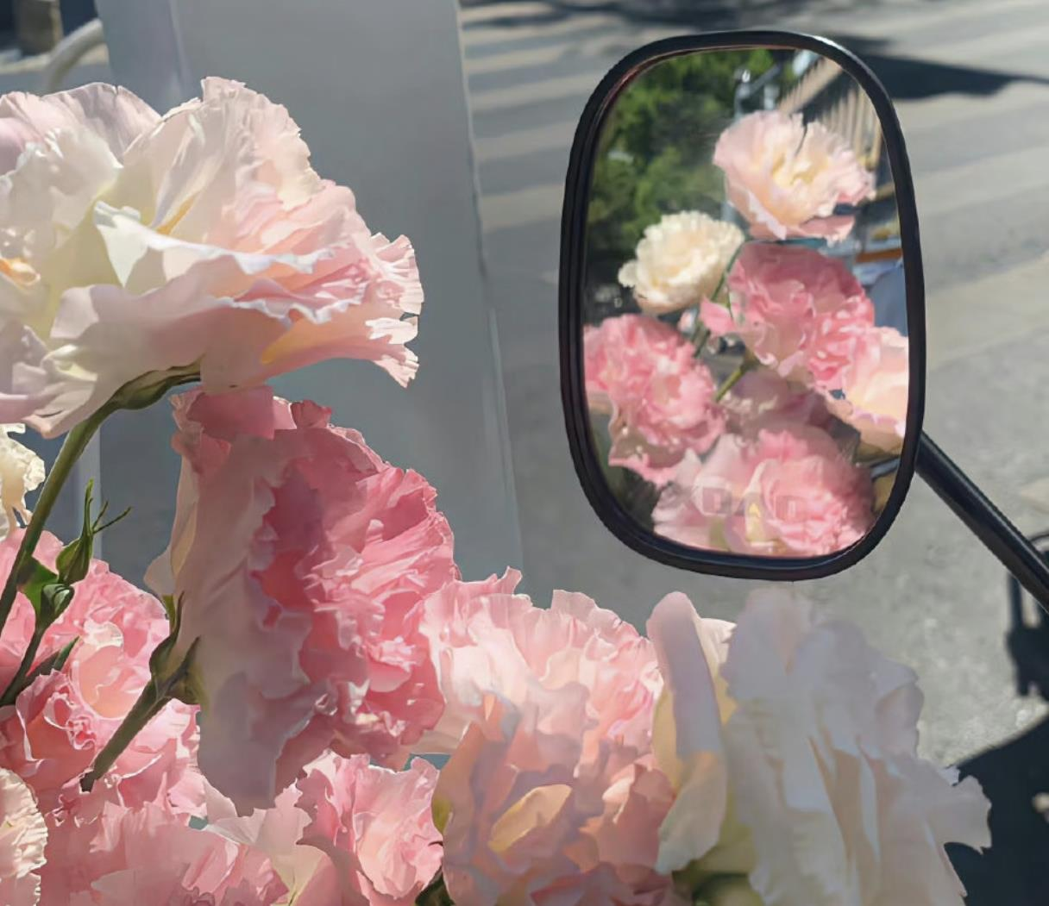
Mirror
镜子
Presenter:
Cheng Sixiang

Slide 2
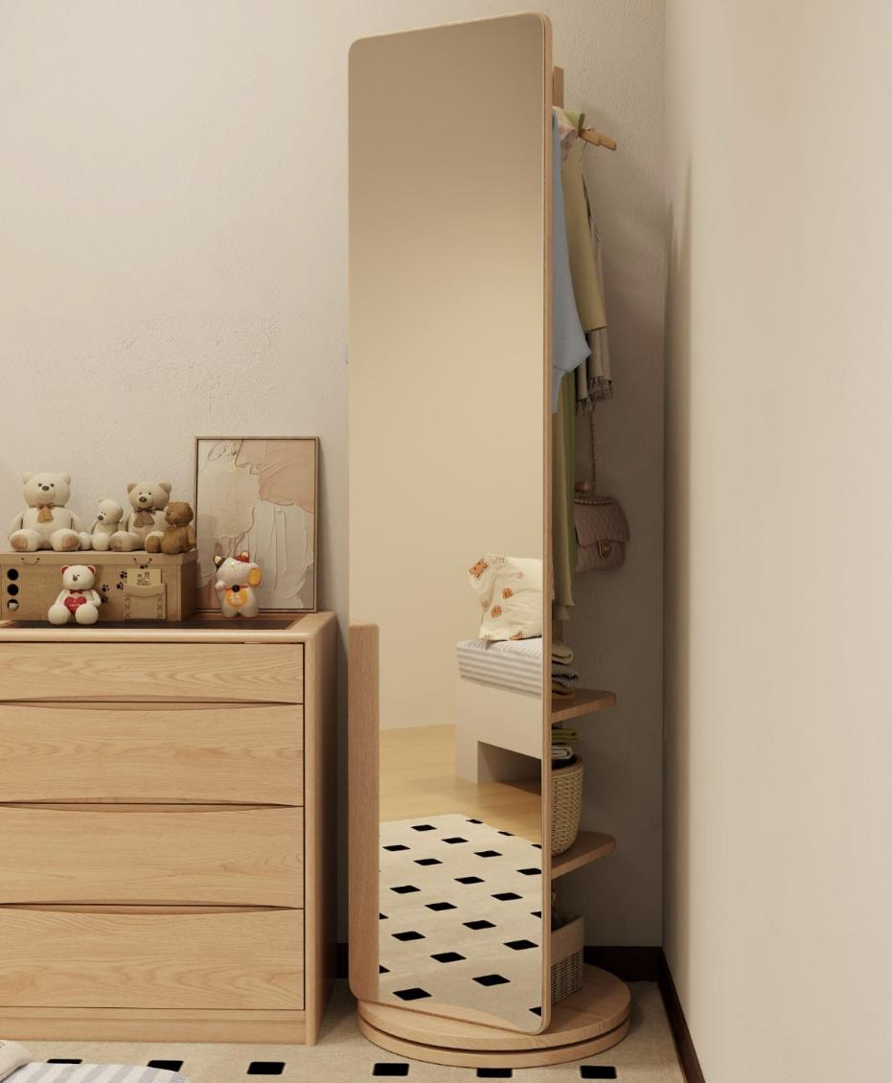
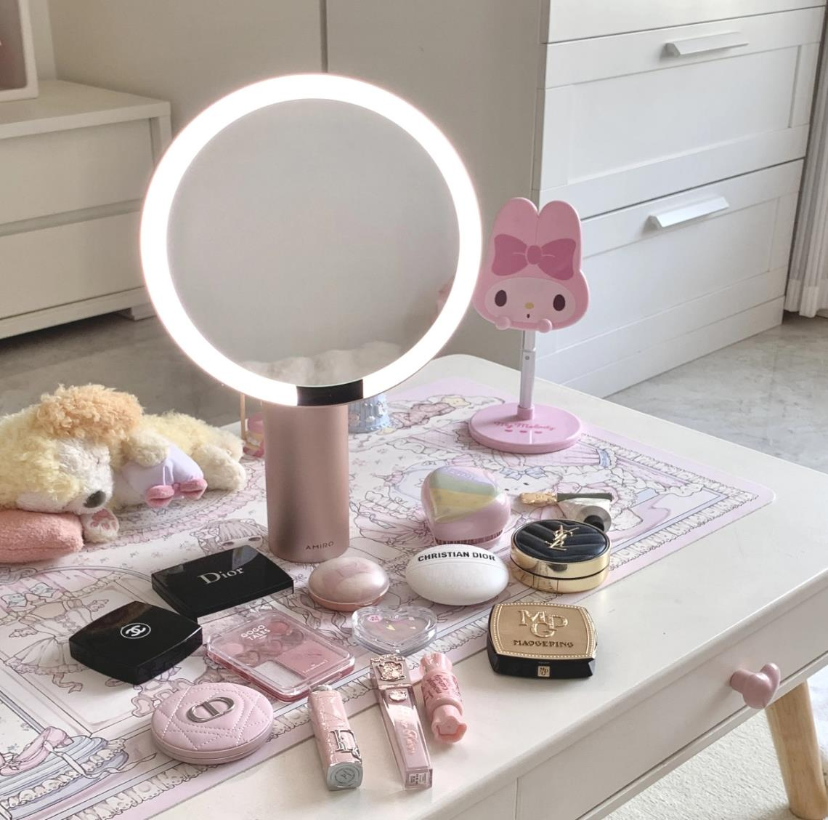
full-length mirror
make up mirror

Slide 3
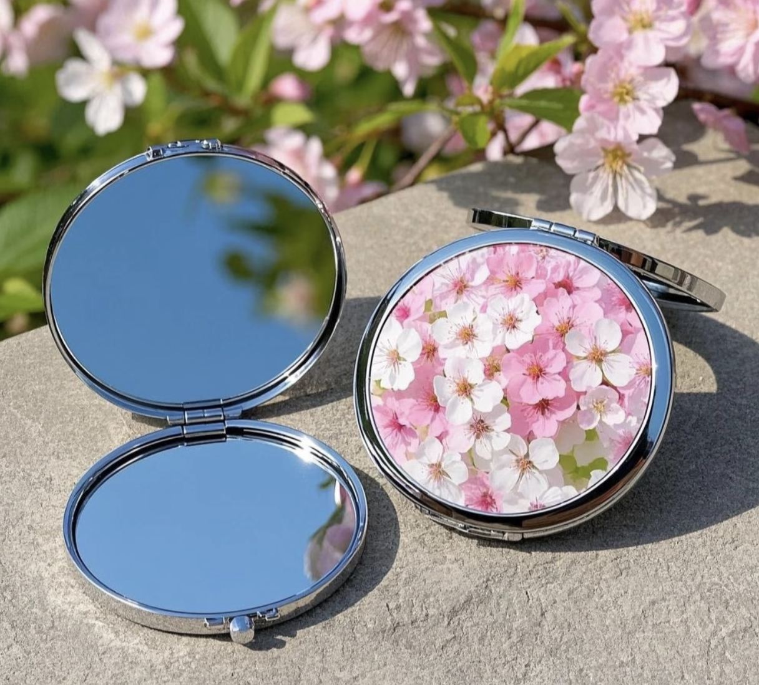
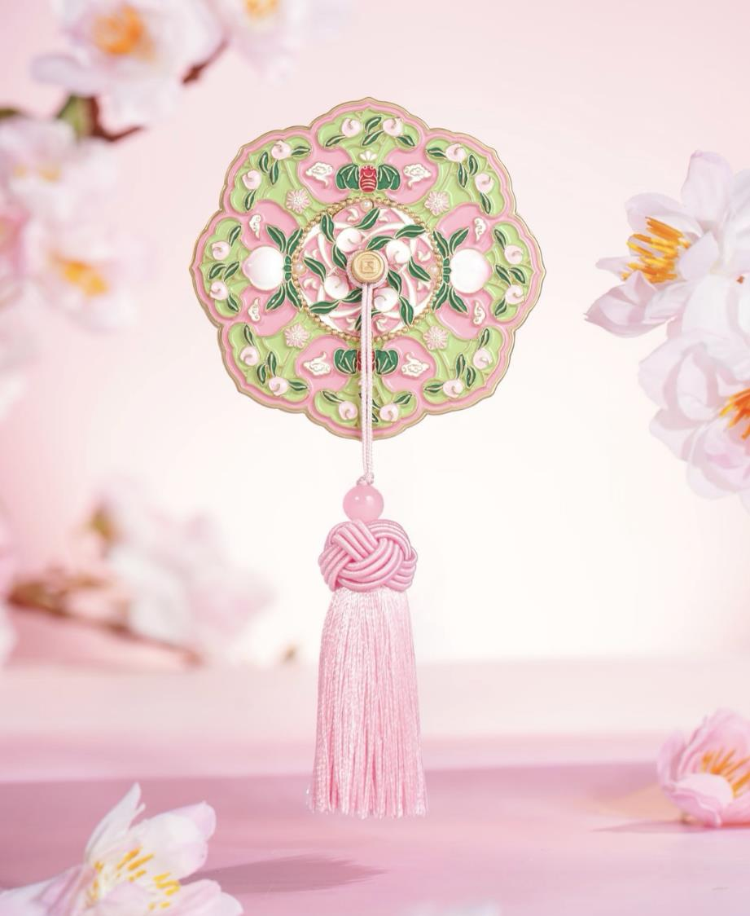
portable mirror
portable mirror

Slide 4
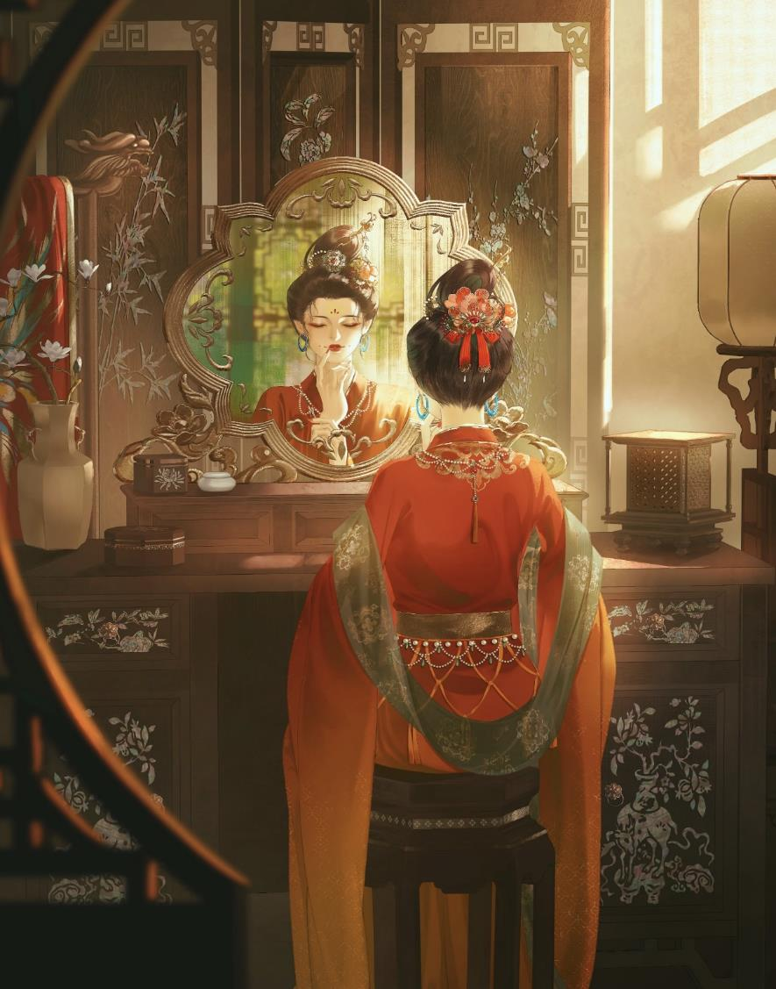
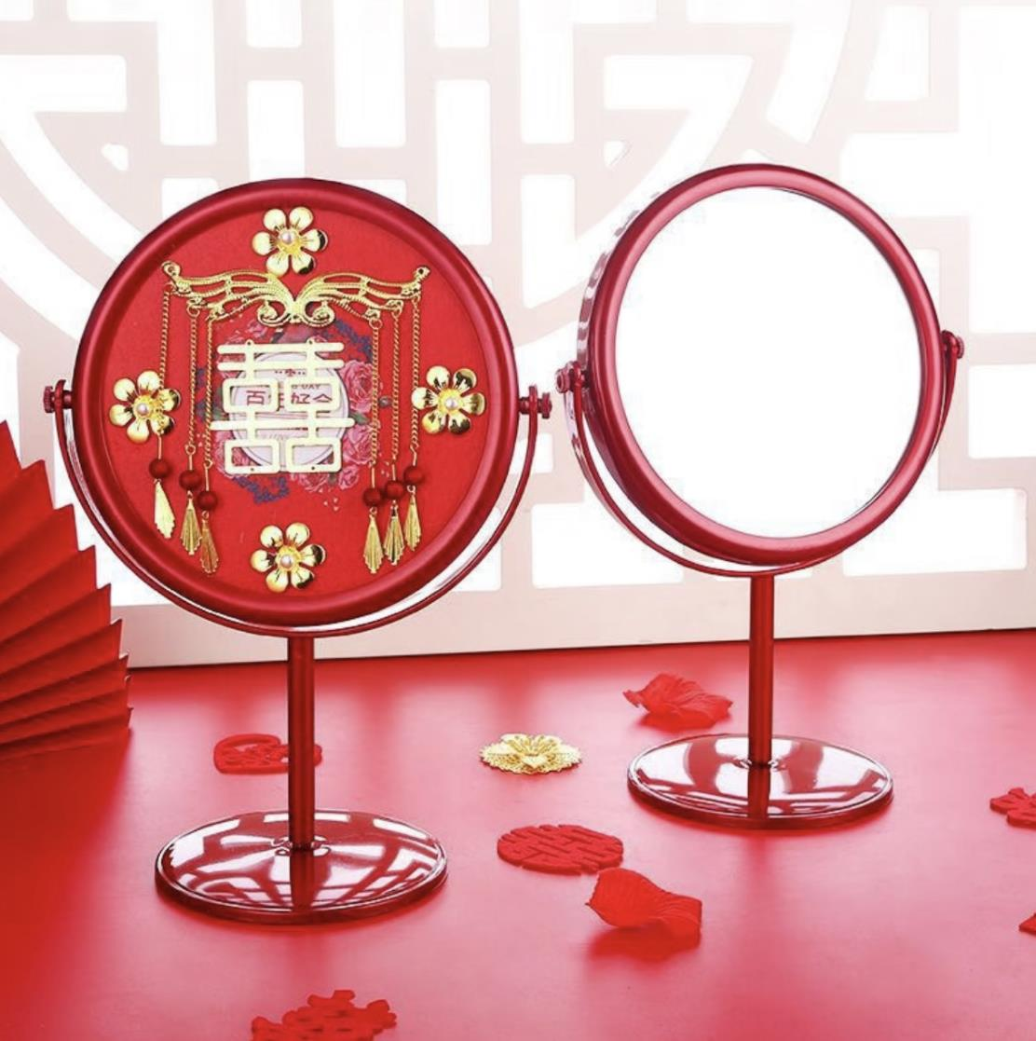
grooming
梳妆
dowry
嫁妆

Slide 5
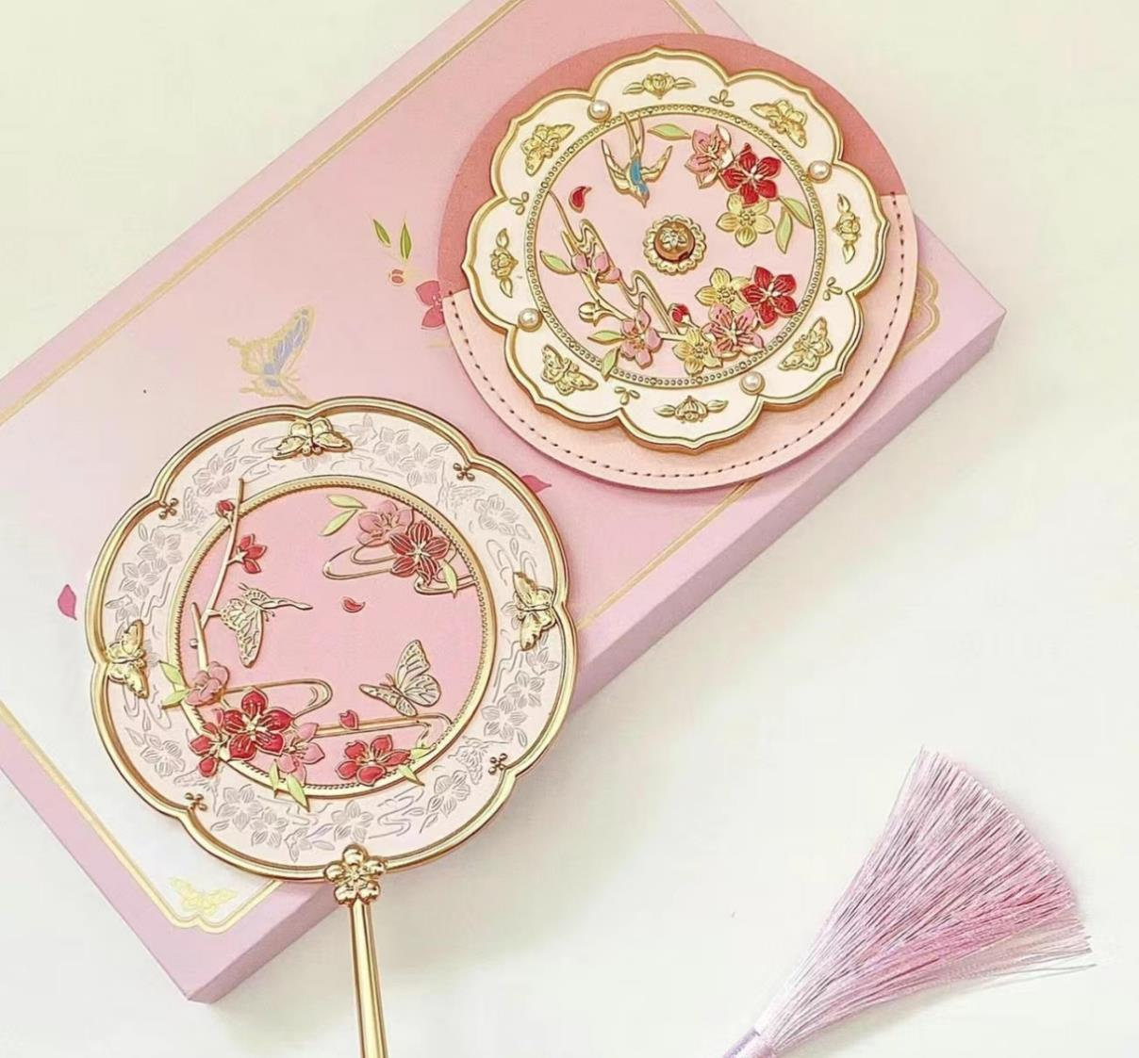
Development History of Bronze Mirrors

Slide 6

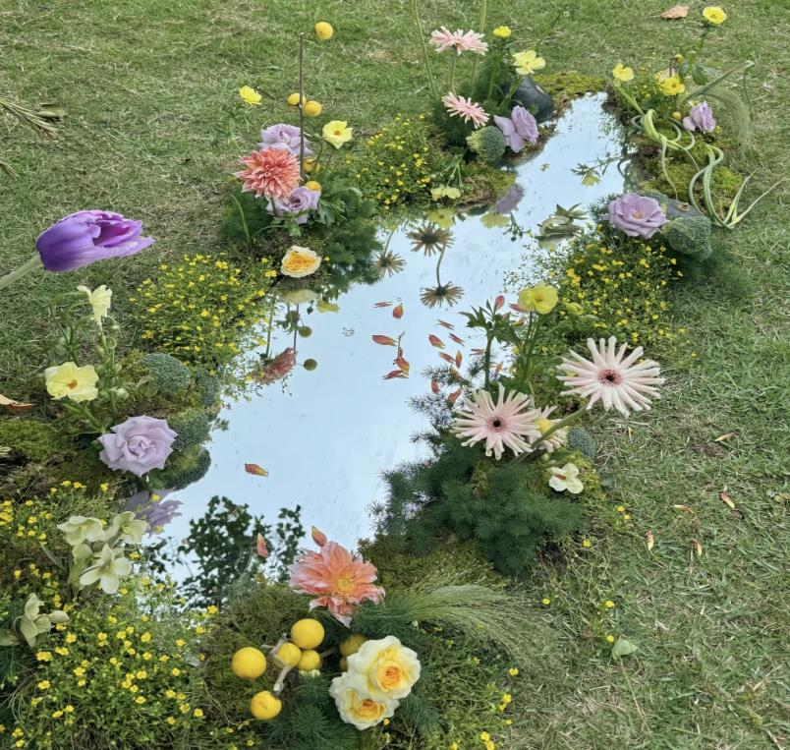
Natural Mirrors

Slide 7

Question1:
When did bronze mirrors first appear
in China?
A.Xia Dynasty
B.Qijia Culture Period
C.Shang Dynasty
D.Zhou Dynasty
Correct Answer：
B.Qijia Culture Period

Slide 8
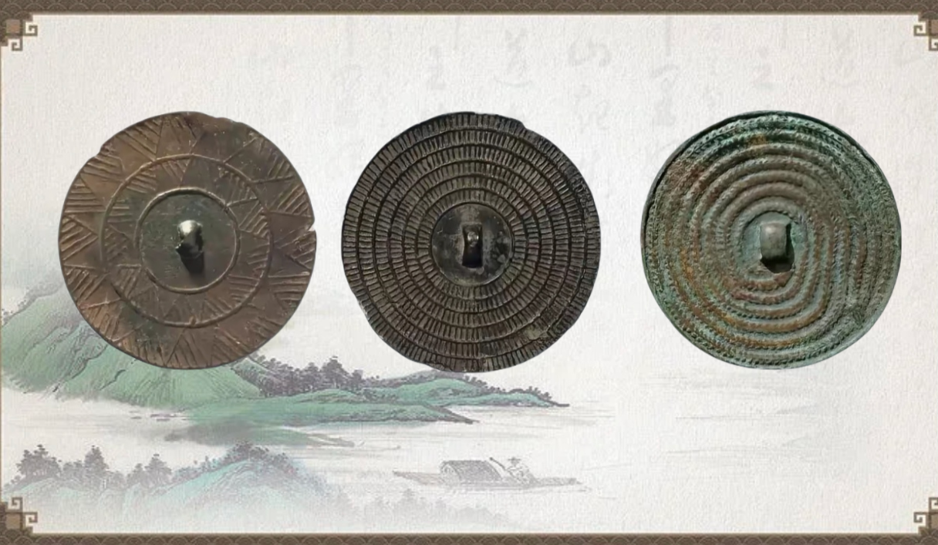
Shang and Zhou Dynasties
齐家文化 三角纹镜
Bronze Mirror with Triangular Patterns
商代 芒纹镜
Bronze Mirror with Ray Patterns
西周 蛇纹镜
Bronze Mirror with Snack Patterns

Slide 9
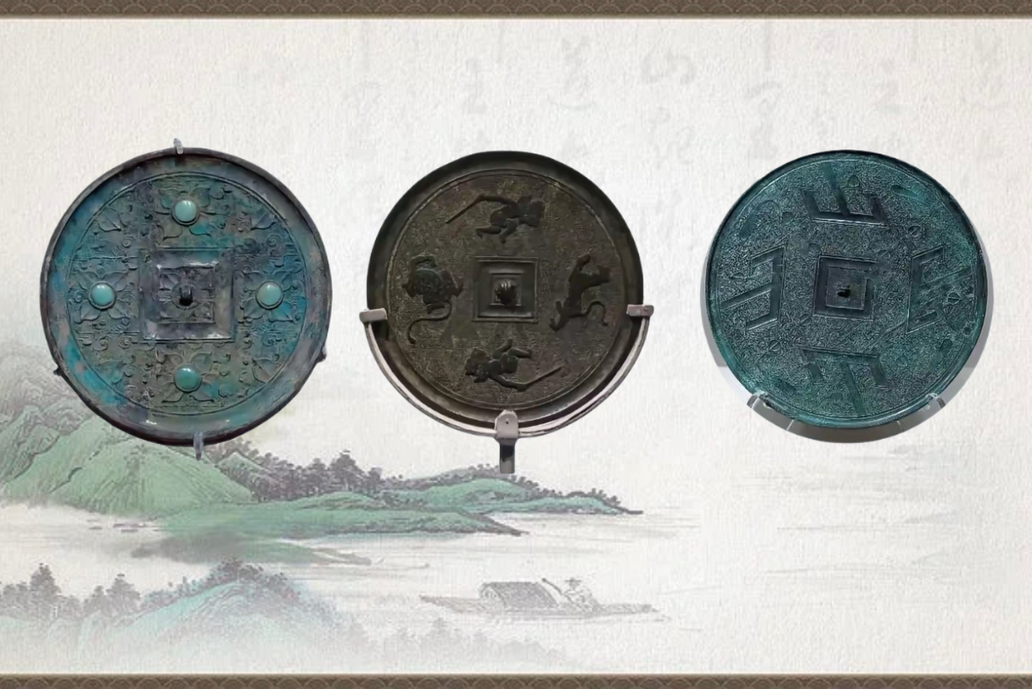
Warring States Period
战国 嵌松石花叶纹铜镜
Bronze Mirror Inlaid with Turquoise and Floral Leaf Patterns
战国 武士斗兽纹镜
Bronze Mirror with Warrior-Beast Fighting Patterns
战国 四山纹铜镜
Bronze Mirror with Four Mountain Patterns

Slide 10
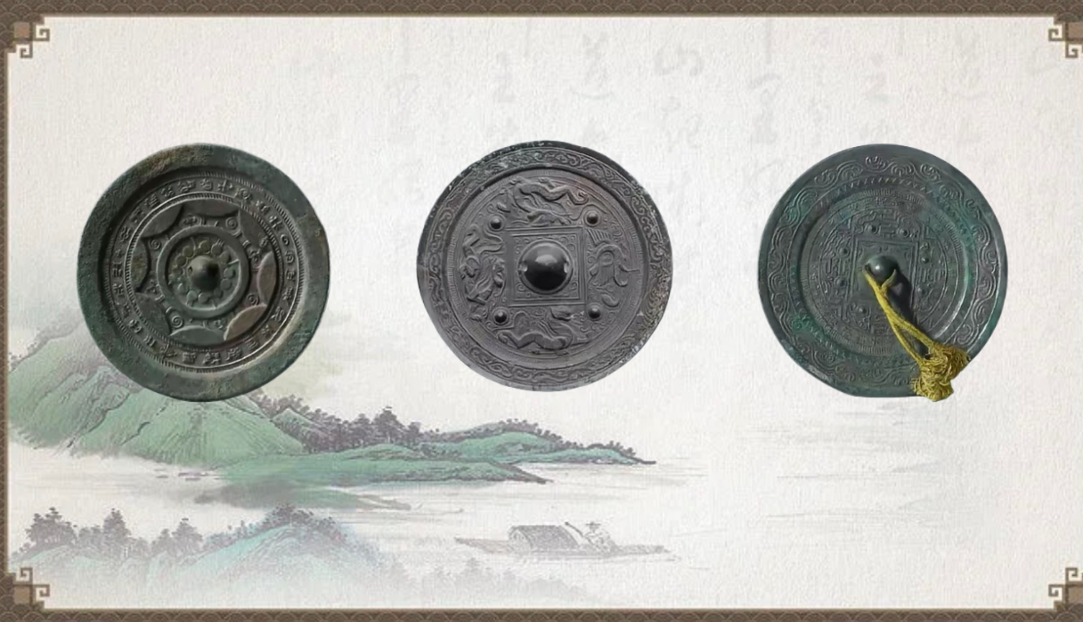
Western and Eastern Han Dynasties
西汉 昭明连狐纹铭带镜
Zhaoming Mirror with Continuous Fox Pattern and Inscription Band
东汉 四神铜镜
Bronze Mirror with Four Spiritual Beasts
新莽至东汉早期 博局文镜
Mirror with TLV Pattern

Slide 11
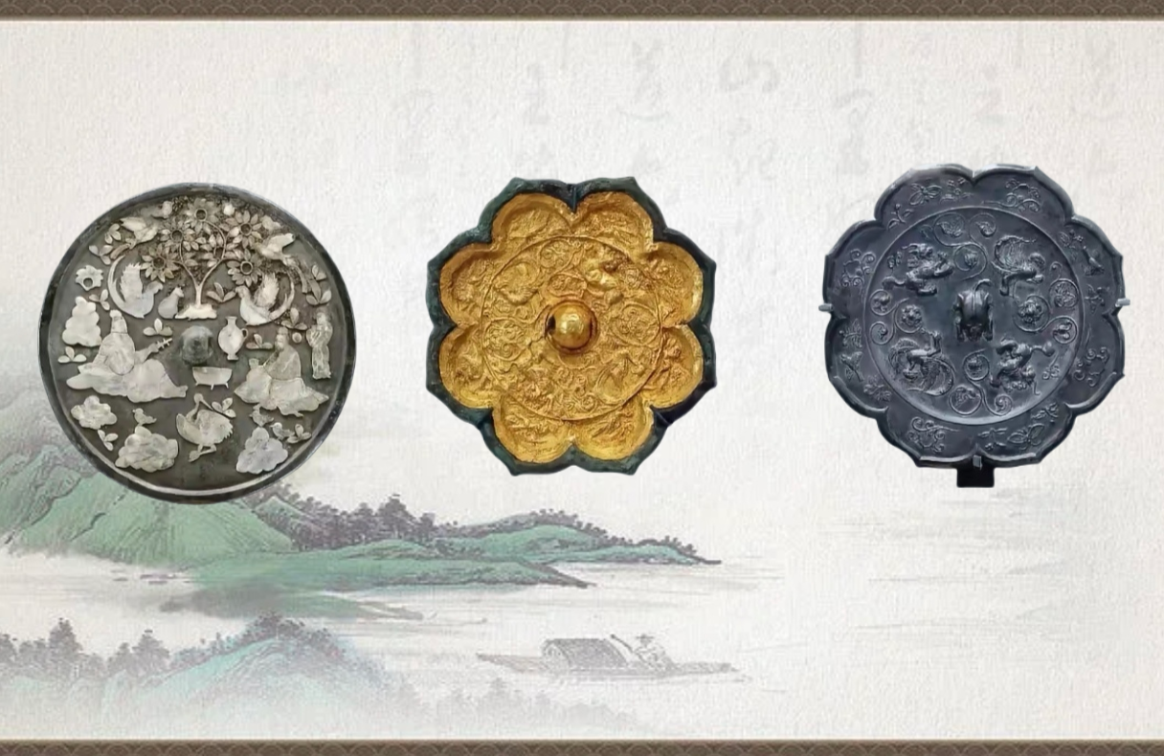
Sui and Tang Dynasties
唐 高士宴乐纹嵌螺钿铜镜
唐 金背瑞兽花鸟纹铜镜
唐 双鸾瑞兽纹菱花镜

Slide 12
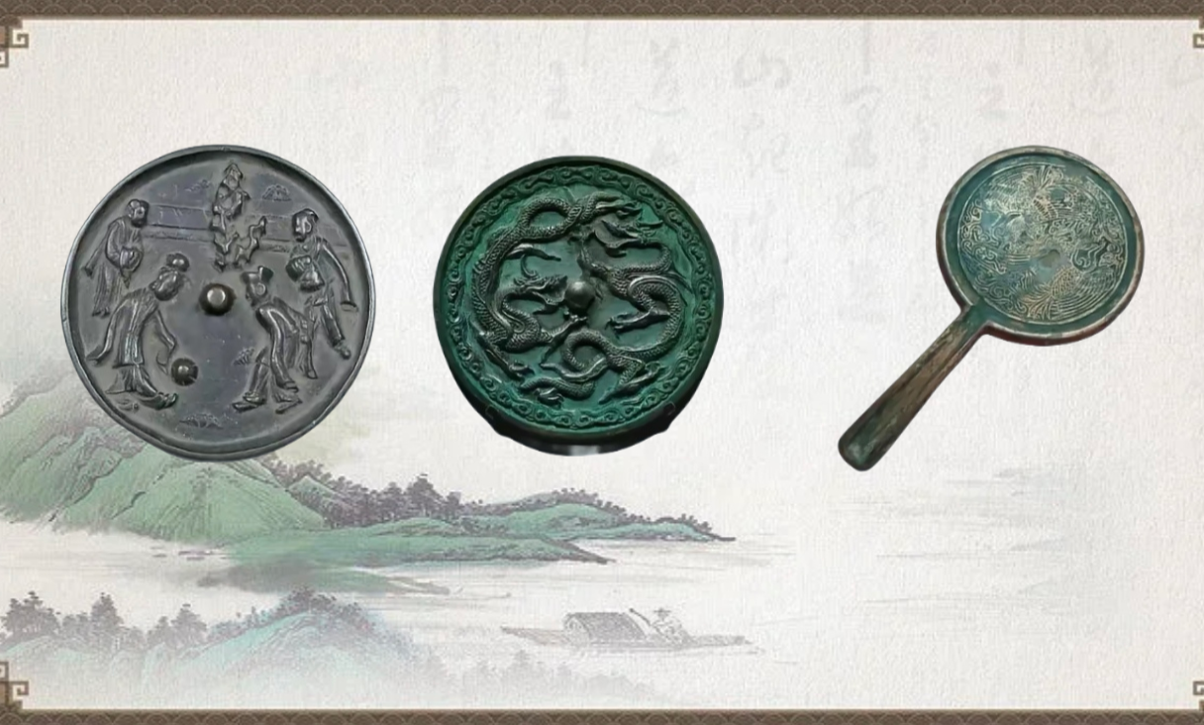
Song and Liao Dynasties
宋 蹴鞠纹铜镜
Bronze Mirror with Cuju Pattern
辽 双龙纹镜
Bronze Mirror with Two Dragon Patterns
宋 风纹手柄铜镜
Handled Bronze Mirror with Phoenix Pattern

Slide 13
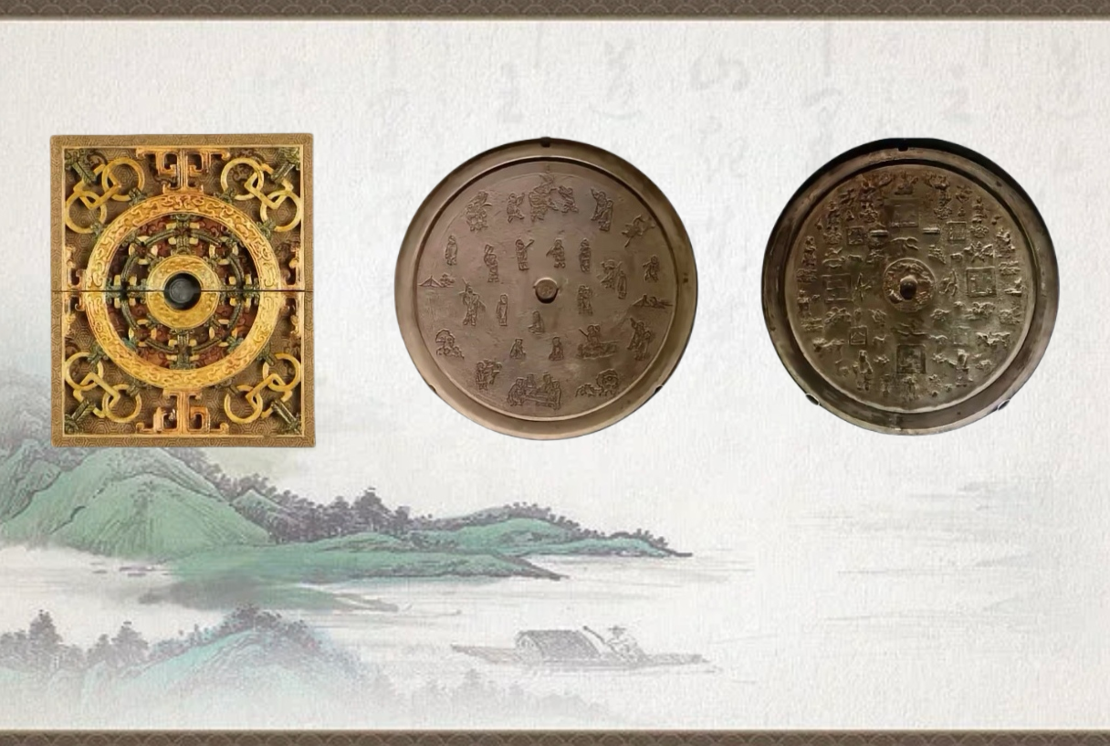
Ming and Qing Dynasties
清 长命元辰镜
清 婴戏铜镜
明 喜生贵子福寿双全铜镜

Slide 14
Question2:
Which Dynasties were the prosperous periods for bronze mirrors?
A.Xia and Shang
B.Han and Tang
C.Song and Yuan
D.Ming and Qing
Correct Answer：B.Han and Tang

Slide 15
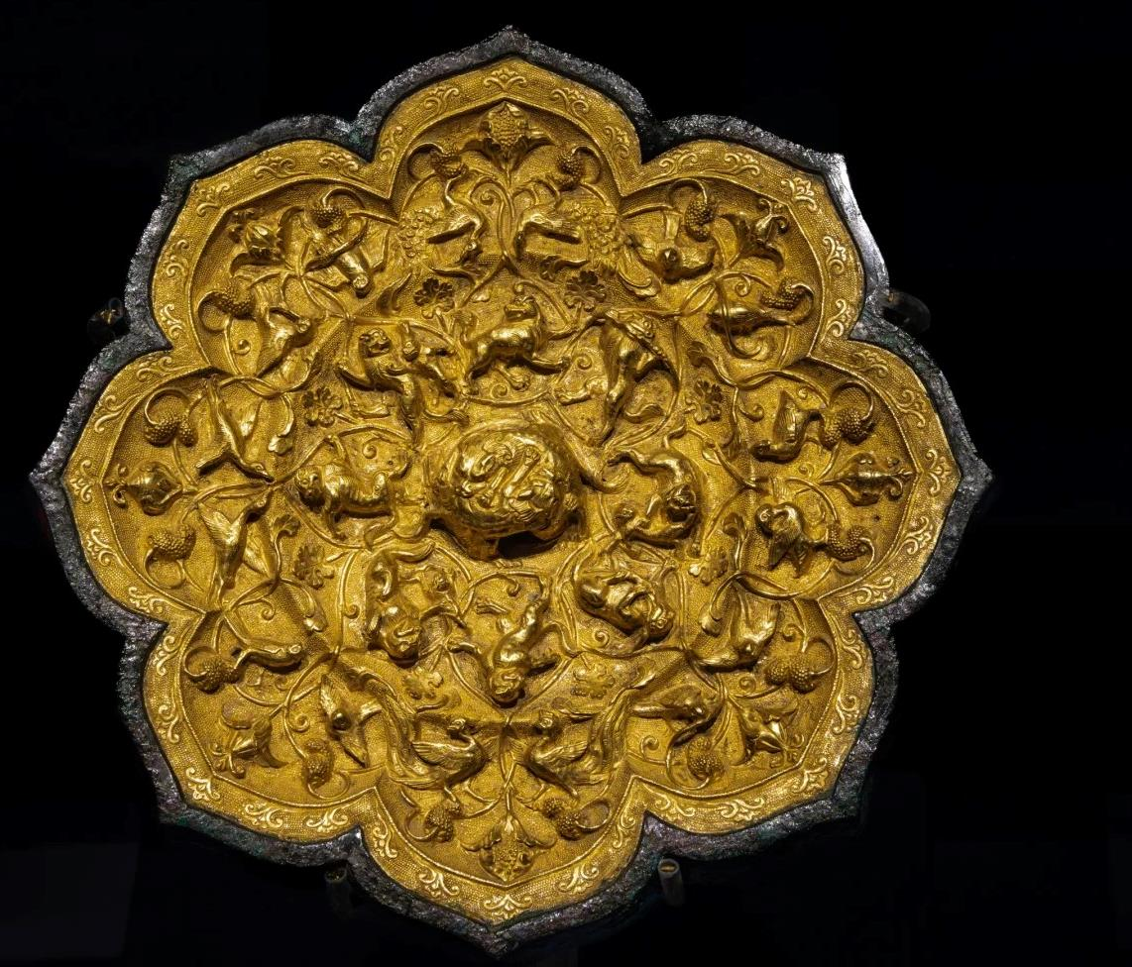
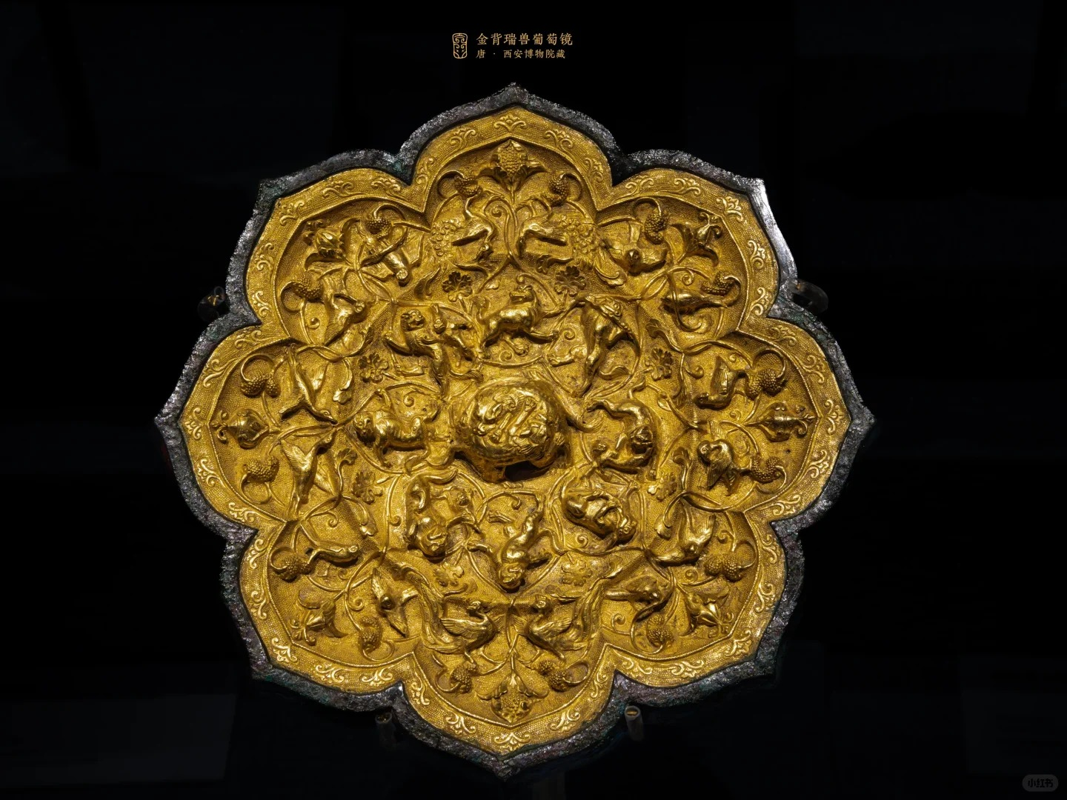
金背瑞兽葡萄镜·唐
Eight-lobed Mirror with Grapes and Auspicious Animals

Slide 16
Thank
you！
Presenter:
Cheng Sixiang

