Slide 1
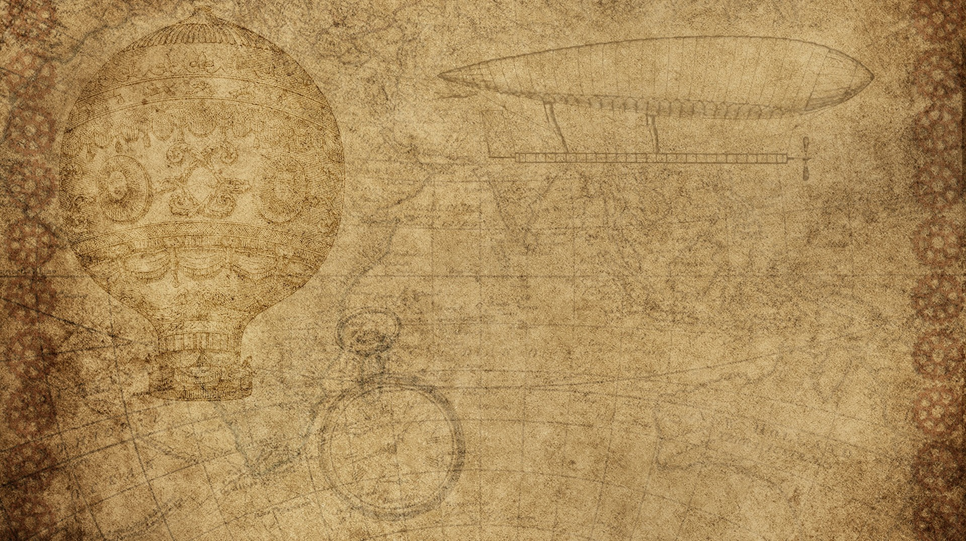

YAN Fu and Tianyan Lun
袁雨晨、肖茜
Yuan Yuchen，Xiao Xi

Slide 2

Contents
YAN Fu’s life experience and education background
Ideas of YAN Fu's Translation
Examples about Three-character ideas of Tianyan Lun
Faithfulness（信）
Expressiveness（达）
Elegance（雅）

Slide 3

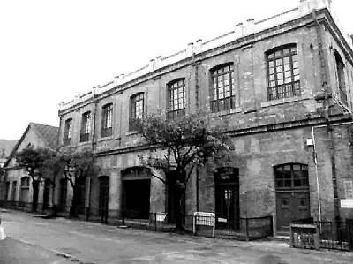
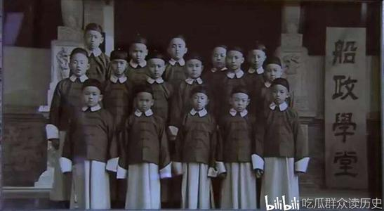
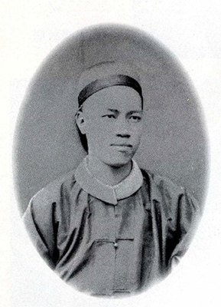
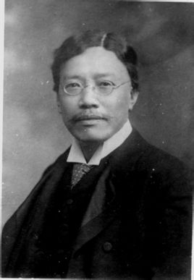
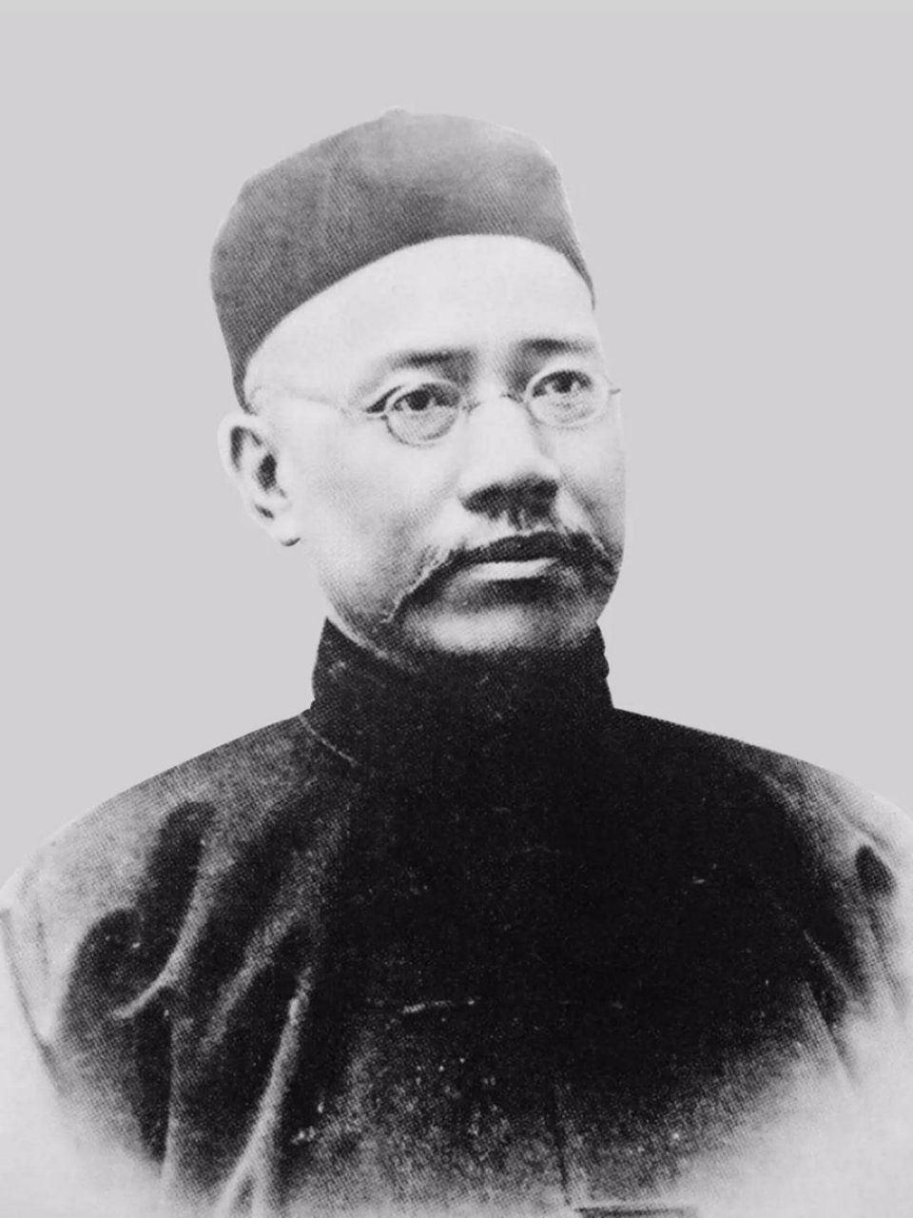
YAN Fu’s Life Experience and Education Background
YAN Fu was born in Houguan, Fujian Province, in the late Qing Dynasty(1853). His family was once rich, which gave him an opportunity in his childhood to study the Chinese classics.
In 1867, he entered the Fuzhou Shipyard School.
On graduation from the school, he did his internship on warships at first, and was then sent to study abroad in Great Britain.

Slide 4

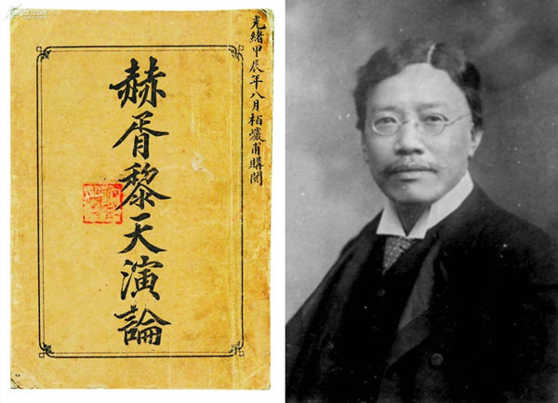
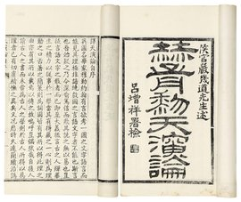
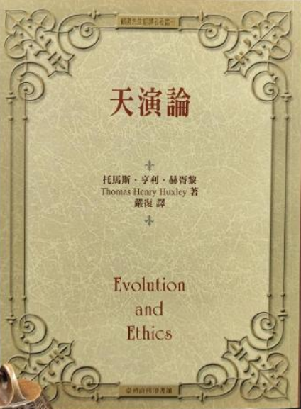
Tianyan Lun
YAN Fu started his translation career in 1898, when he translated Huxley's Evolution and Ethics.
For the first time in China, YAN Fu systematically introduced through his translation the western capitalist economic theories, sociology, politics and methodology.
His introduction greatly widened people's perspective, satisfied their need to search for the truth from the West to save the nation, and promoted the development of new thoughts in modern China.

Slide 5

Ideas of YAN Fu's Translation
We often refer to the three-character ideas, namely, "faithfulness, expressiveness and elegance".
Faithfulness means the translation should be loyal to the original text.
Expressiveness means that the contents of the original text should be adequately intelligibly expressed in the translation, and for this purpose, equivalence in form can sometimes be modified. The source language text should also be converted in an intelligible way, he believed that the two ideas were not contradicted to each other.
As for "elegance", it means the beauty of the language style, he was very careful about the vocabulary and syntax of his translation.

Slide 6

Examples about Three-character ideas of Tianyan Lun
Faithfulness
Original text: However complete may be the indifference to public opinion, in a cool, intellectual view, of the traditional sage, it has not yet been my fortune to meet with any actual sage who took its hostile manifestations with entire equanimity.
Translation：或谓古有人焉，举世誉之而不加劝，举世毁之而不加沮，此诚极之若反，不可以常法论也。

Slide 7

Examples about Three-character ideas of Tianyan Lun
Expressiveness
Original text: The characteristic feature of the latter is the intense and unceasing competition of the struggle for existence. The characteristic of the former is the elimination of that struggle，by the removal of the conditions which give rise to it.
Translation: 天行者以物竞为功，而人治则以使物不竞为的。

Slide 8
Examples about Three-character ideas of Tianyan Lun
Elegance
Original text: Or it may seem preferable to compare the expansion of the germ into the full-grown plant to the unfolding of a fan, or to the rolling-forth and widening of a stream; and thus to arrive at the conception of “development” or “evolution”.
Translation: ..故天演者如网如筵，又如江流然，始滥觞于昆仑，出梁益，下荆扬，洋洋浩浩，趋而归海，而兴云至雨，则又反宗。

Slide 9
Examples about Three-character ideas of Tianyan Lun
Original text: Protection against extremes of heat and cold would be afforded by houses and clothing; roads, bridges, canals, carriages, and ships would supplement the natural strength of men and of their draught animals; hygienic precautions would check, or remove, the natural causes of disease.
Translation: 是故民屈于寒暑雨场，则为致衣服宫室之宜;民屈于旱干水溢，则为致瀦渠吠浍之宜。民屈于山川道路之阻深，而艰于转运也，则有道徐、桥梁、漕挽、舟车，致之汽电诸机，所以增倍人畜之功力也:致之医疗药物，所以救民之厉疾天死也。

Slide 10
Thank you for your listening!

