Slide 1




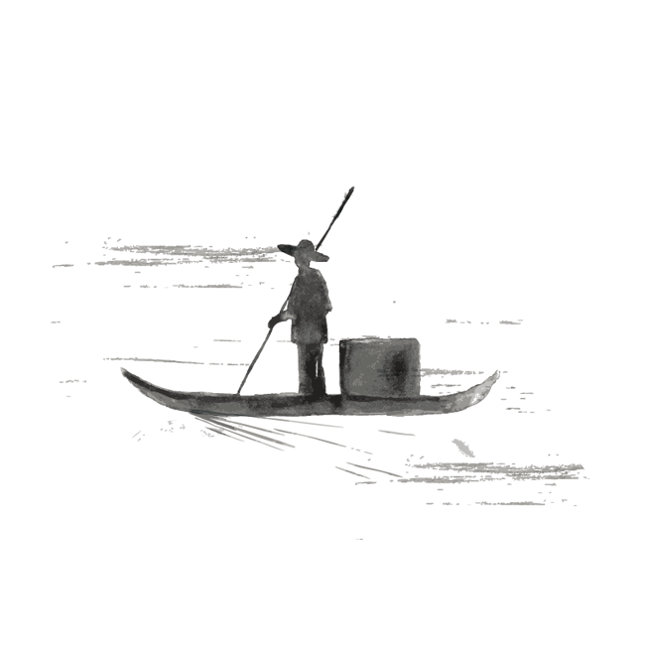
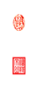
Language:Chinese Language
龙翰良 202170081589

Slide 2
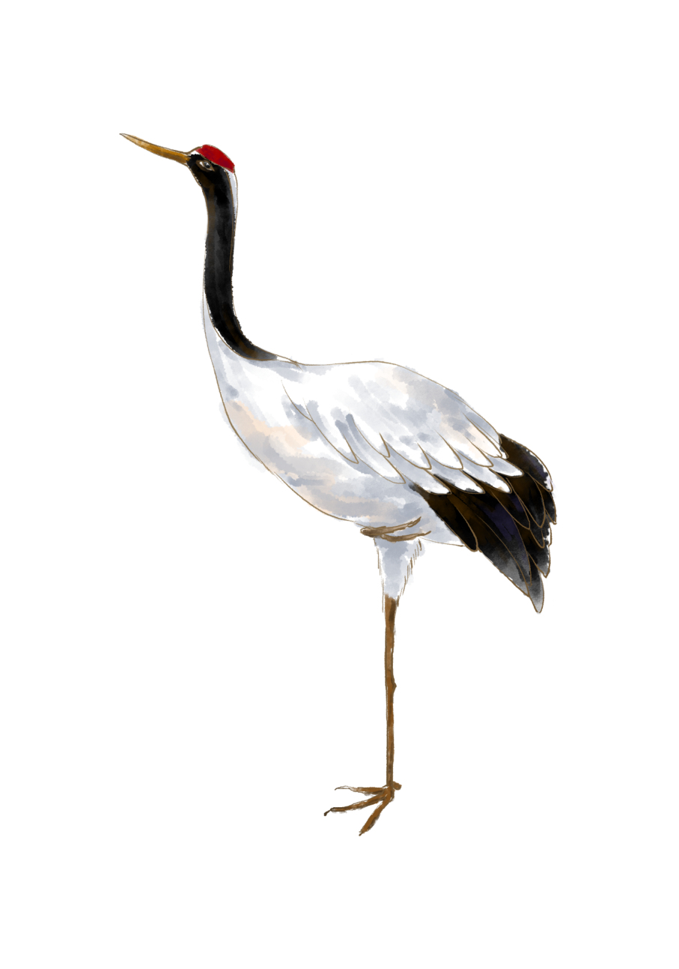
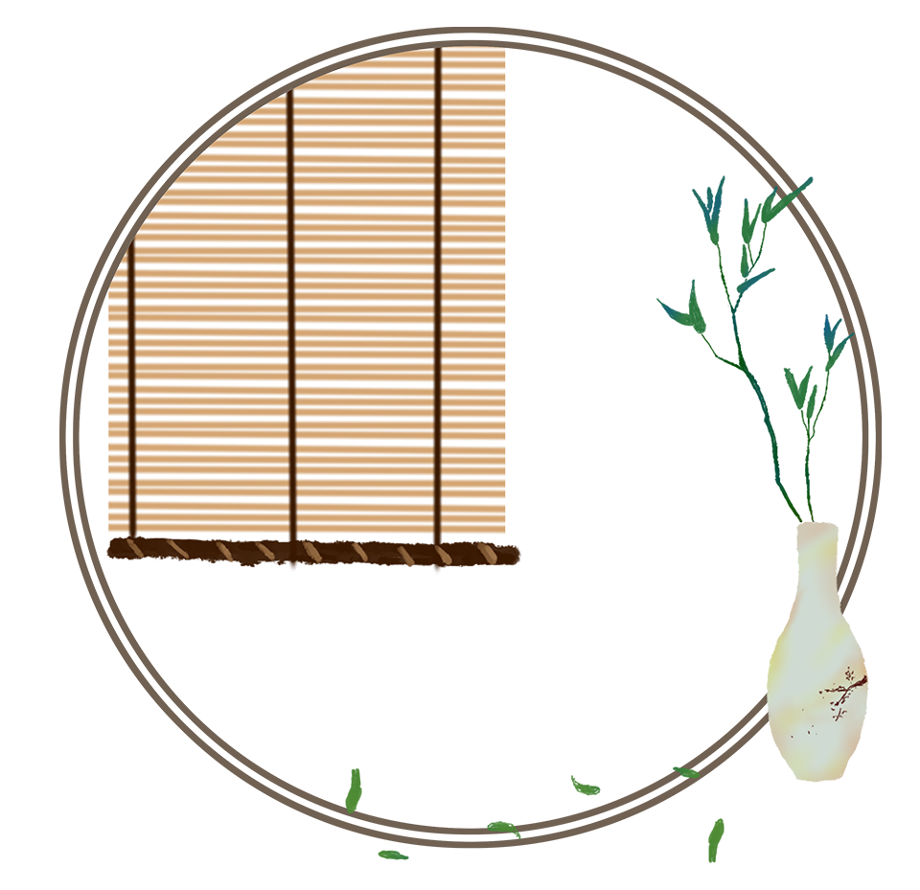
壹
Introduction
贰
Putonghua and dialects
目录
叁
Ancient Chinese and Modern Chinese
肆
Idiomatic Phrases-Idioms, Proverbs, Common Sayings, and
Allegorical Sayings
伍
Language policy

Slide 3


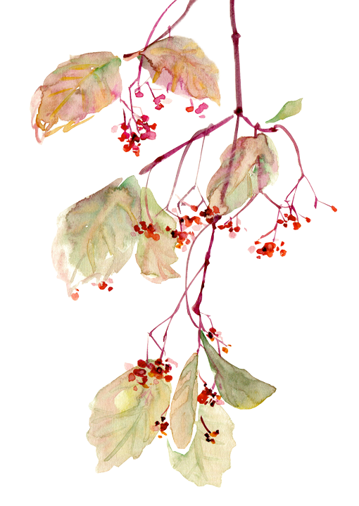
壹
Introduction

Slide 4
Introduction
China is a very big country with a large population, multi-ethnic, and multi-lingual. Each ethnic groups may have its own lingo, or dialects and there are great differences between the dialects because of the speech impediment. For example, if people in different places use their dialects to talk, they may not be able to understand each other, and the situation may lead to embarrassment and misunderstanding. Therefore, the Chinese people communicate with each other in a common language, called Putonghua and also known as Mandarin in Western countries. Government also has implemented a strategy to promote Putonghua and to facilitate it learning with Pinyin.

Slide 5
贰
Putonghua and dialects

Slide 6

Putonghua and dialects
Differences between Putonghua and dialects
Putonghua is the national language of China, and Chinese is the most widely spoken language in the world. More than one billion of the world's populations are Chinese speakers. The Chinese population is already one fifth of the population of the world and is rapidly expanding its presence everywhere and influence many people around the world.
While Chinese dialects are usually divided into seven groups: northern dialect, Wu dialect, Hunan dialect, Jiangxi dialect, Hakka dialect, and Cantonese dialect and Fujian dialect,with the northern dialect sounds more like Putonghua than other dialects.

Slide 7
Putonghua and dialects
Why do we need to speak Putonghua?
The dialects in China differ greatly. Speaking Putonghua allows the Chinese people to communicate better with each other and promote the development of economy and culture everywhere.
Only by learning Putonghua can you communicate with people from all parts of China and event with Chinese-speaking people all over the world. While striving to promote Putonghua among the people of the whole country, China also pays special attention to the protection of dialects, which should not be lost after learning Putonghua.

Slide 8
叁
Ancient Chinese and Modern Chinese

Slide 9
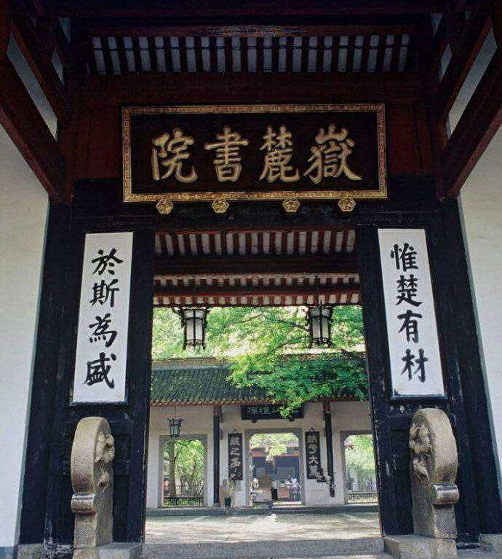
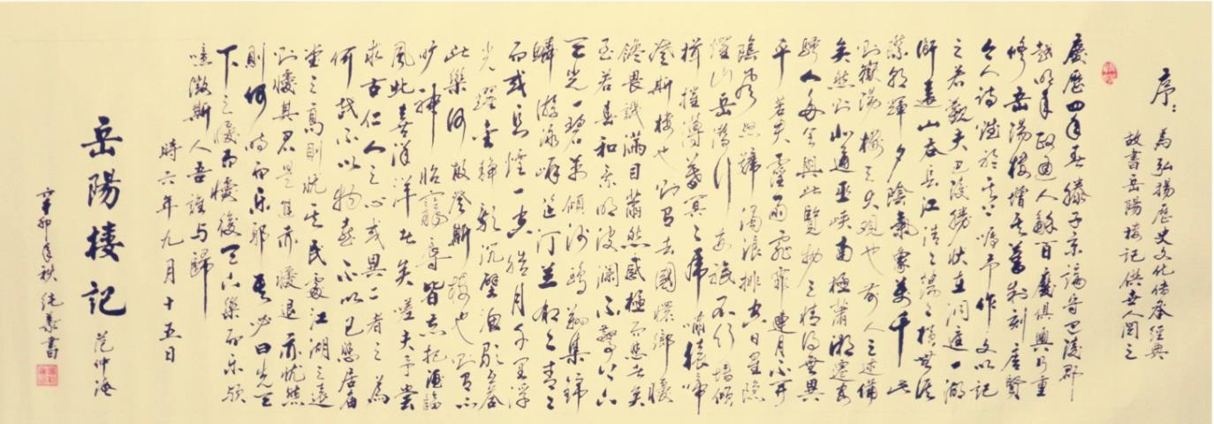
Ancient Chinese and Modern Chinese
Differences between Ancient Chinese and Modern Chinese
Ancient Chinese and written Chinese characters are not exactly the same as they are now. When we visit Chinese historical sites, we often see couplets, poems, and inscriptions. Most of them are written in classical Chinese and traditional Chinese characters. Classical Chinese is a written language formed on the basis of the spoken language in the pre-Qin period. The May Fourth Movement is considered as divide between Ancient Chinese and Modern Chinese. Compared with ancient Chinese, modern Chinese absorbs a lot Western grammar and has added many disyllabic words.

Slide 10
肆
Idiomatic Phrases-Idioms, Proverbs, Common Sayings, and
Allegorical Sayings in Putonghua and Dialects

Slide 11
Idiomatic Phrases-Idioms, Proverbs, Common Sayings, and
Allegorical Sayings in Putonghua and Dialects
Many phrases with fixed meanings in Chinese have been handed down from the ancient times. Mastering these phrases will make your language more authentic and vivid. Phrases containing four Chinese characters each, are called idioms;Proverbs are common and easy-to-understand fixed phrases used orally, often explaining a truth. Common sayings mostly come in a three-character format, but there are also other formats. In addition to the literal meaning, there are deep metaphorical extensions. An allegorical saying is divided into two parts. It is like a riddle: The first part is a metaphor, and the second part is an explanation. There are two types of allegorical sayings: homophonic and figurative.

Slide 12
Examples
Idioms:高山流水（‘Lofty mountains and flowing rivers’means meeting someone who can really understand and appreciate them）对牛弹琴（‘Playing the lute to the cow’ means casting pearls before swine’）
Proverbs:不当家不知柴米贵（If you are not in charge of a home, you don’t know how expensive the firewood and rice）百闻不如一见，百见不如一干（Seeing is better than hearing 100 times, and doing is better than seeing 100 times）
Common Sayings: 吹牛皮 (blow cow skin’ meaning bragging) , 不管三七二十一(‘regardless of 3x7=21’ regardless of consequences)
Allegorical Sayings:Homophonic type：和尚打伞——无发（法）无天‘the monk opens an umbrella – no hair and no sky ’ (‘no hair ’ is pronounced similar to ‘ lawless ’ in Chinese).
Figurative type：哑巴吃黄连，有苦说不出(A mute person takes a dose of bitter medicine- they can’t say it is bitter .）

Slide 13
伍
Language policy

Slide 14
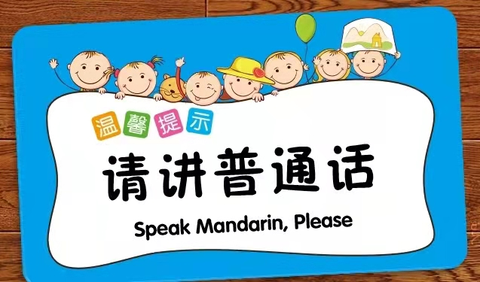
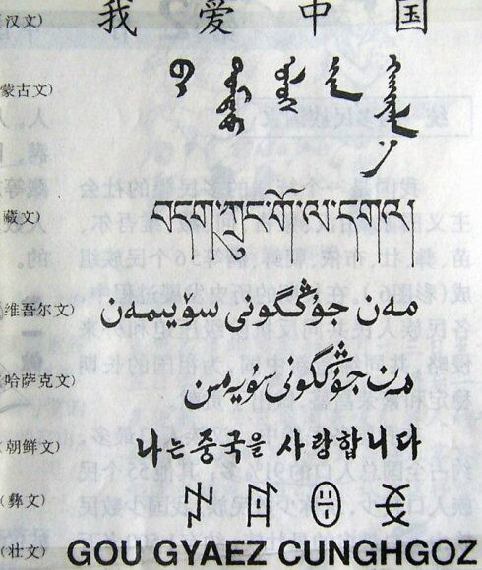
Language policy
While vigorously promoting Putonghua, the Chinese government has
also promulgated many policies to protect dialect and minority languages. In order to promote Putonghua, China promulgated the Chinese Pinyin Program in 1958. With the popularization of modern information technology, pinyin is widely used to input the Chinese characters on computers and mobile phones. Pinyin affects all aspects of social life. In translation, names, places, food, and even some cultural concept with Chinese characteristics are directly spelled with Pinyin, which is therefore an important standard for translation and a bridge for international exchange.

Slide 15
Thanks

