Slide 1

Chinese Popular Memes
主讲人：
Sean
时间：
2025.5

Slide 2
Warm-up
What’s your Catchphrase(口头禅)?
absolutely(包的）？
ThaiCoolah(泰裤辣)？
Trudoo? Falsedoo（真嘟假嘟）?

Slide 3
+
目录
CONTENT
02
01
Main Examples
03
Classification of Internet Memes
Social-Psychological Analysis

Slide 4
Classification of Internet Memes
01
PART

Slide 5
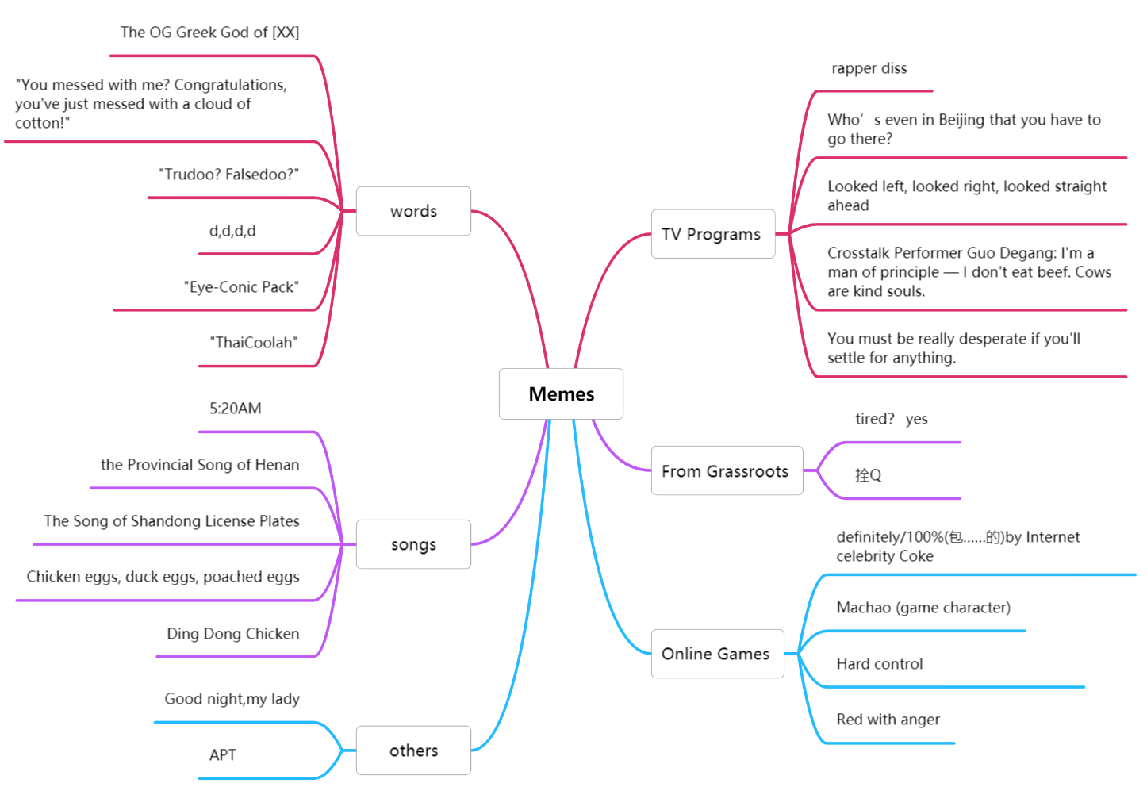

Slide 6
Classification of Internet Memes
Main categories
① Social-Phenomenon Memes
② Language-Play Memes
③ Visual-Emoji Memes

Slide 7
Main Examples
02
PART

Slide 8
Social-Phenomenon Memes
Examples：
• Involution (内卷): Too much competition for little reward.
• Lying Flat (躺平): Choosing rest over burnout from work.
• Involution (or rat race) (内卷)
• Lying Flat (躺平)
• Four-No Youth (四不青年)

Slide 9
Language-Play Memes
• YYDS: Pinyin acronym for “永远的神” (“Forever the God”).
• Versailles Literature (凡尔赛文学): Self-deprecating boasting packaged in faux-humble remarks,
• “City bu City”: A playful fusion of English and Chinese, it sounds like “so trendy!”
Examples：
01
•”YYDS”
•“Versailles Literature”
•“City bu City?”

Slide 10
Visual-Emoji Memes
• Social-Anxiety Smile (社恐式微笑): A set of stickers showing cringe-worthy, forced smiles—perfect for reacting to awkward group chats.
• Viral GIFs: From the “Huawei: Always Leading” animation to the global “Drake Hotline Bling” pose, these GIFs illustrate how quickly a single image can become a shared shorthand across chat platforms.
Examples:
• Social-Anxiety Smile (社恐式微笑)
• Viral GIFs：Huawei’s ‘Always Leading（遥遥领先）

Slide 11
Social-Psychological Analysis
03
PART

Slide 12
•
Collective Anxiety & Self-Deprecation
Words like “involution” and “lying flat” become cathartic outlets for young people facing sky-high housing prices and job markets, turning private stress into communal humor.

Slide 13
•
Symbolic, Instant Communication
Acronyms and image-memes satisfy the fragmented, fast-paced nature of online chats—transmitting complex feelings in a blink.

Slide 14
•
Cultural Identity & Subculture Fusion
The mix of Chinese, English, gaming, and anime references shows how Chinese netizens craft “interest-based communities,” bonding over shared jokes and niche passions.
Commercialization & Meme Inflation
Brands co-opt viral memes (e.g., registering “Involution” as a trademark), highlighting both the marketing power of memes and the risk of over-commercialization diluting their original bite.

Slide 15
Thank you
主讲人：
Sean
时间：
2025.5

