Slide 1
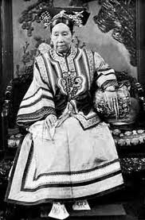
Qing Dynasty
The Qing Dynasty lasted nearly 300 years and was overthrown in 1911 due to effects from the boxer rebellion.
The Qing Dynasty was the last Dynasty in China. It ended China’s long history of dynastic rule.
There was an empress in the Qing Dynasty named Empress Dowager Cixi. Cixi became a concubine to emperor Xianfeng. Later due to her determination she eventually worked her way up and seized the throne in 1864 when emperor Xianfeng died.

Slide 2
Qing Dynasty to Modern China

Slide 3
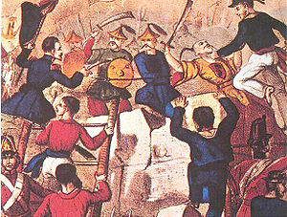
The Opium Wars
1840-1856
The opium wars propelled china into a modern world direction. These wars were a direct result of China isolating itself from the rest of the world. Western powers desperately wanted to trade with China so they forced open China’s trading policy through the Opium War. China ends up signing a plethora of “unfair treaties” at this time.

Slide 4
Boxer Rebellion
Began in 1898 and was started by a group of peasants in China who wanted to get rid of Western influences.
An international force was sent to subdue the rebellion in China.
Before the international militaries could arrive Empress Dowager ordered foreigners to be killed.
On August 14th, 1900 the international force took Peking and crushed the rebellion.

Slide 5
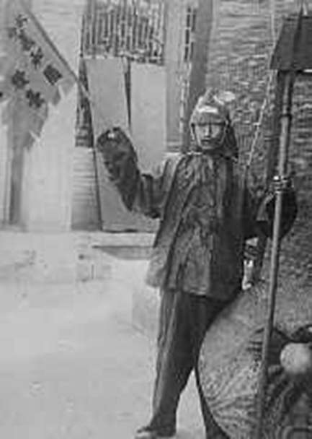
Boxers:
(righteous and harmonious fists)
The boxers gained support from Empress Dowager which led to the eventuality of the uprising which is known as the “Boxer Rebellion”.

Slide 6

Republic of China

Slide 7


The Republic of China put an end to more than 2,000 years of imperial rule in China.
The party was unified under the Kuomintang (The Chinese Nationalist Party).
The Kuomintang had many conflicts with the Communist Party of China.
After the Kuomintang’s defeat the party retreated to Taiwan and has evolved.

Slide 8
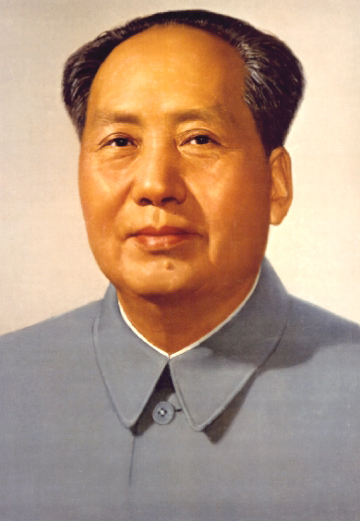
People’s Republic of China
The People’s Republic of China began on October 1st, 1949.
Everything became highly censored under Mao’s Rule.
Literature and culture must reflect the class interest of the working people.
The People’s Republic of China is still in affect today.

Slide 9
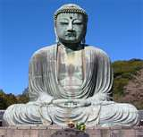
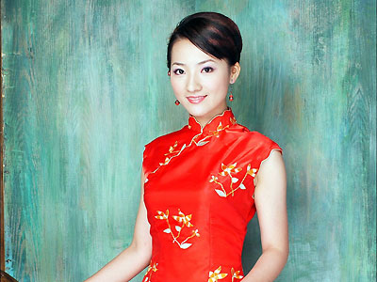
Modern Day China
There are 56 ethnic groups in China. The majority of the people are Hans. They make up 93% of the population while the minorities total around 7% of the population.
China has many religions in its country. Including, Buddhism, Taoism, Islam, Catholicism, and Protestantism.

Slide 10
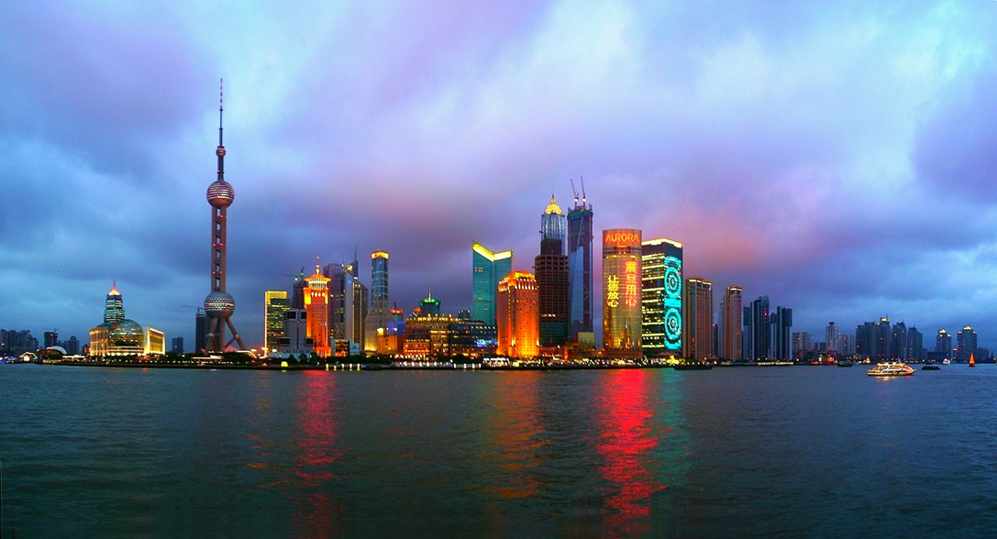
China’s economy is at a an all time high. they're using this economical wealth to build new buildings and expand their lifestyle and international influence.

