Slide 1
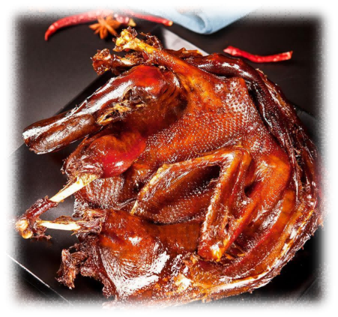
2025
Changde Spiced Salted Duck
演讲人：
邢雪晴
时间：
2025.5

Slide 2
目录
CONTENTS
Unique Flavor
01
Introduction
03
Historical Origins: An Overview
Cultural Heritage
02
04

Slide 3
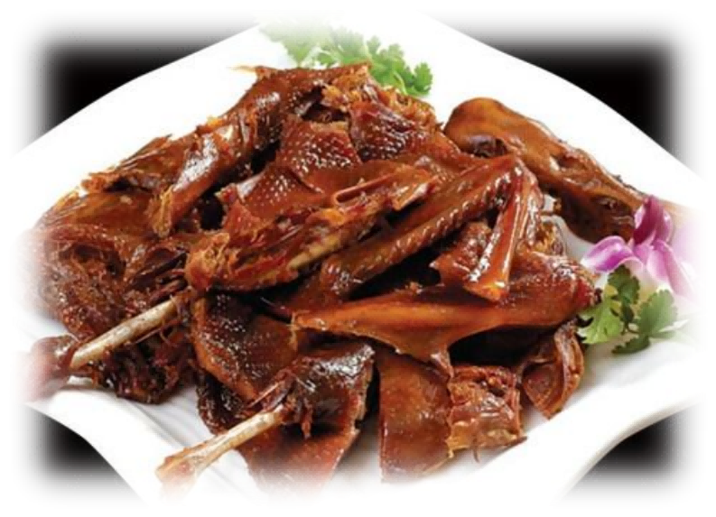
01
Introduction

Slide 4
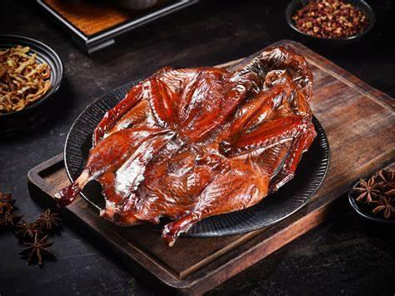
Introduction
Changde Spicy Salted Duck is visually stunning, with a golden, glossy appearance.
Its combination of spices and tender meat creates a memorable gastronomic experience.
It represents Hunan's culinary excellence and cultural heritage.
The dish has evolved over centuries, reflecting historical and geographical influences.

Slide 5
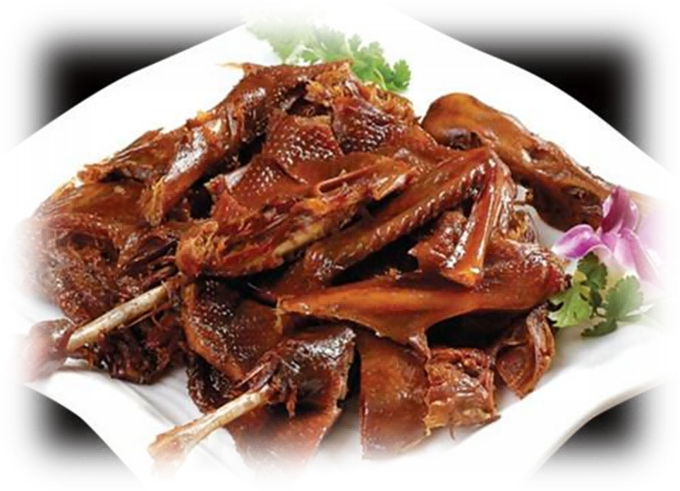
02
Historical Origins

Slide 6
Origin Theories
Chef Tao's Accidental Discovery
Chef Shi Jiu of King Chuzhuo
Fishermen's Preservation Story
During the Southern Song Dynasty, there was a chef named Tao who accidentally dropped a duck on the ground while making roast duck. To remedy this mistake, he hung the duck in the air to dry and added seasonings, unexpectedly creating a delicious spicy salted duck.
King Zhuo of Chu's Royal Chef Shi Jiao Story: It is said that more than 2000 years ago, Shi Jiao, the royal chef of King Zhuo of Chu, was from Wuling. To repay the duck farmer who saved his mother, he used his skill in marinating swans from the palace to process the local ducks into marinated ducks for the benefit of his neighbors. Because of its unique and complicated craftsmanship and its outstanding taste, it was later named "Tribute Changde spicy salted duck" by the King of Chu and was exclusively supplied to the Chu Palace all year round.
Another story suggests that the origin of Changde spicy salted duck is related to fishermen in Changde, Hunan. In order to preserve the caught ducks, the fishermen marinated and air-dried them, and found that the processed ducks not only had a unique flavor but also tender and crisp meat. As a result, the craftsmanship of making Changde spicy salted duck spread locally.
The dish quickly gained popularity among locals. It became a signature dish in the region.

Slide 7
03
Unique Flavor

Slide 8
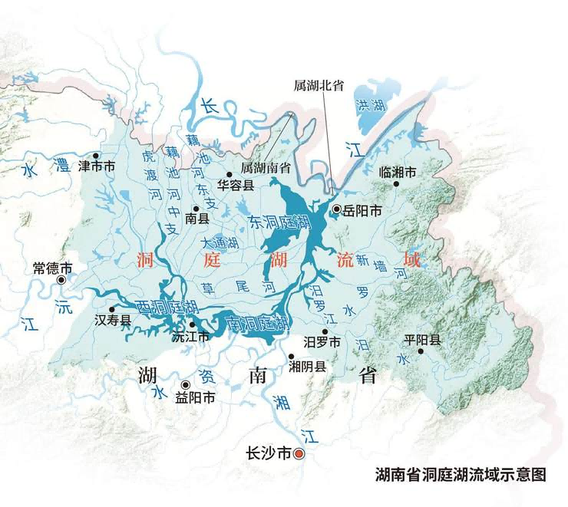
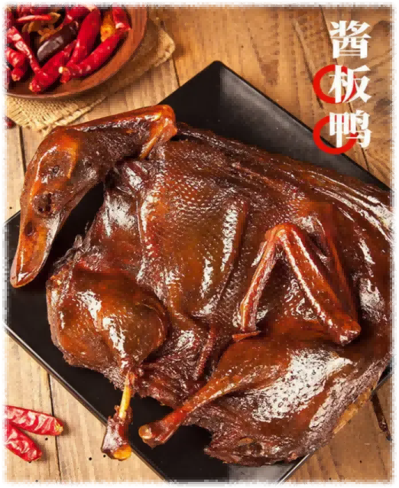
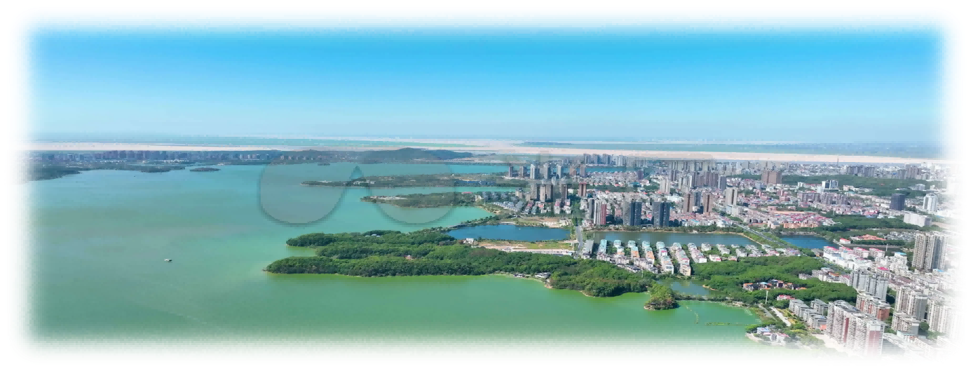
Changde's Natural Resources
Local Ingredients
Dongting Lake's Role
Local spices and herbs enhance the dish's flavor profile. The availability of fresh ingredients ensures authenticity.
Dongting Lake provides abundant aquatic resources, including ducks. The lake's ecosystem supports high - quality duck farming.
Climate and Environment
Changde's mild, four - season climate is ideal for duck - rearing. The environment contributes to the ducks' flavor and texture.

Slide 9
Taste and Appearance
Rich Aroma and Golden Appearance
Juicy and Flavorful Meat
Visual Appeal
The marinating and seasoning process gives the duck a rich aroma. The final product has a golden, glossy appearance.
Each bite is tender, juicy, and full of flavor. The dish combines the freshness of duck meat with the richness of the sauce.
High - quality images highlight the dish's color and texture. The presentation enhances its appeal to diners.
01
02
03

Slide 10
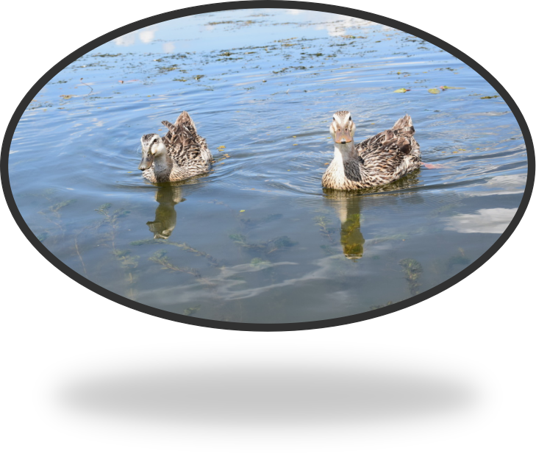
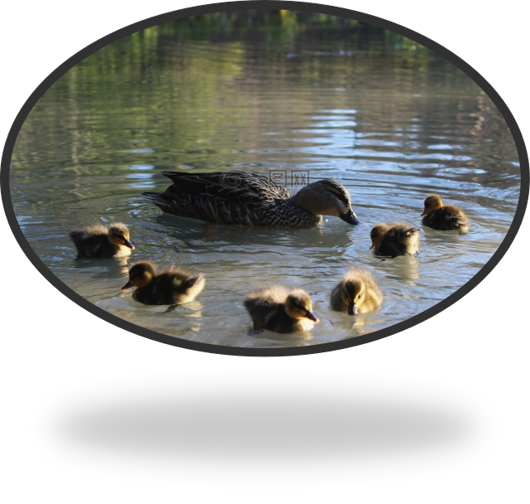
Selection of Ingredients
Local Water Ducks
Comparison with Other Breeds
Sourcing and Sustainability
Local water ducks have a perfect fat - to - meat ratio. Their meat is flavorful and tender.
Other duck breeds lack the same depth of flavor. Local ducks are preferred for their superior quality.
Sustainable sourcing practices ensure the availability of high - quality ducks. Local farmers play a crucial role in maintaining tradition.

Slide 11
Elaborate Craftsmanship
Drying
Marinating
Air - drying the duck enhances its texture. The process removes excess moisture.
Seasoning
The duck is marinated in a blend of spices and herbs. This step infuses the meat with flavor.
Final seasoning adds depth and complexity to the flavor. Each step requires precision and attention to detail.

Slide 12
04
Cultural Heritage

Slide 13
Reflection of Chinese Culinary Culture
Culinary Techniques
Nutritional Value
The making process showcases traditional Chinese cooking techniques. It reflects centuries of culinary wisdom.
Cultural Symbols
Duck meat is considered nutritious in traditional Chinese culture. The dish is valued for its health benefits.
Traditional cooking utensils and symbols emphasize the cultural aspect. The dish is a cultural artifact.

Slide 14
Role in Chinese Festivals
Special Dish for Celebrations
Family Traditions
Cultural Significance
Hunan Spiced Duck is often served during festivals. It is a symbol of abundance and joy.
Families gather to enjoy the dish during celebrations. It strengthens family bonds and traditions.
The dish represents the rich cultural heritage of Hunan. It is a symbol of community and togetherness.
01
02
03

Slide 15
谢谢大家
演讲人：
邢雪晴
时间：
2025.5

