Slide 1
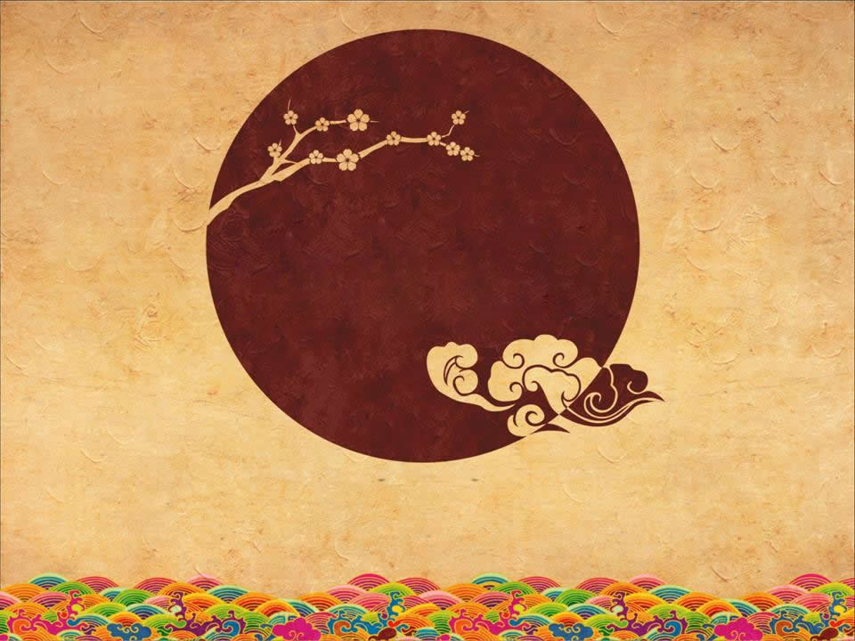

The art of Chinese cooking
Cao Runxin & Zou Xinyu

Slide 2
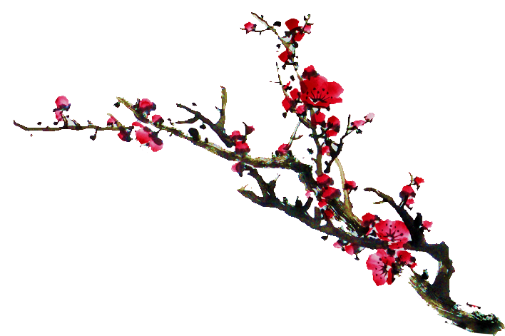



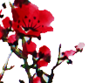
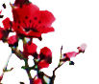

Contents
标
1.Raw materials and combination of ingredients
2.Cutting
3.Seasoning
4.Time and temperature
题
副标题

Slide 3


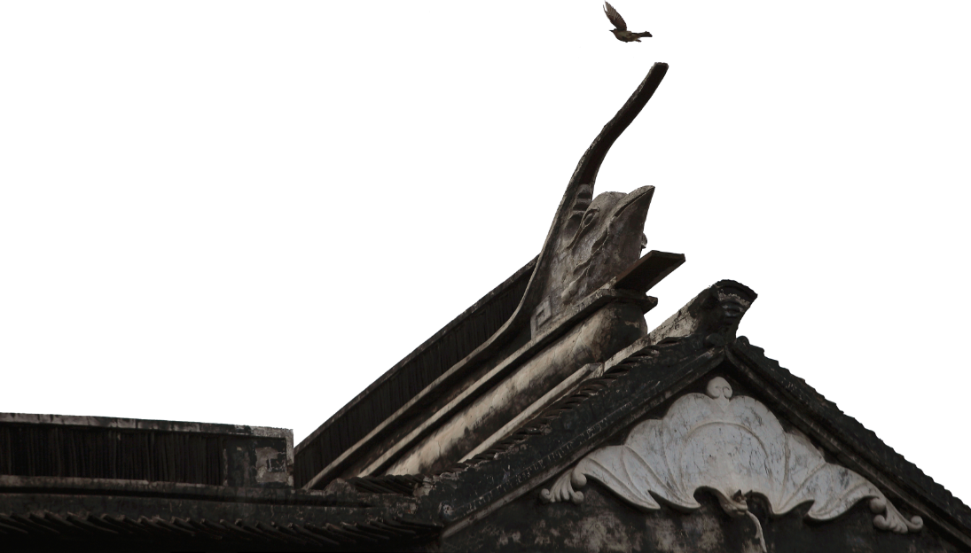
Raw materials and combination of ingredients
Chinese cooking emphasizes proper selection of ingredients
合时：choosing the right ingredients at the right time
合地：choosing raw materials suitable for local people’s eating habits
合烹：the selection of raw materials should meet the cooking requirements, and the best parts of the raw materials should be selected, and the cooking method should be selected according to the different parts of the raw materials.

Slide 4
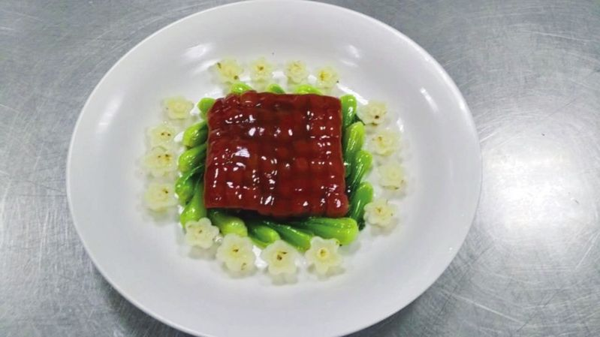

Cheery meat
上页
下页
The scientific side dishes in Chinese cooking are more realized through artistic means. For example, the famous Suzhou dish “Cherry Meat”, the flesh is red, resembling cherries, surrounded by green vegetables, The meal is delicious, meat and vegetable match. The food content is rich and colorful, diverse and unified, reflecting the obvious characteristics of the art of Chinese side dishes, and the scientific and reasonable meal matching.
XXXXXXXXXXXXXXXXXXXXXXXXXXX>>
XXXXXXXXXXXXXXXXXXXX>>

Slide 5
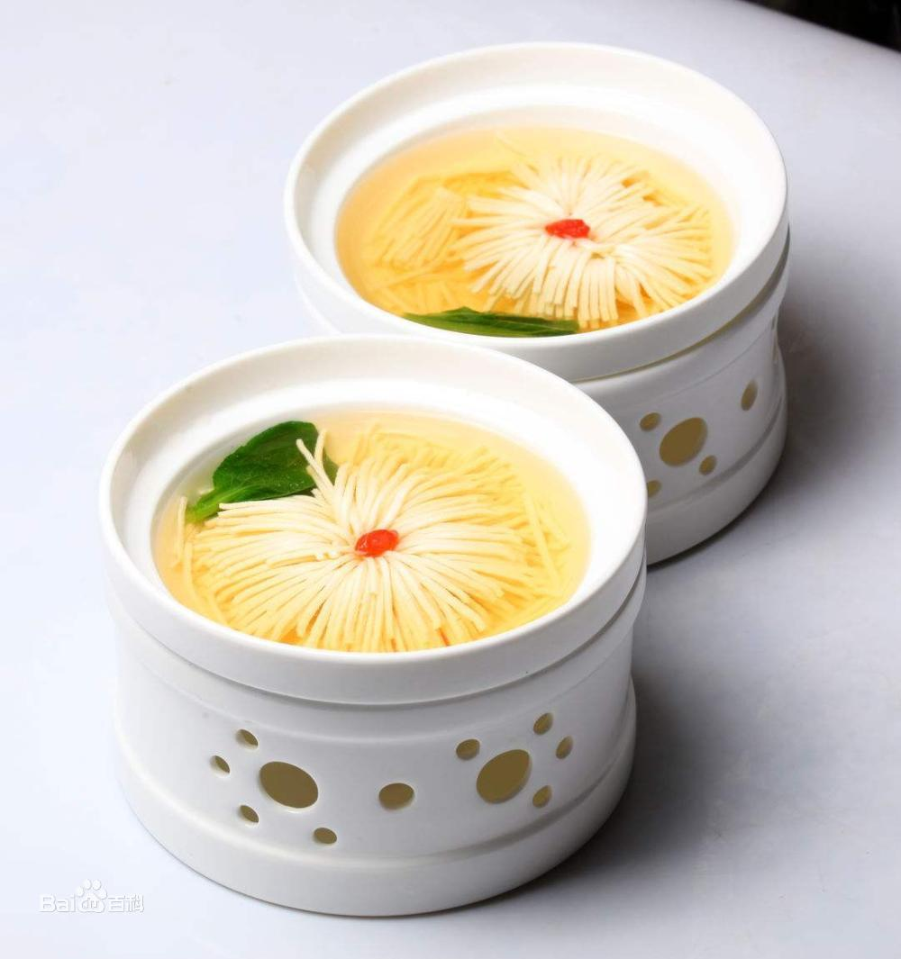
Cutting
Chrysanthemum tofu
Cutting is an important condition for the visual aesthetics of Chinese cooking, and it is also the charm of Chinese cuisine.
There are so many knife skills, They all use superb techniques to give the dish a new shape, giving people the enjoyment of neat and harmonious beauty.

Slide 6

Seasoning
Seasoning is the soul of Chinese cuisine, and it is also one of the important conditions that constitute the taste of Chinese cooking. The seasoning of Chinese dishes is the proper blending of various seasoning materials and various condiments to make them interact to form the unique flavor of various dishes.

Slide 7
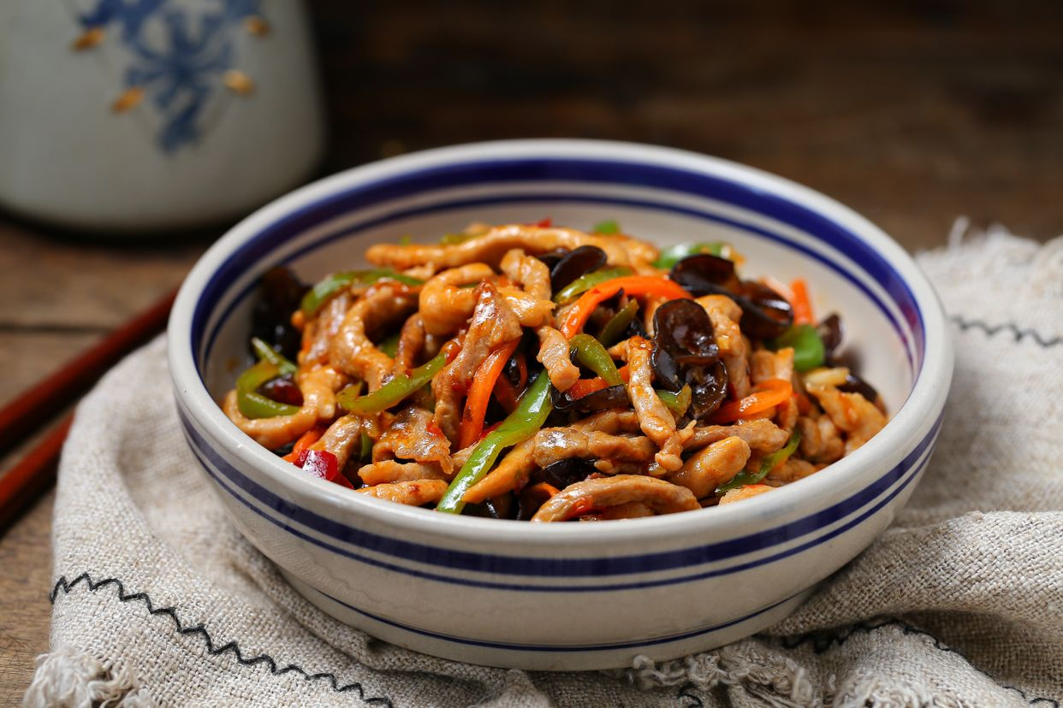
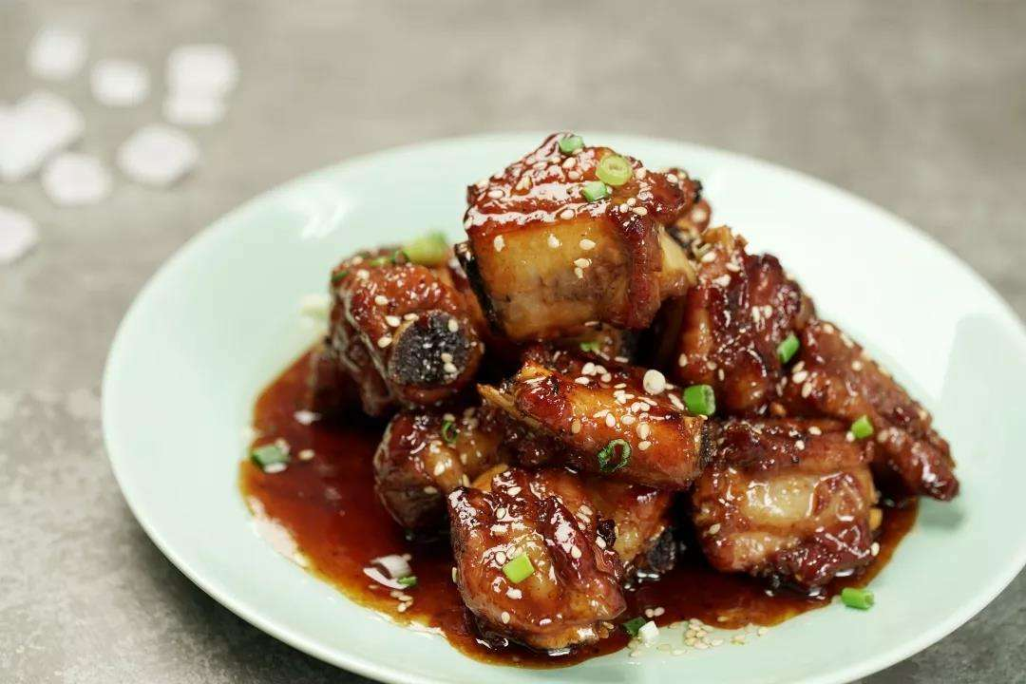
Chinese cuisine is generally a complex taste that has two or more flavors.
Fish-flavored shredded pork
Sweet and sour pork ribs

Slide 8

Time and temperature
Different cooking time and heat will give people different tastes such as rotten, slippery, tender, soft and crisp.
Accurate control of the heat can not only make the food mature, but also improve the texture of the raw materials , and at the same time the deliciousness of the raw materials can be effectively stimulated.

Slide 9
Thanks

