Slide 1
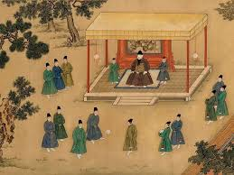
Cuju: The Ancient Chinese Football
Speaker:Ouyang Yihong

Slide 2
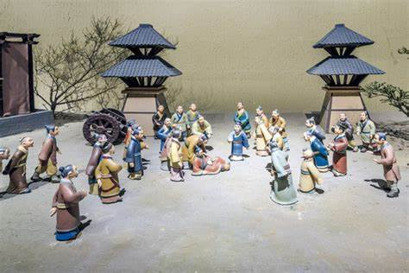
Introduction to Cuju
Cuju means “kick the ball” in Chinese, with “蹴” meaning kick and “鞠” meaning ball. It is a sport with deep historical roots.
This ancient game is often considered as the precursor to modern football, showcasing early forms of ball sports in human history.

Slide 3
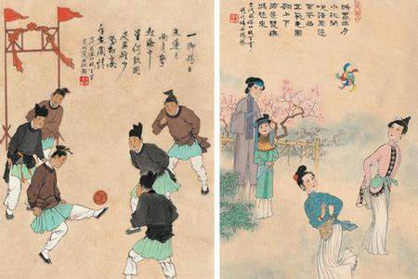
Origin and Development of Cuju
Zhou Dynasty (around 500 BC): Cuju’s earliest form appeared, initially as a form of military training to improve soldiers’agility and coordination.
Han Dynasty (206 BC – 220 AD): Cuju became more formalized with rules and structures. It was popular in both royal courts and military training.
Tang Dynasty (618–907 AD): Cuju was at its peak, played widely by nobles and commoners.

Slide 4
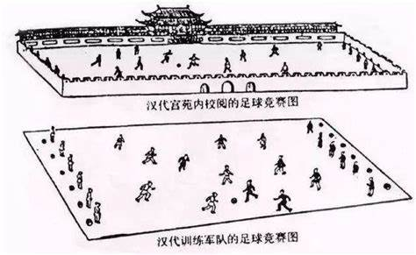
Rules and Gameplay of Cuju
Cuju was played with a leather ball filled with feathers or cloth.
The game had no hands—just like modern football. Players kicked the ball using feet, knees, and head.
There were different variations of the goalposts: some had netting, while others had a hole in the wall to score through.

Slide 5
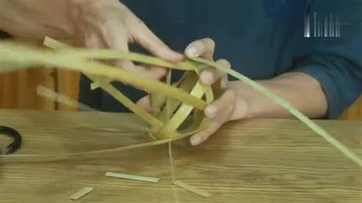
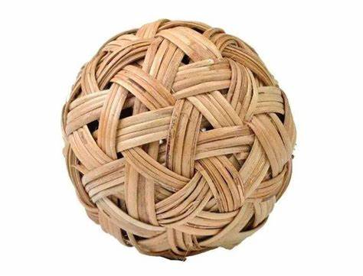
How to make a Cuju ball
To make a bamboo-woven Cuju ball:
Weave bamboo strips into a spherical shape.
Leave gaps for flexibility and lightness.
Fill with soft materials like cloth or feathers for bounce.
Secure ends of the bamboo and close openings. The ball should be lightweight and durable.

Slide 6
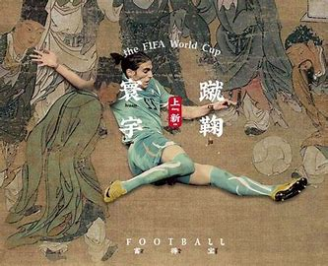
Modern Revival and Legacy of Cuju
In 2004, FIFA officially recognized Cuju as a prototype to modern football, acknowledging its historical contributions to the sport.
This recognition helped raise awareness about Cuju’s legacy and its influence on modern football.

Slide 7
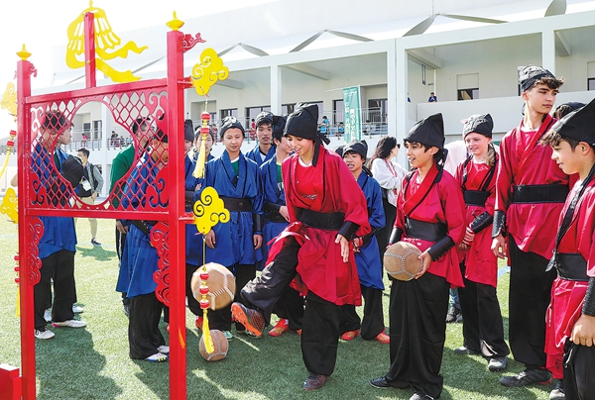
Chinese Cuju’s culture shines in Qatar
A friendly soccer match between Chinese and Qatari youths was held.
The event is part of a series of international exchange promotion activities, dubbed Cultural Journey to the Origin of Football.

Slide 8
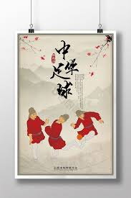
Conclusion
Cuju is not just an ancient sport, but a key piece of China’s cultural history that influenced the development of modern football.
From the royal courts to the military training fields, Cuju helps shape the way we play the beautiful game today.

