Slide 1
Christianity
彭锐宏（Peng Ruihong)

Slide 2
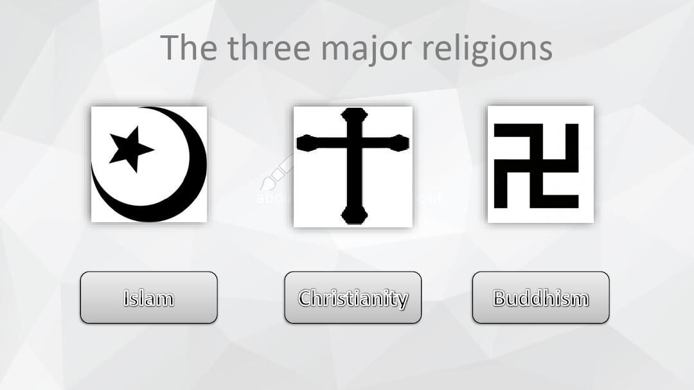

Slide 3
Christianity Introduction
Christianity is a monotheistic(一神论的)religion based on the life and teachings of Jesus Christ（耶稣）. It is the world’s largest religion, with over 2.4 billion followers, or 33％ of the global population, known as Christians. Christians believe that Jesus is the son of God and the savior of humanity whose coming as the Messiah(The Christ) was prophesied in the Old Testament.

Slide 4
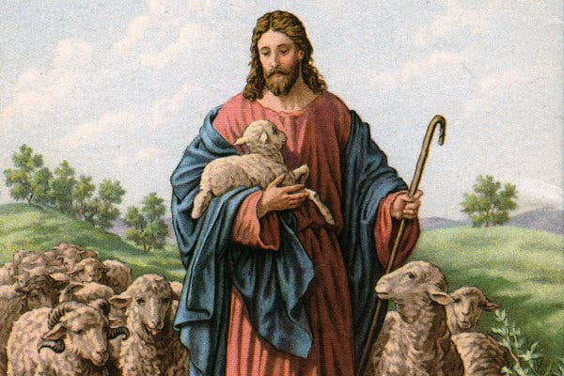
Jesus Introduction

Slide 5
The History of Christianity
Christianity began in the 1st century AD after Jesus died and resurrected, as a small group of Je wish people in Judea, but quickly spread throughout the Roman empire. Despite early persecution of Christians, it later became the state religion. In the Middle Ages it spread into Northern Europe and Russia.

Slide 6
The Branches of Christianity
"Christian denominations" (or "self-identified Christian denominations") are listed in order of historical or doctrinal relevance. The Christian religion is divided into three main denominations: the Catholic Church, the Orthodox Church, and the Protestant Church. Within Protestant Christianity, there are denominations that are subdivided for minor doctrinal differences, such as Lutheran, Presbyterian, and Baptist, while smaller denominations may have only a few churches.

Slide 7
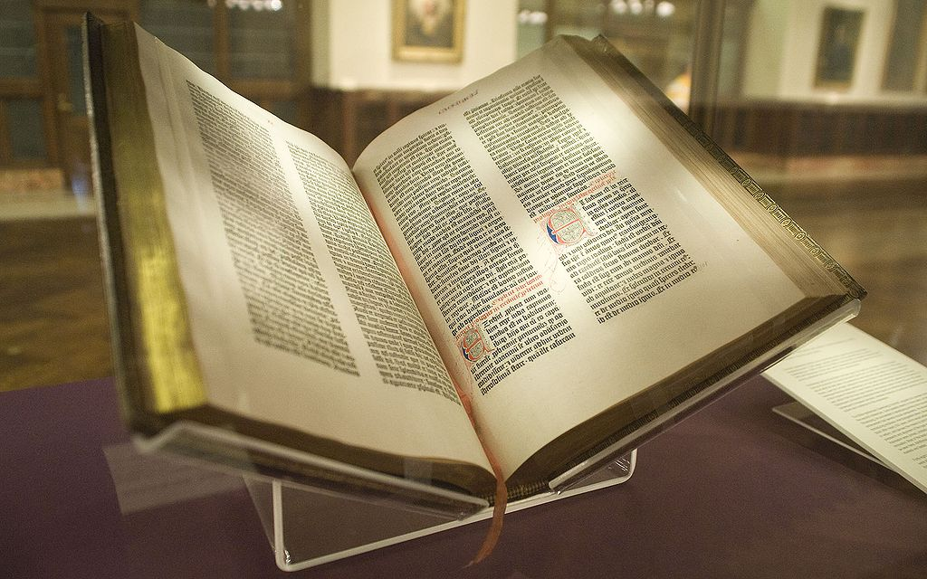
Bible

Slide 8
Thank you!

