Slide 1
Translation theorie of Xu Yuanchong
——The only person who translates poems
into English and French

Slide 2
1.
Life experience
Contents
Major translation
works
2.
3.
Translation theorie

Slide 3


Life experience
1921, born in Jiangxi province of China.
1943, graduated from department of Foreign Language National Southwestern Associated University(国立西南联合大学外语系)
1948,studing in France.
Since 1951 he came back to China and'works,as theEnglish and French professor in some foreign language schools.
Since 1983 he has taught as a professorfor international culture course at Peking University.

Slide 4
Life experience
His mother is well-educated and good at painting.His uncle is a famous translator who translated WangBaochuan into English version which was played in Britain and caused sensation.
Influenced by his mother and his uncle, he loved English and was determined to learn it when he was a child.
In National Southwestern Associated University he translated :
Three principles of the people:
Of the people, by the people, for the people.

Slide 5
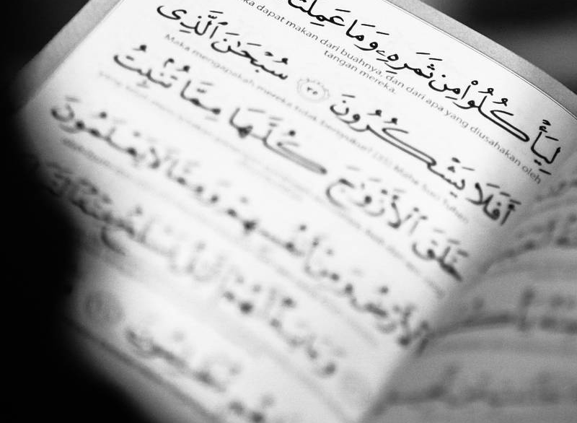

Translation works
Romance of the western Chamber
The Book of Songs
Song Poems
The Songs of Chu
《中国古诗词六百首》
《汉魏六朝诗一百五十首》
《唐诗三百首》
《新编千家诗》

Slide 6
BEST WORDS IN BEST ORDER 三美合一
. Beauty in sense 意美
. Beauty in sound 音美
. Beauty in form 形美
Appreciation:
In the steep sky cold waves are swiftly sweeping by
On the vast earth warm winds gradually grow high.
高天滚滚寒流急，大地微微暖风吹。
Translation theories

Slide 7
三 似 论
Translation theories
similar in meaning 意似
similar in form 形似
.similar in spirit 神似

Slide 8


Translation theories
三化论
01
02
03
Simplifying
浅化
Being equivalent 等化
Deepening
深化

Slide 9
A Tranquil night
Before my bed a pool of light.
Translation appreciation
Can it be hoarfrost on the ground?
Look up, I find the moon bright,
Bowing, in homesickness I 'm drowned

Slide 10
[1] 许渊冲. 文学与翻译 [M]. 北京：北京大学出版社, 2003a. [2] 许渊冲. 翻译的艺术 [M]. 北京：五洲传播出版社, 2006. [3] 许渊冲. 汉英对照唐诗三百首 [M]. 北京；高等教育出版社，2000. [4] 余光中. 余光中谈翻译 [M]. 北京：中国对外出版翻译公司，2002. [5] 中国翻译编辑部.诗词翻译的艺术 [C]. 北京：中国对外出版翻译公司，1986. [6] 谢天振. 翻译研究新视野 [M]. 青岛：青岛出版社，2003.

Slide 11
Thank you !

