Slide 1



A Brief History of
Chinese Poetry Translation
(1949 and before)
handout:牟一心
speaker:饶金盈

Slide 2
CONTENTS
01. Introduction
02. The 1st Stage
03. The 2nd Stage
04. The 3rd Stage

Slide 3
Introduction

Slide 4
Introduction
As a part of literary translation, poetry translation has
a history of more than two thousand years.
three stages of Chinese poetry translation:
Zhou Dynasty to Northern Song Dynasty
Ming Dynasty to the May Fourth Movement
the May Fourth Movement to the founding of New China.

Slide 5
The 1st stage

Slide 6
The 1st stage
Time: from Zhou Dynasty to Northern Song Dynasty
Chinese poetry translation originated from the interpretation of folk songs.
Wuyue dialect → Chinese
The earliest poen translation of 《越人歌》in Zhou dynasty adopted the Chu folk song style and it is easy to understand with graceful rhythm.
“山有木兮，木有枝。心说君兮，君不知。”

Slide 7
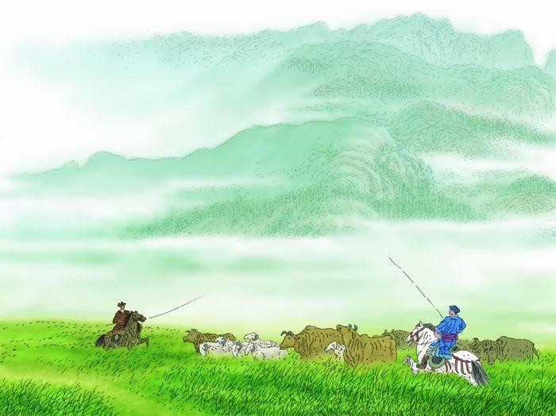
The 1st stage
Xianbei dialect → Chinese
Chile folk song《敕勒歌》was created by Hulvjin in the Northern Qi Dynasty.
The poem depicts the vast and beautiful living environment of the people on the grasslands, and reflects the social environment of Chile people.
“敕勒川，阴山下。天似穹庐，笼盖四野。
天苍苍，野茫茫，风吹草低见牛羊。”
(The picture is from Internet.)

Slide 8
The 2nd stage

Slide 9
The 2nd stage
Time: from the Ming Dynasty to the May Fourth Movement
At the end of the Ming Dynasty and the beginning of the Qing Dynasty, foreign poems were widely introduced and translated in China.
English→Chinese(with a form of ancient poetry)
George Gordon Byron’ s The Isles of Greece
查良铮，苏曼殊，马君武，胡适，闻一多，卞之琳，杨德豫，梁启超......
(https://baike.so.com/doc/1349840-1427051.html#1349840-1427051-2)

Slide 10
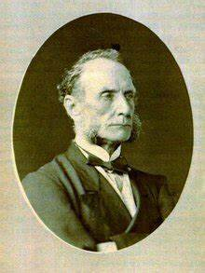
The 2nd stage
Henry Wadsworth Longfellow’ s A Psalm of Life
The earliest English poem translation in China
Thomas Francis Wade translated this poem into Chinese and invited the Dong Xun to polish it. Later, the poem was written on a fan and given to Longfellow.
Life is real! Life is earnest! 天地生才总不虚，
And the grave is not its goal; 由来豹死尚留皮。
Dust thou art, to dust returnest, 纵然出土仍归土，
Was not spoken of the soul. 灵性长存无绝期。(2nd stanza of A Psalm of Life)
(The picture is from Internet.)

Slide 11
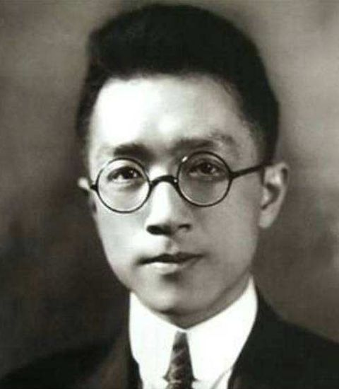
The 2nd stage
At this stage, Hu Shi made a breakthrough in poetry translation.
In his early years, he used Chinese ancient style to translate The Charge of the Light Brigade by Alfred Tennyson and Day Break by American poet Longfellow. Later, his poetry translation gradually turned to the vernacular(白话的) style of free poetry.
Hu Shi
(The picture is from Internet.)

Slide 12
The 2nd stage
Poetry translation in this period began to introduce and translate many excellent foreign poems, which can be regarded as the pioneering period of our country’ s poetry translation.
However, due to the uneven level of translators at that time and the lack of scientific and systematic translation theories in China, most poetry translation works are still immature, which only focused on the content transmission, but ignored the form of the original poem.

Slide 13
The 3rd stage

Slide 14
The 3rd stage
Time: the May Fourth Movement to the founding of New China
In the context of the era of saving the nation, China’ s poetry translation was not only introducing foreign poetry art, but also focusing on introducing modern ideas from all over the world.
English→Chinese(vernacular白话的, free verse)
鲁迅、郭沫若、刘半农、闻一多、林语堂、梁实秋、徐志摩、孙大雨、成仿吾......

Slide 15
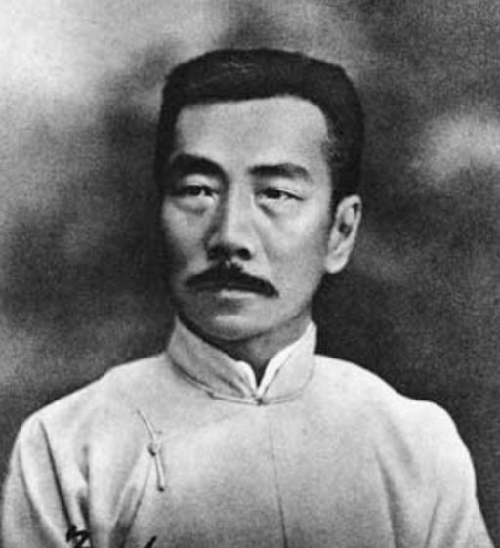
The 3rd stage
Lu Xun is a pioneer in modern Chinese translation of foreign literature. Among the works of foreign writers he translated and introduced, there are ten poems, including poems from Poland and Hungary.
Lu Xun
(The picture is from Internet.)

Slide 16
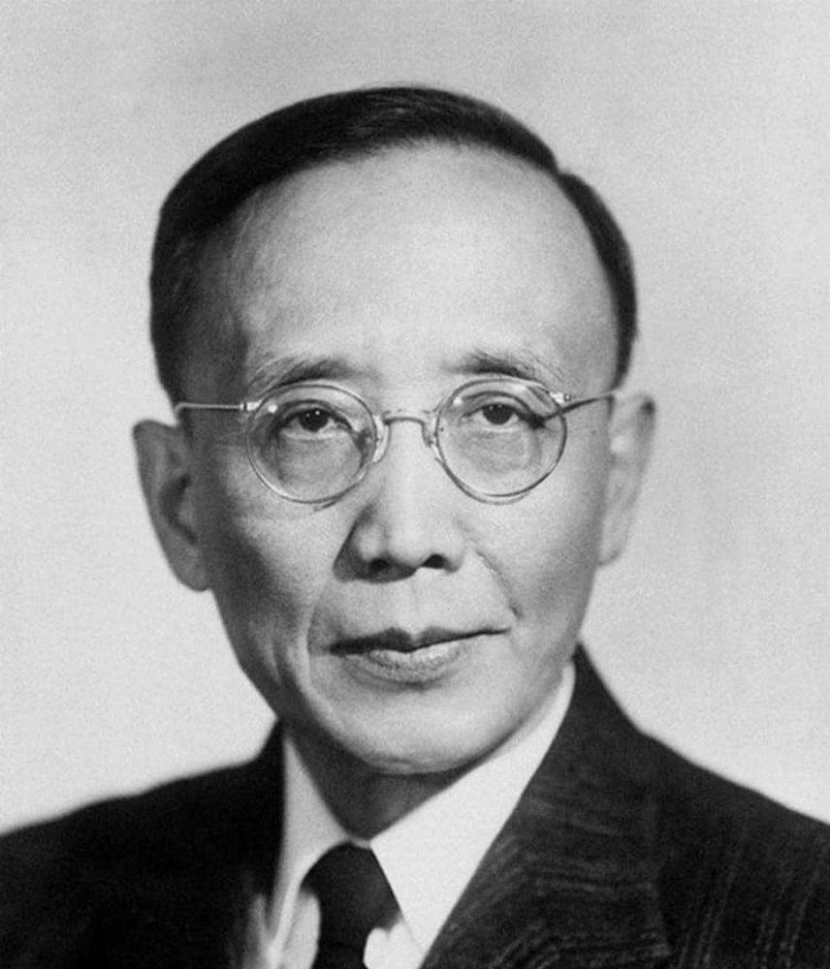
The 3rd stage
Guo Moruo had translated The Rubaiyat(《鲁拜集》), Selected Poems of Shelley (《雪莱诗选》)and Goethe’ s poems.
Better than all measures 诗人爱汝巧，
Of delightful sound, 贵比百声律，
Better than all treasures 读破万卷书，
That in books are found, 书中无此物，
Thy skill to poet were, thou scorner of the ground.
汝高扬在天，藐视此尘俗！(the 20th stanza of To a Skylark)
Guo Moruo
(The picture is from Internet.)

Slide 17
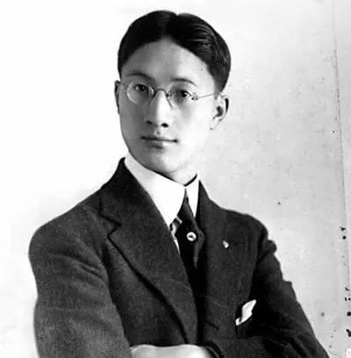
The 3rd stage
Xu Zhimo translated William Blake’ s TheTyger, and also translated some sections of Romeo and Juliet into poetry.
Tyger! Tyger! Burning bright 猛虎，猛虎，火焰似的烧红
In the forests of the night!在深夜的莽丛，
What immortal hand or eye 何等神明的巨眼或是手
Dare frame thy fearful symmetry? 胆敢擘画你的惊人的雄厚？
(the 6th stanza of The Tyger)
Xu Zhimo
(The picture is from Internet.)

Slide 18
Thanks for your patience
handout:牟一心
speaker:饶金盈

