Slide 1

The Development of Machine Translation
Group members:
Deng Jinxia 邓锦霞
Han Wanzhen 韩宛真

Slide 2
Contents
Part one(stages)
Proposal
Early stage
Setback
Recovery
Development
Prosperity
Part Two(methods)
Rule-based Translation
Statistical Machine Translation
Neural Machine Translation

Slide 3
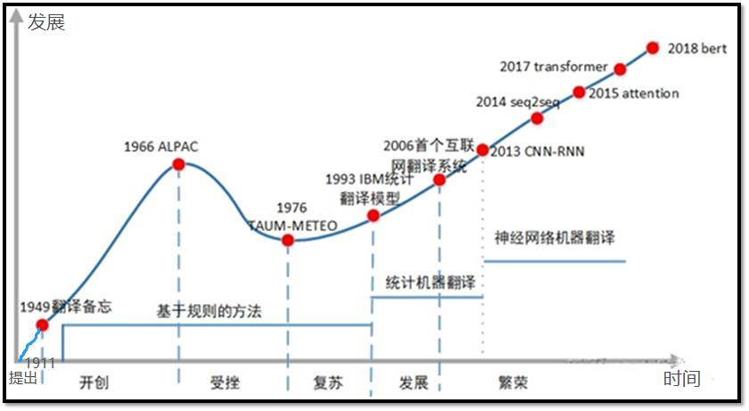

Slide 4
What is machine translation?
Machine Translation means that translation from source language to target language by machine.

Slide 5
Part one: The Development of Machine Translation according to Time
1.Proposal
2.Early stage
3.Setback
4.Recovery
5.Development
6.Prosperity

Slide 6
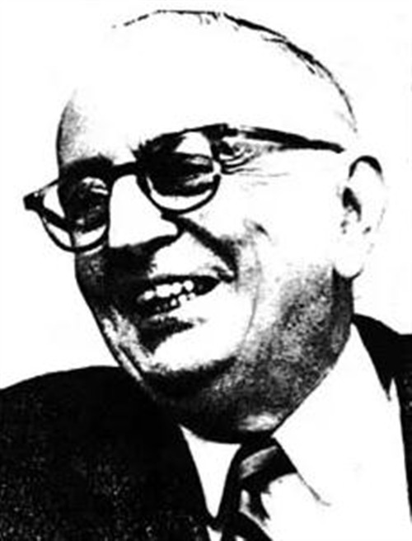
Proposal of Machine Translation(1935-1947)
In 1911,G.B Artsouni (French scientist) An idea
In 1947,Warren Weaver “Translation Memo”
Formally put forward the idea of machine translation
Warren Weaver

Slide 7
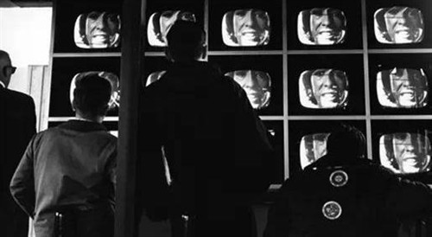
Early Stage of Machine Translation(1949-1964)
In 1954,with help of IBM company, Georgetown University used the IBN-701 computer to complete the machine translation experiment for the first time.(English-Russian )
Demonstrating the feasibility of machine translation to the public and the scientific community. The main objects of translation are scientific and technical documents, such as articles in scientific journals

Slide 8
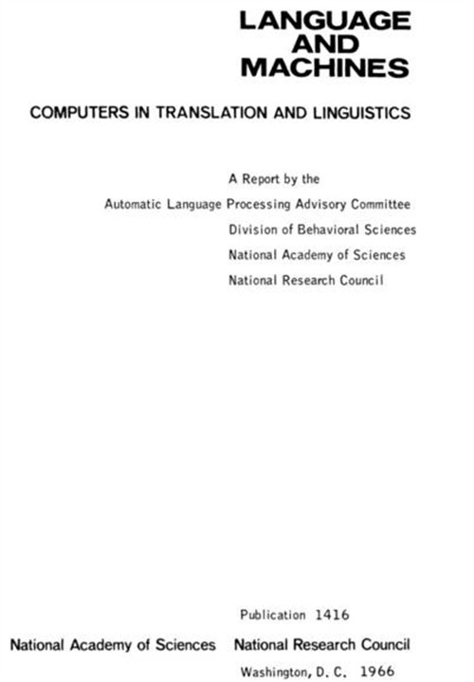
Setback of Machine Translation(1964-1975)
In 1966, Automatic Language Processing Advisory Committee published “Langauge and Machine”, which denied the feasibility of machine translation .
Various machine translation projects have dropped sharply, at least in the USA, was officially declared practically dead.

Slide 9
Recovery of Machine Translation(1975-1989)
Development
Computer technology
Linguistics
Social information service
In the late 1970s
Machine translation began to recover. The industry has developed a variety of translation systems, such as Weinder, EURPOTRAA, TAUM-METEO.
The TAUM-METEO system, which was jointly developed by the University of Montreal and the Translation Office of the federal government of Canada in 1976, is a milestone in the history of machine translation, marking the transition from recovery to prosperity of machine translation.

Slide 10

Development of Machine Translation(1993-2006)
In 1993, Brown and Della Pietra of IBM proposed a translation model based on word alignment. It marks the birth of modern statistical machine translation.
Franz Och（ In 2003）
Statistical phrase-based translation;
Minimun error rate training in statistical machine translation
It remarked the real rise of statistical machine translation

Slide 11
Prosperity of Machine Translation(2006-Now)
Since 2011, with the rapid development of speech recognition and machine translation technology and the needs of economic globalization, the research of automatic oral translation has become a new research hotspot in the field of information processing
Modern translation mainly uses neural machine translation. In 2016, companies such as Baidu and Google successively upgraded their online machine translation systems to neural machine translation systems.

Slide 12
Part two：Development of Machine Translation in Methods
Rule-based Translation
Statistical Machine Translation
Neural Machine Translation

Slide 13
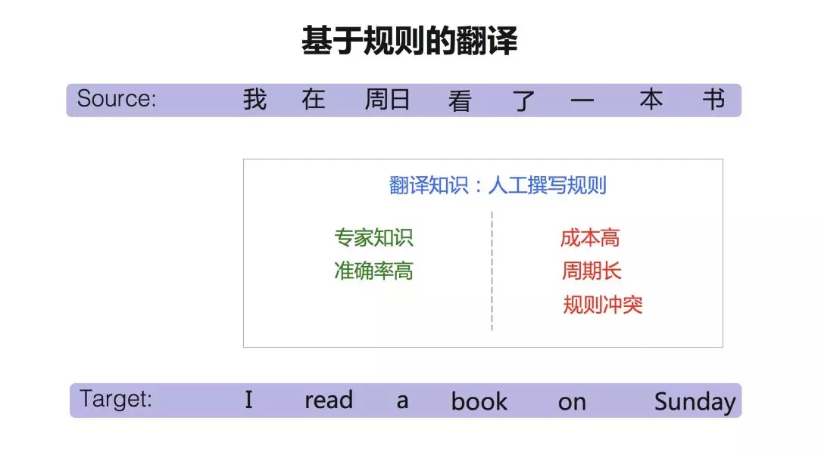
Rule-based Translation
Meaning: Translating knowledge comes from human experts, so human linguists make rules. For example, the specific word is translated into the corresponding word, the specific component is translated into another component, and the positions of these words are expressed by the rules.

Slide 14
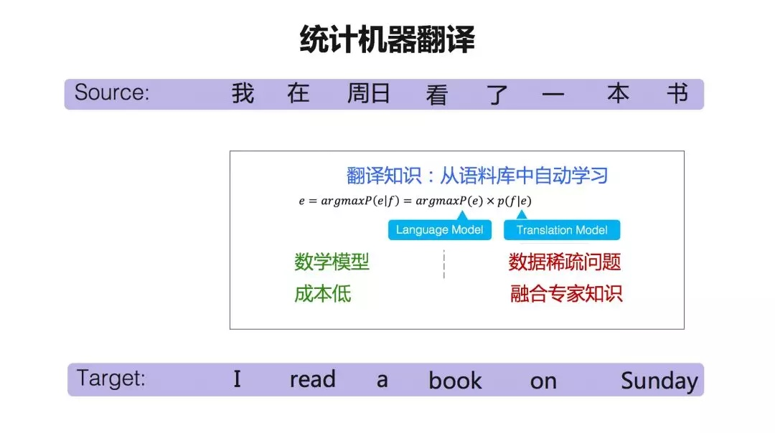
Statistical Machine Translation
Statistical machine translation is a corpus-based method, so if the amount of data is relatively small, it will face a data sparse problem. Translating knowledge mainly comes from two types of training data: parallel corpus, one sentence of Chinese and one English sentence, and this sentence of Chinese and English corresponds to each other, also called bilingual corpus; monolingual corpus, for example, English only is called the monolingual corpus.

Slide 15
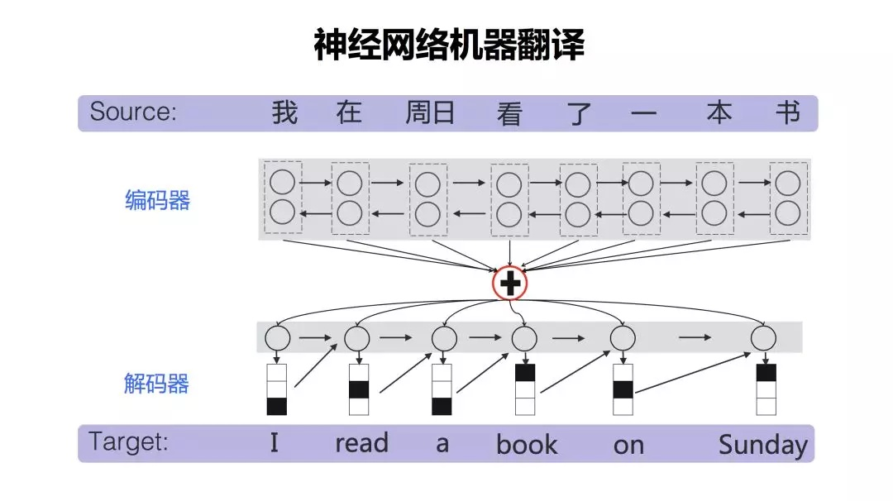
Neural Machine Translation
Compared with statistical machine translation, neural network translation is relatively simple in terms of model. It mainly contains two parts, one is the encoder and the other is the decoder. The encoder expresses the source language into a high-dimensional vector after a series of neural network transformations. The decoder is responsible for re-decoding (translating) this high-dimensional vector into the target language.

Slide 16
More Information
Wolfram Wilss. The Science of Translation: Problems and Methods. 上海外语教育出版社, 2001.
Koehn, P. , F. J. Och , and D. Marcu . "Statistical Phrase-Based Translation." Conference of the North American Chapter of the Association for Computational Linguistics on Human Language Technology Association for Computational Linguistics, 2003.
National Research Council. Automatic Language Processing Advisory Committee. "Language and machines; computers in translation and linguistics; a report." Methods in Molecular Biology 260(1966):73-82.
黎亚飞, and 张瑞华. "机器翻译发展与现状." 中国轻工教育 5(2019).
许钧, and 穆雷. 翻译学概论. 译林出版社, 2009..

Slide 17
Thank you !

