Slide 1
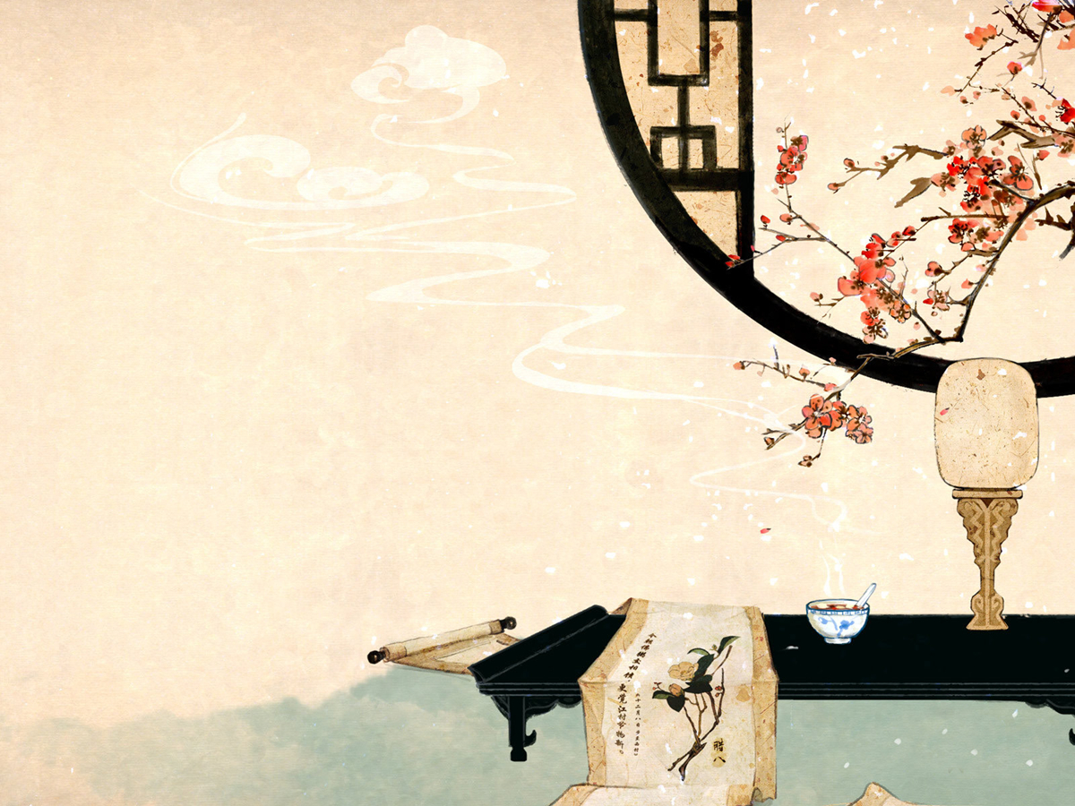

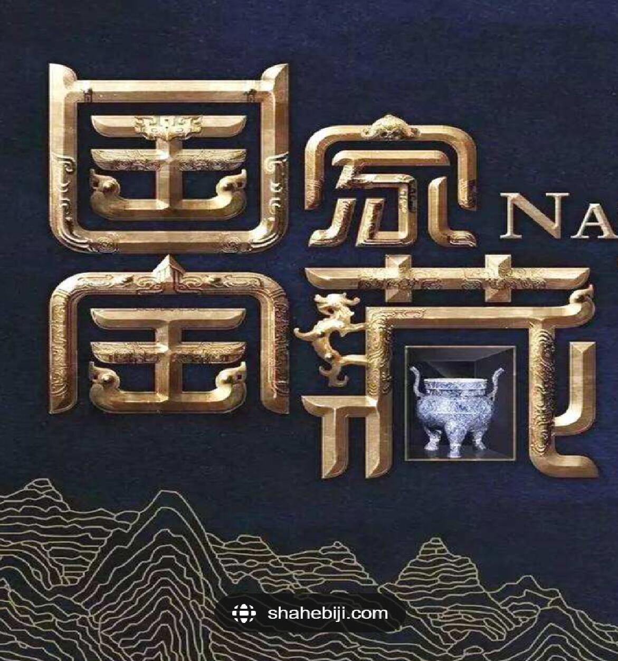
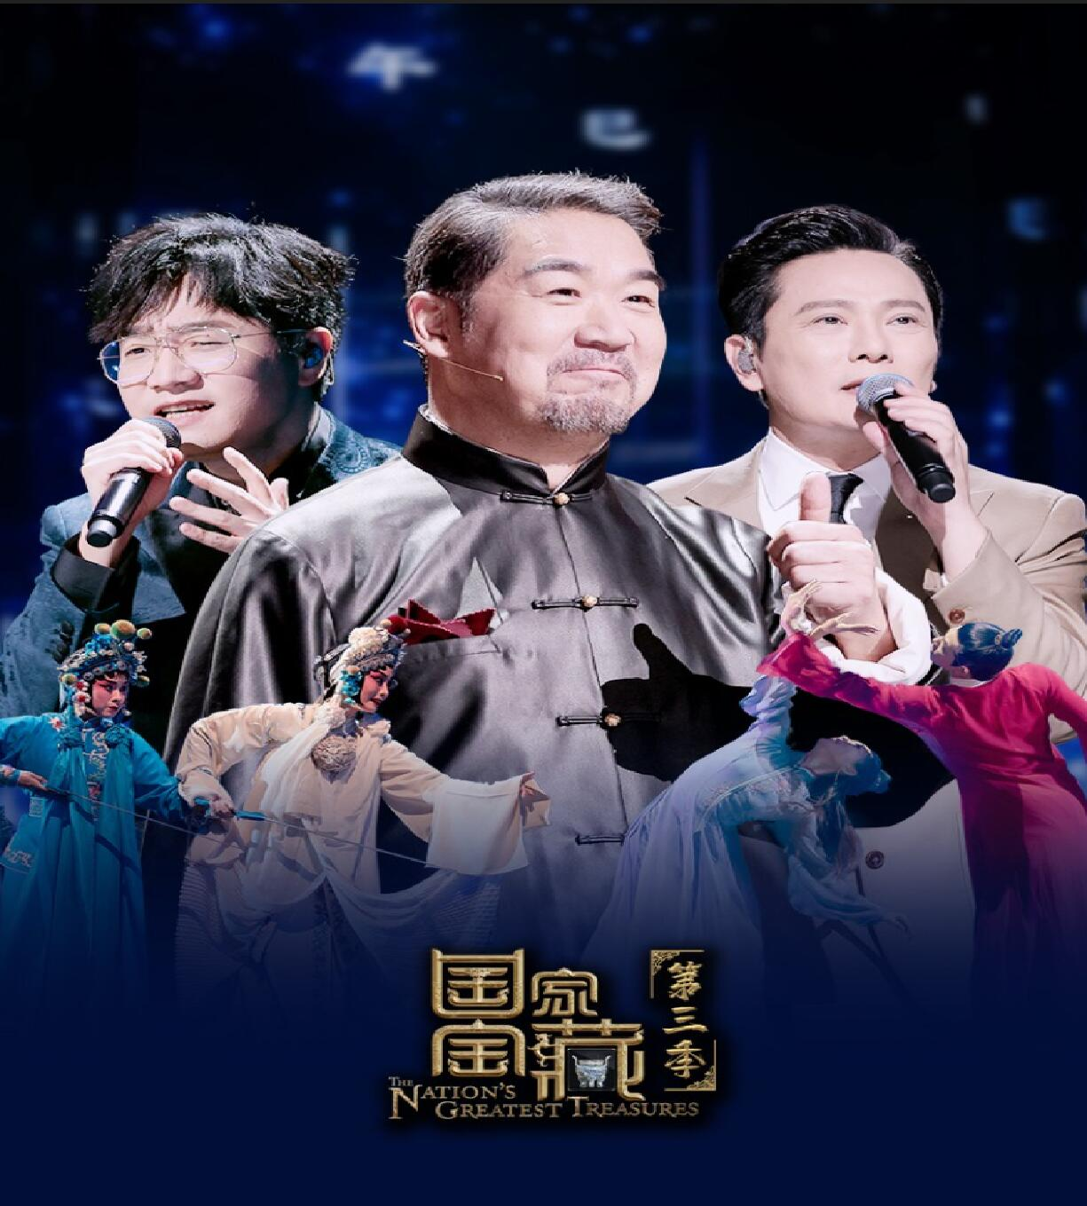
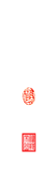

Slide 2
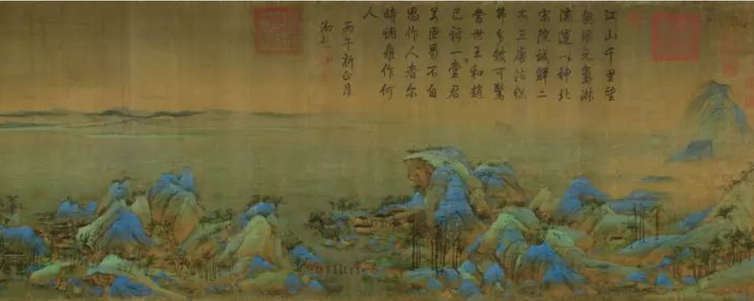
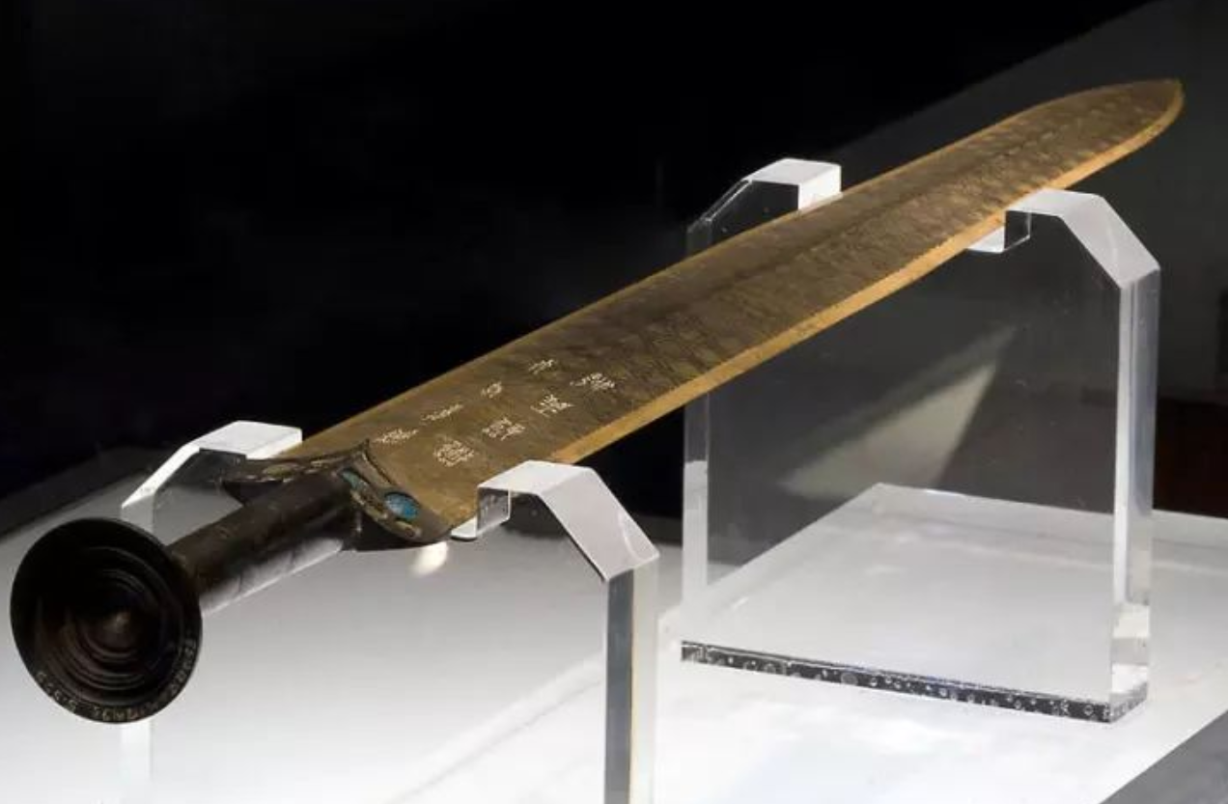
▲《千里江山图》卷，北宋，王希孟作，绢本，设色，纵51.5cm，横1191.5cm。
▲越王勾践剑 春秋晚期，1965年江陵望山1号墓出土，长55.7厘米。

Slide 3

Four State-Level Cultural Relics
Repoter:吴梨萍

Slide 4
CONTENTS
1.The introduction of the four relics.
2.The significance of inheriting and protecting cultural relics.
3.Questions

Slide 5
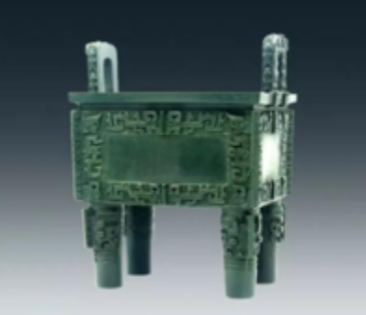
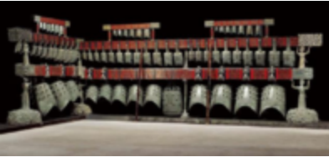
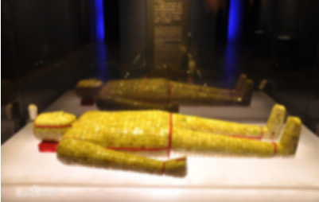
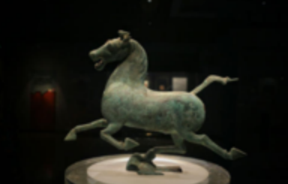
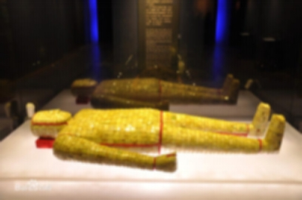
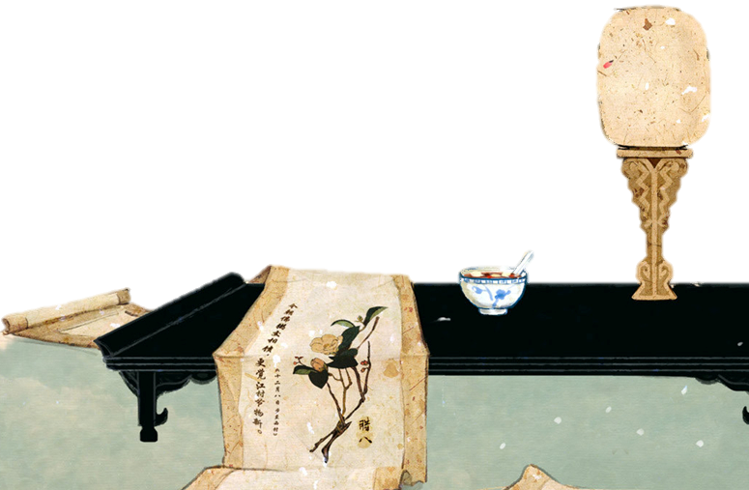


Four State-Level Cultural Relics
The Chime Bells of Marquis Yi
Bronze Galloping Horse
Jade Suit with Gold Thread
Simuwu Ding

Slide 6
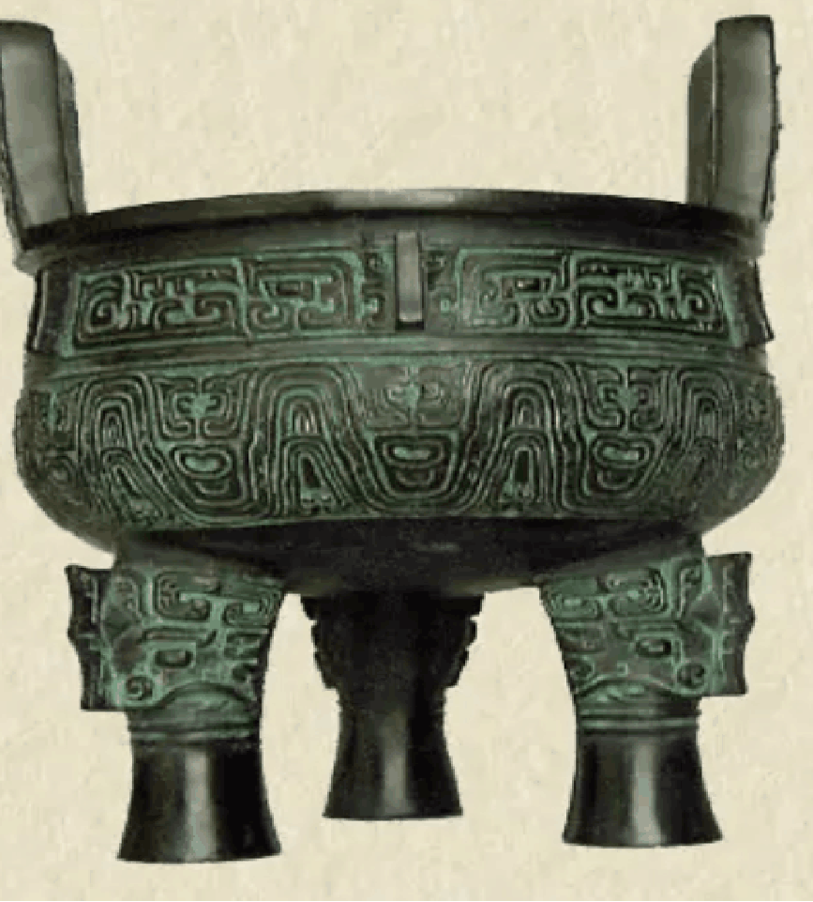
1.
Ding
鼎
It was first seen in the Oracle of the Shang Dynasty. It was originally intended to be an ancient tool for cooking food.
In ancient China, Ding was a symbol of imperial power. Therefore, ding is often used in phrases and expressions in the Chinese language to imply authority.

Slide 7
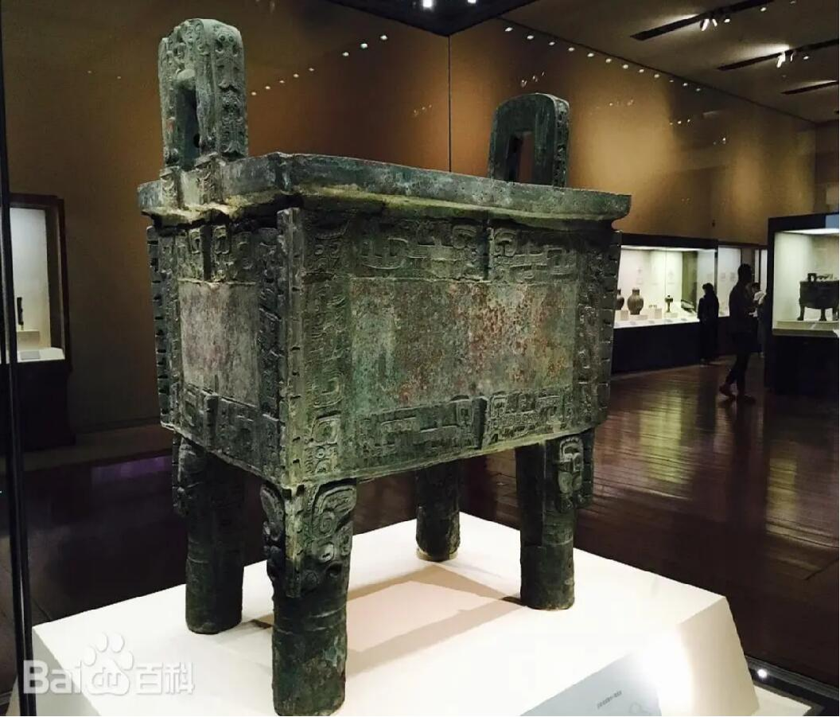
1.
Simuwu Ding
司母戊鼎
Simuwu Ding was a very precious cultural relic, found in 1939 in Anyang of Henan Province. It was produced in the late Shang Dynasty more than 3000 years ago. This square-shaped ding is the largest existing bronzeware in the ancient world.

Slide 8
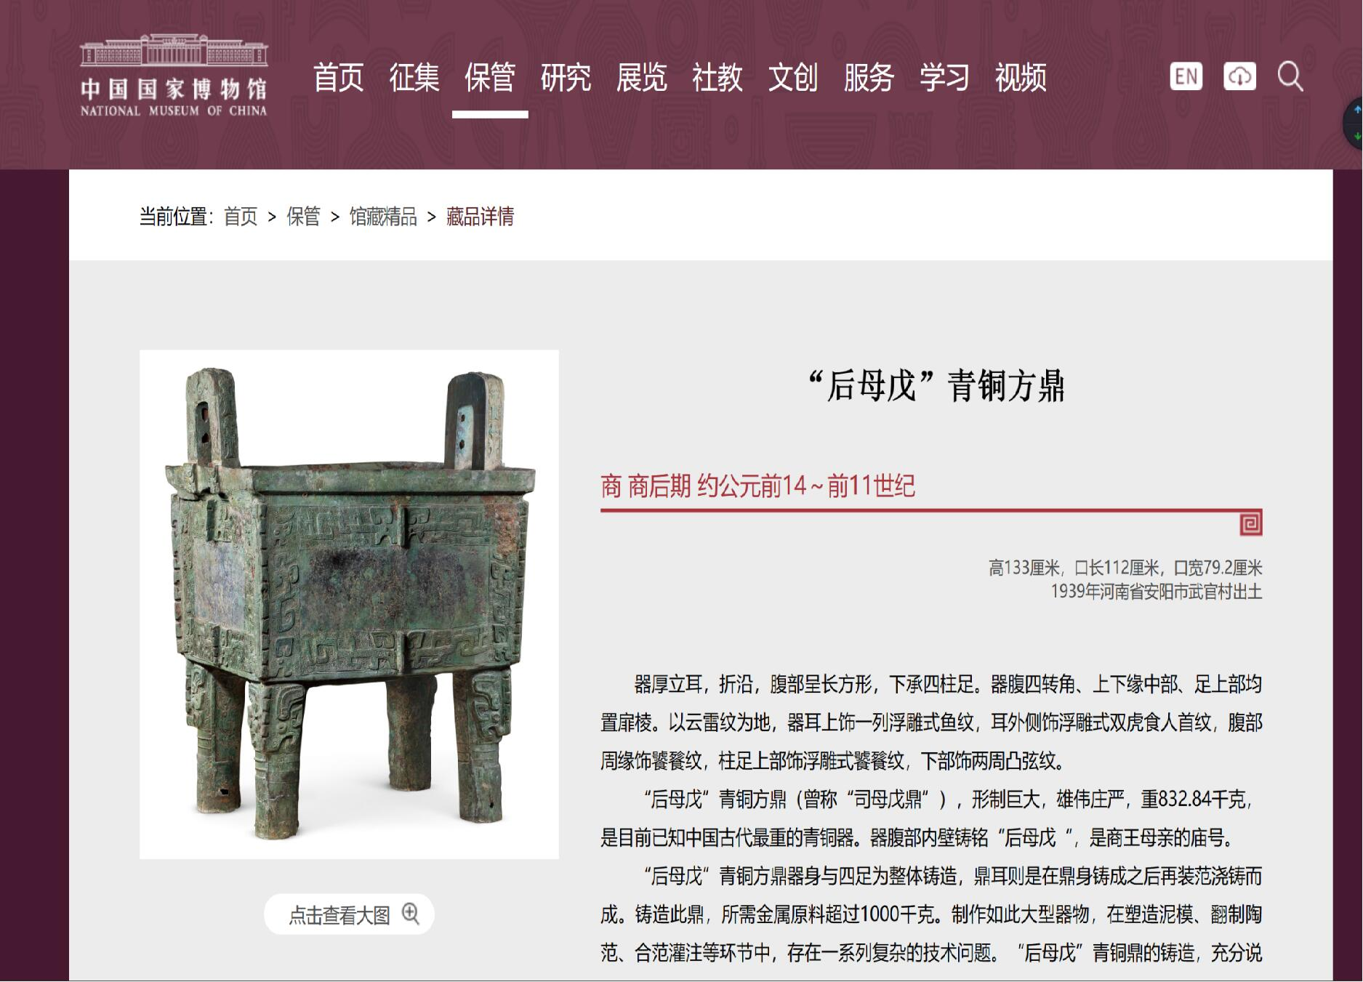

Slide 9
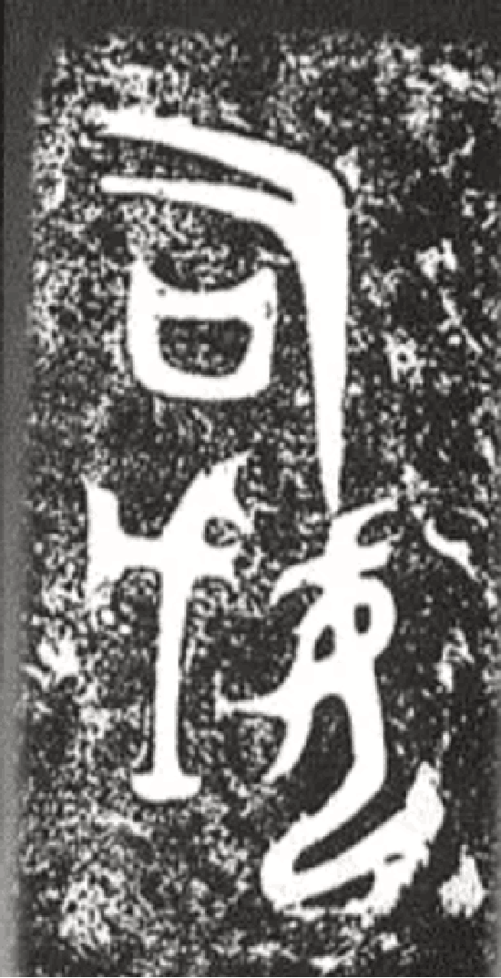
How did it got its name?
Simuwu Ding was cast by Emperor Wuding of the Shang Dynasty as a ritual object for a ceremony to offer sacrifices to his mother. The three characters simuwu form an inscription on the inside of the sidewall. According to archeologists, si means sacrificial ceremony and muwu is the name of the emperor’s mother.

Slide 10
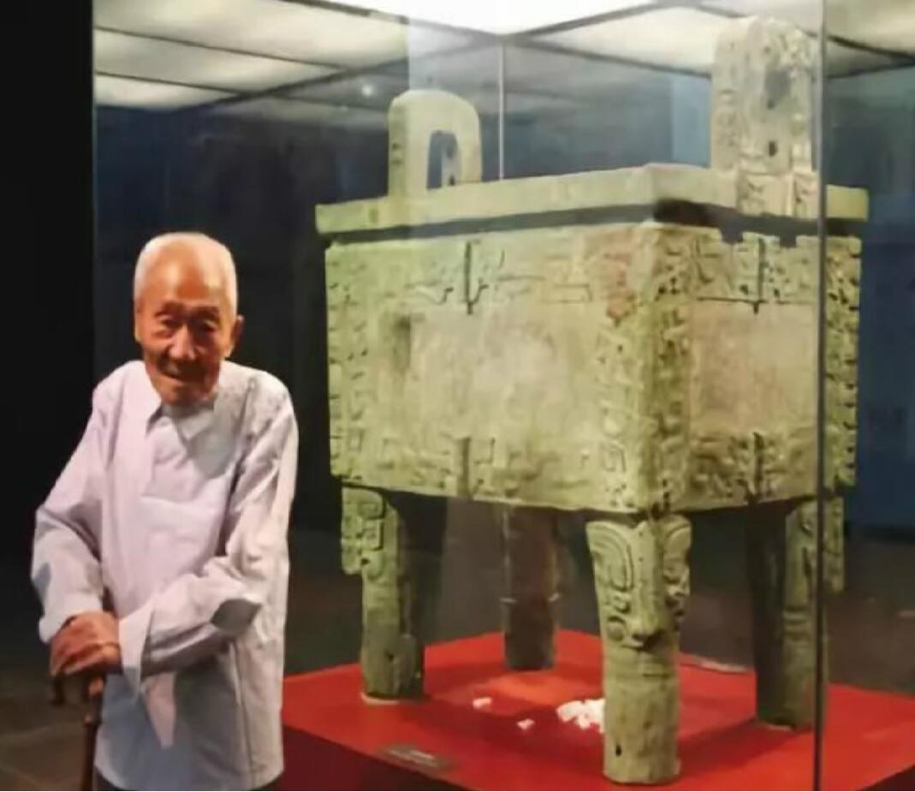
Simuwu Ding
司母戊鼎
Houmuwu Ding
后母戊鼎
In 1959, Guo Moruo, verified the bronze inscription on the inner wall of the tripod and believed that the Ding’s inscription was the three words "Simu Wu", so it got its own name - Simuwu Ding
However, at the end of March 2011, the national treasure was officially renamed "Houmuwu Ding".

Slide 11
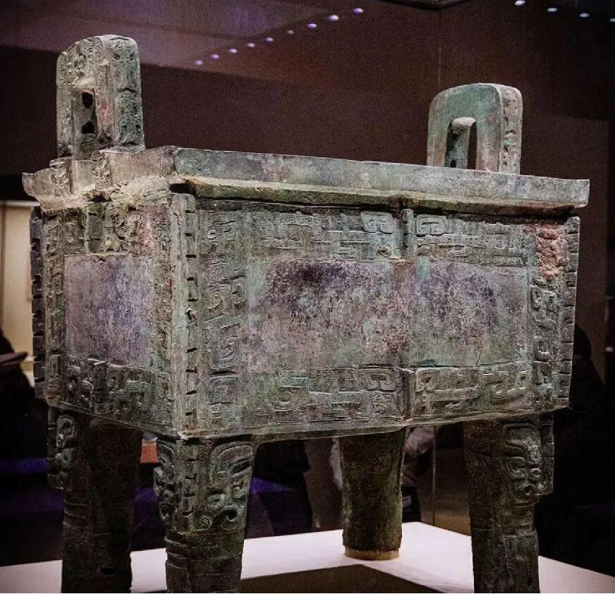
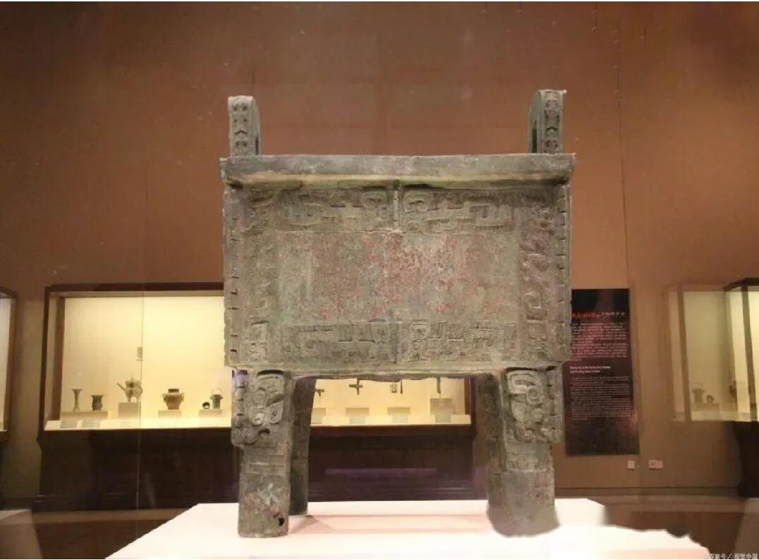
Contemporary miracle, the best bronze in the world!

Slide 12
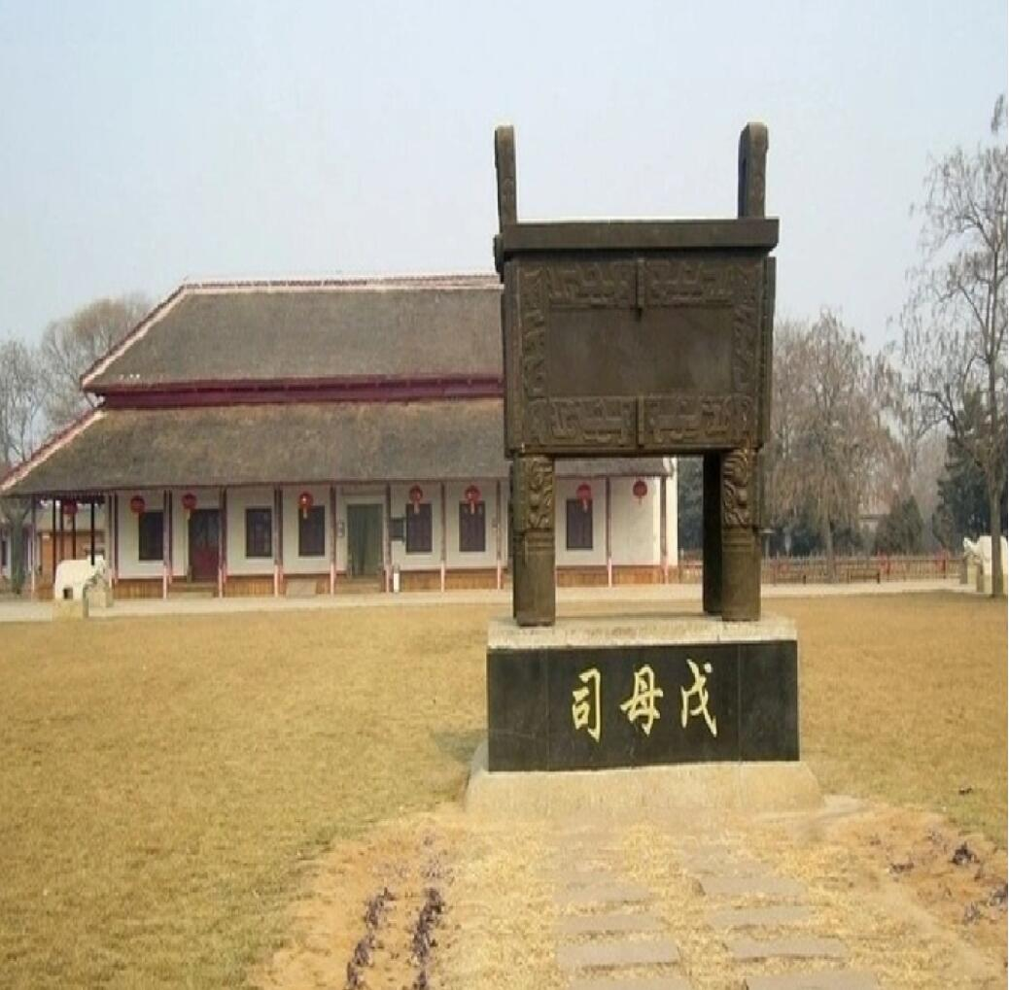
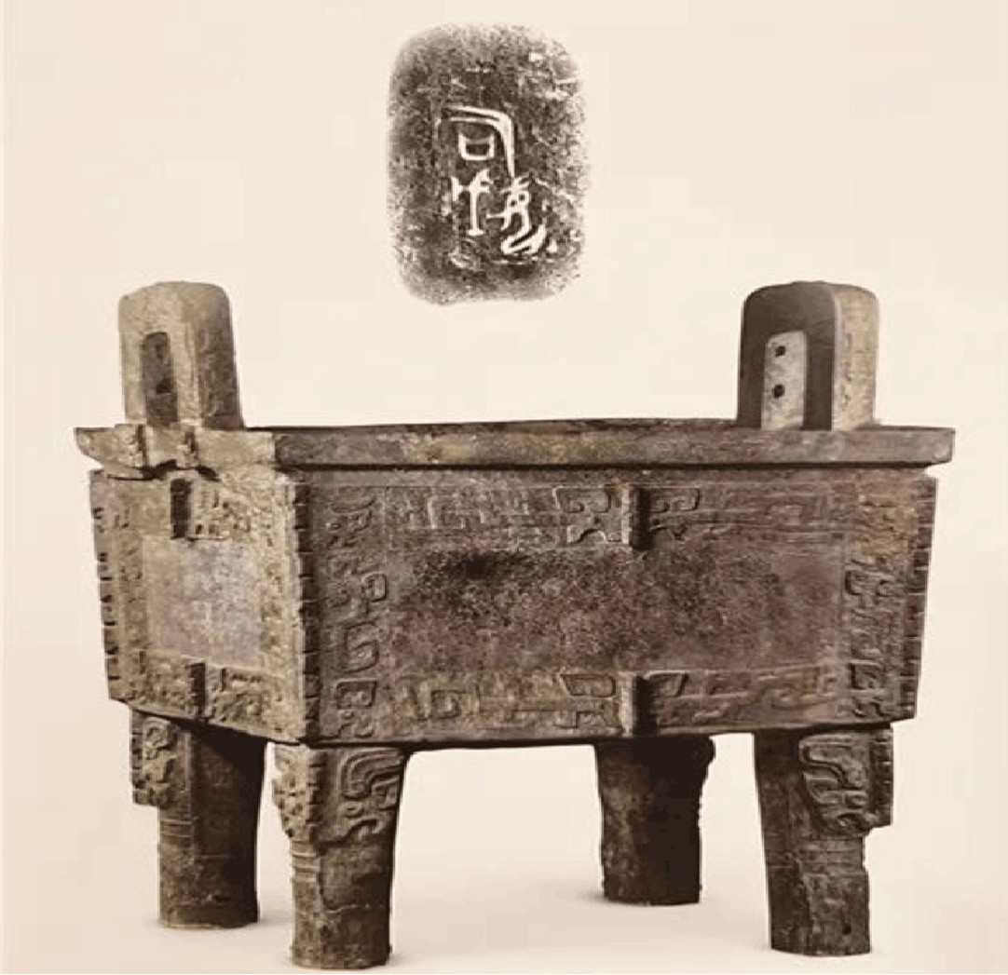
1.It highlights the prosperous landscape of the Shang Dynasty.

Slide 13
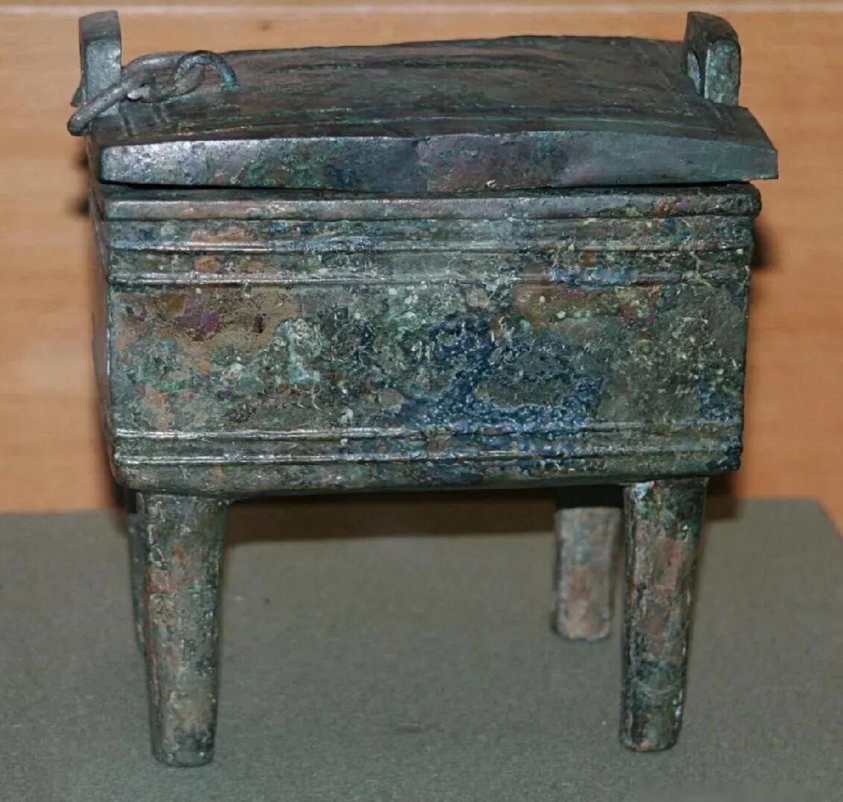
2.Its exquisite craftsmanship can be regarded as the benchmark of China's bronze age casting art.

Slide 14
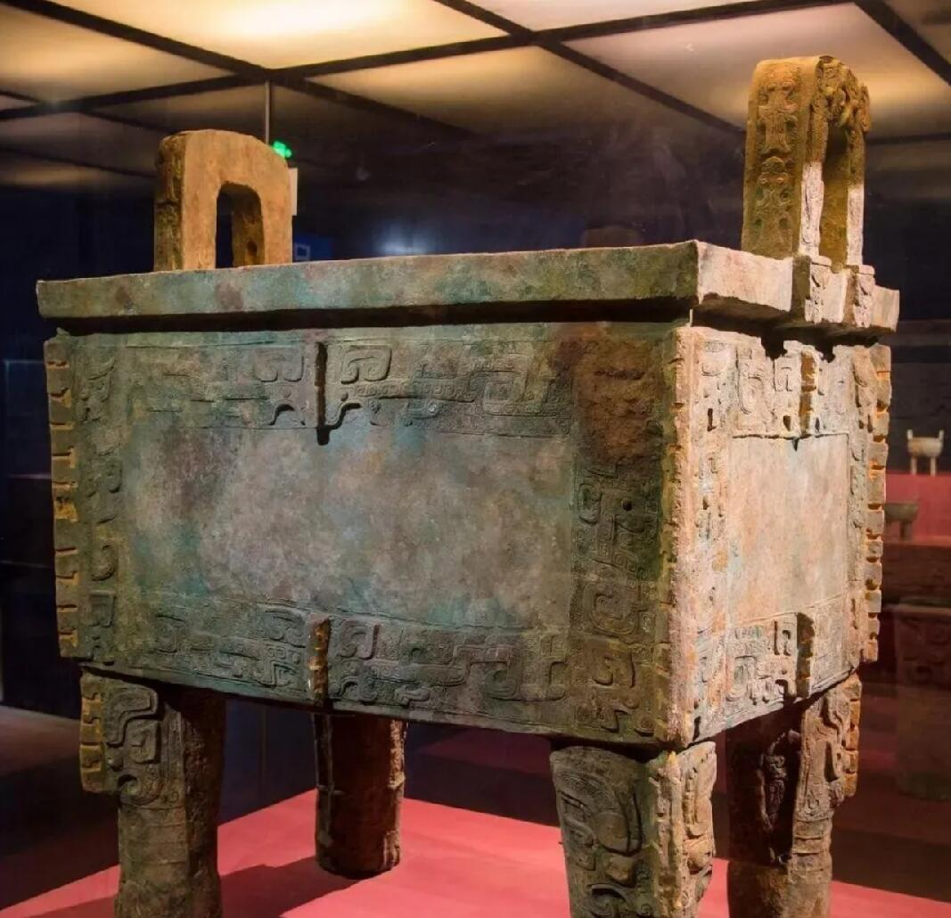
3.It reflects the Shang Dynasty's attitude towards commemorating and respect for women.

Slide 15
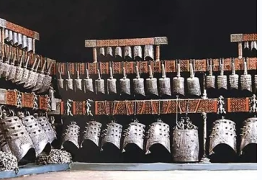
2.
The Chime Bells of Marquis Yi
曾侯乙编钟
It is a national first-class cultural relic. In 1978, it was unearthed in the tomb of Zenghou Yi in Sui County, Hubei Province (now Suizhou). It is now preserved in the Hubei Provincial Museum, which is the "most precious treasure of the museum".

Slide 16
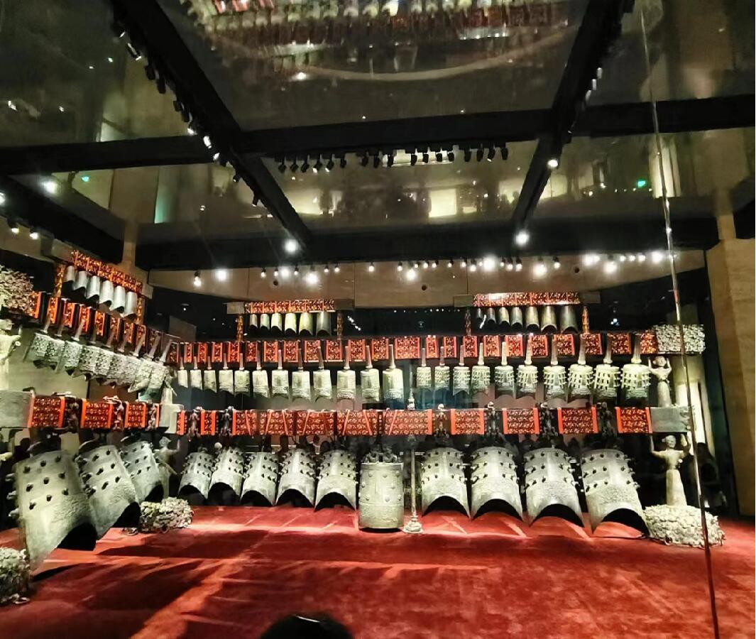
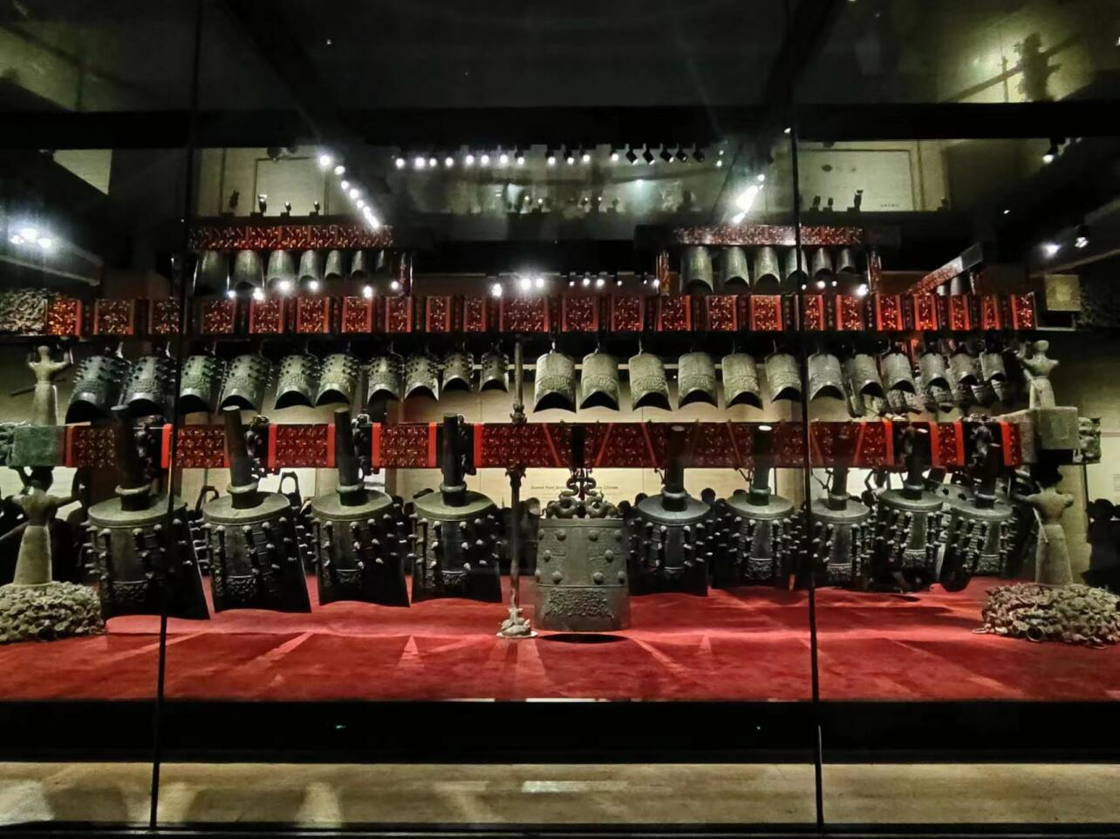
Why do we call it an exquisite Chinese musical instrument?
1.The Chime Bells of Marquis Yi are the largest and the most complete ancient chimes existing today in China.

Slide 17
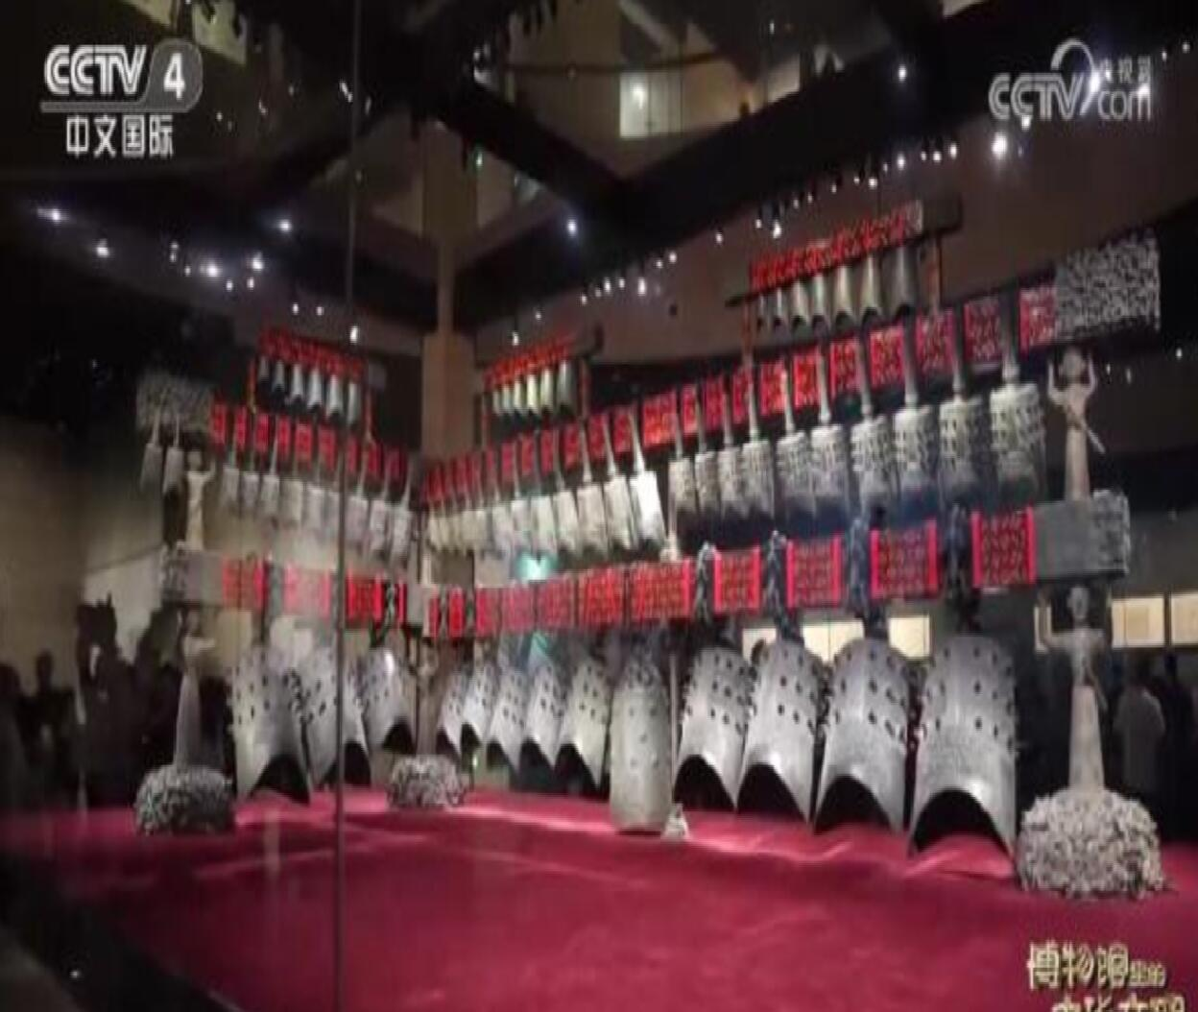
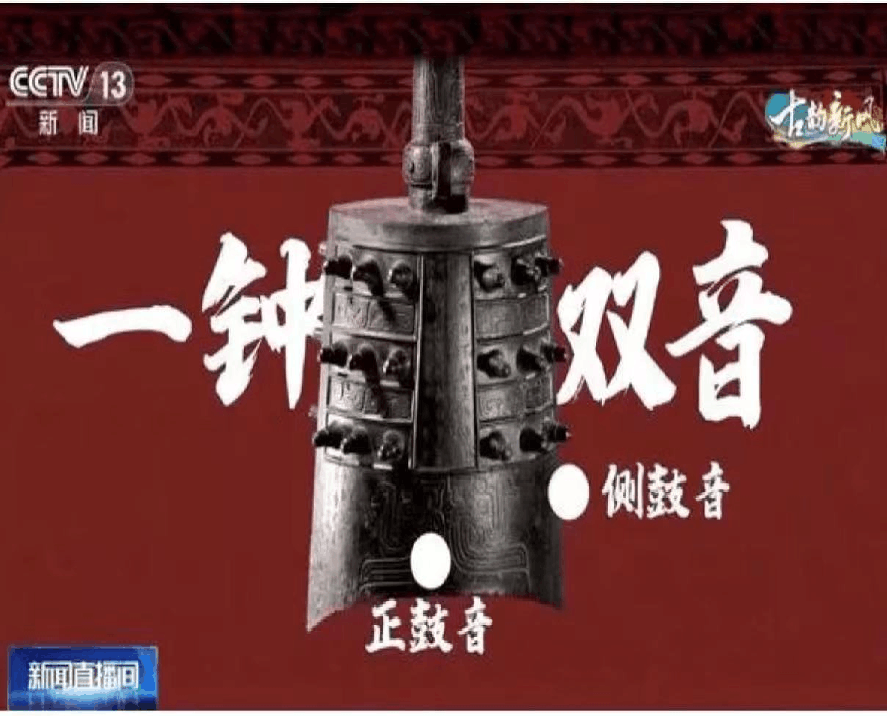
2.The discovery of the clock broke the statement that the seven-tone scales of China came from Europe.

Slide 18
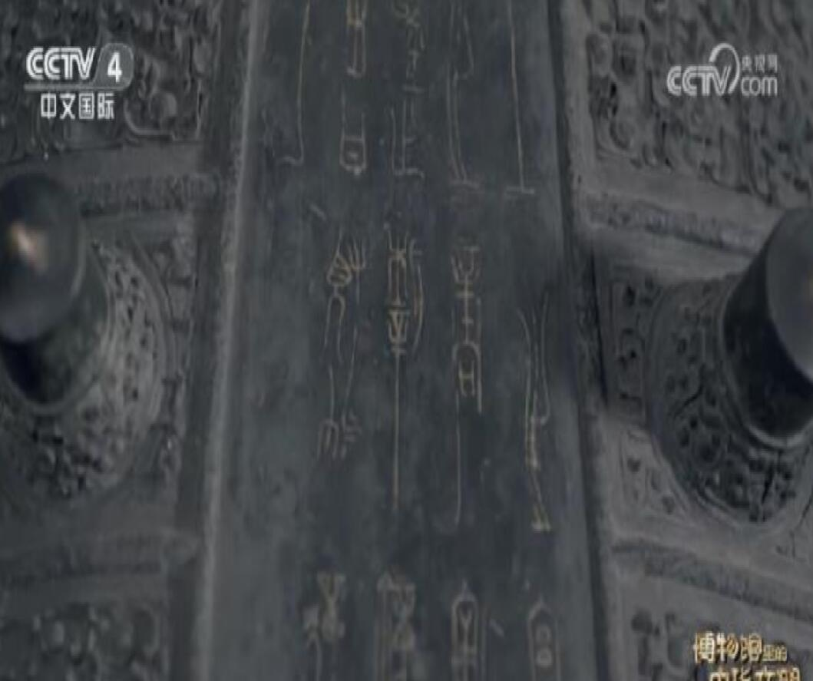
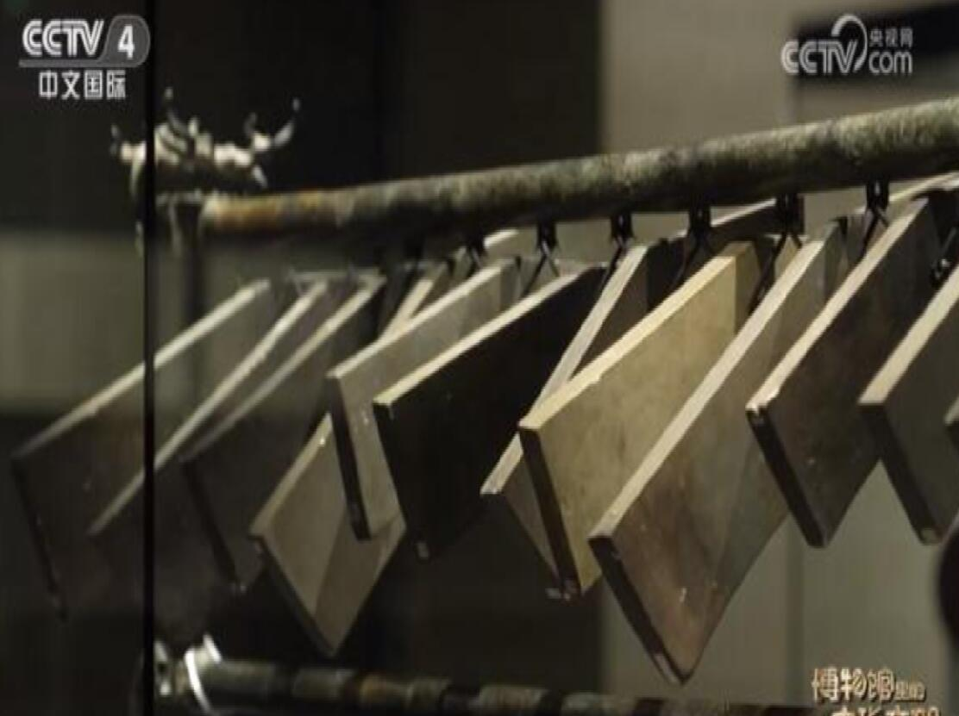
3.What is more precious is that there are a large number of inscriptions on the whole set of clocks, which record rich knowledge of music and history.

Slide 19
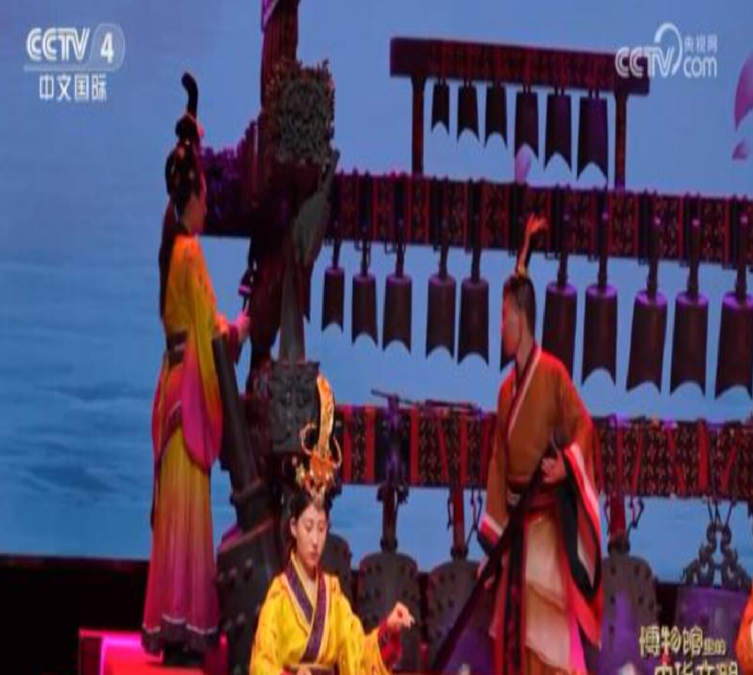
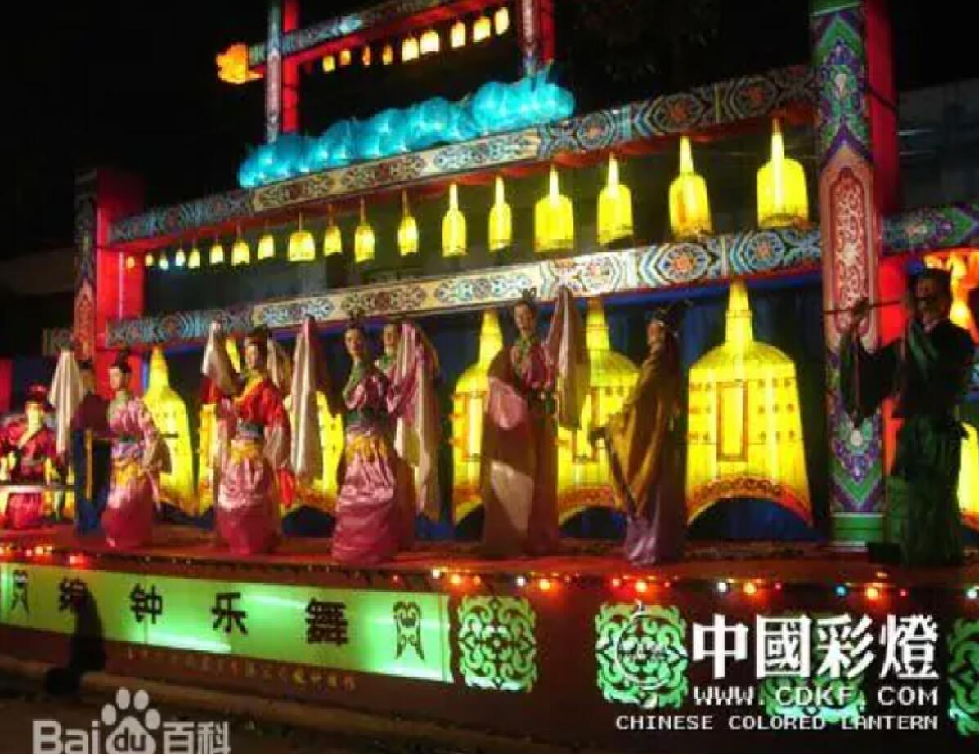
Bianzhong Yuewu 《编钟乐舞》

Slide 20
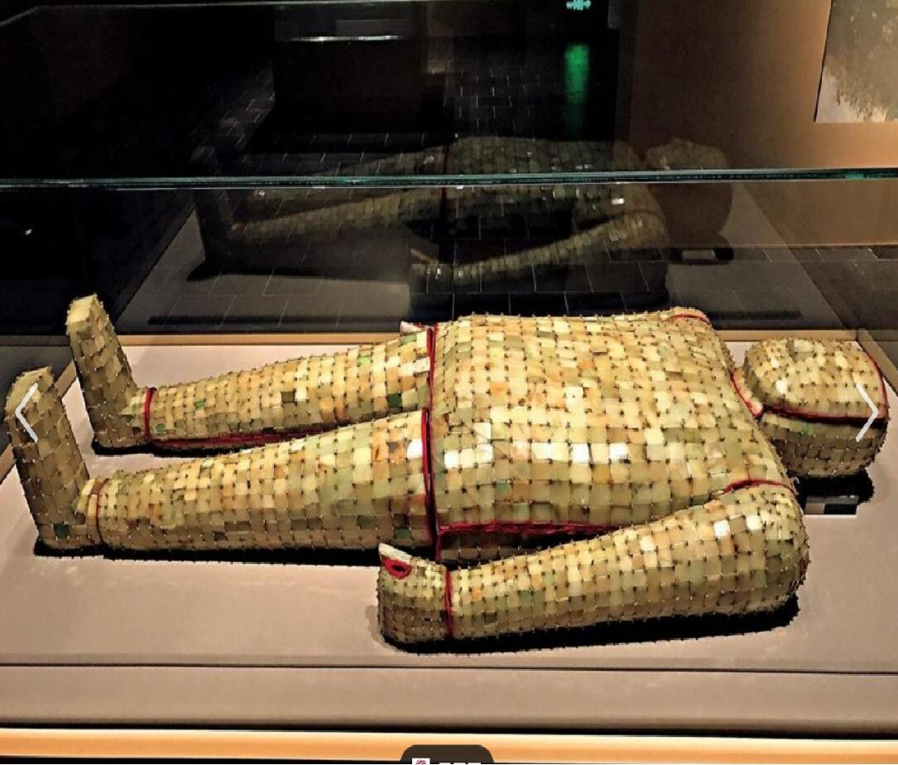
3.
Jade Suit with Gold Thread
金缕玉衣
Ordinarily, the texture of clothes is cotton, flax or silk. However, there were suits made of gold and jade, that is “Jade Suit with Gold Thread”.

Slide 21
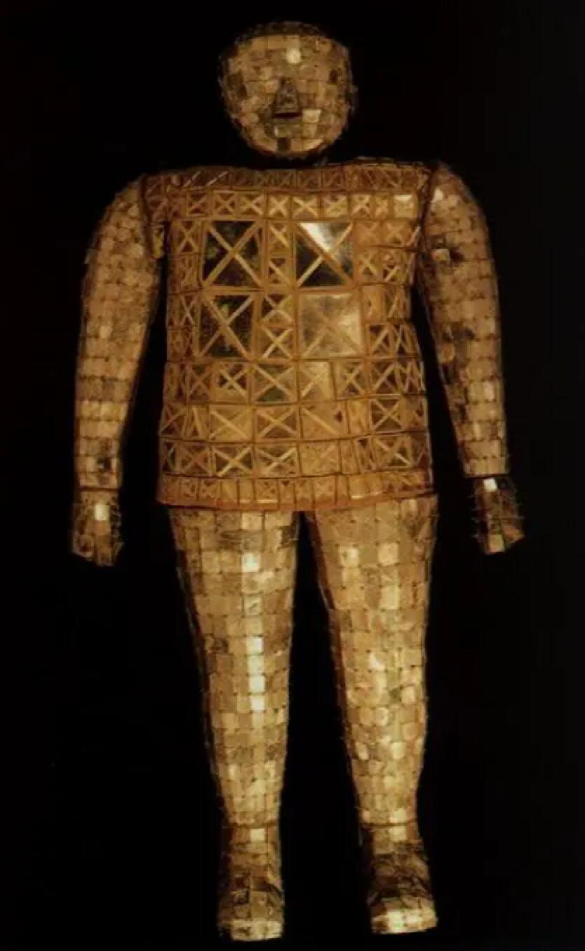
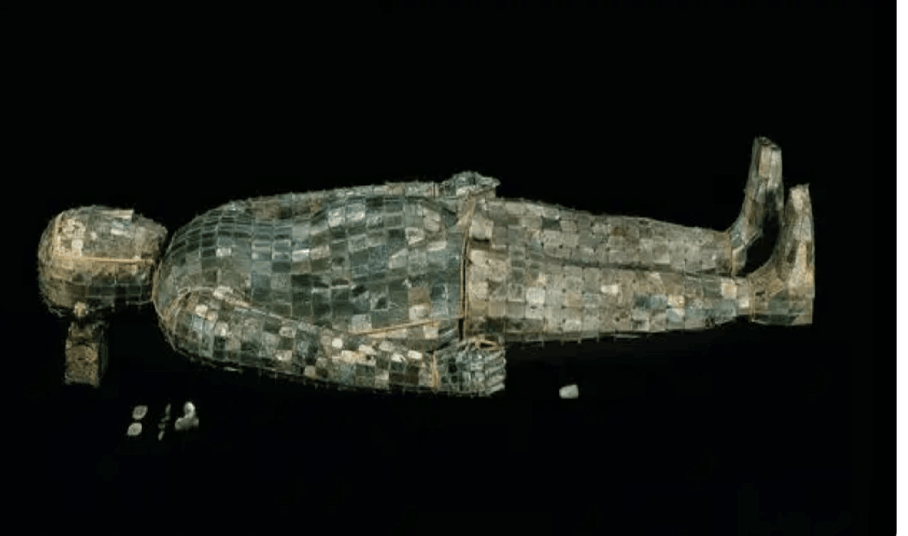
Jade Suit with Gold Thread was mainly unearthed in Henan, Jiangsu, Hebei, Anhui and Shandong. the emperors and senior nobles of the Han Dynasty used jade suits as their grave clothes. The appearance is the same as that of the human body.

Slide 22
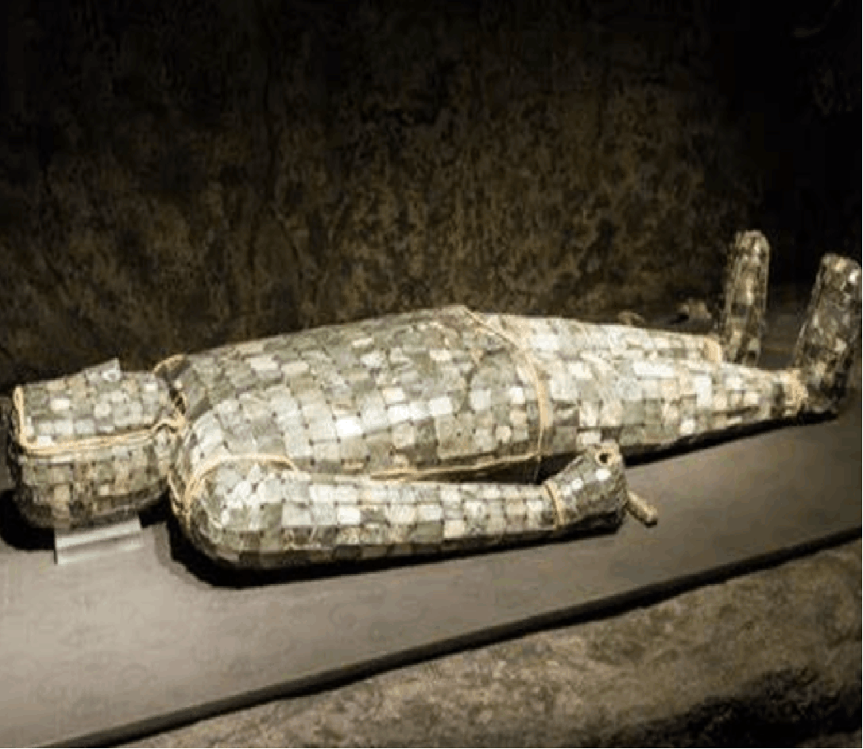
Jade Suit Sewn with Silver Thread 银缕玉衣
Jade Suit Sewn with Copper Thread 铜缕玉衣

Slide 23
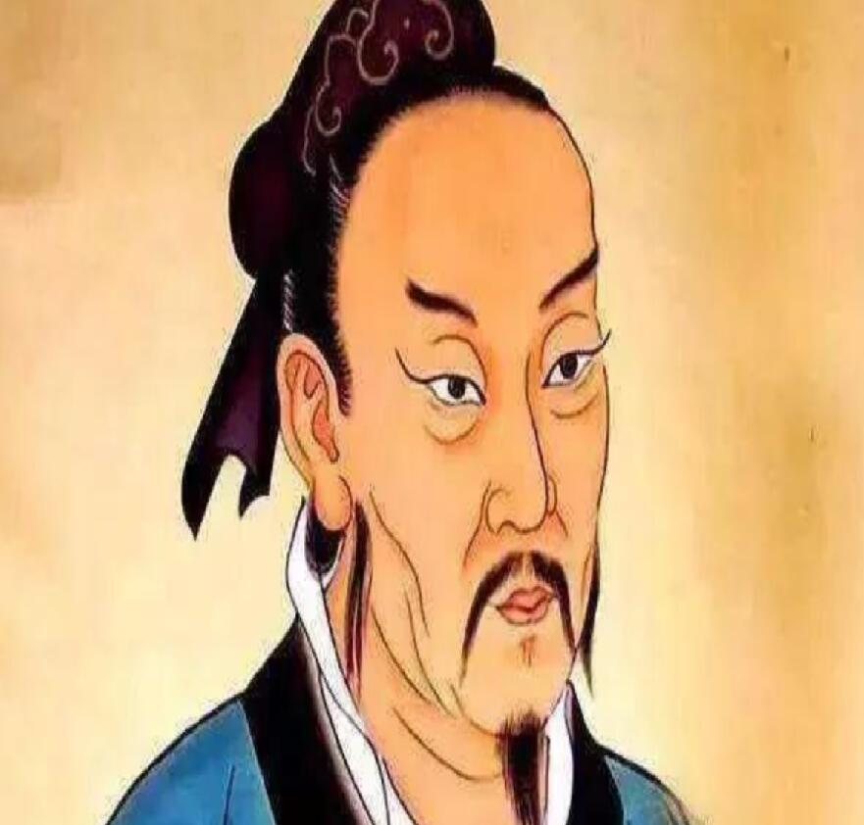
Why did the nobles of the Eastern Han Dynasty use jade clothes as grave clothes?
1.In the Han Dynasty, people advocated the Confucian thought of "guiyu".People endow jade with beautiful moral character.
《礼记·玉藻》云：“君子无故，玉不去身，君子于玉比德焉。”
2.People believe that jade can keep corpses immortal for thousands of years.

Slide 24
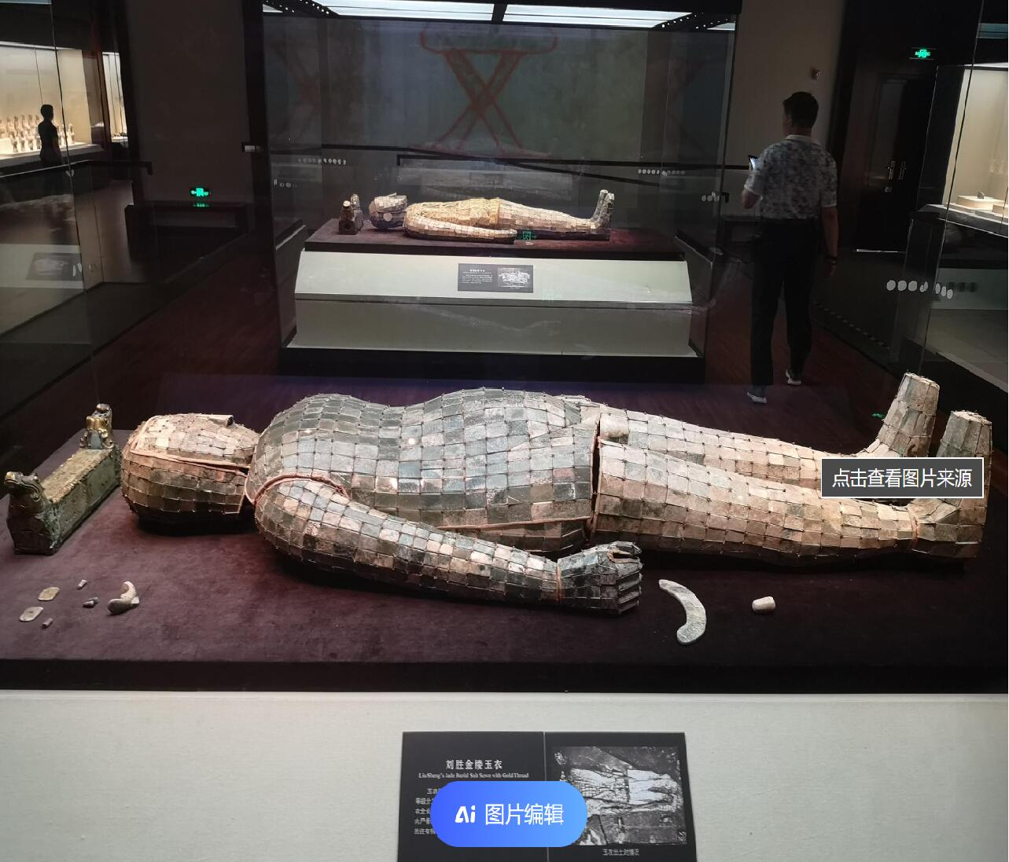
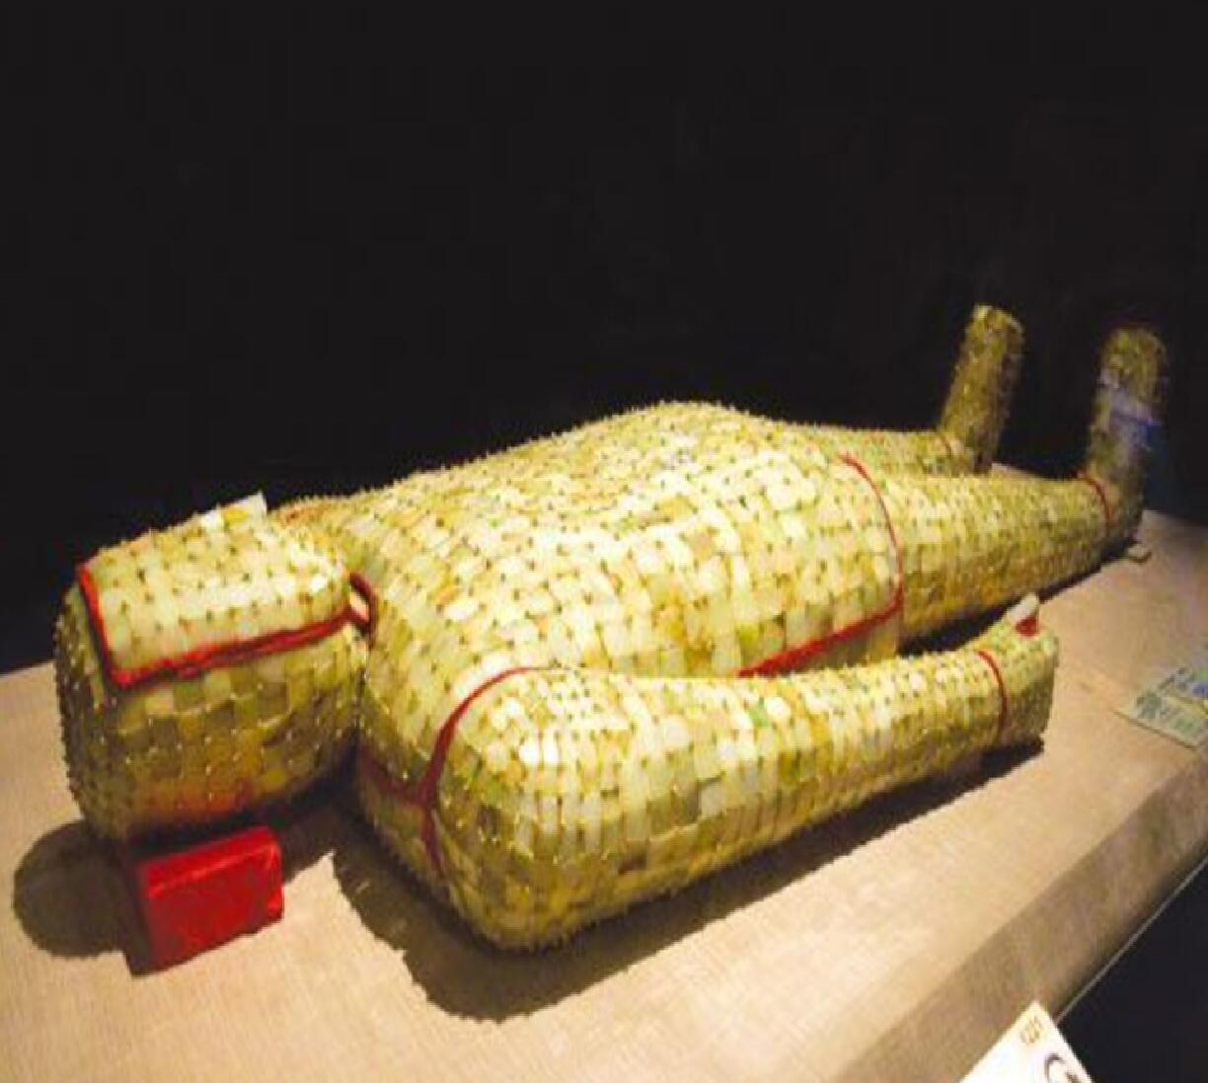
Liu Sheng’s jade suit
刘胜金缕玉衣

Slide 25
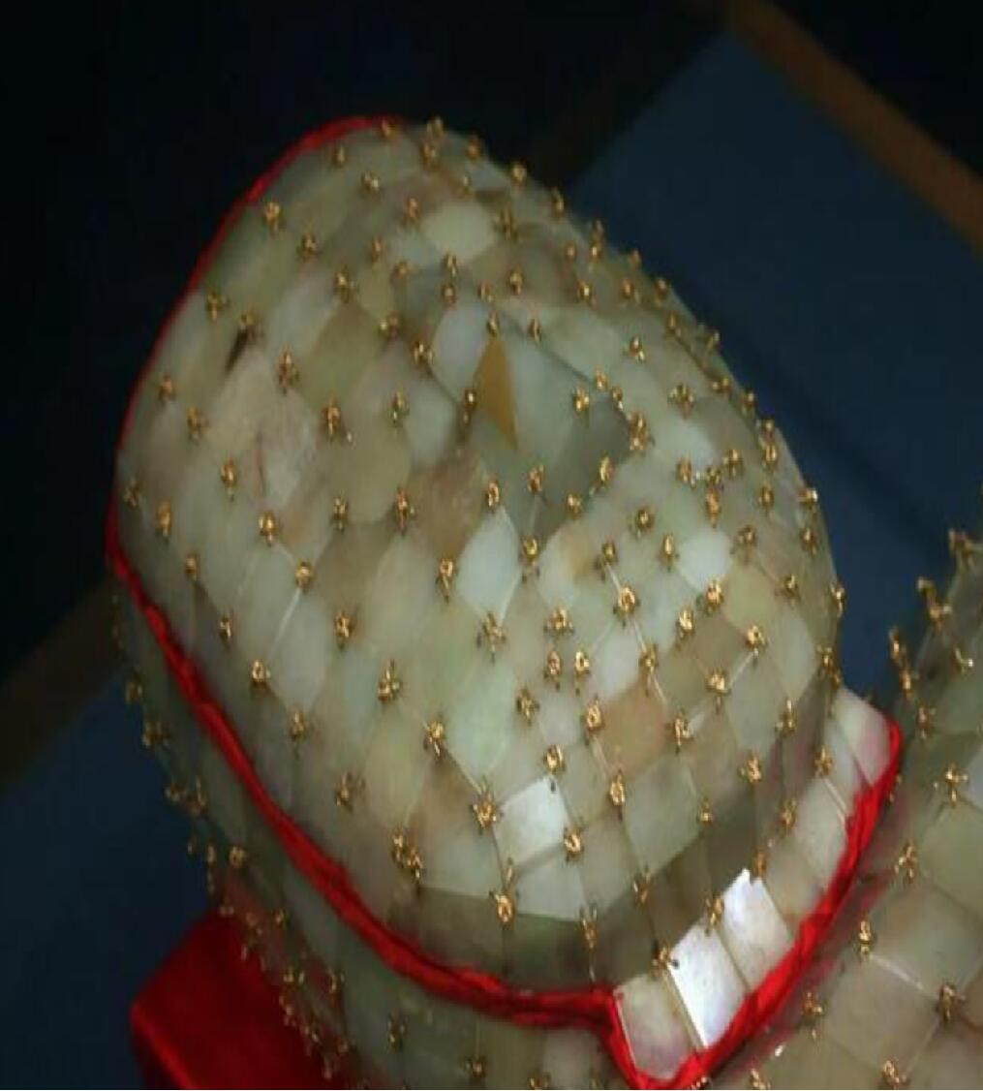
Such refined suits made some 2000 years ago in the Han Dynasty indicate the high design level and excellent craftsmanship of that time. In fact, of course, the rulers’ dream of preventing their corpses from decaying could never be realized. The practice of wearing jade suits was banned during the Three Kingdoms Period.

Slide 26
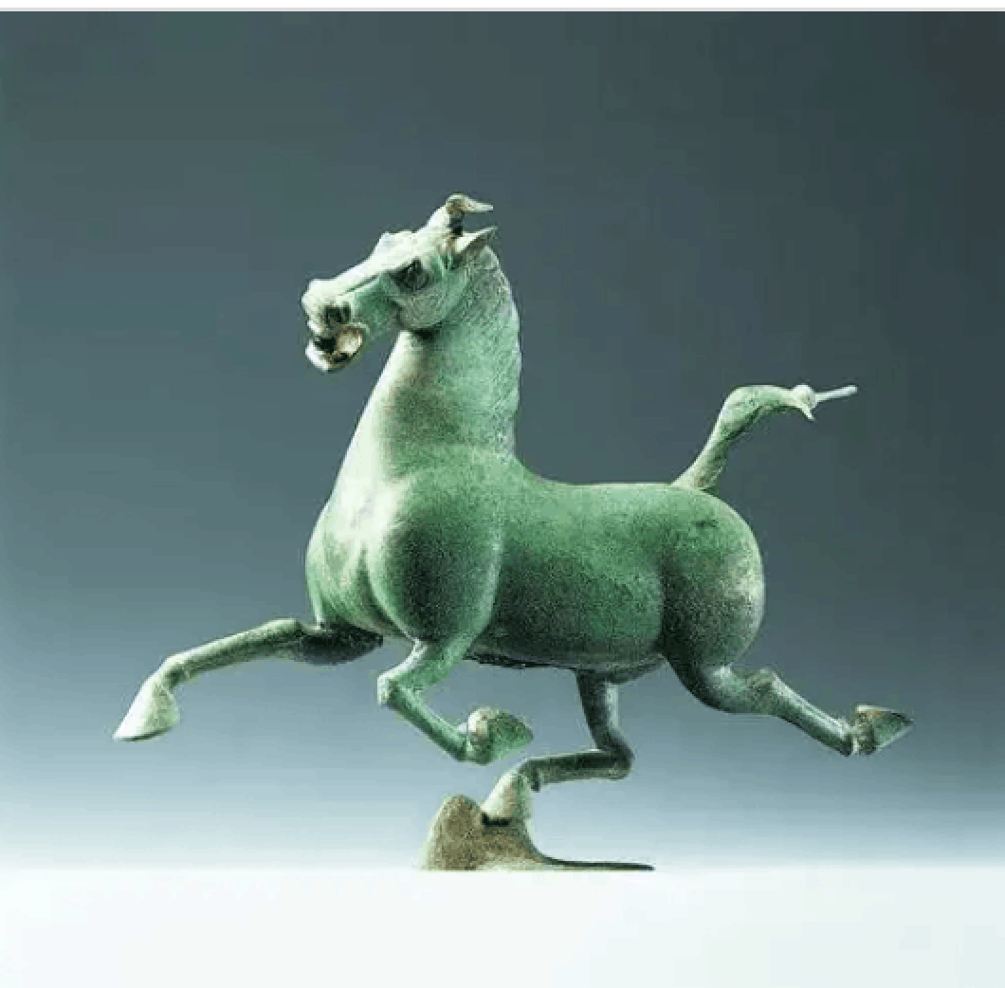
4.
Bronze Galloping Horse
马踏飞燕
In 1969, a galloping horse in bronze was unearthed in an Eastern Han Dynasty (206 BC-220 AD) tomb in Wuwei, Gansu Province in western China. It is now preserved in the Gansu
Provincial Museum.In 1983, it was identified as China's tourism symbol by the National Tourism Administration.

Slide 27
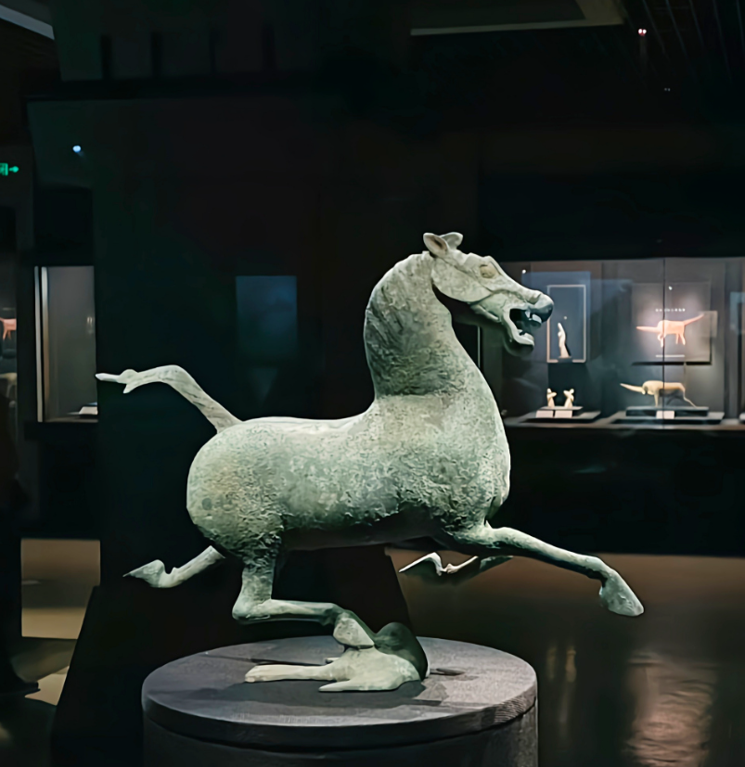
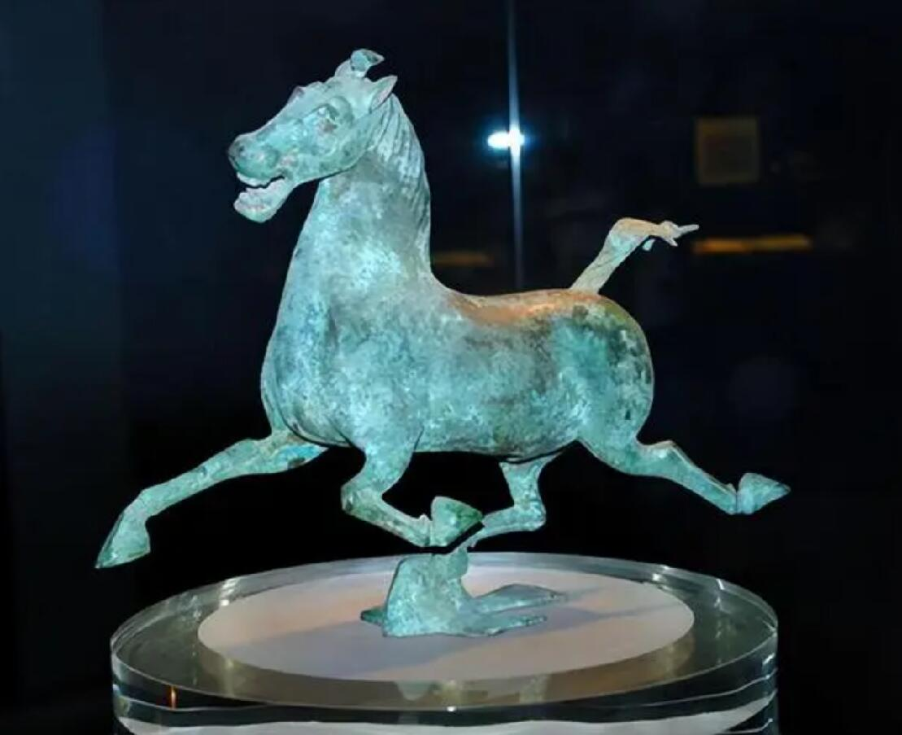
What is ingenious about it is that one of its hind feet is stepping on a flying swallow. That means the galloping horse is faster than a flying swallow.

Slide 28
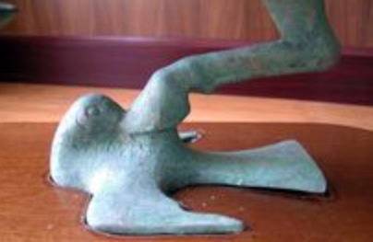
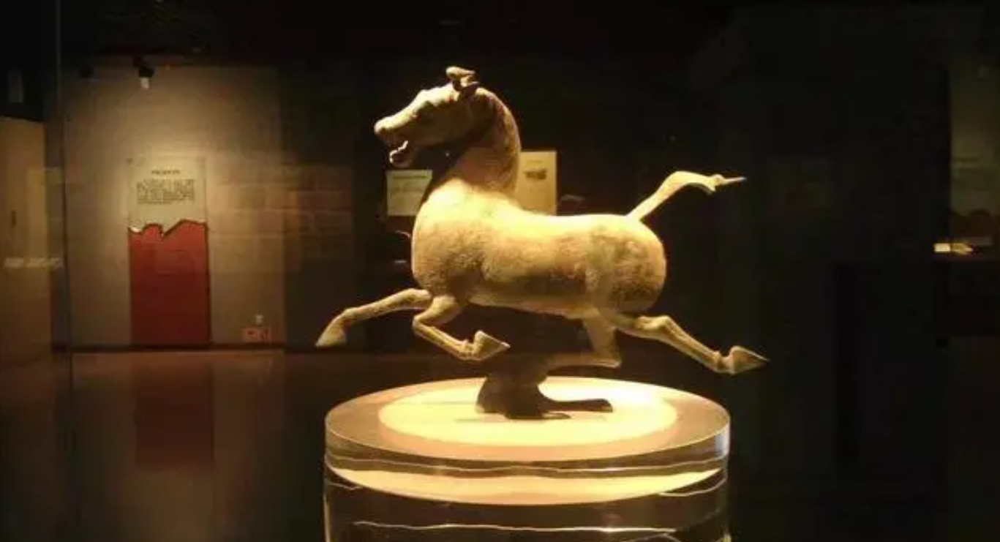
According to analysis of its mechanics, Bronze Galloping Horse finds a center of gravity in the swallow to give the statue its stability.

Slide 29
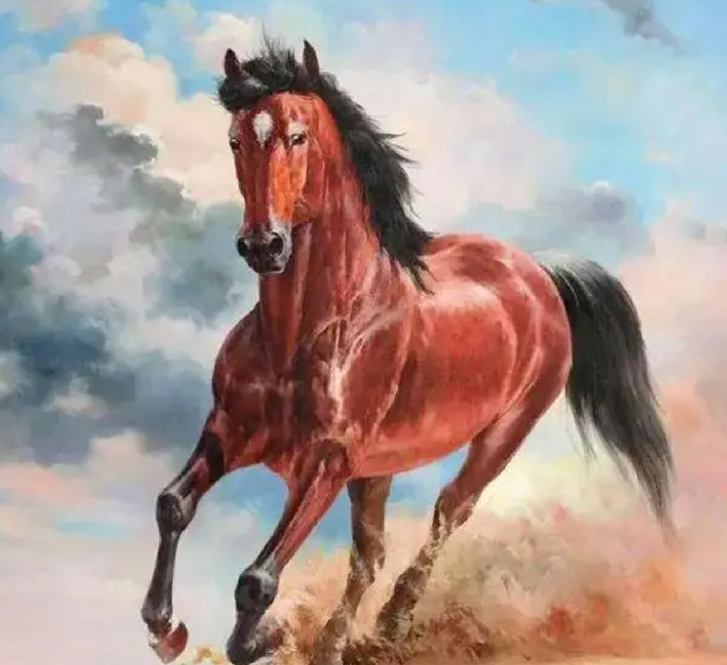
What kind of horse is this?
The first statement is the "Tianma" introduced by Emperor Wu of the Han Dynasty from the northwest, which is the "hanxuebaoma" . This kind of horse is truly "white, rich and beautiful". It is not only thin, tall and slender, but also a "beauty" in the eyes of modern people.

Slide 30
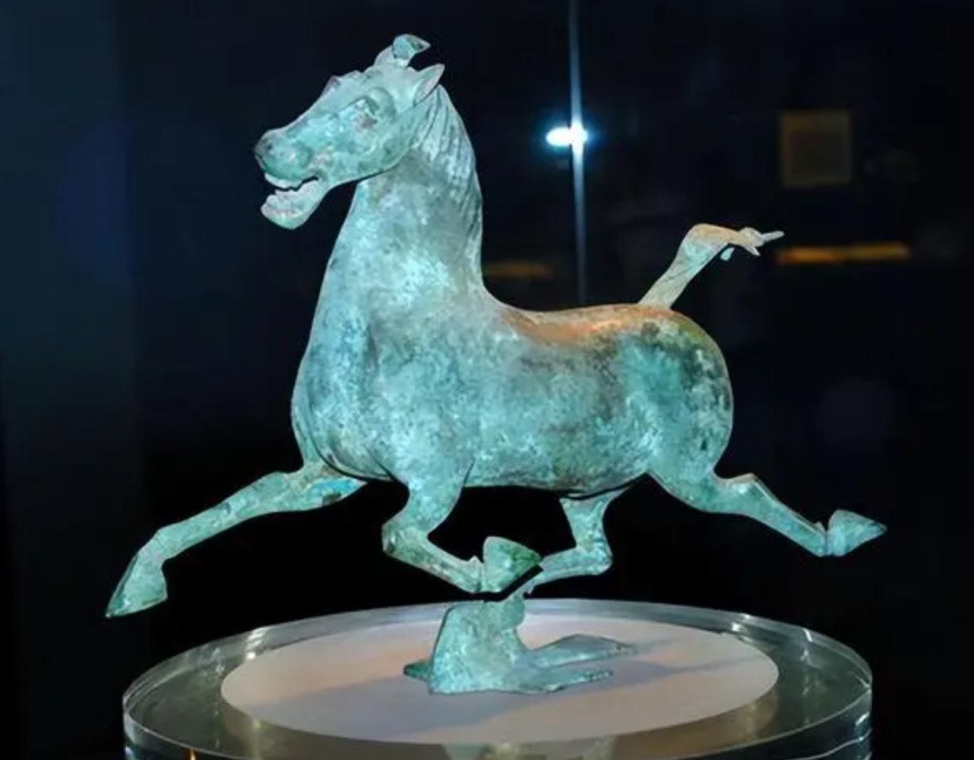
What is the bird under the horse’s hoof?
Tong Benma is well known for Guo Moruo's name as "Ma Ta Feiyan". It is said that Guo Lao thought of Li Bai's poem at that time. However, most scholars today do not accept this statement.

Slide 31
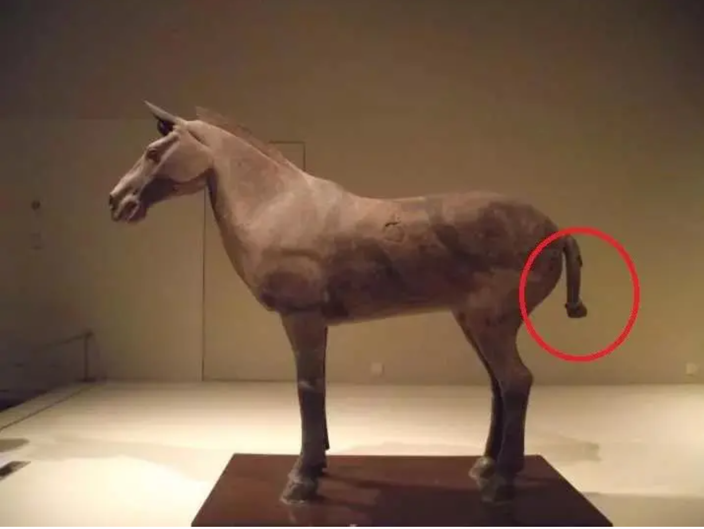
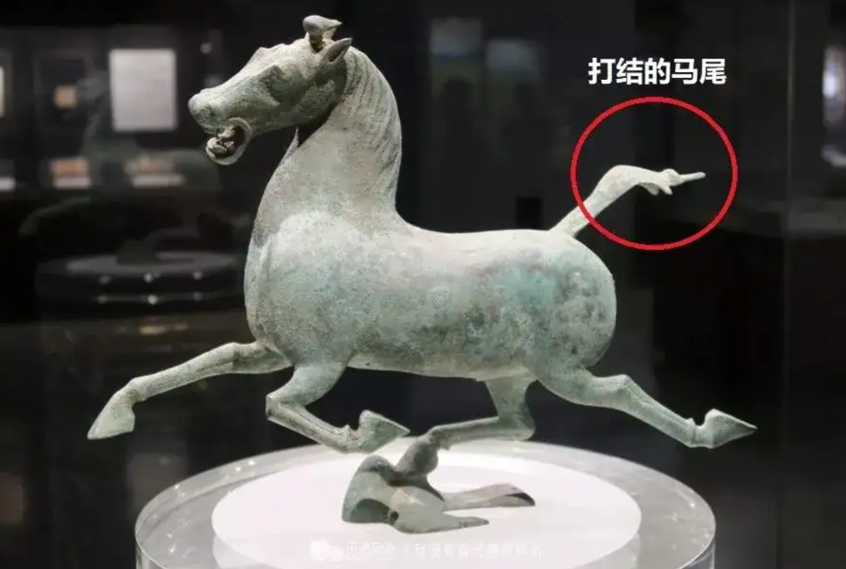
Its pony tail is knotted.
Terra Cotta Warriors兵马俑

Slide 32
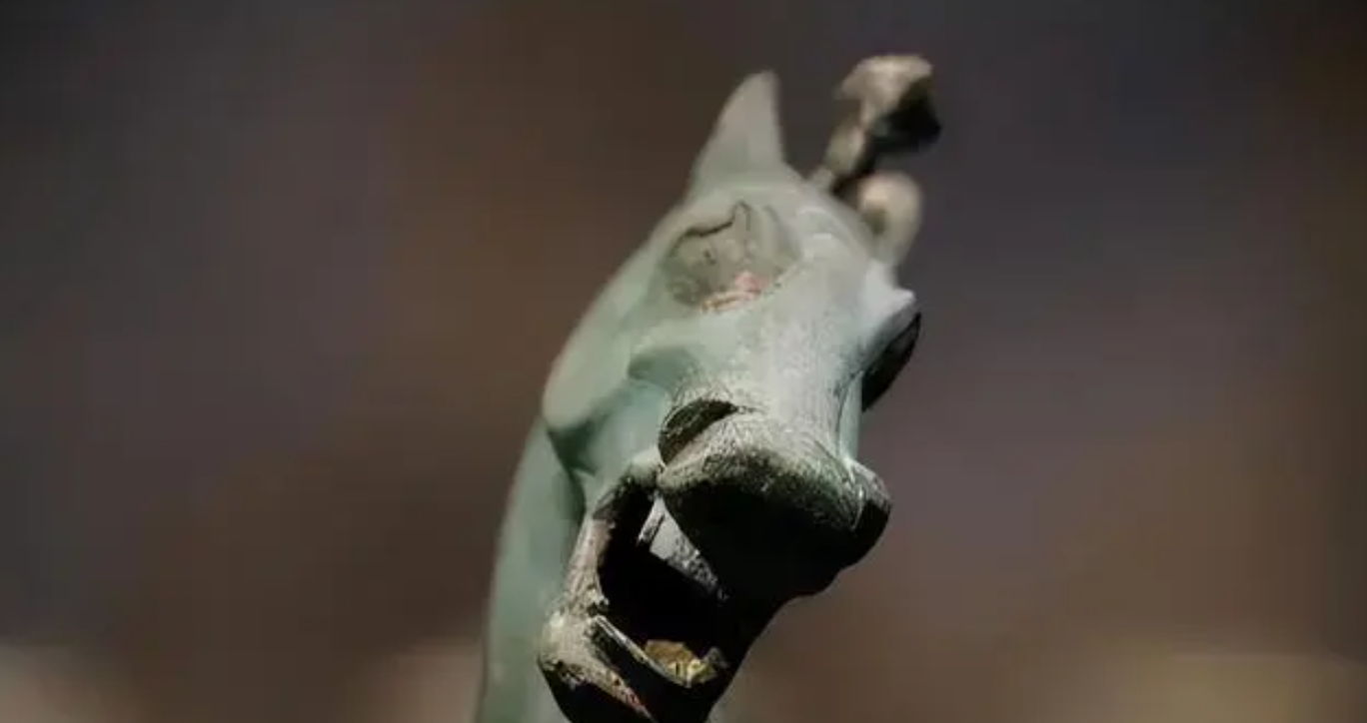

Its front image is very funny and makes people laugh.

Slide 33
2.What is the significance of inheriting and protecting cultural relics?

Slide 34
1.Cultural relics inherit excellent traditional culture and inspire people's patriotism.
2.It can enhance the exchange and mutual learning of civilization.
3.It can enhance cultural self-confidence.

Slide 35

3
Questions
1.What does ding symbolize?
2.How many bells do the chime bells of Marquis Yi contain?
3.What kind of thread was used to link pieces of four-square jade?
4.What is ingenious about the Galloping Horse?
Ding was a symbol of imperial power.
There are altogether 65 bells hung in eight groups on wooden or bronze bars.
Gold thread, silver thread or copper thread was used to link pieces of four-square jade.
What is ingenious about it is that one of its hind feet is stepping on a flying swallow.

Slide 36
Thank you!

