Slide 1
古筝 GUZHENG
HUANG LIPEI
黄沥霈

Slide 2
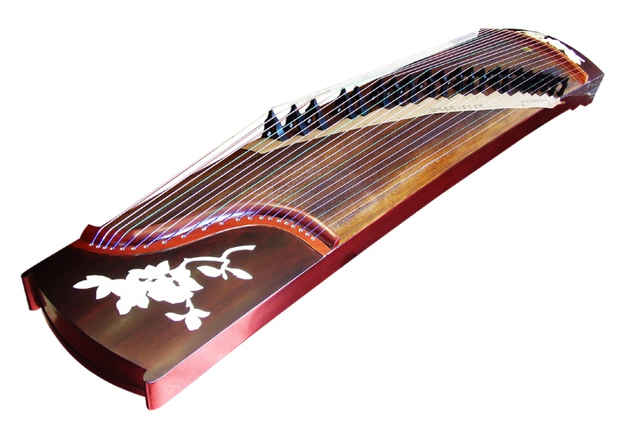
ZHENG ‘筝’or GUZHENG ‘古筝’ literal meaning “ancient zheng”
↘ is a Chinese plucked zither
one of the most traditional ethnic musical instruments in China
Belongs to plucked stringed instruments
Beautiful timbre 音色
Broad ranges
The reasons why guzheng is deeply
loved by Chinese
Rich performance skills
Strong expressive power

Slide 3
Origin
①
②
③
Warring States Period
Zheng was regarded as a weapon which was used vertically to beat enemies.
Later, strings were added to it, and when plucked, it was found to be pleasing to the ears, so it developed into an instrument.
The zheng is said to have been invented by Meng Tian, a general of the Qin Dynasty.
But according to the biographies of Meng Tian in Historical Records, there is no record of his invention of the zheng.
The guzheng came about largely influenced by the se
When two people fought over a 25-string se, they broke it in half, one person receiving a 12-string part and the other the 13-string part.

Slide 4
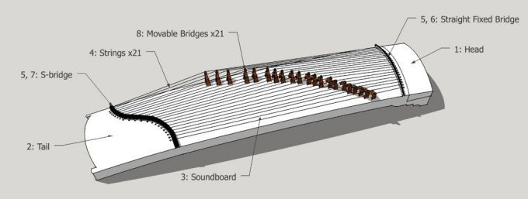
Structure
has 21 strings
movable bridges
is 163 centimeters long
Originally made of silk
By the 20th century, metal strings are used
In the mid-20th century, steel strings wound with nylon
Also known as YanZhu (雁柱) which are moved to change the timbres

Slide 5
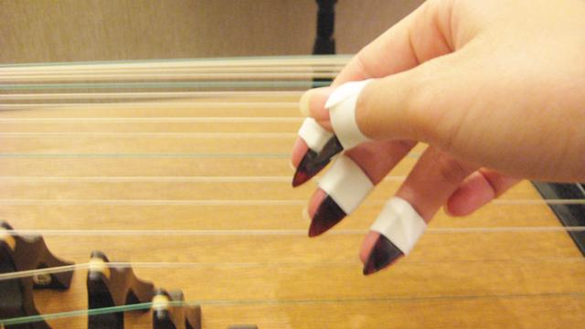
Fingerpicks
also called Dai Mao(玳瑁) or Yi Jia (义甲)
are often made from materials such as plastic, resin, tortoiseshell, or ivory
In ancient times, picks were made of materials
such as bamboo, bone, animal
teeth, or even jade.

Slide 6
Fingering methods : gou tuo pi tiao mo
Generally speaking, performers traditionally use the thumb, index finger, middle finger and ring finger of the right hand to pluck notes while the left hands to add ornamentation such as pitch slides and vibrato.
(勾托劈挑抹)

Slide 7
The Schools of the Guzheng
Northern School | Southern School
Henan Province Shanxi Province Shandong Province | Chaozhou Regional school Hakka Regional school Fujian Regional school
{

Slide 8
Some famous pieces: (Shandong)
High Mountains and Running Water（高山流水）
The Autumn Moon in the Han Palace（汉宫秋月）
‘High Mountain and Flowing Water’
‘The Autumn Moon over The Han Palace’

Slide 9
Representatives: (Chaozhou)
Jackdaw Playing in the Water(寒鸦戏水)
The Tune of Liu Qin Niang（柳青娘）
‘Winter Crows Playing in the Water’
‘Jackdaws Gambol(嬉戏) Water’
‘The Girl Liu Qing’

