Slide 1
Traditional Cuisine: The Art of Chinese Cooking
by Liu Zhouli (lovia)

Slide 2
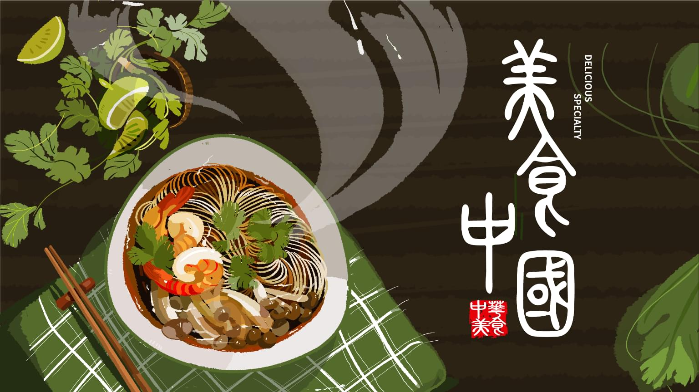
In China, cooking is an art. Quite different from Western cooking where recipes are followed strictly like laboratory instructions, Chinese cooking always allows for a creative and stylistic touch to it. Such words as “colorful”, “varied”, “delicious” and “complex” are often used to describe Chinese food.

Slide 3
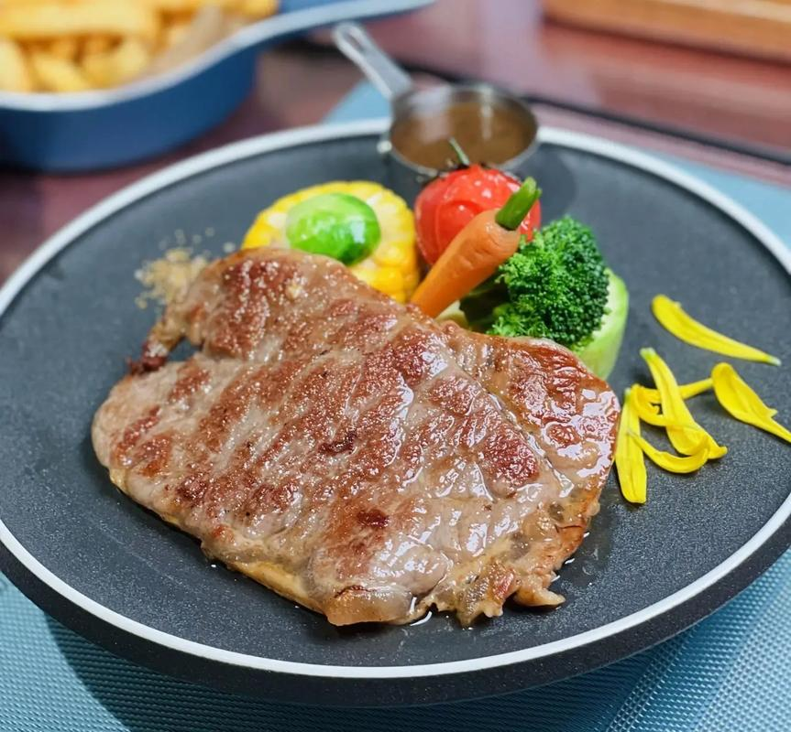
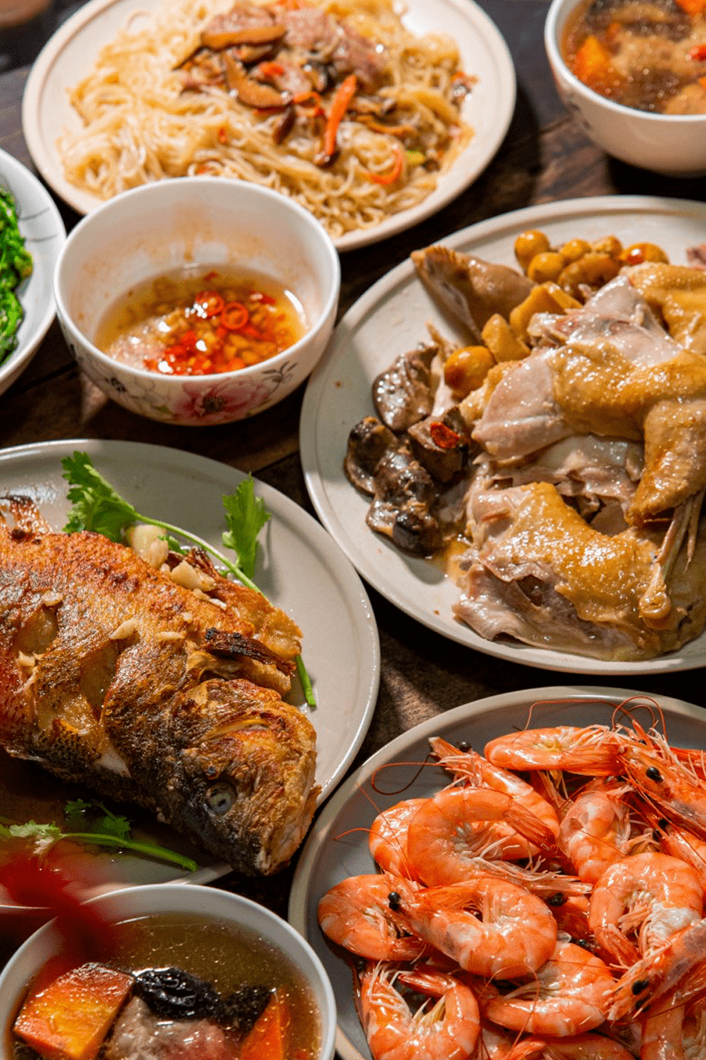
Great attention is paid to the aesthetic appreciation of food because food should be good not only in flavor and smell, but also in color and appearance.

Slide 4
﹒Raw materials
﹒Combination of main ingredients
﹒Cutting
﹒Time and heat control

Slide 5
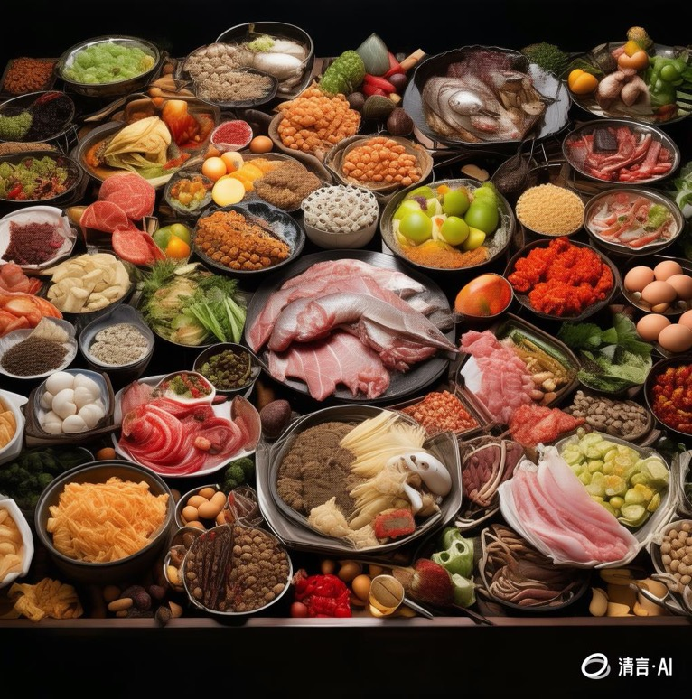
Raw materials
Chinese cuisine uses a variety of raw materials, which may include chicken, fish, meat, seafood, eggs, vegetables, fruits and nuts.

Slide 6
Combination of main ingredients
In Chinese cooking, meat and vegetables are often cooked together so that they not only look good and taste delicious, but are nutritious as well.

Slide 7
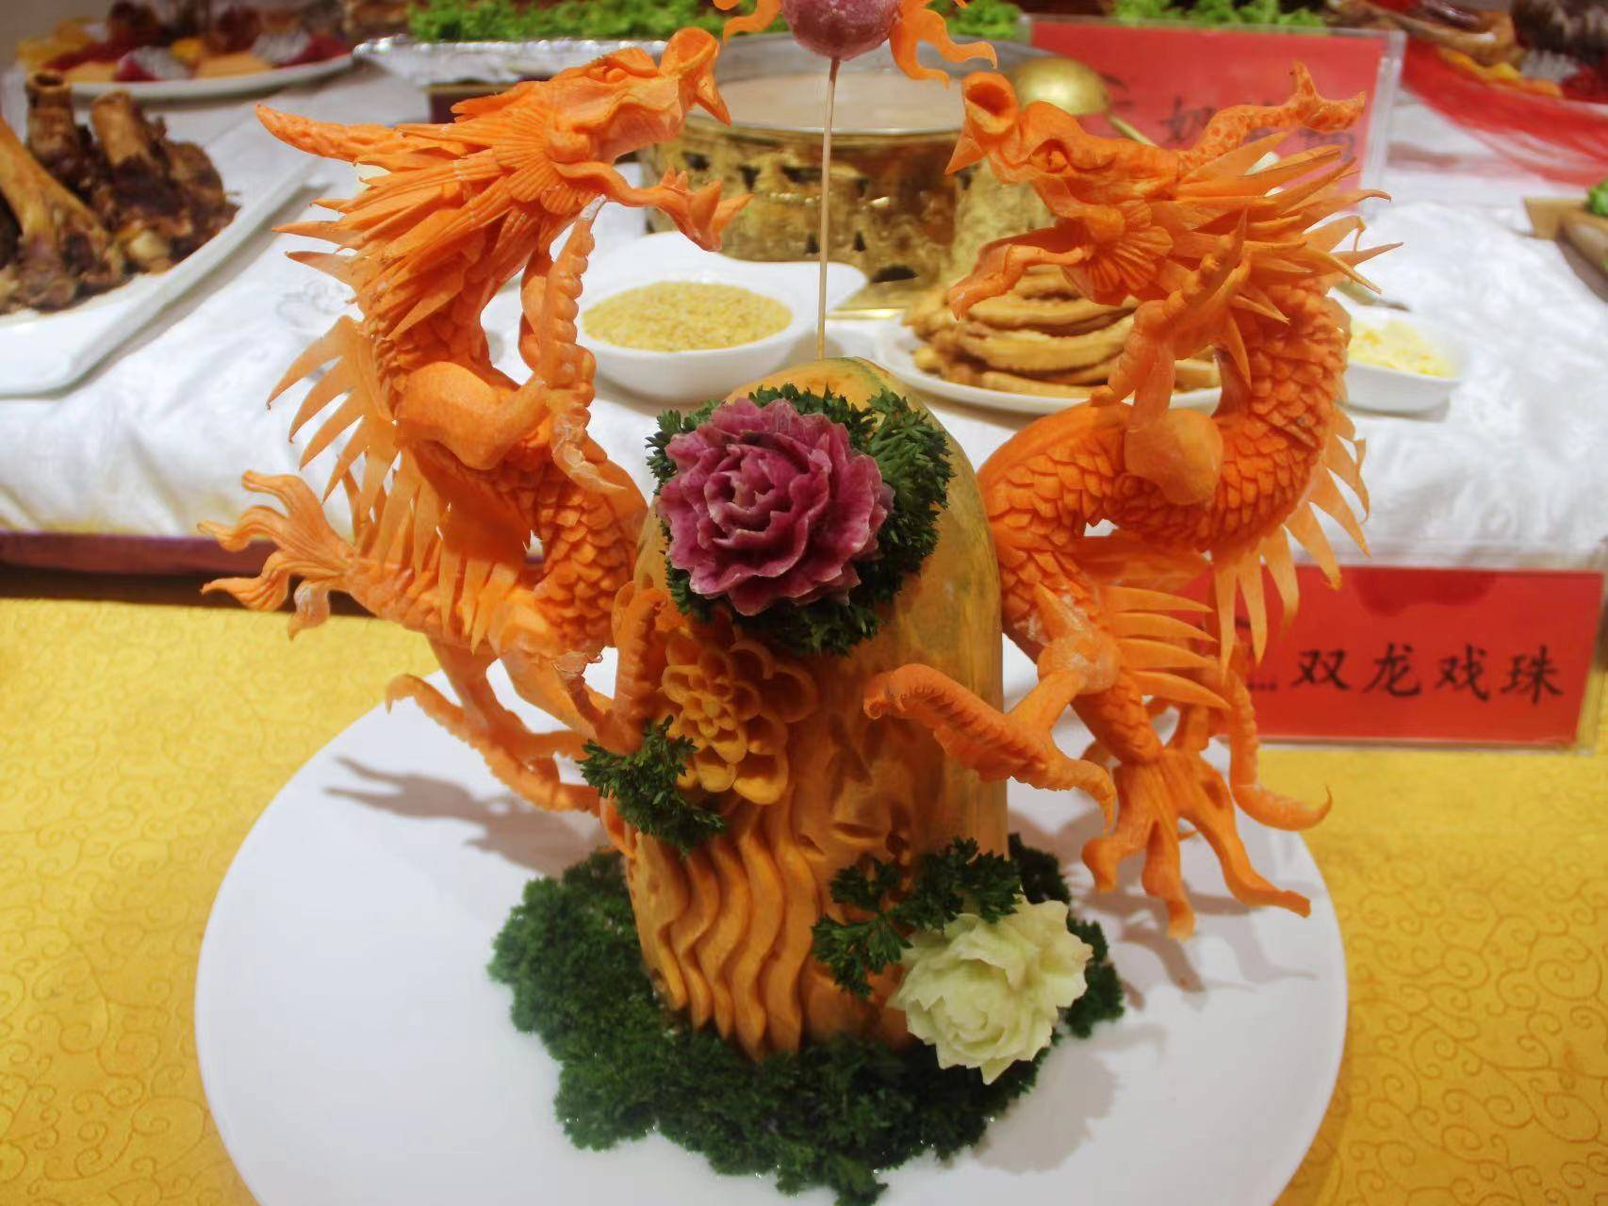
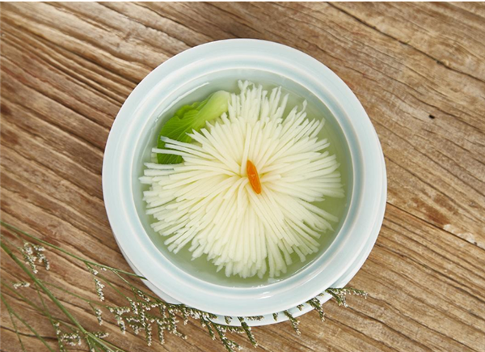
Cutting
Cutting has always been a distinctive feature of Chinese culinary art. The ingredients of a given dish can be cut into slices, strips, shreds, cubes, segments, dices, grains, or minced. Some materials, like carrots, potato, can be carved into the shapes of flowers and animals.

Slide 8
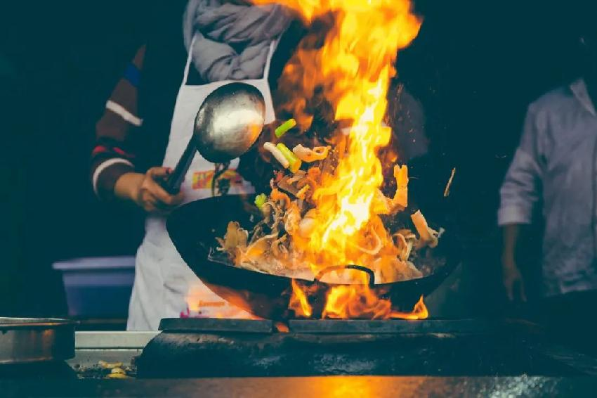
Time and heat control
In Chinese cooking，time and heat control are also decisive factors. Different ingredients require different cooking times and heat control so that they may be hard, soft, crisp or tender.

Slide 9
Watch a Vedio

Slide 10

Questions：
In this dish“Pagoda meat”
1.What is the raw material?
2.What are main ingredients ?
3.Which aspect is the most important?
4.Share a specialty of your hometown!

Slide 11
THANK YOU FOR LISTENING！

