Slide 1
中國語言文化
Session 14, Thursday Dec 12, 2024, Zhishan Bldg. 至善楼105, room 105
Martin Woesler

Slide 2
12 TOPICS, 10 min. each
19:00 216. Ancient Chinese Women's Culture：Nüshu (Women's Script) 女书 p. 1970（He Chuwen/Lyra）
19:10 219. Chinese snack: spicy gluten 中国小吃：辣条 p. 2003(Jiang Yaping/Sunny)
19:20 220. Women Being Urged to Get Married 婚姻：被催婚的女性 p. 2010 Liu Xinyu
19:30 221. Chinese Dragon Culture 中国龙是什么 p. 2019 (Zhang Shuai / Andy)
19:40 BREAK
19:50 223. Torch Festival Among China's Ethnic Minorities 团结的火炬——中国少数民族庆祝火把节 p. 2041 Xiao Feiyan
20:00 224. Chinese Painting: A Thousand Miles of Rivers and Mountains 《千里江山图》 p. 2048 (Yao Yiyun/Olivia)
20:10 225. Festival: Qixi Festival 七夕节 p. 2055（Li Ru/Lee)
20:20 227. Education: Chicken Child (Fired-up Child) 教育：鸡娃 p.2071 (Tao Yu/mikansei)
20:30 228. The Three-Body Problem 中国科幻小说：《三体》 p. 2083 (Zhang Mengzhe/Nine)
20:40 BREAK
20:50 229. The Cycle of Life and Death, Ancient Witchcraft 湘西赶尸：古老巫术下的生死轮回 p.2092 (Liao Wenyao/Rose)
21:00 231. Chinese Animation 中国动画传统 p. 2110（pan yilin/ceci）
21:10 235. Suona Horn 唢呐 p. 2157（Liu Jieyu/Erica）
21:20-35 PUFFER AND DISCUSSION

Slide 3
Prepare for next time
Homework:
1. Please read the six texts for next time in the textbook.
2. Please add your final exam paper topic and your name in the respective section above.
3. Take the surveys (EU: https://wn8ae3qwafbc11zv.mikecrm.com/9gdWrQT
, 2024: https://wn8ae3qwafbc11zv.mikecrm.com/CTrdOjm).

Slide 4
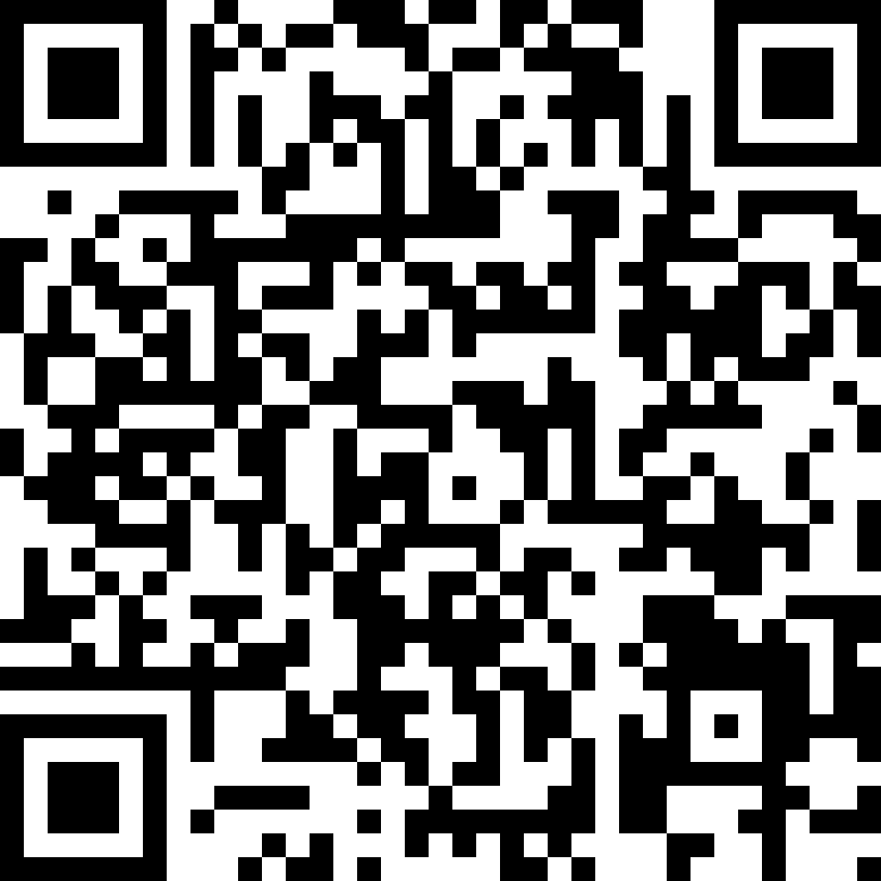
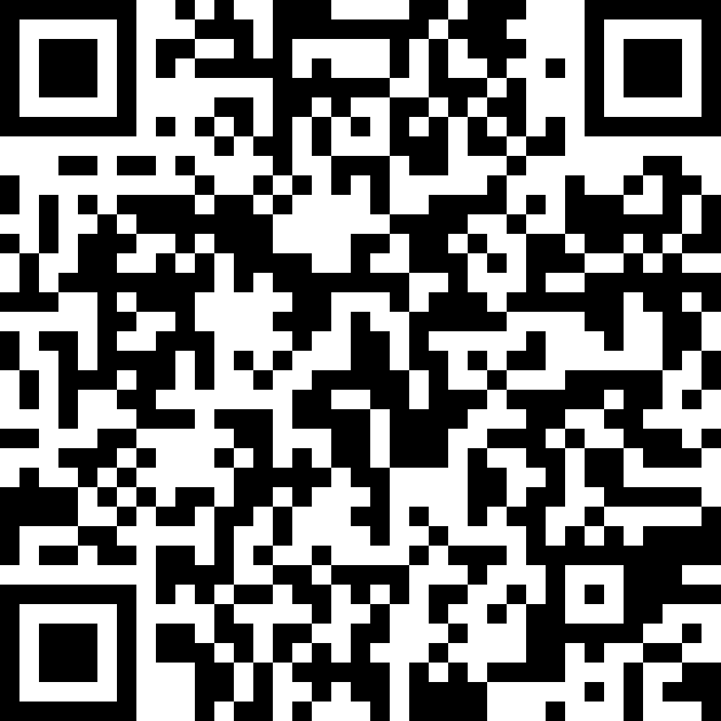
Questionnaires
EU
https://wn8ae3qwafbc11zv.mikecrm.com/9gdWrQT
2024 https://wn8ae3qwafbc11zv.mikecrm.com/CTrdOjm

