Slide 1


National Symbols:
National Flag of the People’s Republic of China
Speaker：Liao Zuoyun
Date：2025.03

Slide 2
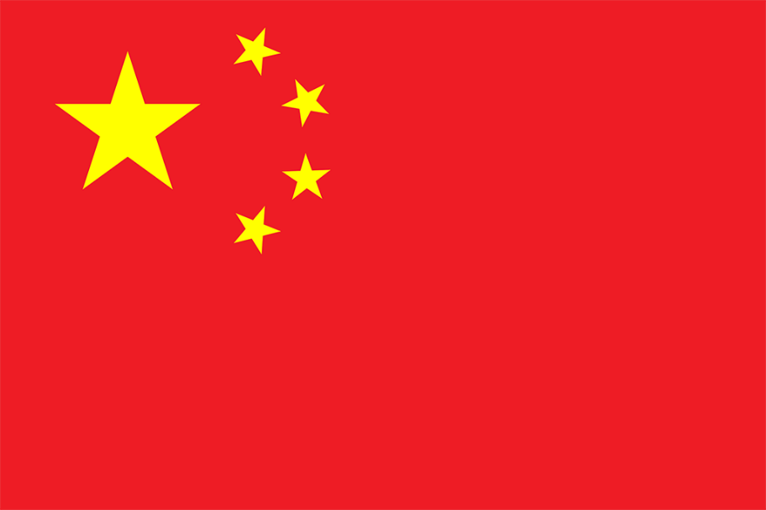
Lead in
What do the elements on the Chinese flag symbolize?
Color: red and yellow Pattern: five-pointed star

Slide 3
Introduction
Designer: Zeng Liansong
Shape: A red rectangle with a ratio of length to width of three to two.
The history of its design:
From July 14th to August 15th, 1949, the design of the national flag was solicited.
On August 20th, 1949, the Flag and Emblem Selection Committee received 2,992 (or 3,012) designs for the national flag.
On September 27th, 1949, the First Plenary Session of the Chinese People's Political Consultative Conference adopted the Five-Star Red Flag as the national flag.
On October 1st, 1949, Mao Zedong raised the first national flag in Tiananmen Square.

Slide 4


The connotation of an element
1
Red: revolution, passion and the Chinese revolution and socialist undertakings under the leadership of the CPC.
Yellow: light and hope.
the Communist Party of China
workers, peasants, the petty bourgeoisie and the national bourgeoisie

Slide 5
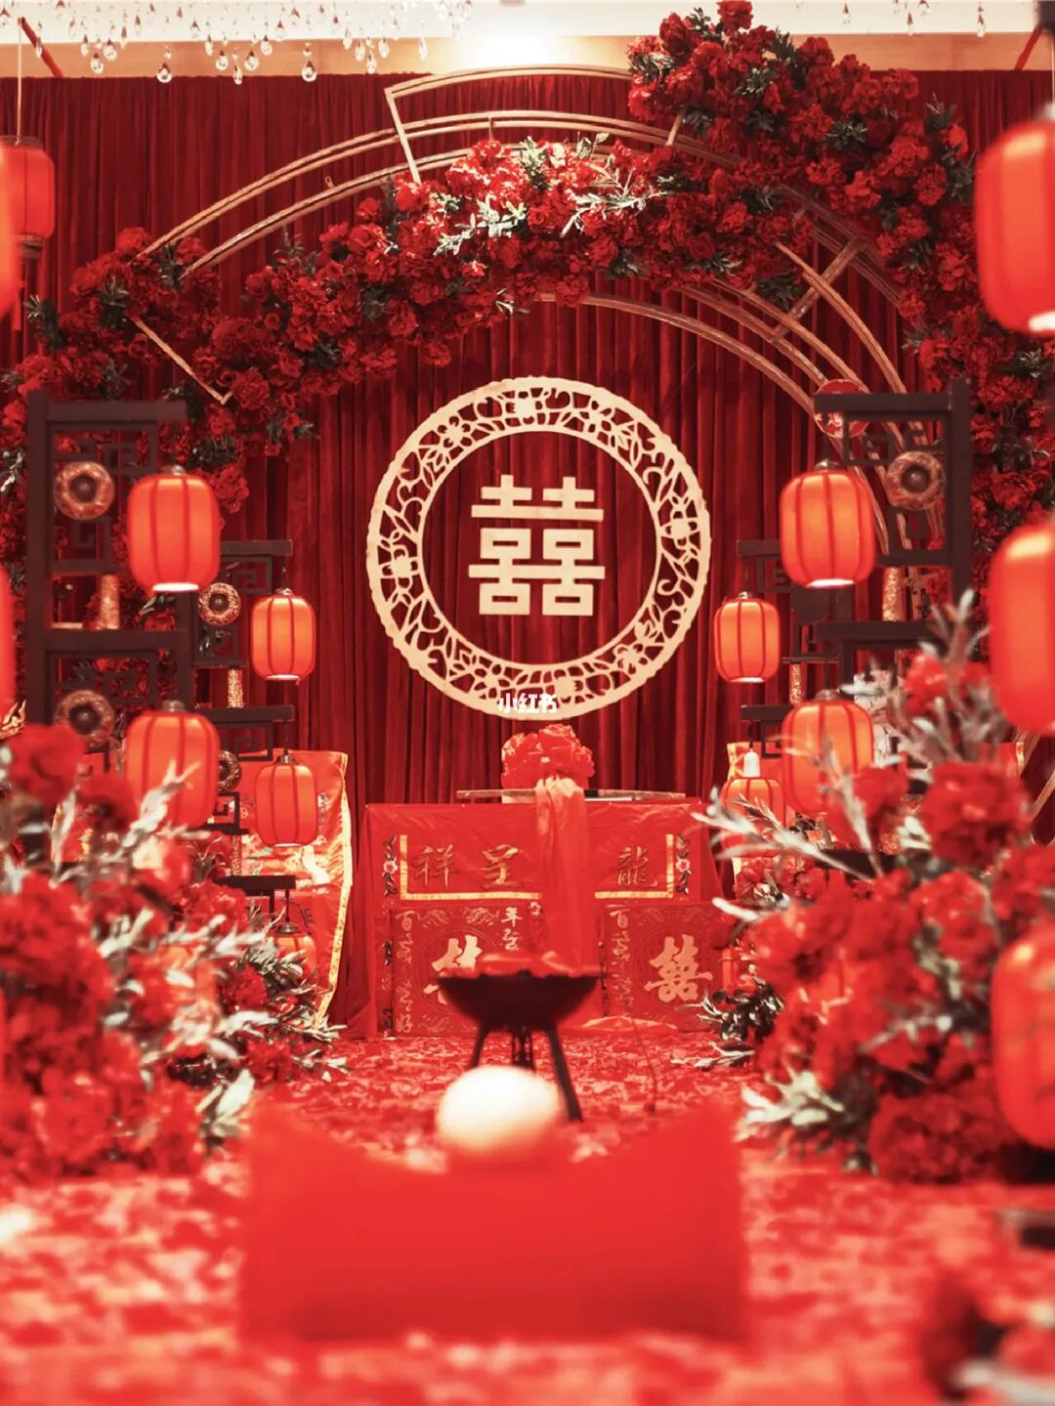
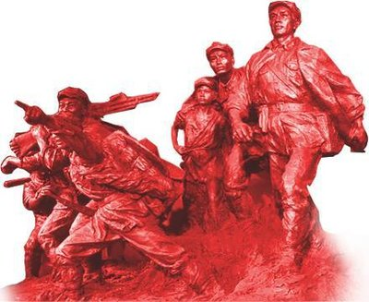
The connection between flag and Chinese language and culture
2
Color: In Chinese culture, red is a very symbolic color. It stands for enthusiasm, vitality, happiness and prosperity.
The red color in the national flag is a symbol of the blood and sacrifice of the revolutionary martyrs.

Slide 6
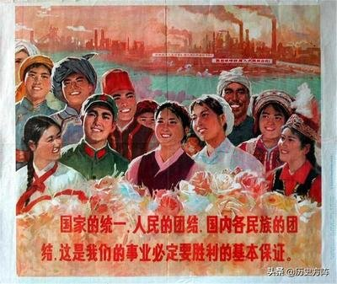

The connection between flag and Chinese language and culture
2
Five-pointed star:These four small stars surround the big star, symbolizing that the people of all ethnic groups in China are closely united around the Communist Party of China and work together to achieve the great rejuvenation of the Chinese nation.
In Chinese, the word "star" is often used as a metaphor for light, hope and things that point the way.

Slide 7
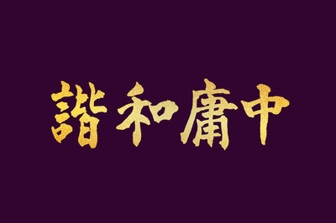
The connection between flag and Chinese language and culture
2
Design concept: The collocation of the red flag and the yellow five-pointed star in the national flag is bright and harmonious, reflecting the pursuit of harmonious beauty in Chinese language and culture. At the same time, the arrangement of the five stars also reflects the idea of order and unity.

Slide 8
Thanks for
your listening

