Slide 1
Li Zhi
李贽

Slide 2
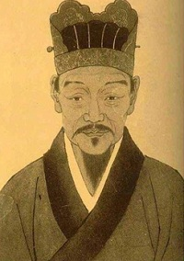

Slide 3
My Life, my journey, me!
Born: 1527
Died: 1602
I was born in Jinjiang Fujian, Modern day QuanZhou
I am known as Li zhi but have also been known by many different names…
Hongfu, Zhuowen and many others, However, Zhuowen and Li Zhi are the most known.

Slide 4
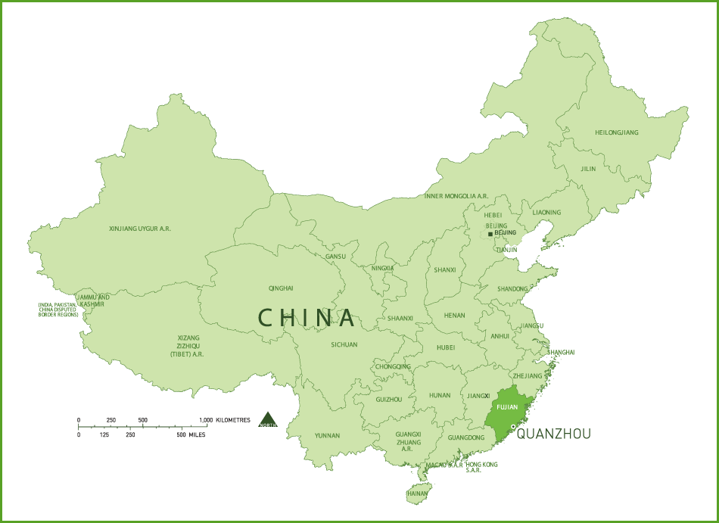

Slide 5
Coming of Age…
My Ancestors studied and believed in the Islamic Faith but that did not carry on by the time I was born.
I learned much as a young child, this was mostly due to my Father being a teacher. I carried this lifestyle of learning by preparing to take the village examinations.
At the age of 24, I passed the examinations and prepared for a life of learning and teaching.

Slide 6
Coming of Age…
In 1556, I became a teacher in Henan, I stayed there for about 4 years before going to Nanjing to teach at the Guozijian.
The Guozijian was known as the National University, it was also known as “School for the Sons of the State”
I taught here only briefly as I returned home form a period of filial mourning.

Slide 7
Filial Mourning
This type of mourning was done for either a death of a parent or grandparent. I was called back and returned to my hometown for a period of 3 years.
Mourning was a requirement amongst public officials and not doing so could be grounds for impeachment.
Even the Emperor was subject to this tradition, however, there mourning period usually lasted 4 weeks as they held an important position.

Slide 8
Later on life, my teachings cont…
After my period of filial mourning, I returned to the Guozijian. However, instead of returning to Nanjing, I taught at the Guozijian in Beijing.
After years of teaching, I became learned in Buddhist thought as well as Yangmingxue (Neo Confucianism).
I continued teaching and eventually holding other political positions. I traveled around continuing in the ways but eventually ran into hardships.

Slide 9
End of my Journey
In 1602, I was arrested and imprisoned on the charge of deceiving and heretical ideas.
I had heard that I was to be exiled and could not stand to live trapped and secluded from the world. Before they had a chance to exile me, I committed suicide.

Slide 10
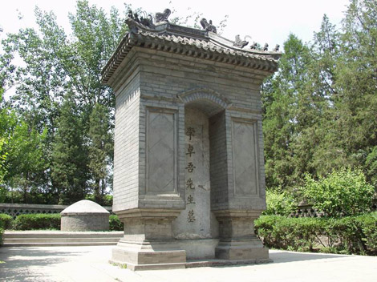

Slide 11
My works…
In my life I taught and wrote many things. Of the most famous are two books. The first is called “A Book to Hide” and the second being “A Book to Burn”
“A Book to Burn” was extremely controversial as it was an open critique of the social norms of the day. I named it such as I knew the controversial would result in it being banned and burned.

Slide 12


