Slide 1

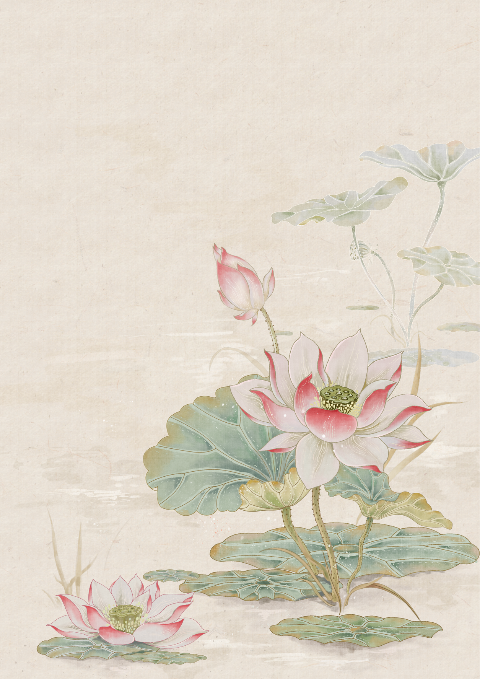
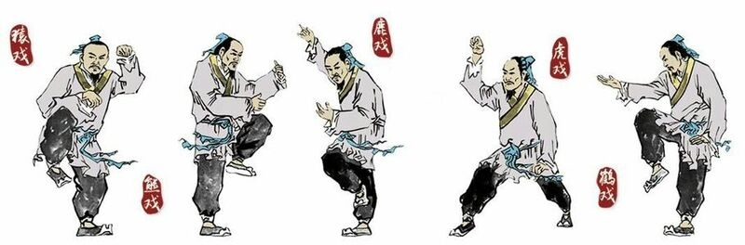
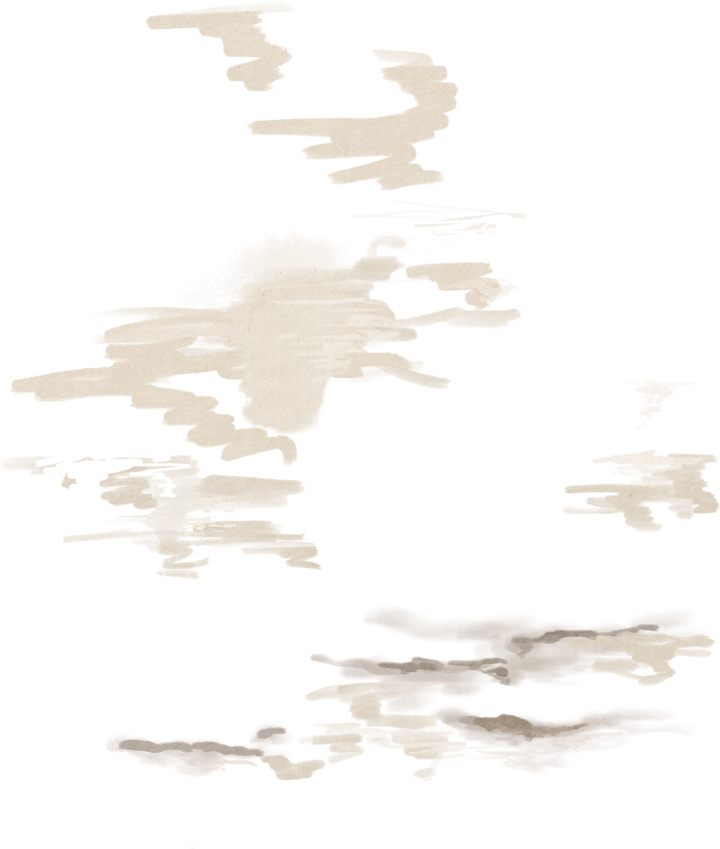
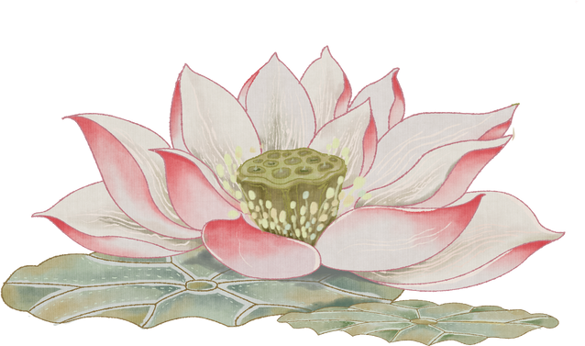
Martial Arts:
Frolics of the Five Animals
汇报人：龙雨涵

Slide 2
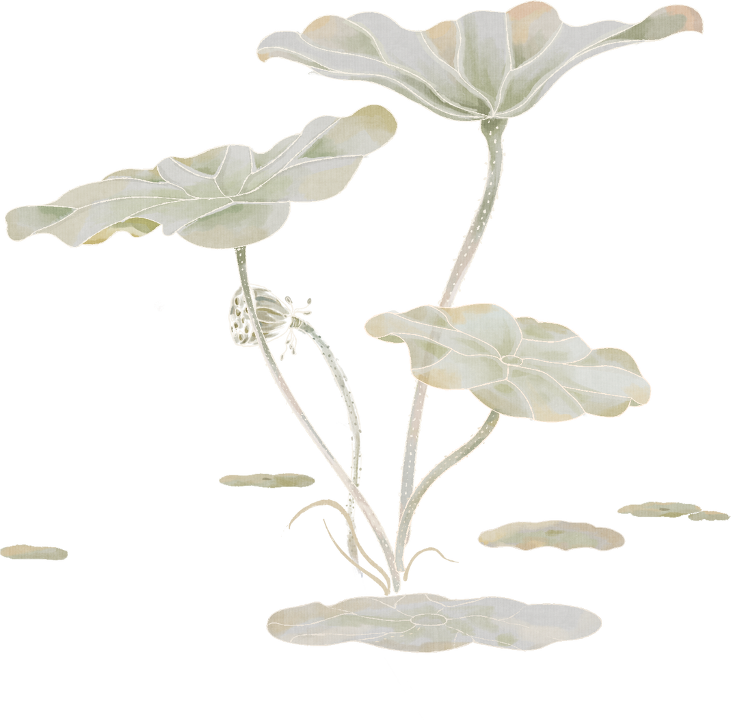
Contents
01
02
Introduction
Details
03
04
Benefits
Questions

Slide 3
Introduction
Part.01

Slide 4
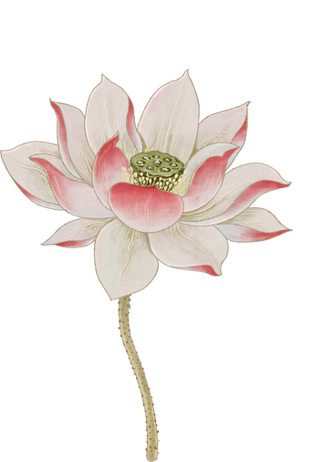
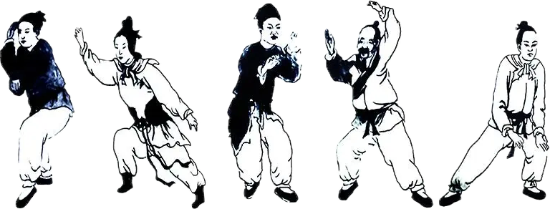
Introduction
Frolics of animals originated in the Spring and Autumn Period and the Warring States Period, from Frolics of the Two Animals, Frolics of the Three Animals to Frolics of Multiple Animals. Based on this, Hua Tuo developed the Wuqinxi (Frolics of the Five Animals), a series of exercises based on movements of the tiger, deer, bear, ape, and crane.

Slide 5
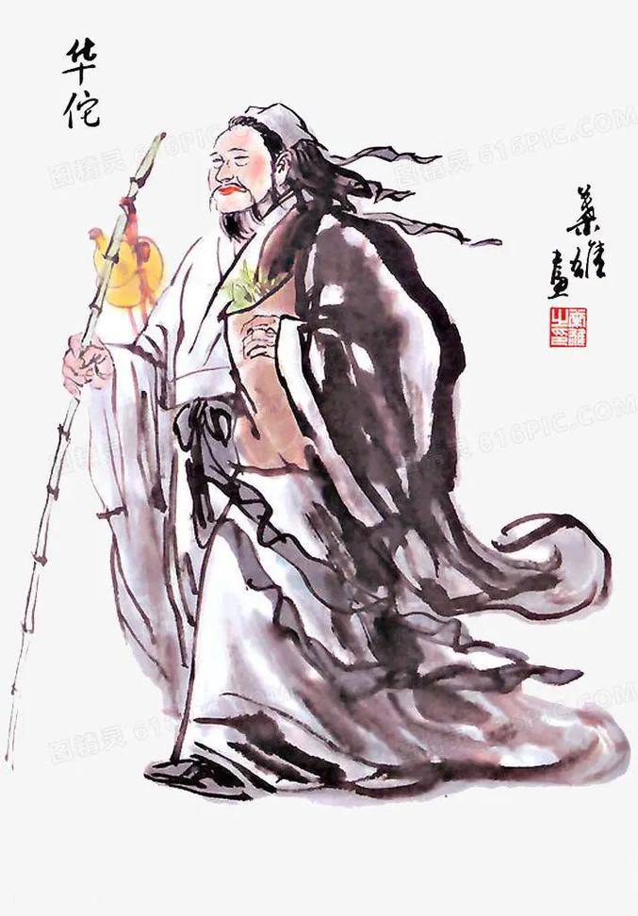
Hua Tuo
Founder：
“Knowing well the way to keep one in good health, Hua Tuo still appeared in the prime of his life when he was almost 100, and so was regarded as immortal.”
“晓养性之术，时人以为年且百岁，而貌有壮容。”
Hua Tuo was born in Qiao, present-day Anhui Province (present-day Haoxian County, Anhui Province).
He devised movements that were similar to the movements of five different animals. These were the tiger, deer, bear, monkey and bird.

Slide 6
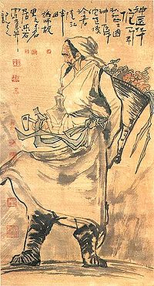
Hua Tuo was called "Holy Hand of Surgery" (外科圣手）and "Ancestor of Surgery" （外科鼻祖）by later generations. Later generations often referred to him as "Divine Doctor Hua Tuo"（神医华佗) and praised him as "Hua Tuo Reborn"（华佗在世） and "Yuan Hua Reborn"（元化重生） with outstanding medical skills.
"The human body wants to work, but it is not appropriate to make the pole ear when shaken, the vulgar will be eliminated, the blood will flow, the disease will not be born, and the household pivot will be immortal."
“人体欲得劳动，但不当使极耳，动摇则俗气得消，血脉流通，病不得生，户枢不朽也。”

Slide 7
Details
Part.02

Slide 8
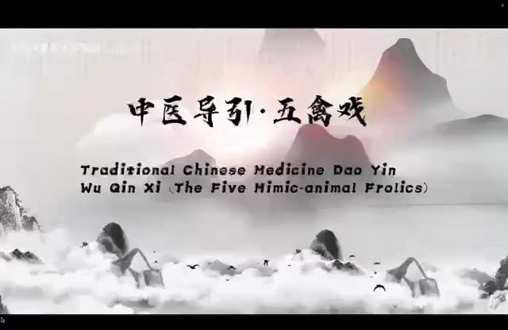

Slide 9
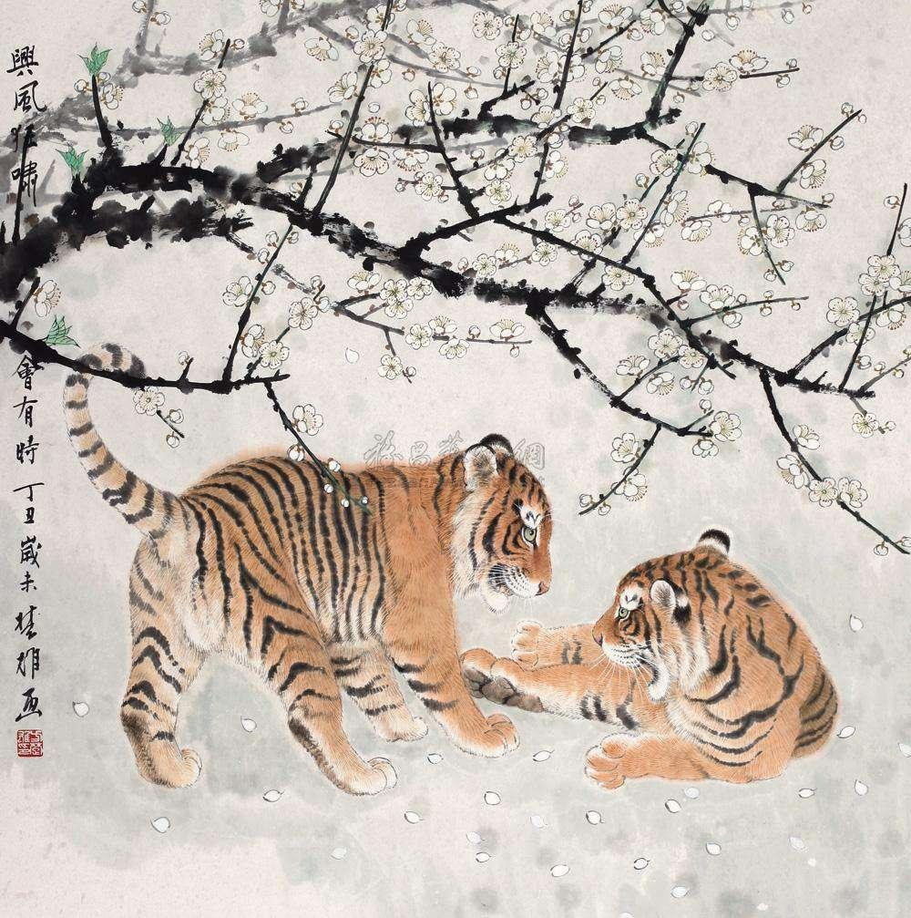
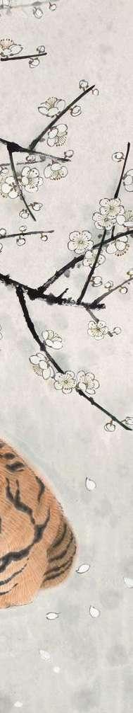
The features of a tiger：
·Ferocity
The Monarch Of All Beasts
百兽之王
·Strong body
Both divine and imposing
神威并重，气势凌人
·Jumping
虎举
·Scratching
虎扑

Slide 10
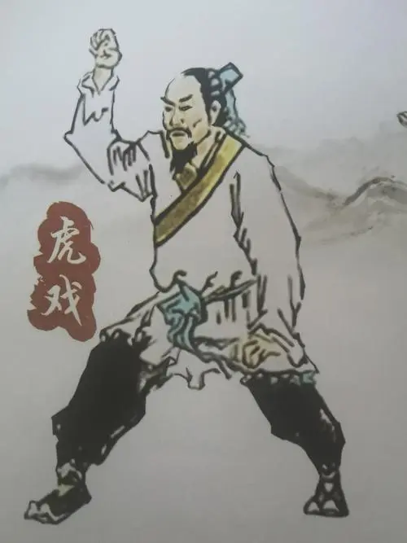
Tiger
虎戏
The most important element in the Tiger Play is to imitate the awe-inspiring attitude of a tiger. Its spirit is shown in its eyes and its awesomeness comes out of its craws. It stared at angry eyes and moved like wind. It twists its waist with force, wags its head, swings its tail, and vibrates its body.
Training under this form will develop the bones, joints, and tendons as it requires intricate coordinated movements. The body is trained in the manner where it holds in twisting stances to develop a coil-like exertion. This centers the body to the ground and develops the legs to become more graceful yet deadly. This form is perhaps the most physically challenging of all the forms.

Slide 11
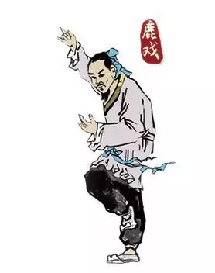
Deer
鹿戏
The Deer Play is to imitate the shape and movement of a deer hoping to attain long life and pure soul like a deer. The features of a deer are its gentle disposition, swift movement, love of pushing with horns, and good at running.
When practicing "deer play", the action should be light and stretched, and the expression should be quiet and quiet, thinking of their own tailored to the deer on the hillside or grassland free and enjoying happy activities. Imitating the deer form can move the whole body’s muscles and bones, so it has the effect of relaxing the tendons, activating the tendons, and strengthening the bones.[1]

Slide 12
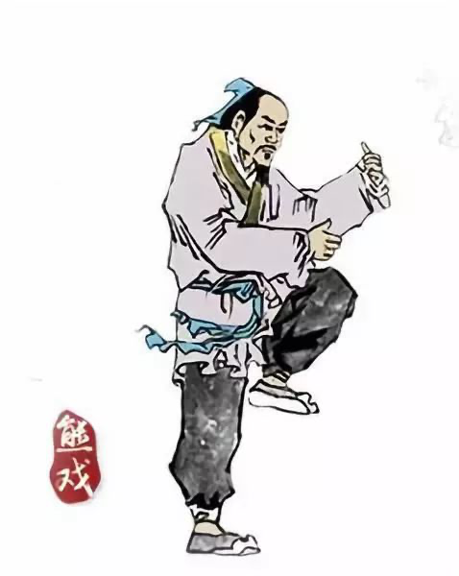
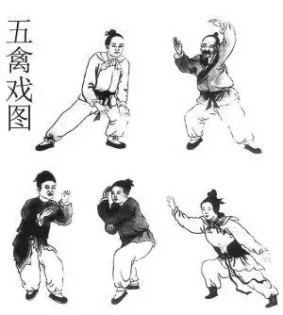
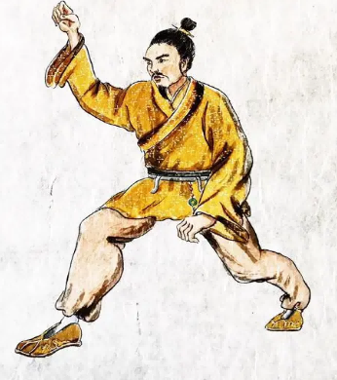
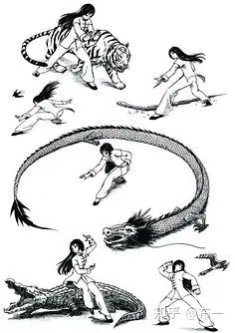
Bear
熊戏
In general, bear forms emphasize turning, twisting, and bending at the waist; and a focus on the power of the shoulders and upper back when reaching, grabbing, and "clawing. " Bear forms usually have the feet separated in a horse stance or lower lunges, which helps exercise (stretch and strengthen) the lower body.

Slide 13
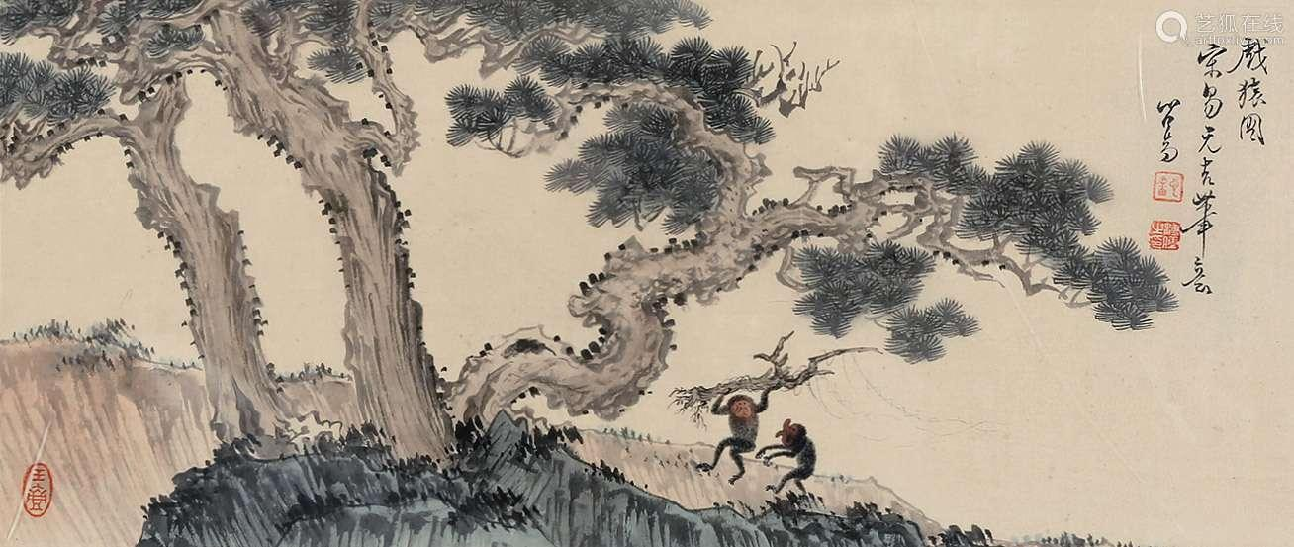
Ape
猿戏
The Ape Play is to imitate the shape and movements of an ape to show its alertness, agility, and constant movement.
When performing the ape exercise, try to imitate the light and swift movements of the ape, but for the internal exercise, you should keep your mind like a bright moon shining in the quiet and still night. So the ape exercise is externally dynamic and internally static.
油画奖项

Slide 14
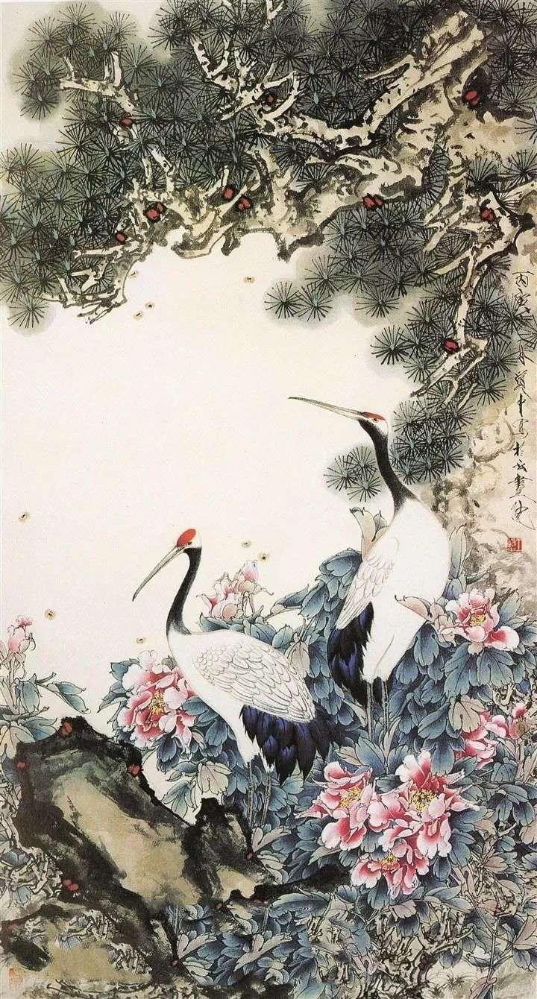
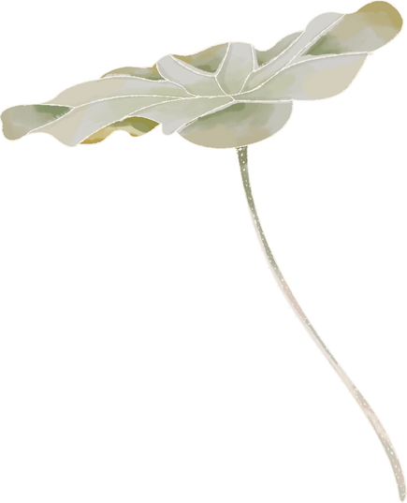
Crane
鹤戏
The crane exercise involves imitating a crane, traditionally regarded in China as a symbol of calmness, litheness, and longevity.
The crane exercise can promote the circulation of Qi（气） and blood（血） in all the meridians and improve the motility of all the limbs.

Slide 15
Benefits
Part.03

Slide 16
Benefits
Mental: 调心
Breath: 调气
Contour: 调型

Slide 17
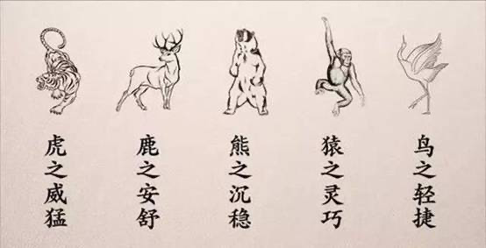
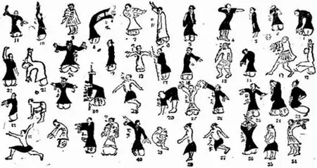
功效
Benefits
Mental:调心
When practicing the five animals play, the tongue is required to touch the palate, which is equivalent to aerobic endurance exercise. At the end of each play, there is the effect of mental relaxation that can indirectly massage the heart.

Slide 18
功效
Benefits
Breath:调气(Qi)
The composition of the human body is also based on "qi" as its most basic material basis, because of its strong vitality and continuous movement characteristics, it has a role in promoting and warming human life activities.

Slide 19
功效
Benefits
Contour:调型
Although the "Contour" is displayed on the outside, the mental is embodied by imitating animals. Frolics of the Five Animals require that the “Qi” in the Dantian（丹田） should also be moved with the movement, and the breath should also be done according to the law of lifting, inhaling, and exhaling, in order to achieve the requirement of "Mind and Breath Interdependent".[2]

Slide 20
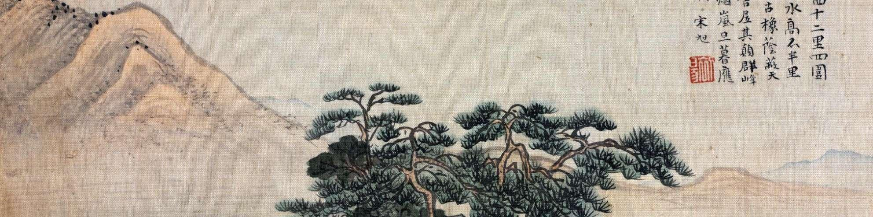
练习
Practice
In a word, Frolics of the Five Animals can help us exercise our body and mind. It can strengthen the body, nourish the spirit, and adjust the posture. In addition, it can also help prevent and overcome various diseases, such as lung disease, asthma, high blood pressure, and so on. The Five Poultry Play is a sport suitable for all ages.
If you want to practice the Five Poultry play, you should practice twice a day for 15 minutes each time, once in the morning and once in the evening. You should choose a place with fresh air and lush vegetation to practice.

Slide 21
Questions
Part.04

Slide 22
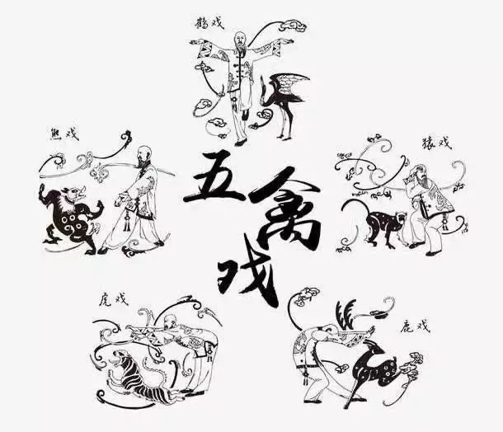
Questions
问题
1. Who is the founder of Wuqinxi?
Hua Tuo
2. What animals does Wuqinxi imitate?
Tiger, bear, deer, ape, and crane.
3. What does the crane symbolize in traditional Chinese culture?
The bird exercise involves imitating a crane, traditionally regarded in China as a symbol of calmness, litheness, and longevity.
4. What kind of play is externally dynamic and internally static?
The ape play.
5. What are the characteristics of the deer?
The features of a deer are its gentle disposition, swift movement, love of pushing with horns, and good at running.

Slide 23
References
参考文献
[1]林飞.“五禽戏”的养生保健作用及其应用研究[D].南京中医药大学,2010.
[2]司红玉.健身气功五禽戏的养生之道[J].中国临床康复,2006(47):145-147.

Slide 24
Thank You
感谢您的观看
汇报人：龙雨涵

