Slide 1
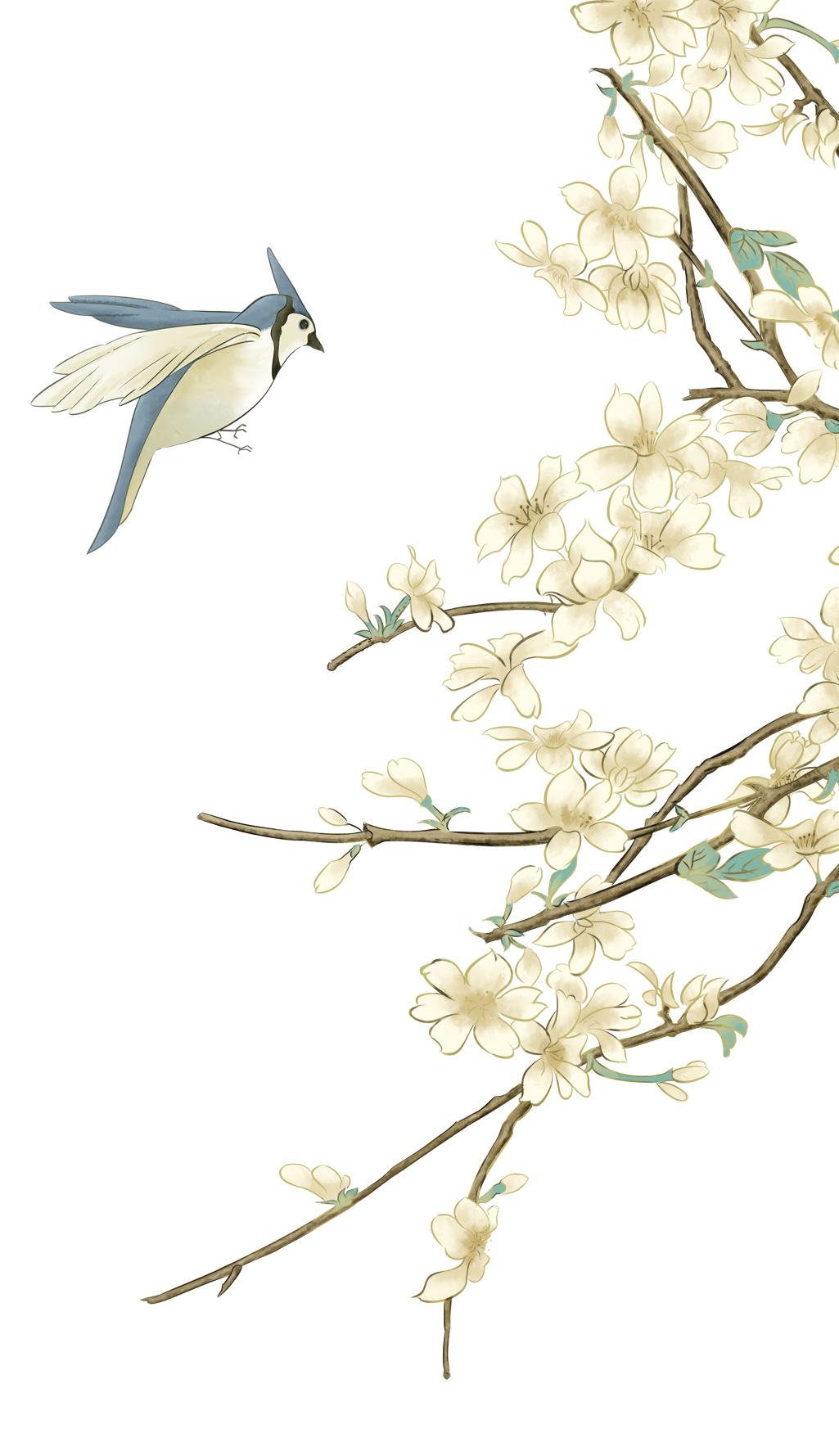
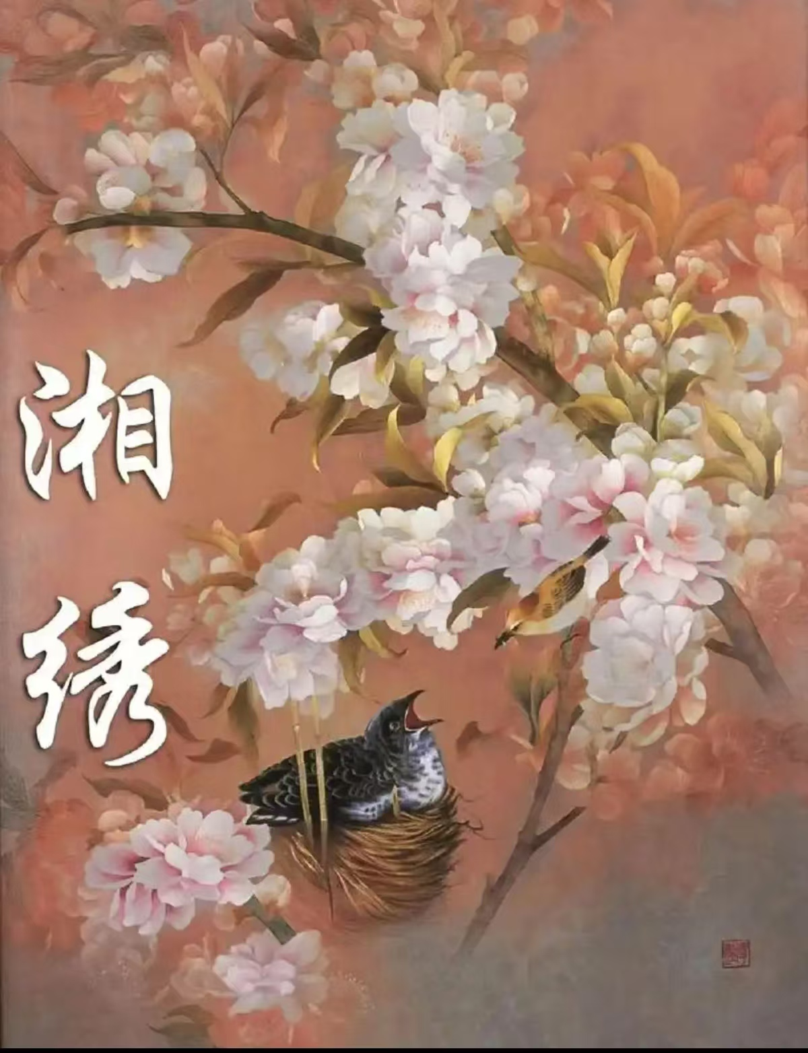
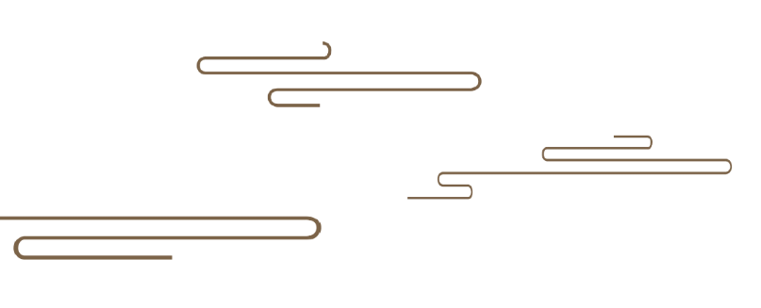
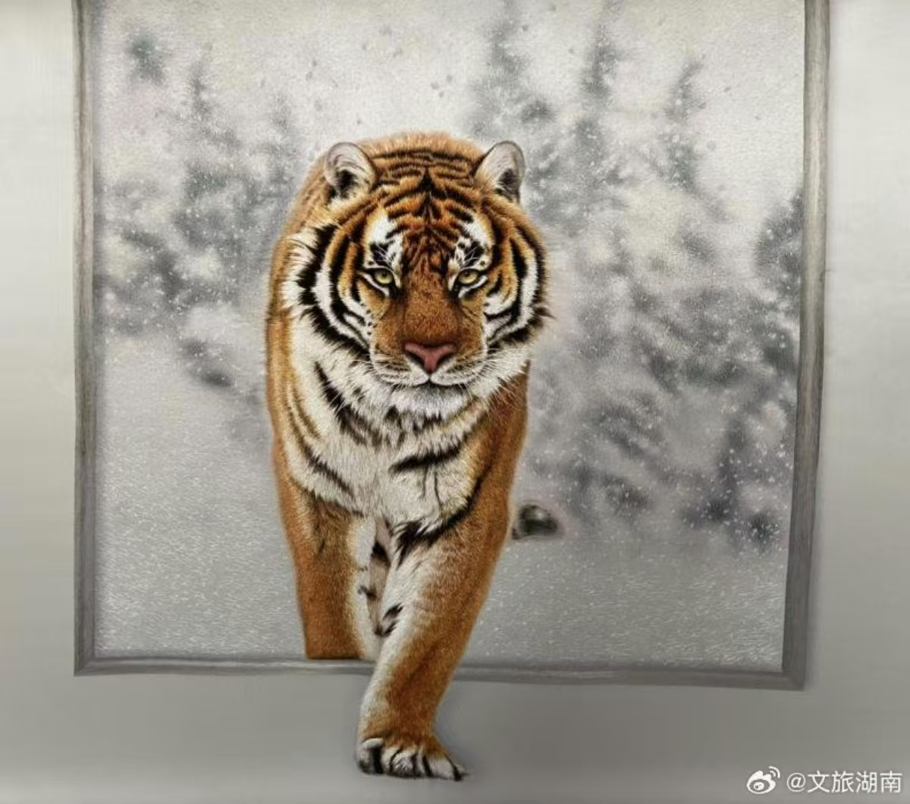

You seem to smell the scents of them when seeing the flowers in Xiang embroidery.(绣花能生香）
The Beauty of Hunan Embroidery
You may see it running when watching the tiger in Xiang embroidery.
（绣虎能奔跑）
古典国风
By Zhang Huifang, student number: 202470081626

Slide 2
Content
壹
贰
叁
肆
Introduction
Changes of themes
Development of stitches
Inheritance and development

Slide 3
壹
Introduction
Xiang embroidery, also known as Hunan embroidery, is a time-hornored intangible cultural heritage in China. With more than 2000 years of history, Xiang embroidery has embraced rich Chinese cultural and artistic values, especially Chu culture, becoming a symbol of Hunan Province.

Slide 4
贰
Changes of themes

Slide 5
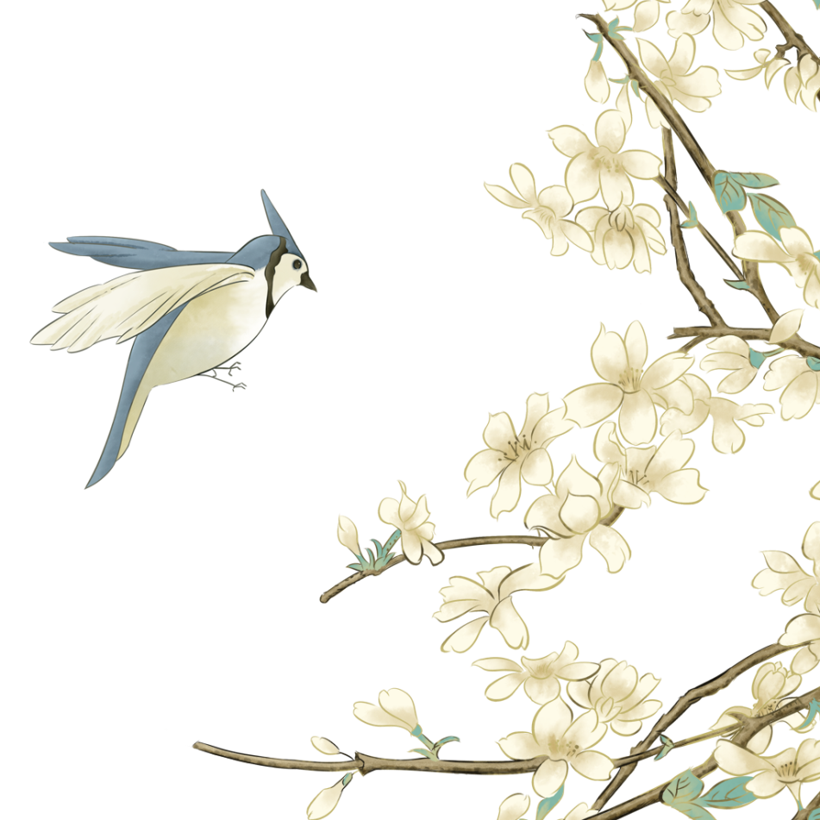
The development of themes in Hunan embroidery has gone through multiple stages.
Modern Period
Introduction of Western Elements in China:
European - style buildings and Western figures
History scenes : social changes and daily life at that time, making Hunan embroidery more in tune with the times.
Contemporary Period
Diversification:
Contemporary Hunan embroidery themes cover various fields including traditional culture, modern art, science and technology, and daily life.
Traditional Period:
Early Focus on Nature and Mythology: flowers, birds, fish, and insects "Dragon and Phoenix Presenting Auspiciousness"
Addition of Characters and Religion in the Ming and Qing Dynasties:
images of Guanyin and Arhats, reflecting the religious culture of the time and people's spiritual beliefs.
中国风

Slide 6
叁
Development of stitches

Slide 7
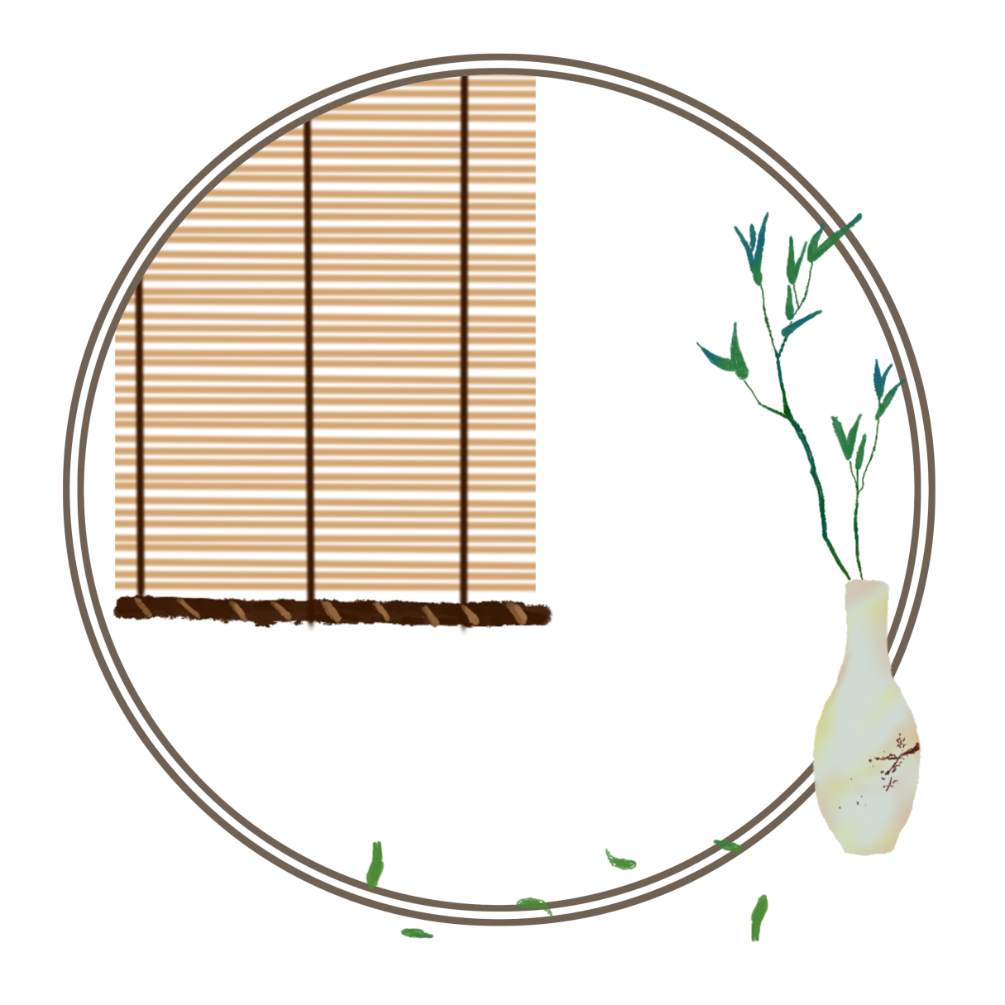
Development of stitches
The development of Hunan embroidery stitches is a continuous process of enrichment and innovation. The following are its main development stages:
Completion of the Stitch System in the Ming and Qing Dynasties:
During the Ming and Qing dynasties, the Hunan embroidery stitch system was basically formed, with a wide variety of stitches. For example, the blending stitch could make the color transition natural by blending different colored threads. The hyena hair stitch could vividly show the texture and shape of animal hair.
Formation Period of Traditional Stitches
Emergence of Simple Early Stitches: In the early days, Hunan embroidery stitches were relatively simple, with plain - stitch being the main one. It was used to outline patterns and fill in colors. Later, loose - stitch gradually emerged. By using loose stitches, it could show the light, shade, and texture of objects.

Slide 8
Development of stitches
Modern Times
During the period of the Republic of China, influenced by Western culture and painting art, Hunan embroidery stitches began to integrate the techniques of other embroidery types and painting. Attempts were made to incorporate the principles of light, shadow, and perspective from Western paintings into Hunan embroidery.
After the founding of New China, Hunan embroidery artists continuously innovated stitches. New stitches such as the cross - stitch were created. By using crossed stitches, the three - dimensionality and texture of the embroidered works were enhanced. The random - stitch embroidery had a unique effect in presenting modern themes and abstract art. With irregular stitches, it could show the rich layers and color changes of the picture.
古典国风

Slide 9
Development of stitches
Contemporary Development
Combination of Stitches and Modern Technology: In contemporary times, Hunan embroidery stitches, while inheriting traditions, are combined with modern technology. With the help of computer - aided design and embroidery machines, traditional stitches are digitally simulated and innovated. Some new combinations of stitches and embroidery methods are developed, improving production efficiency and the stability of the quality of embroidered works.
古典国风

Slide 10
肆
Inheritance and development

Slide 11
Inheritance and development
Challenges
Talent Shortage: The learning process of Hunan embroidery techniques is time - consuming and difficult. With a wide range of career options available, fewer young people are willing to engage in the Hunan embroidery industry, resulting in a talent gap.
Market Competition: The competition from machine - embroidered products and other embroidery types, along with the influx of low - cost and low - quality counterfeit Hunan embroidery products, has impacted the market share and brand image of Hunan embroidery.
Cultural Awareness: In the fast - paced modern life, some young people have insufficient awareness and interest in traditional handicrafts like Hunan embroidery. Thus, the dissemination and promotion of Hunan embroidery culture face challenges.
古典国风

Slide 12
Inheritance and development
Development Strategies
Talent Cultivation: Strengthen cooperation with educational institutions, improve the talent cultivation system, enhance the treatment and social status of practitioners, and attract more young people.
Innovative Development: Continuously innovate in themes, stitches, materials, etc., strengthen the integration with modern design concepts and technologies, and develop products that meet market demands.
Brand Protection: Raise brand protection awareness, crack down on counterfeiting and shoddy products, and enhance the cultural influence and brand awareness of Hunan embroidery through cultural activities, media promotion, etc.
古典国风

Slide 13
Thank you for listening!
古典国风

