Slide 1




Social Phenomenon: Mobile Population
社会现象：人口流动
23英语口译胡泽涛
2024年12月12日

Slide 2





目录
CONTENT
01
02
03
Definition
Scale
Trend
04
Challenges
05
Reflection

Slide 3

01
01
Definition
Definition
新疆
Generally
“Mobile population” refers to people who frequently change their place of residence, whether within a country or across international borders, often for work, education, or personal reasons.
In China
In China, the word refers to the particular group of people who live in the place different from the one registered in their household register.

Slide 4
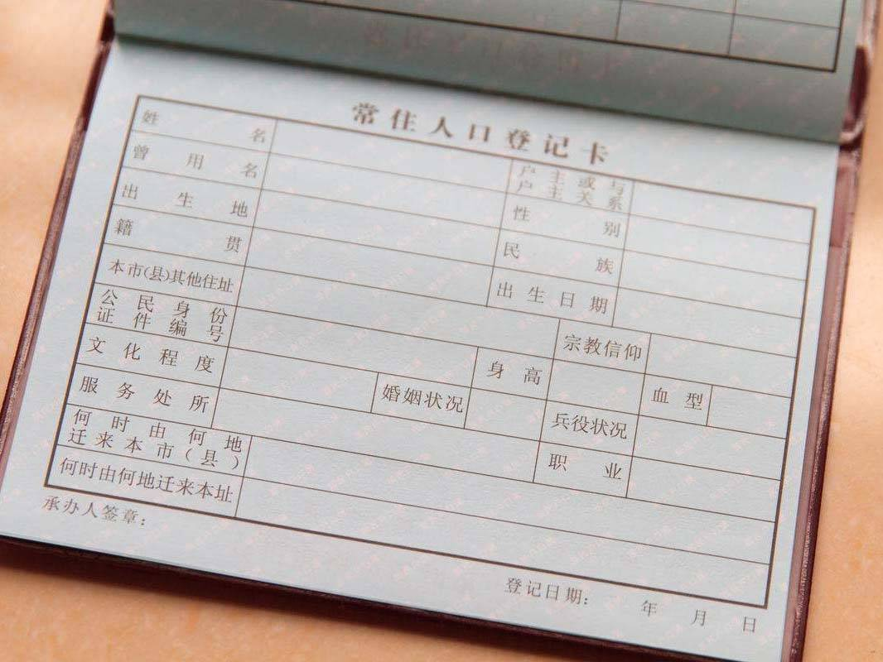
Household Register
Name
Gender
Kinship
Birthplace
Urban nature
Agricultural nature

Slide 5
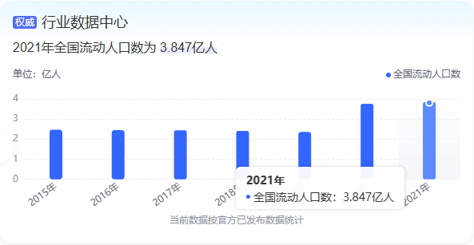



02
Scale
The inter-provincial migration getting more frequent and vigorous and becoming a important element of shaping modern society
inter-provincial migration

Slide 6



03
Trend
From rural areas to cities​
Pearl River Delta and Yangtze River Delta
pull factors
push factors
better job opportunities,
access to modern amenities
limited resouces,
slower development

Slide 7



04
Challenges
Housing: skyrockrting prices
Children’s Education:
limited access
separation
Employment: stiff competition
limited social benefits
Cost of living: rising
hard to achieve financial stability

Slide 8

04
Challenges
NEET(啃老族)
Not Currently Engaged in Employment, Education or Training
Tranditionlly
those who stay at their parents’ home and are not willing to work.
Now
those who work in big cities and spend all their parents' savings to start business, get married, buy a house, and have children

Slide 9



05
Reflection
Depreciation of academic qualifications
Fierce job competition
AI replacing human translators

Slide 10


05
Reflection
Afforadable housing
equal access to education
fair employment opportunities
​
Mobile population is both a driver of change and a reflection of society's development. Understanding their experiences and addressing their challenges will be crucial for fostering a harmonious and inclusive society.

Slide 11



THANK YOU​

