Slide 1
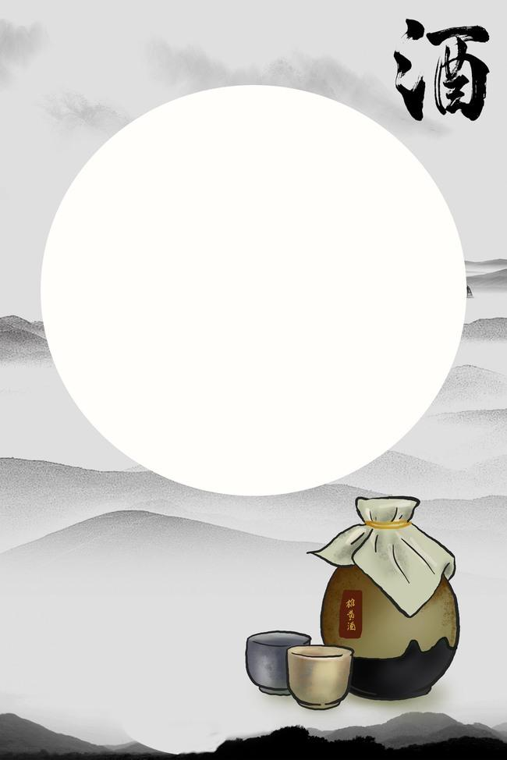
The Liquor Culture of Ancient China
Teng Bixia
2020/05/19

Slide 2
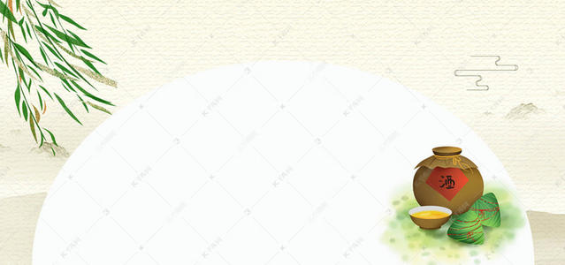
CONTENTS
An Introduction
01
The Origin of liquor
The Types of liquor
The Types of Drinking Vessel
Drinking Games
Translation
02

Slide 3
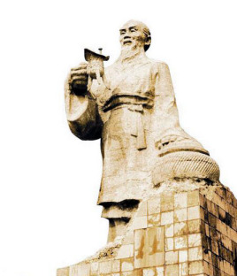
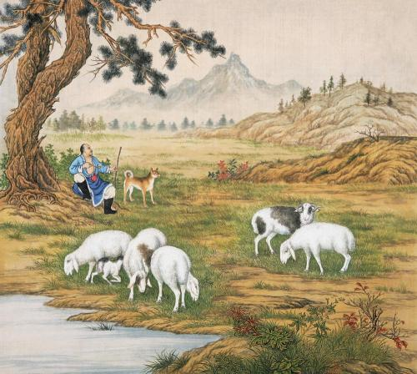
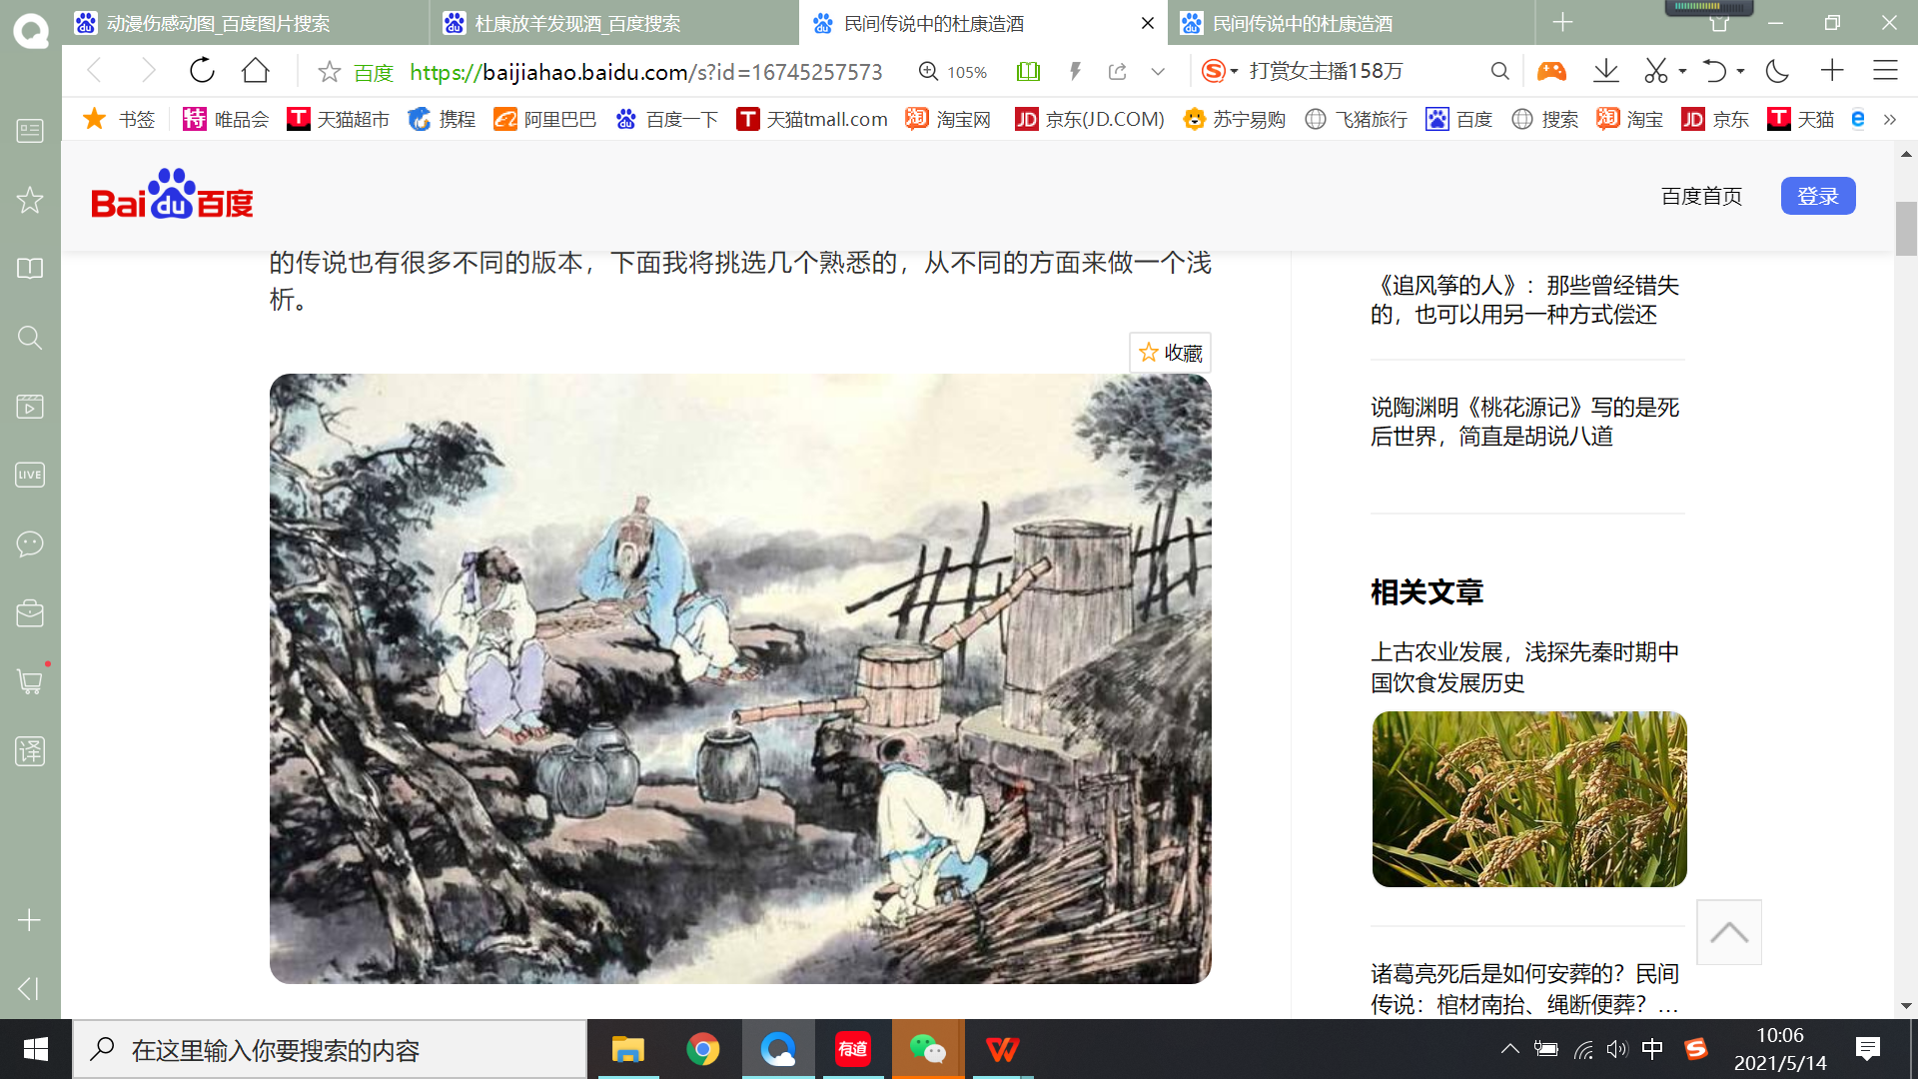
The Origin of liquor in China
Du Kang invented liquor
One day it rained suddenly while Du Kang was herding the sheep. Hastily driving the sheep back to the sheepfold, he forgot some husked sorghum rice in a hollowed trunk by accident
The rice he left there became so fragrant that he couldn’t help tasting some.It was palatable. And this made him start to develop the liquor-brewing technique.
There were birds hovering overhead, making "choo-choo."“啾啾啾” Du Kang thought it was a gift from God, so he called the liquid "liquor". 酒

Slide 4
The Types of liquor in Ancient China
According to the different production techniques, Chinese liquor can be divided into fermented wine(发酵酒） and distilled liquor.（蒸馏酒）
Fermented wine | Distilled liquor
Yellow rice wine | Liquor and Spirits(Baijiu)
1.Shaoxing Wine 2.Mellow Wine 3.Dongwu Rice Wine 4.Jiujiang Old Seal Wine,etc | 1.sauce-flavor type 2.light flavor type 3.strong flavor type 4.other flavour types, etc

Slide 5
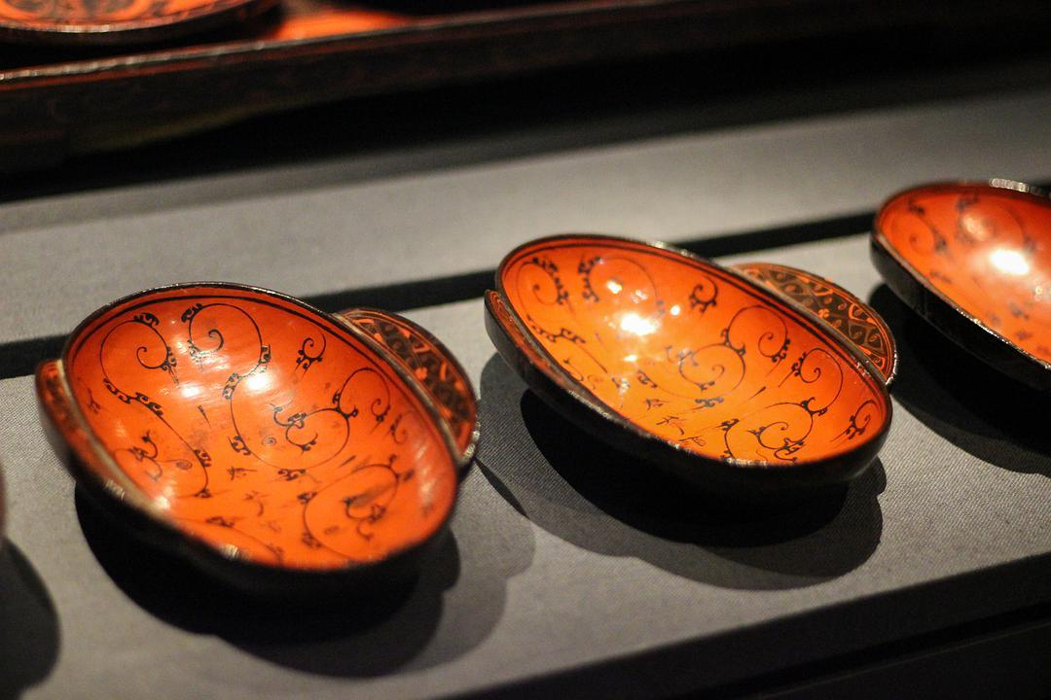
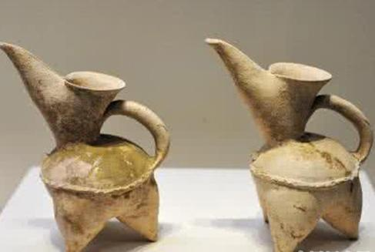
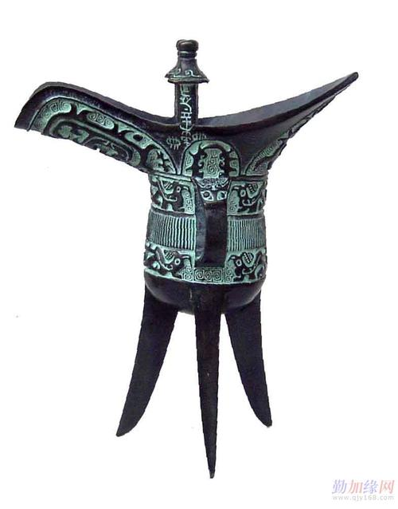
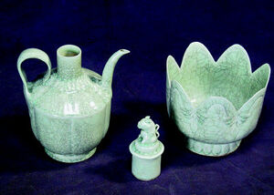
The Types of Drinking Vessel
Exquisiteness and Suitability of drinking vessels
The Neolithic culture period： pottery with shapes similar to later wine-ware, such as the pottery of the Peiligang culture period, appeared.
During the Qin and Han Dynasties, lacquered wine utensils(漆酒器具） became popular in Southern China.
Porcelain wine vessels roughly appeared around the Eastern Han Dynasty.People in the Song Dynasty like to warm rice wine before drinking it. So the matching combination of injection vessel and bowl were invented.
Xia，Shang and Zhou Dynasties：bronze wine vessels got its prosperity.

Slide 6
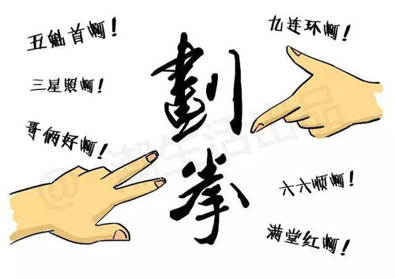
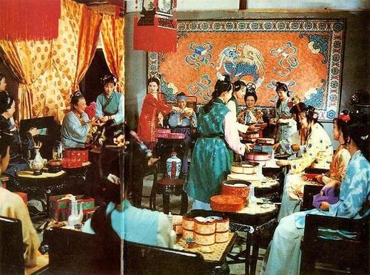
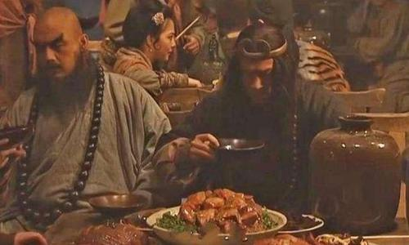
Drinking Games in Ancient China
There are many ways to make wine games. The way the literati and the ordinary people make drinking games are naturally very different. Literati often use poems or couplets, guessing characters or guessing puzzles, etc. while ordinary people use simple ways to act without any preparation. It requires a quick, witty, artistic and talented person to do liquor games.
Drinkers'wager game行酒令/射覆
Finger-guessing game划拳/猜拳

Slide 7
Difference between Wine ,Liquor and Spirit
alcohol content /production techniques
wine /waɪn/ : an alcoholic drink made from the fermented juice of specific plants or fruits
Red wine, kiwifruit wine
liquor /ˈlɪkə(r)/:an alcoholic beverage that is distilled rather than fermented，it can be a general name of all kinds of wine.
spirit /ˈspɪrɪt/ [ usually pl. ] :a strong alcoholic drink
Liquor and Spirits 白酒

Slide 8
杜康酒 Du Kang
贵州茅台 Kweichow Moutai ← Guizhou Maotai
东吴老酒 Dongwu Rice Wine : place+ material +wine
Dongwu Old Wine/ Dongwu Wine
黄酒 Yellow rice wine: color+ material+ wine
白酒 Liquor and Spirits/ Chinese spirits
...
Basic Principles:
1. Pronunciation
2.Place+features(materials/color/ flavor or taste...)+wine
3.Chracteristics(+wine)
....

Slide 9
THANKS

