Slide 1
17th Century China and Europe

Slide 2
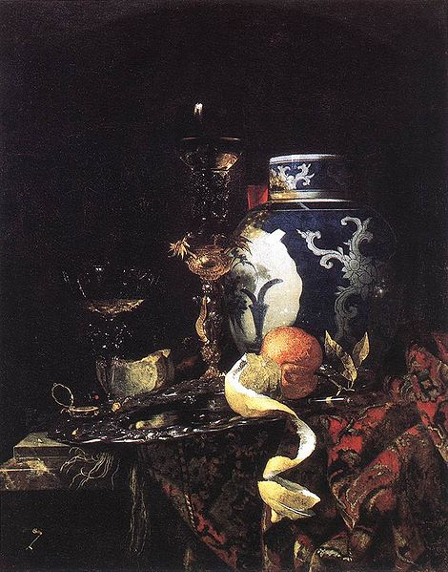
This is a dutch painting from 1698. What do you notice that is interesting about it?
http://commons.wikimedia.org/wiki/File:Willem_Kalf_-_Still-Life_with_a_Late_Ming_Ginger_Jar_-_WGA12080.jpg

Slide 3
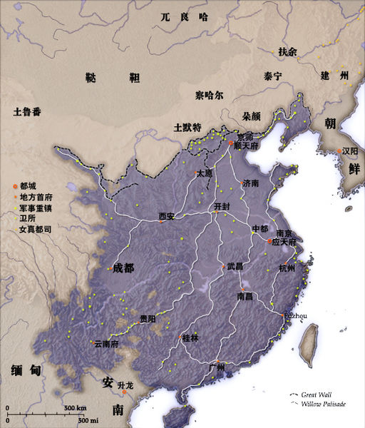
The Ming Dynasty
http://commons.wikimedia.org/wiki/File:China_Ming_1580.jpg

Slide 4
Ming Dynasty
What do we know about the Ming Dynasty?

Slide 5
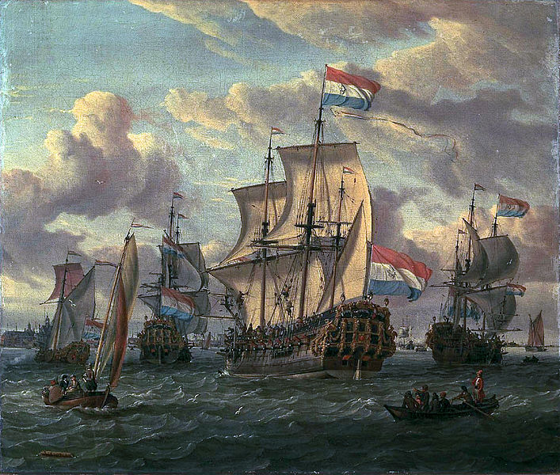
Europe in the 17th Century
What do we know about Europe during this time?
How would Europe’s demand for Chinese goods affect the Chinese economy?
http://commons.wikimedia.org/wiki/File:The_%27Pieter_and_Paul%27_on_the_IJ_in_Amsterdam_in_1698_(Abraham_Storck).jpg

Slide 6
Fiscal Collapse
From 1573 – 1619, 23,000 clansmen were receiving stipends.
Military Campaigns
Bureaucracy became less efficient
Revenue did not keep up as peasants lost their land to the wealthy, and the wealthy found ways to pay less taxes.

Slide 7
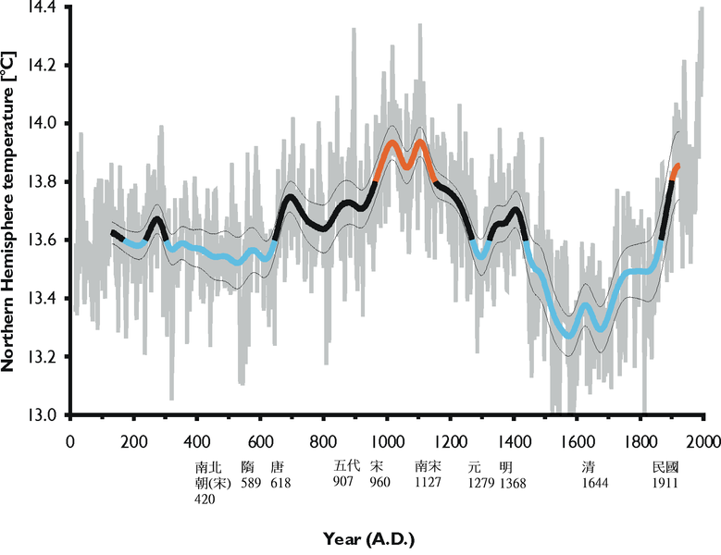
Fiscal Collapse
The Little Ice Age
http://commons.wikimedia.org/wiki/File:NH_temperature_2ka_correspond_to_Chinese_dynasty.png

Slide 8
Fiscal Collapse
The government was unable to effectively help the citizens during this little Ice Age and other natural disasters of the period.
Serious famine
Civil unrest
Gangs formed from army deserters
Hordes of beggars

Slide 9
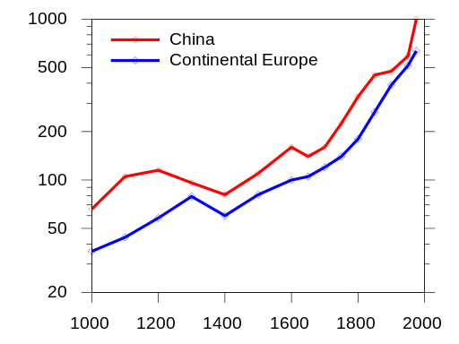
Population Decrease
Population dropped by 10’s of millions due to:
Epidemics(smallpox)
Famine
Warfare
http://commons.wikimedia.org/wiki/File:China_Europe_population_1000-1975.svg

Slide 10
The Little Ice Age and Plague
http://www.youtube.com/watch?v=UpZqAPmW6d0
At 6min 11 sec

Slide 11
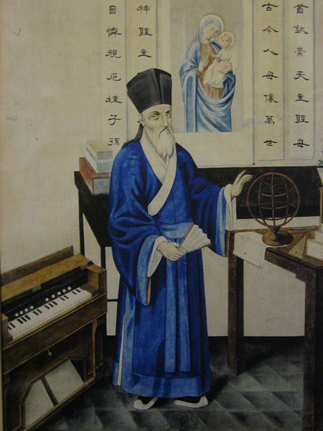
Jesuit Missionary Work in China
What do we know about about Matteo Ricci?
How were missionaries in China used by European Countries?
How did the Jesuit missionaries transition into the new government when the Ming Dynasty fell in 1644?
http://commons.wikimedia.org/wiki/File:Matteo_Ricci_2.jpg

Slide 12
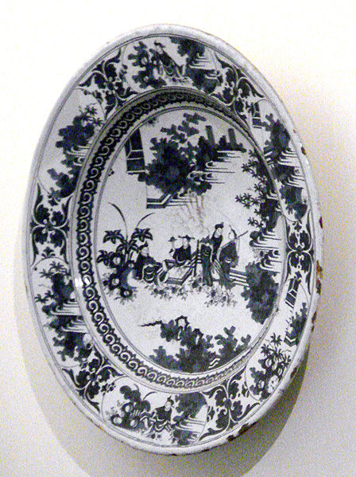
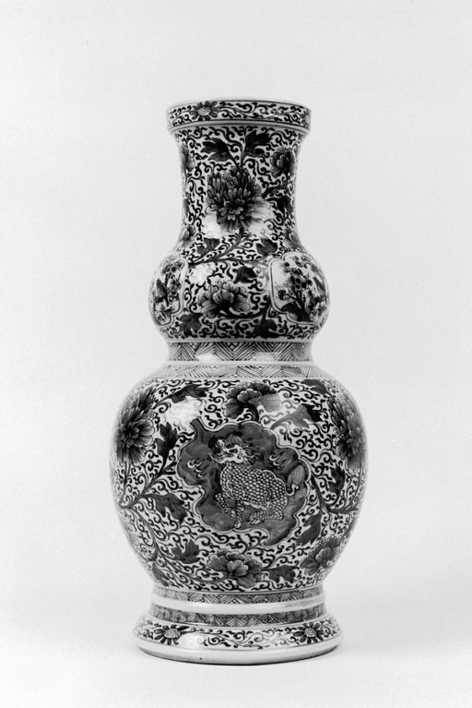
Chinese Porcelain
Millions of pieces of pottery exported by the Dutch East Indies company for sale in Europe throughout the 17th Century.
http://commons.wikimedia.org/wiki/File:Chinese_-_Double-Gourd-Shaped_Vase_-_Walters_491648_-_View_B.jpg
http://commons.wikimedia.org/wiki/File:Blue_and_white_porcelain_with_Chinese_scene_Nevers_Manufactory_France_end_of_the_17th_century.jpg

Slide 13
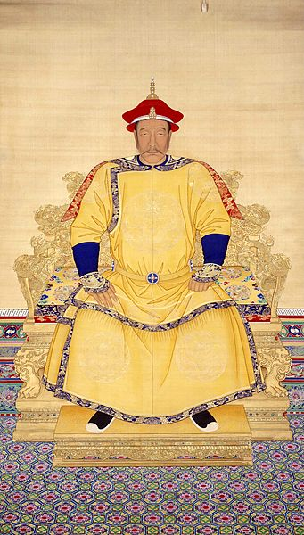
The Qing Dynasty
Who was Nurhaci?
http://commons.wikimedia.org/wiki/File:%E6%B8%85_%E4%BD%9A%E5%90%8D_%E3%80%8A%E6%B8%85%E5%A4%AA%E7%A5%96%E5%A4%A9%E5%91%BD%E7%9A%87%E5%B8%9D%E6%9C%9D%E6%9C%8D%E5%83%8F%E3%80%8B.jpg

Slide 14
References
Ebrey, Patricia Buckley. Cambridge Illustrated History of China, 2nd Edition. (New York: Cambridge University Press, 2010).
Lion-Goldschmidt, Daisy. Ming Porcelain (Rizzoli, 1978).
Mungello, D. E. The Great Encounter of China and the West, 1500-1800, 2nd Edition. (Rowman & Littlefield Publishers, 2005)
Ruiz-Stovel, Guillermo. Chinese Merchants, Silver Galleons, and Ethnic Violence In Spanish Manila, 1603-1686. Cuenca del Pacifico Retos y oportunidades para Mexico (2009) 47 - 63.
Ricci, Matteo. Lettere dalla China, trans. He Gaoji et al. (Zhonghuashu, China: China Press, 1983).

