Slide 1
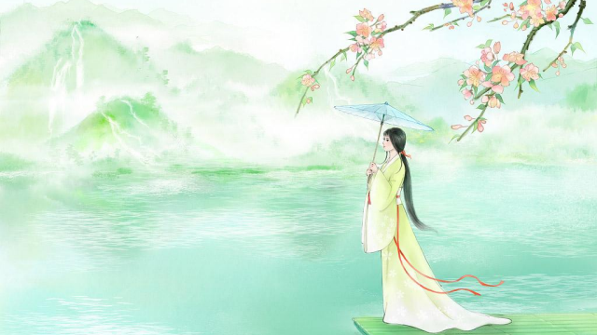

Chinese Term of Endearment
Reporter:Zhu Huiting
2025.04.24

Slide 2



01
02
03
What Chi n ese T e r ms of
E n dea r me n t A r e
Chi n ese T e r ms of
E n dea r me n t
B etwee n Co u p les
The Evol u tio n of
Chi n ese T e r ms of
E n dea r me n t

Slide 3

PART 01
What Chi n ese T e r ms
of
E n dea r me n t A r e

Slide 4
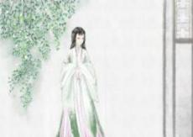
Defin ition
✲
✲ ✲
Informal & Affectionate
forms
Show love,care,or a close
bond with another per son
Be used in var ious
contexts

Slide 5
*
Cultural Significance
Express love,care and affection
Emotional Expression
Strengthen emotional bonds
Create a sense of closeness
Cultural Heritage
Reflect the cultural values and traditions
Social Relationships
Indicate the nature of social relationships

Slide 6
PART 02
Chi n ese T e r ms of
E n dea r me n t B etwee n
Co u p les

Slide 7
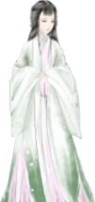

Terms for a Beloved
Question
Terms Used by Men for a Beloved Woman
Connotation
Referring to a person who is idealized or cherished
Reflecting the speaker's admiration or affection
❁
Yi (伊）
Example
“In the water, the one I long for stands afar.”
From The Book of Songs (Shijing)
Emotional Expression
Admiration and reverence

Slide 8
Terms for a Beloved
Terms Used by Women for a Beloved Man
Connotation
O r igi n a t e fr o m P a n Yu e
F o r a h a nds o m e a n d c h a r m i ng m a n
Tan Lan g（ 檀郎 ） Example
" 绣 床 斜 凭 娇 无 那 ， 烂 嚼 红 茸 ， 笑 向 檀 郎 吐 。 "
From Li Yu's "Yi Hu Zhu" (南唐·李煜 《一斛珠》)
❁
Emotional Expression
Ad m i r a ti o n fo r his app e a r a n c e
a n d c h a r m

Slide 9
Formal Spouse Terms
Terms Used by Men for Their Wives
Connotation
Sh o w i ng g r a tit u d e a n d r esp e c t
h u m ility a n d r esp e c t
Zao Kan g（ 糟糠 ） Example
" A w ife w h o h a s s h a r e d h a rds hips s h o u ld n o t b e
❁
a b a n d o n e d . "
" 糟 糠 之 妻 不 下 堂 "
From Records of the Grand Historian (Shiji):
Emotional Expression
Th e i mp o rt a n c e o f v a l u i ng a w ife

Slide 10
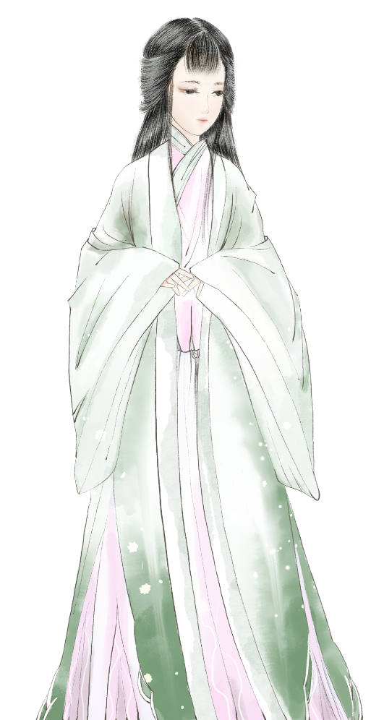
*
Formal Spouse Terms
Terms Used by Men for Their Wives
Connotation
Showing respect and dependence
Example
❁
Guan Ren（官人）
"My lord has returned today, and I am very happy."
"官人今日归来，妾身甚是欢喜。"
Emotional Expression
The wife's deep affection and loyalty to her husband

Slide 11
*
Modern Endearing Terms
Equality and Intimacy
Connotation
Deep Affection
❁
Ai Ren（爱人）
Interdependence and Trust
Emotional Expression
Intimacy and Warmth
Respect and Formality
Connotation
❁
Tradition and Stability
Xian Sheng（先生）
Emotional Expression
Respect and Recognition

Slide 12
PART 03
The Evol u tio n of
Chi n ese T e r ms of
E n dea r me n t

Slide 13

Histor ical Evolution
Clan system
Anc ie nt Tim e s
Hierarchical concepts
Mod e r n Tim e s
Emphas izing
eq ua lity a n d respect
Dive rse a n d pers ona lized
T e mpo r a r y Tim e s
Reta in ing t raditiona l elements while inc orp orating mode rn
c u lt ura l va l u es

Slide 14
Important Impacts
Question
Diversification of Terms
Cultu r a l Ex ch a ng e
B e t w e e n
China a nd th e W e s t
Spread of the Concept of Equality
Cultural Integration
Impa ct of Int e r n e t Cultu r e
Innovation in Terms

Slide 15
Thank
Reporter:Zhu Huiting
You !
2025.04.24

