Slide 1

The Development
of Audiovisual Translation
Group members : Cheng Yusi 成于思
Gong Yumian 龚钰冕

Slide 2

CONTENTS
01
Background
02
What is AVT?
03
Development
04
Discussion

Slide 3
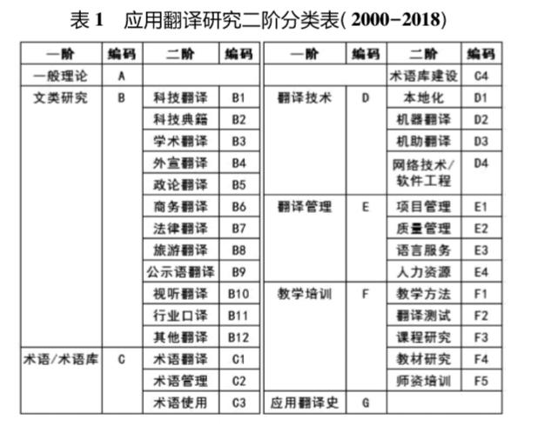
Culture
Society
Others
Economy
Economic growth promotes the emergence of new media
Multicultural environment
Background
Highly refined labor division leads to the specialization of translation
Inter-disciplinarity

Slide 4
Audiovisual Translation
Definition
Audiovisual
“Audiovisual”, used to serve as an audio-visual aid in education, now relates to texts in film and television and other audiovisual works and products. (刘大燕，2010)
Audiovisual Translation
Audiovisual translation (AVT) is a specialized branch of translation which deals with the transfer of multimodal and audiovisual texts into another language and/or culture.
Type
Subtitling（字幕翻译）: shows written text on a screen that conveys a target language version of the source speech.
Dubbing（配音翻译）: involves both the translation and its synchronization as well as dubbing the actors' and actresses' performance.
Voice-over（画外音）: involves the original soundtrack and the translation being broadcast simultaneously.
Audio discription（口述影音）: is intended for those who are blind, visually-impaired or partially-sighted and assists by providing a narration concerning the visual aspects of a film or television show.

Slide 5
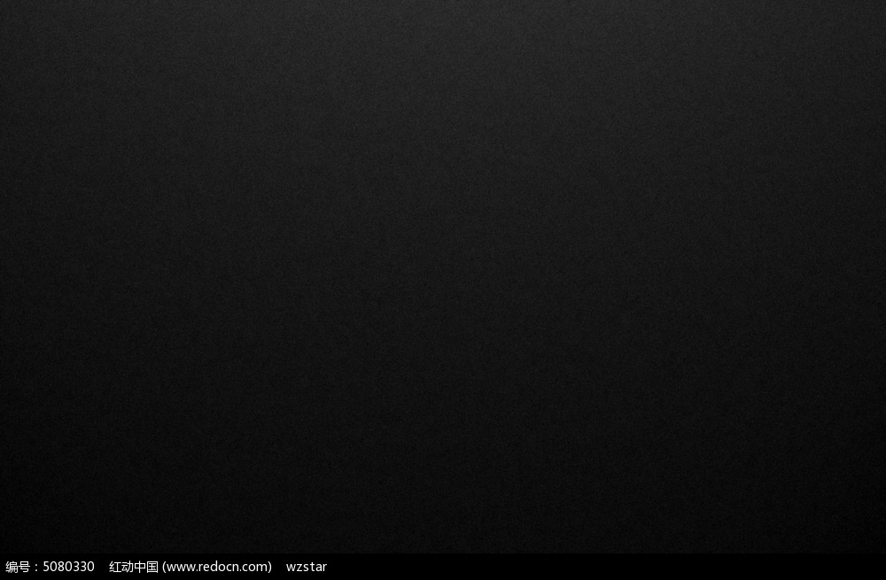
Listen to the translated audio about a blind speaker who tried to illustrate how he “see” the objects through sonar.
Try to get the differences between the original one and the translated one.
“这位嘉宾拿了一块纸板在自己面前来回移动，造成了声音的变化”

Slide 6
Development
During the first half of 20th Century
1995
Future
Film translation 电影翻译
Screen translation
屏幕翻译
Audiovisual translation
视听翻译
Focus on the quality of audiovisual
texts through the lens of
traditional translation theories.
Multimedia translation
多媒体翻译
Audiovisual translation was given different name in different phases. The definition is expanding with time going by.

Slide 7
Discussion
01
How to translate non-linguistic texts in Audiovisual Translation?
Does audio description violate the translation standards of faithfulness
and expressiveness? Which translation standards should be built?
02
How to make bilingual subtitles more accessible in spite of its instantaneity?
03

Slide 8
Thanks for your listening!

