Slide 1
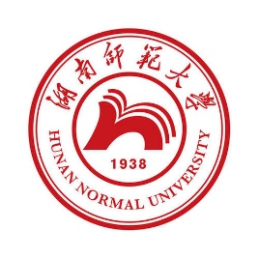
中华典籍外译 Chinese Classics Translation for Master Students of Translation Studies
湖南师范大学 2022年2月25日-2021年6月10日 中国文化基础 周五第九和第十节课14:30-16:10，
上课地点：95433914694 线上VooV
助教：Li Xin 李欣 – Session no. 6
吴漠汀特聘教授 Distinguished Professor Dr. Martin Woesler
培高德 教授 Professor Dr. Cord Eberspächer
湖南师范大学外国学院 Foreign Studies College, Hunan Normal University

Slide 2
Schedule 学期题目
1 2.25 Organizational things, intro to the concept of a „classic“
2 3.4 Canonization
3 3.11 Early Translation of Chinese Literature
4 3.18 Reception of the Red Chamber Dreams in the West
5 3.25 How to make people read classics again?
6 4.1 Western Classics in Chinese clothes: The example of Utopian Literature
7 4.8 Attractiveness of Chinese Classics as part of softpower
8 4.15 Chinese Classics in the West: The Example of Germany
9 4.22 Sinicization – Politics for Cultural Export: The Example of the Chinese classics
10 4.29 Chinese Classics in World Lit. Anthologies and World Literary History Books
11 5.6 Translation of Modern Classics: Mo Yan, Yu Hua, Liu Cixin etc.
12 5.13 Chinese Classics on Overseas Bookfairs
13 5.20 Cinema Movie Adaptions of Chinese Classics
14 5.27 Lessons to learn from the Classics: Integration or Sharpening the Cultural Profile?
15 6.3 Final Discussion
16 6.10 Final Exam

Slide 3
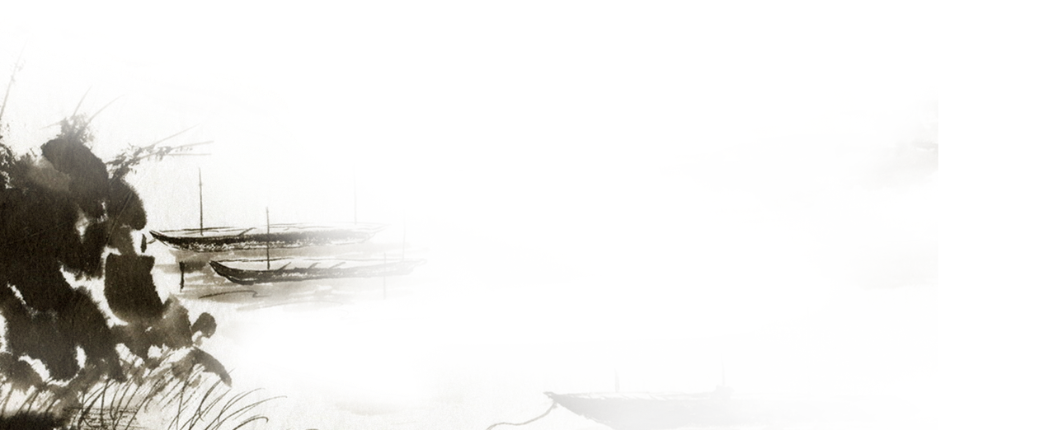



Western Classics in Chinese clothes The Example of Chinese Utopian Literature
吴漠汀教授
Prof. Dr. Martin Woesler
Hunan Normal University
Spring 2022

Slide 4
Students‘ Input
Presentation by Nie Wei 聂薇western classics in Chinese clothes
argumentative debate live in class on Utopian Literature or Dystopian Literature by Bian Wangqian卞王倩&Tong Yumeng仝雨梦 handout:Utopian Literature or Dystopian Literature
literature review with handout by Wang Yajuan 王亚娟 An Overview of Chinese Utopian Literature

Slide 5
Teachers‘ Input
吴漠汀教授
Prof. Dr. Martin Woesler
Hunan Normal University
Spring 2022

Slide 6
第一节 中国文学现代化的起点：
The starting point of modernization in China:
20世纪初乌托邦文学和不同文学社的趋向
Utopian literature and the trends of Literary Societies at the beginning of the 20th century
Martin Woesler

Slide 7
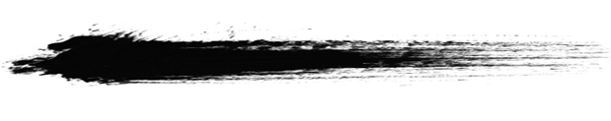
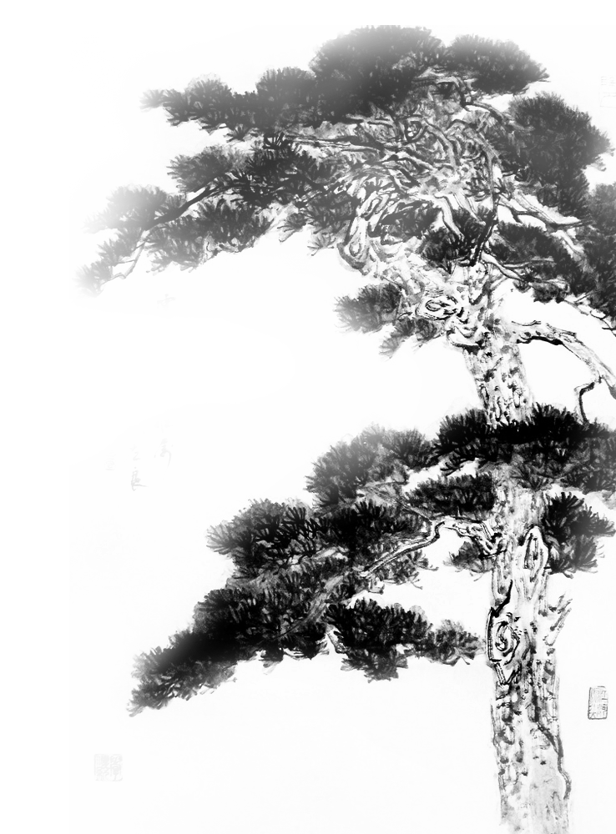
Sinotopia
Cao Xueqin, Der Traum der Roten Kammer 3
Kang Youwei, Das Buch der Großen Einheit 10
Wu Jianren, The New Story of the Stone 10
Liang Qichao, An account of the Future of New China, 1902 13
Dun Wang, The Late Qing’s Other Utopias: China’s Science-Fictional Imagination, 1900-1910 15
John Fitzgerald, The Unfinished History of China’s Future 40
Liang Qichao: Foreword to the Publication of Political Novels in Translation 55

Slide 8
Discussion topics
Regarding the prepared texts:
a) What role does money play?
b) What role do physical work and machines play?
c) How are nations characterized, how are conflicts between nations resolved?
d) What is the relationship between the technical and moral superiority of Western nations and China?
e) What is China's position in Asia / the world?
f) What government system prevails? How did it come about?
g) How is peace assessed?
h) How are differences between people treated?

Slide 9
Gilgamesh (ca. 2600 BC)
He finished twelve miles, and it got bright. Before him lay a shark of the gods. When he saw him, he went towards him. Rubies he wears as fruit, hanging with vines to look beautifully. Lapislazuli are his branches, he bears fruits worth seeing. Gilgamesh stopped one in his walk and raised his eyes to that shark of the gods.
Aus: The Gilgamesh Epos: The oldest traditional myth in history. MarixVerlag, 2011, p. 74 (end of Table IX).

Slide 10
Sinotopia
„Great Unity“ in the Book of Rites ca. 2500 BC
According to it, the society in Great Unity was ruled by the public, where the people chose men of virtue and ability, and valued trust and harmony. People did not only love their own parents and children, but also secured the living of the elderly until their ends, let the adults be of use to the society, and helped the young grow. Those who were widowed, orphaned, childless, handicapped and diseased were all taken care of. Men took their responsibilities and women had their homes. People disliked seeing resources being wasted but did not seek to possess them; they wanted to exert their strength but did not do it for their own benefit. Therefore, selfish thoughts were dismissed, people refrained from stealing and robbery, and the outer doors remained open. Source: Datong (great unity) concept in: Liji (Book of Rites), chapter "Lǐyùn" (禮運), paragraph 1, full text: http://ctext.org/liji/li-yun.

Slide 11
Li ji (Book of Rites)
According to it, the society in Great Unity was ruled by the public, where the people chose men of virtue and ability, and valued trust and harmony. People did not only love their own parents and children, but also secured the living of the elderly until their ends, let the adults be of use to the society, and helped the young grow. Those who were widowed, orphaned, childless, handicapped and diseased were all taken care of. Men took their responsibilities and women had their homes. People disliked seeing resources being wasted but did not seek to possess them; they wanted to exert their strength but did not do it for their own benefit. Therefore, selfish thoughts were dismissed, people refrained from stealing and robbery, and the outer doors remained open.
Source: Datong (great unity) concept in: Liji (Book of Rites), chapter "Lǐyùn" (禮運), paragraph 1, full text: http://ctext.org/liji/li-yun.

Slide 12
Sinotopia
Utopian novels became popular in China through translations of Jules Vernes novels into Chinese ca. 1902-1903 (e.g. Lu Xun (trans.): Jules Verne: Journey to the Moon, Twenty Thousand Leagues under the Sea).
An important role had the utopia especially at the end of the imperial dynasties (around 1900): They symbolized [einläuten] the societal transformation process towards modernity. Kang Youwei and Liang Qichao started the attempt of a reform, which ended 100 days afterwards mostly due to the lack of support from the imperial administration and the eunuchs.
Kang Youwei wrote the Utopian essay “Das Buch der Großen Einheit大同書”. Liang Qichao wrote a fragment (see beneath).
The concept of the Great Unity was later also taken up by Sun Yat -sen and occurs in several places in the National Anthem of the Republic of China (Taiwan): 「三民主義，吾黨所宗，以建民國，以進大同。」「毋自暴自棄，毋故步自封，光我民族，促進大同。」

Slide 13
Utopia, China & Taiwan
As early as in 1516, we find the term “Utopia”, coined from the Greek by Thomas More (1478-1535) for his likewise named book Utopia. More imagines such a non-existent society which is considered much superior to the real one in legal, governmental and social status in his book.
Ever since the birth of Utopia, a succession of this kind of fictions that portrays an ideal society, with perfect system, has come out prolifically, such as Citivas Solis (1623) by Tommaso Campanella(1568-1639), New Atlantis(1627) by Sir Francis Bacon(1561-1626), Oceana(1656) by James Harrington(1611-1677) and so forth.
In China and Taiwan, the literary tradition of the depiction of an ideal world is not as definitive and legible as the western utopian literature. Chinese ideal society in literature appears quite different from western utopia. In fact, the case is much more complicated in Chinese literature. For so long in the ancient China, people, ranging from Confucians, Taoists to Buddhists, had their own dreaming societies. Taohuayuan Ji was written by Tao Yuanming about a chance discovery of an utopia where the people lead an ideal existence in harmony with nature, unaware of the outside world for centuries.

Slide 14
Utopia, China & Taiwan
In the twentieth century not only China but also Taiwan meeting a great volume of foreign culture and literature, Chinese prospects for the nation’s future were regenerated with tremendous changes. The late Qing dynasty contained such signs which indicated Chinese conceptual transformation in its form of fictional imagination. Taiwanese Literary is influenced by many different cultures, such as Japanese, American. Literary utopian imagination turns different from the formal in Chinese tradition and the artistic skills, values and themes in all forms of ideal societies have imprinted marks of modernization demands, foreign culture and literature. Meanwhile, traditional Chinese values are not eliminated entirely in modern literature, the air of idyll and aesthetic attribute still existing in works of many Chinese writers. Hereafter, there are distinct kinds of imagination corresponding to
different situations in each historical stage. They all have grown out of certain reality and reflected the current social status and people’s ideological situation.

Slide 15
Studies on Chinese Utopian Writing
The novel is the crystallization of human thought, reflecting the thinking patterns of different eras and cultures. Although the proposed thesis focuses on the utopian imagination in modern and contemporary Chinese literature, a clear understanding of the differences between conceptions of ancient Chinese idealistic society and foreign utopian project must be achieved first because the development of Chinese utopian writing since the nineteenth century involves the acceptance and appropriation of foreign culture and literature. Much of the research on utopian literature in the late Qing is inspired by David Der-wei Wang’s studies on this period of literature. The influence of translation of foreign literature on the establishment of Chinese utopian novels at that time and the transforming course in people’s thoughts reflected in the novels.

Slide 16
Studies on Chinese Utopian Writing
Except for these studies of representative utopian works in a certain period of history, there are also a big volume of articles concentrating on individual modern and contemporary Chinese utopian fictions which not only have broaden the range of utopian writings in modern literature, but unconsciously work together in the inclusive definition of Chinese utopian literature. Accordingly, when we have discussions on Chinese utopian writing, the term we use to summarize and name them will inevitably go through a process of localization too. In the various attributes that Chinese scholars uses to describe Chinese utopian fictions, we could find several faces of Chinese utopian literature: aesthetic, bucolic, political features and highly romantic character in world of love.
There are many narratives, novels, and literary works in the world about Utopia, whether in the West or similar ideas in the East. As mentioned in the introduction above, in the East and the West, the ideas and narratives of Utopia are far from each other. In Taiwan, between the two cultures, there are also literary works similar to Utopia. Therefor it is worth studying the differences between the three cultures.

Slide 17
From the earth to the moon Jules Verne

Slide 18
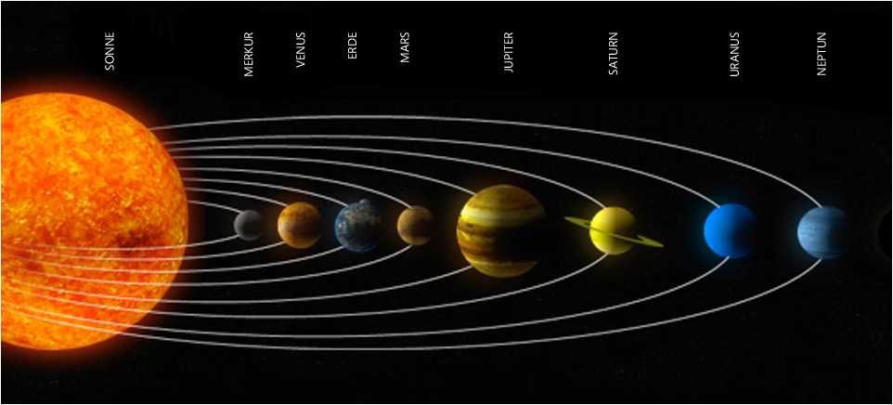
Contents
Jules Verne
Science Fiction
Portraying America
The Columbiade
Comparison
References

Slide 19
Content
Gun Club: Ballistics dying art
-> Members are bored
Barbicane (president of the club) has an idea:
-> Cannons for the conquest to use the moon
Planning together with the Cambridge Observatory
Which gun, bullet and powder
International financing

Slide 20
Content
Rival: Captain Nicholl of Philadelphia
->Producer of tank plates
Michel Ardan (French): Request cannon fire with human crew
Crew: Michel Ardan, Captains Nicholl and Barbicane
Shooting triggers natural disaster
Cannonball misses the moon
-> in the orbit of the moon

Slide 21
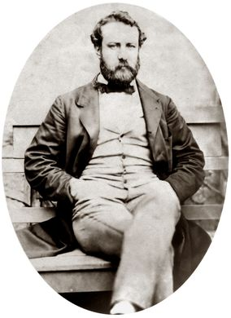
Jules Verne (1828-1905)
Childhood: shipowning district of Nantes
Studied law in Paris
Contact with the world of Paris literature (e.g. Alexandre Dumas)
After graduation (1849) writes in dramatic genres
Married Honorine Morel (widow + 2 children) (1857)
Birth of the son Michel (1861)
Shipping trips to Scotland and Norway
Getting to know Pierre -Jules Hetzel (1862)
Breakthrough as author: "Five weeks in the balloon"
De la Terre a la Lune / From Earth to Moon (1865)
1905 Death to Diabetes

Slide 22
Definition
[ˌsaɪəns ˈfɪkʃən̩]
Science fiction is a narrative genre in literature.....Characteristic are scientific and technical speculation, space themes, distant future, alien civilizations and mostly future developments

Slide 23
Science fiction
1851 for the first time by British poet and essayist William Wilson
Reference to a (natural) scientific consideration
19th century (industrialization):
Science fiction (utopian -futurological)
Science and Technology Fear -> Dystopia (e.g. George Orwell 1984)

Slide 24
Jules Verne and Science Fiction
Has much to do with the technical achievements of time
good optimizer of already existing knowledge

Slide 25
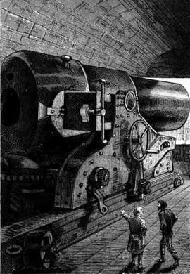
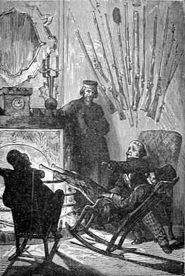
Portraying America
Militarism / Craziness for cannons: p. 68

Slide 26
Portraying America
Land of Progress:
p. 33

Slide 27
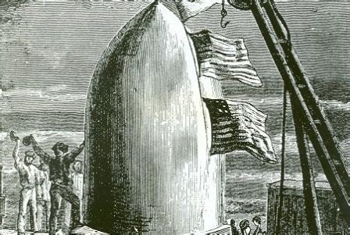
Portraying America
Common enthusiasm among the people: p. 293

Slide 28
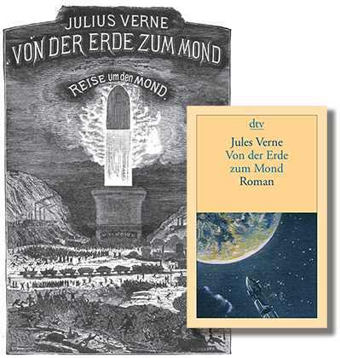
Portraying America
Shadow side of progress: p. 290

Slide 29
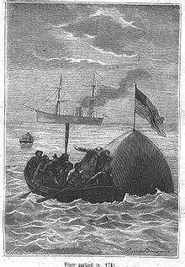
Portraying America
International Cooperation

Slide 30
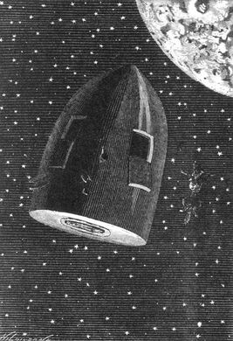
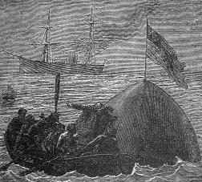
The Columbiade
Length | 300m
Fuel | 200 tons Explosive Cotton
Hollow -grenades diameter weight | 108 feet 10 tons
Crew | Manned with two Americans and a Frenchman and two dogs.

Slide 31
Commons | Differences
Launching place in Florida | Canon („The Columbiade“) vs. Rocket („Apollo 11“)
Route that leads around the moon and then back to Earth (route Apollo 13) | Shooting route (not considered influence factors: rotating earth and the gravity of the sun)
Moon surface phenomena | Organiser private organization(Gun Club, artillery experts) vs. state authority (NASA)
Original bullet becomes a manned space capsule | Fuel: Explosive cotton vs. Kerosene, hydrogen and oxygen
Landing in the Pacific Ocean | International Cooperation

Slide 32
References
https://www.jules-verne-club.de/jvc/jules_verne/biographie/
http://www.j-verne.de/
https://www.welt.de/geschichte/gallery137533493/Wie-Jules-Verne-sich-die-Reise-zum-Mond-dachte.html
http://www.j-verne.de/verne_bio_scifi.html
https://de.wikipedia.org/wiki/Jules_Verne
https://de.wikipedia.org/wiki/Apollo_13
https://lexikon.astronomie.info/satelliten/julesverne/
https://www.scinexx.de/dossierartikel/von-der-erde-zum-mond-2/
https://de.wikipedia.org/wiki/Von_der_Erde_zum_Mond

Slide 33
The New Story of The Stone
Wu Jianren

Slide 34
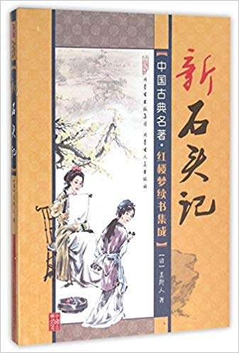
Author
By Wu Jianren (1866 -1910)
Journalist in Shanghai 1880
Other works: A strange case of nine murders, Annals of Sorrow, Bizarre Happenings Eyewittnessed in two decades
Story of the New Stone: 1905
Under the artist's name "Old Youth", "Wo Fo Shan Ren“
Simple writing style
Genre: Science Fiction

Slide 35
Science Fiction in China
Came up in the late Qing Dynasty (early 20th century, s. References)
Translations by Western authors (1903)
Esp. Works by Verne: From Earth to Moon; The journey to the center of the Earth
First Chinese science fiction novel: Lunar Colony (1904)

Slide 36
Historical Context
Qing Dynasty: 1616 to 1911
Farmer uprisings and unrest in the first half of the 19‘ See References
Increasing European influence
Decreasing power of the government: From 1900's decline of the Qing Dynasty
Japanese war fleet destroyed
Was divided into spheres of influence
1911: The fall of the last emperor
1912: proclamation of the Republic of China

Slide 37
The new Story of the Stone
Continues the story "Dream of the Red Chamber“
End of Dream of the Red Chamber: Jia Baoyu disappears into the mystical land
Beginning "The new story of the stone“
Baoyu remembers his failure
He returns to civilization

Slide 38
The Story of the Stone
Part one:
Baoyu lands in pre-industrial Shanghai，China
Part two:
Imaginative Utopia: The Civilized Kingdom
Meeting with "Old Youth": Inspection of Baoyu's Nature through the Human Nature Inspection lens
Travel through the civilized realm

Slide 39
The new Story of the Stone
The Civilized Kingdom
Think of the rest of the world
Esp. the barbaric West: Falsely civilized states
An empire of superlatives: technical and moral superiority
Traditional Confucian morality
Political dominance: civilized authoritarianism

Slide 40
The new Story of the Stone
Inventions of advanced China:
Sub -boats firing silent electric guns
Communication underwater
Flying cars
Subway network
Human Nature Inspection Lens
Chemical weapons (called Benevolent Special Art)

Slide 41
The Civilized Realm
Ruler: Dongfang Qiang (Strength of the East)
3 Sons: Dongfang Ying (Eastern England), Dongfang De (Eastern Germany), Dongfang Fa (Eastern France),
1 -daughter Dongfang Mei (Eastern America)
Eight districts: loyalty, respect for parents, kindness, compassion, loyalty, righteousness, peace, equality
Dongfang Qiang /Zhen Baoyu as a secular double by Jia Baoyu (from the dream of the Red Chamber)

Slide 42
Motifs
Anti -Western world view:
Chinese invention > Western inventions
West. Inventions are made ridiculous
Humor
Western technology was purely materialistic, lacking in spirituality and morality
Western civilization was barbaric: "The ancient people" used wine to test people's moral state. It's inevitable that after being drunk, people will disclose their true nature. I'm sorry. I have seen this verified with the people of barbarian countries. They pretend to be decent all the time, claiming that they are "civilized." However, after they are drunk, they make trouble shamelessly, without any restraint."

Slide 43
Motifs
Confucianism & Daoism:
The true reason for the domination of the Chinese Empire
Power is not based on technical progress but above all on morality
Human Nature Inspection Lens: A lens to recognize the true nature of man

Slide 44
Human Nature Inspection Lens
Baoyu: “I used to think that ‘human nature’ is an incorporeal thing. If you want to inspect ‘nature,’ it should be investigated through daily reflection. How can it be inspected by using a lens?” (Wu 168)
Old Youth:
“After the inception of science, what thing can not be subject to experimental verification? Take air for example. If you inspect it carefully, you can find myriads of things contained in it. The halfbarbaric and half-enlightened people usually call all these things by the appellation ‘air.’ How can this mindset be sufficient? If air is shapeless and cannot be experimentally verified, how come the European and American acousticians can identify sound waves? However, although the acousticians can detect sound waves, the sound wave diagrams they make are only illustrations. The science doctors in our land will let you see the things with your own eyes every time they inspect something. Take the inspection of human nature for instance. This is achieved through a lens which was made by a prestigious medical doctor. The chemically-made glass is processed through several treatments by special liquid compounds. When one inspects the human body through it, his vision will bypass the blood, the muscle, the bones, and the sinews. The inspector can only see the inspectee’s nature. If the inspectee’s nature is civilized, it looks clear and bright like ice and snow. If his nature is barbaric, it is as turbid as smoke. You can evaluate the degree of barbarity by examining the density of the smoke. If it is as pitch-black as ink, it will be impossible to improve that person’s nature.”

Slide 45
Session 6: Wu Jianren vs. Jules Verne
Utopia:
Wu Jianren: The New Story of the Stone*
Jules Verne: From the Earth to the Moon

Slide 46
Session 6: Wu Jianren vs. Jules Verne
Just as we find early literary utopia in the West, e.g. at Gilgamesch (the earliest version approx. 2600 v.Chr.), there were also early literary testimonies in China (e.g. "Great Unity" in the Book of Rites approx. 2500 c. Chr.).

Slide 47
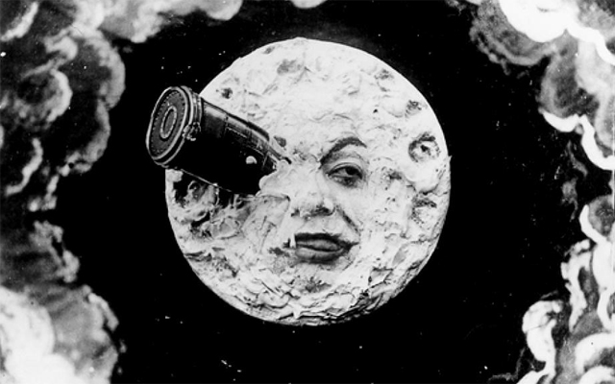
Session 6: Wu Jianren vs. Jules Verne
Utopia became popular through translations of utopian novels by Jules Vernes into Chinese about 1902 -1903 (e.g. Lu Xun (transl.): Jules Verne: Journey to the Moon, Twenty Thousand Leagues under the Sea).

Slide 48
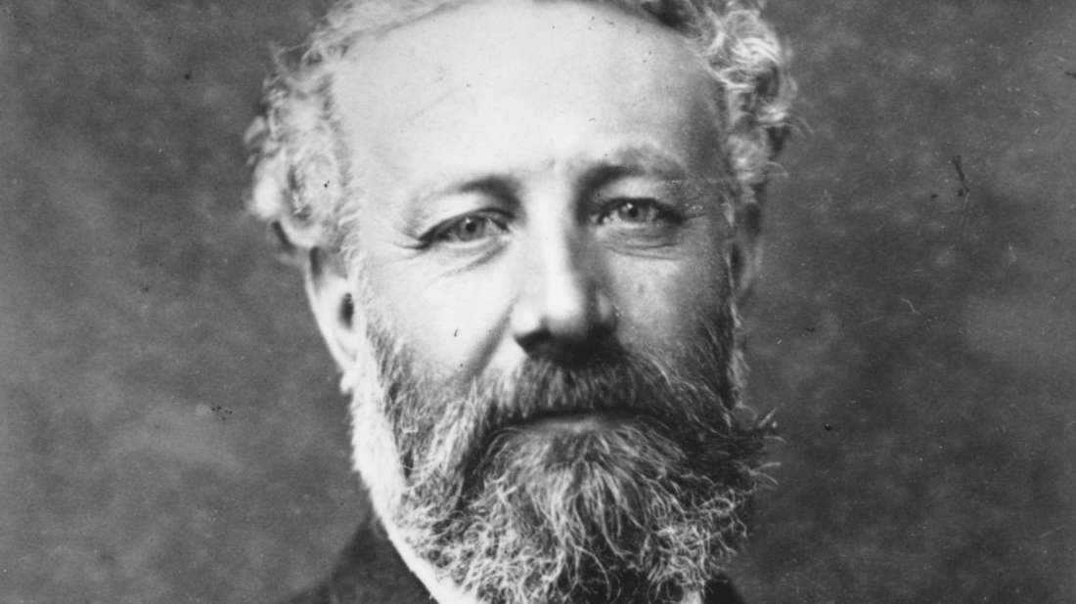
Session 6: Wu Jianren vs. Jules Verne
Populär wurden Utopien durch Übersetzungen von utopischen Romanen Jules Vernes ins Chinesische ca. 1902-1903 (z.B. Lu Xun (Übers.): Jules Verne: Journey to the Moon, Twenty Thousand Leagues under the Sea).

Slide 49
Session 6: Wu Jianren vs. Jules Verne
Kang Youwei wrote the utopian essay "The Book of the Great Unity“
Utopia played an important role, especially at the end of the imperial era (around 1900's): it called for the process of social transformation to be modern.
Kang Youwei and Liang Qichao started an attempt at a first reform, which only lasted a hundred days.

Slide 50
Session 6: Wu Jianren vs. Jules Verne
Kang Youwei wrote the utopian essay "The Book of the Great Unity";" Liang Qichao wrote a fragment (see below).The concept of the Great Unity was later also taken up by Sun Yat -sen and occurs in several places in the National Anthem of the Republic of China (Taiwan).
Kang Youwei 2010, Datong Shu, Beijing: Renmin chubanshe.
「三民主義，吾黨所宗，以建民國，以進大同。」 Three principles of the people, our goal is to build the Republic and to move forward into the Great Union。
毋自暴自棄，毋故步自封，光我民族，促進大同。」 If you are desperate, give Not up, you succeed, you are not satisfied; increase the glory of our people on the way to the Great Unity."

Slide 51
Session 6: Wu Jianren vs. Jules Verne
Kang Youwei: The book of the Great Unity (approx. 1900, 2. See? 1937) 2010, Beijing: Volksverlag 160 pp。;
Kang developed his ideas in lecture notes 1884. His students encouraged him to develop it into a book, the first version of which he only completed after approximately two decades after his return from Indian exile. The first two chapters appeared at the beginning of the 20th. In the 19th century in Japan, the entire book was only posthumously 1935, about seven years after his death.160s;Kang beat a future (utopian) world free of political borders and racial differences, and centrally governed democratically. The world would be divided into rectangular administrative zones which managed themselves with direct democracy but loyal to

Slide 52
Session 6: Wu Jianren vs. Jules Verne
Zentralregierung waren. Nach Kangs Eugenik würden die „braunen und schwarzen“ Rassen innerhalb eines Jahrtausends verschwinden und zu einer homogeneren Menschenrasse führen. Ihre Mitglieder wären "von gleicher Hautfarbe, gleichem Erscheinungsbild, gleicher Größe und mit derselben Intelligenz ausgestattet". Er hoffte auf eine Beendigung der traditionellen Clanstrukturen, in denen er ein Hauptübel sah. Die Familien würden von staatlichen Einrichtungen wie Hebammen-Schulen, Kindergärten und Schulen ersetzt. Die Ehe würde durch Jahresverträge zwischen Mann und Frau ersetzt. Kang hielt die zeitgenössische Form der Ehe besonders für die frauenfeindlich, weil diese darin für ein Leben lang gefangen wären. Kang glaubte an die Gleichberechtigung von Mann und Frau und es sollte keine gesellschaftliche Institution oder Hindernisse geben, warum Frauen nicht alles das tun können sollten, das Männer durften.

Slide 53
Session 6: Wu Jianren vs. Jules Verne
Wu Jianren, The New Story of the Stone
[Excerpts, summary.]
[Baoyu’s peaceful meditation is disturbed when he suddenly remembers his failed mission, his failed attempt to fix the´ fractured Tian-sky or Tian-heaven. Dun Wang, 41]
"When the Goddess produced stones of five colours, she meant to use them to mend Heaven. While the other thirty-six thousand and five hundred have been put to use, only I have been neglected. Although I was later endowed with supernatural power, I only wasted it by squandering some years with those girls [in the Grand View Garden]. I have yet to carry out my purpose of mending Heaven. If I could fulfill this wish, I would have no regrets even if I disappeared into smoke and ashes" (Wu 1986, 3, transl. by David Der-wei Wang in David E. Pollard 1998, p. 322)

Slide 54
Session 6: Wu Jianren vs. Jules Verne
[As a result, he cannot stay in the stagnant mythical realm any longer, and he embarks on a journey which leads him to Shanghai, a semi-colonial metropolis in pre-industrial China. The journey symbolizes an ambivalent search for “modern” China.
The first half of The New Story of the Stone relates the resurrected Baoyu’s disappointing, dystopian adventures in the late Qing society. He encounters a race of humans that is degenerating along with their society. The novel’s second part transports him into an imaginary utopian future called the “Civilized Realm” (文明境界). Appropriately, the portal to this utopia is located somewhere close to Confucius’ hometown in Shandong province. The new, utopian adventure starts from Chapter 21. Baoyu—having narrowly escaped a political murder—is taking an excursion to Northern China. Ironically, at Qufu, (曲阜) Confucius’ hometown, he is robbed twice during the night. Being helpless and lost, Baoyu roams the main road from dark until daybreak. At the precise point where the sun rises Baoyu sees a high memorial arch with the inscription “Civilized Realm.”

Slide 55
Session 6: Wu Jianren vs. Jules Verne
A gentleman with the name “Old Youth” greets him. After Baoyu passes the inspection of his “nature” at
a border office, Old Youth becomes his companion on a tour of the territory.
Baoyu now finds this Civilized Realm to be in every respect superior to both a decaying China and an aggressive West, which the citizens of this utopia call the “Barbarian Realm” (野蠻境界) and the “Falsely Civilized States” (假文明國), respectively. The Civilized Realm imaginatively fulfills the late Qing dream of not only equaling but surpassing Western technology. Dun Wang, 41]
[On top of this amazing technology we also have a traditionally Confucian moral order, the true governing power. Its “civilized authoritarianism” (文明專制) is thought to be the most advanced political system in the world, far superior to Western “falsely civilized” values. Dun Wang, 42]

Slide 56
Session 6: Wu Jianren vs. Jules Verne
[Summary by David Wang:
Wu Jianren casts Jia Baoyu as a lonely traveler in time, who adventures to late Qing China and then to a futuristic utopia. Baoyu's old passion for the girls of the Grand View Garden is now replaced by a compassion for the people of the Middle Kingdom; romantic yearning gives way to an eager practicality [...] The Civilized World is a country strong in military power, political structure, scientific advancement, educational institutions, and moral cultivation. It is a tremendous technocratic empire that in every aspect leads its time. [...]
In chapter 25, after watching a military review of flying cars, Baoyu sighs, "What fiction about 'flying amid the clouds and riding the fog' - the well-known skill of deities and humans endowed with supernatural powers - could be more fantastic than this flying car?" [One of his escorts replies:] "We have come a long way in experimenting with the flying car, the idea of which was derived from our ancestors. It is laughable that Europeans and Americans have

Slide 57
Session 6: Wu Jianren vs. Jules Verne
by now only come up with inventions like those dangerous and clumsy balloons. How can a balloon match our flying cars?"[Wang: Fin-de-siècle splendor..... p. 275]
Dongfang Qiang divides his territory into eight districts named after the eight Chinese virtues (ba de: loyalty, filial piety, benevolence, compassion, fidelity, righteousness, peacefulness, equality). His three sons, Dongfang Ying (Eastern England), Dongfang De (Eastern Germany), Dongfang Fa (Eastern France), and one daughter, Dongfang Mei (Eastern America), are administrators of state affairs [...] all the rulers of the Dongfang family are [Wang p. 276] "gifted with the talent to administer the world, and the will to rule the state."
To Baoyu's puzzlement, toward the end of their conversation, Dongfang Qiang [which means "Strong East"] calls Baoyu "brother", as if they were of the same generation despite their apparent

Slide 58
Session 6: Wu Jianren vs. Jules Verne
difference in ages. Upon Baoyu's departure, Dongfang Qiang reveals his true identity: he is Zhen Baoyu, the worldly double of Jia Baoyu, from The Story of the Stone! This revelation takes us back into the intricate world of similitude and illusion as presented by the original. Zhen Baoyu, it will be recalled, was a duplicate of Jia Baoyu in appearance, but he grew up to become what Jia Baoyu refused to become, a success in the secular world of the red dust. [...]
In a manner reminiscent of Cao Xueqin's novel, at the end of Wu Jianren's search for an ideal utopia, a dream sequence appears. In the dream, Baoyu takes a voyage back to China. To his amazement, a World's Fair exhibition is about to take place in Peking, while the Yangtze valley has been so industrialized that one sees hundreds of factories on either bank and ships sailing busily up and down the river. Bao Yu attends an international conference on world peace. When the keynote speaker, the Emperor of China, is welcomed to the stage, he turns out to be none other than Zhen Baoyu/Dongfang Qiang. In great shock, Bao Yu falls off his chair and wakes up.]

Slide 59
Session 6: Wu Jianren vs. Jules Verne
"How sad I feel about all the miseries of the world,
And how sad I feel for those who are born in the world.
Time does not endow me with the skill to mend heaven,
Instead it lets busy rats run everything." (p. 323)
Text
吳趼人 (Wu, Jianren 1866-1910) 1905. 老少年 (“Old Youth”) [i.e. Wu Jianren (吳趼人; 1866-1910)], 新石頭記 (New Story of the Stone), 南方報 (Nanfang Bao) in 1905 (8.21-11.29), book reprint “Wo Fo Shan Ren” (我佛山人)﻿: Illustrated new Story of the Stone, Shanghai Reform Fiction Press (上海改良小說社 Shanghai gailiang xiaoshuoshe), 1908﻿, reprint Zhongzhou Guji Chubanshe (中州古籍出版社) 1986, edited and annotated by Wang Liyan (王立言).
Based on early Chinese translations by Jules Verne, which were available since around 1900.

Slide 60
Session 6: Wu Jianren vs. Jules Verne
References
Wang, David Derwei. Fin-de-siecle Splendor: Repressed Modernities of Late Qing Fiction, 1849-1911. Stanford: Stanford UP, 1997.
Wang, David Derwei. “Translating Modernity.” Pollard, David E., ed. Translation and Creation: Readings of Western Literature in Early Modern China, 1840–1918. Amsterdam: John Benjamins, 1998. 303-30.
Wang Dun (王敦). “The Late Qing’s Other Utopias: China’s Science-Fictional Imagination, 1900-1910”, in: Concentric: Literary and Cultural Studies 34.2, September 2008: 37-61
Other early utopian Chinese works:
Kang Youwei, Datongshu (The treatise of grand unity, 1884-1885)
Liang Qichao, An account of the Future of New China, 1902 [utopian fragment]

Slide 61
Utopia in the US series Black Mirror
What do you think about the following dystopian fantasy from the Netflix series “Black Mirror”?
(a) Primary school pupils, students and professionals are not willing to be misled (e.g. (i) education of the national history and the relationship with Europe) which they must receive and repeat until they can credibly assure them that the wrong is true.
(b) Workers in a factory receive helmets in which brain scanners are mounted, so that the brain currents and insb. emotional fluctuations can be detected immediately by the employer and measures (until dismissal) can be taken.
(c) There is a Facebook Grading system according to which each citizen has a point value, particularly due to his or her Internet behaviour.
(d) There is total surveillance with millions of cameras (teachers have 3d ball cameras in the classroom, students have another half dozen), there is no privacy and no data protection (except for party officials).
(e) Internet, press and books are censored and linked, a concept develops to hype, decides an algorithm whether all the corresponding posts and if necessary, the users are blocked.

Slide 62
謝謝觀賞

Slide 63
Preparation for next session
1 2.25 Organizational things, intro to the concept of a „classic“
2 3.4 Canonization
3 3.11 Early Translation of Chinese Literature
4 3.18 Reception of the Red Chamber Dreams in the West
5 3.25 How to make people read classics again?
6 4.1 Western Classics in Chinese clothes: The example of Utopian Literature
7 4.8 Attractiveness of Chinese Classics as part of softpower
8 4.15 Chinese Classics in the West: The Example of Germany
9 4.22 Sinicization – Politics for Cultural Export: The Example of the Chinese classics
10 4.29 Chinese Classics in World Lit. Anthologies and World Literary History Books
11 5.6 Translation of Modern Classics: Mo Yan, Yu Hua, Liu Cixin etc.
12 5.13 Chinese Classics on Overseas Bookfairs
13 5.20 Cinema Movie Adaptions of Chinese Classics
14 5.27 Lessons to learn from the Classics: Integration or Sharpening the Cultural Profile?
15 6.3 Final Discussion
16 6.10 Final Exam

Slide 64
Preparation for next session
Read paper provided for Chinese classics as part of soft power
Take the quiz
Translation
Correction of translation
Please choose your final exam paper and start writing (grade)

