Slide 1


哦耶！
终于轮到我汇报了
汇报人：李松林 Solin

Slide 2
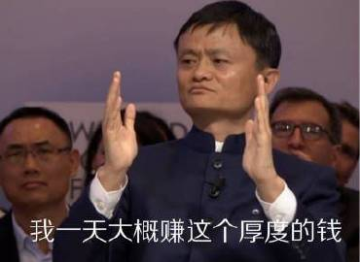
淘宝
Taobao

Slide 3


尊敬的公主王子们请看目录
1
Taobao's history and development
2
Taobao Technological Innovations
3
Money-Saving Tips

Slide 4

PART 01
公主王子们
这是第一部分
Part 1 Taobao’s history and development

Slide 5

Part1
Taobao’s history and development
Establishment (2003):
Taobao was established by Alibaba Group in 2003 as an online trading platform.
01
Launch of Alipay (2004):
To increase the security of transactions, Taobao introduced Alipay, an online payment tool.
02
Overtaking Competitors (2005):
Taobao quickly surpassed eBay EachNet to become China's largest online shopping platform.
03

Slide 6

Part1
Taobao’s history and development
Launch of Taobao Mall (2008):
The launch of Taobao Mall (later known as Tmall) marked Taobao's entry into the B2C business.
04
05
"Double 11" Shopping Festival (2009):
Taobao first launched the "Double 11" shopping festival in 2009, which later became the world's largest online shopping event.
Continuous Growth (2010 to Present):
Taobao has continued to grow, becoming one of the world's largest online retail platforms.
06

Slide 7
让你们看看什么才是专业
Q1 Who established Taobao ?
Ma Yun
Q2 How many stages of Taobao’s development?
6

