Slide 1

中國文化概要
Session 10, Friday March 10, 2024, 8 room 603, 10 room 404
Martin Woesler, co-taught with Ole Döring
Session 11: Tomorrow! 明天

Slide 2
TOPICS
This semester‘s topics overview see homepage and textbook.
Session 10
翻译一班 Fri May 10 8:00-9:40 room 603
  167 王晨 Wáng Chén（PPT） History: Wang Yangming
  147 赵欣雨 Zhào Xīnyǔ ppt Traditional Crafts: Folk Art - Chinese Paper-cutting
  176 刘欣雨 Liú Xīnyǔ ppt Traditional Crafts: Handcraft - Oil-paper Umbrella
翻译二班 Fri May 10 10:00-11:40 room 404
  20 谭雅兰 Tán Yǎlán 20. Beverages: Milk Tea
  61 吴梨萍 Wú Lípíng 61. Landscapes and Tourism: Four State-Level Cultural Relics
  7 裴心弦 Féi Xīnxián 7. Animals: Panda Culture
  51 杨子璇 Yáng Zǐxuán 51. Games: Kite Flying

Slide 3
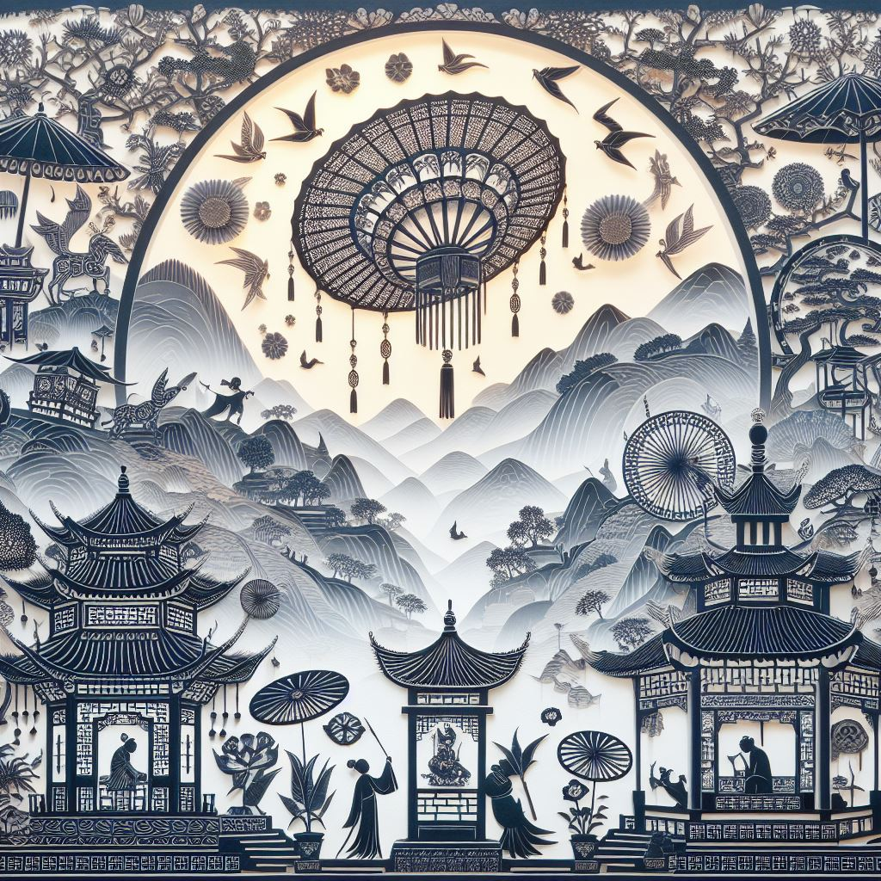
Session 10
翻译一班 Fri May 10
8:00-9:40 room 603
167 王晨 Wáng Chén（PPT） History: Wang Yangming
147 赵欣雨 Zhào Xīnyǔ ppt Traditional Crafts: Folk Art - Chinese Paper-cutting
176 刘欣雨 Liú Xīnyǔ ppt Traditional Crafts: Handcraft - Oil-paper Umbrella

Slide 4
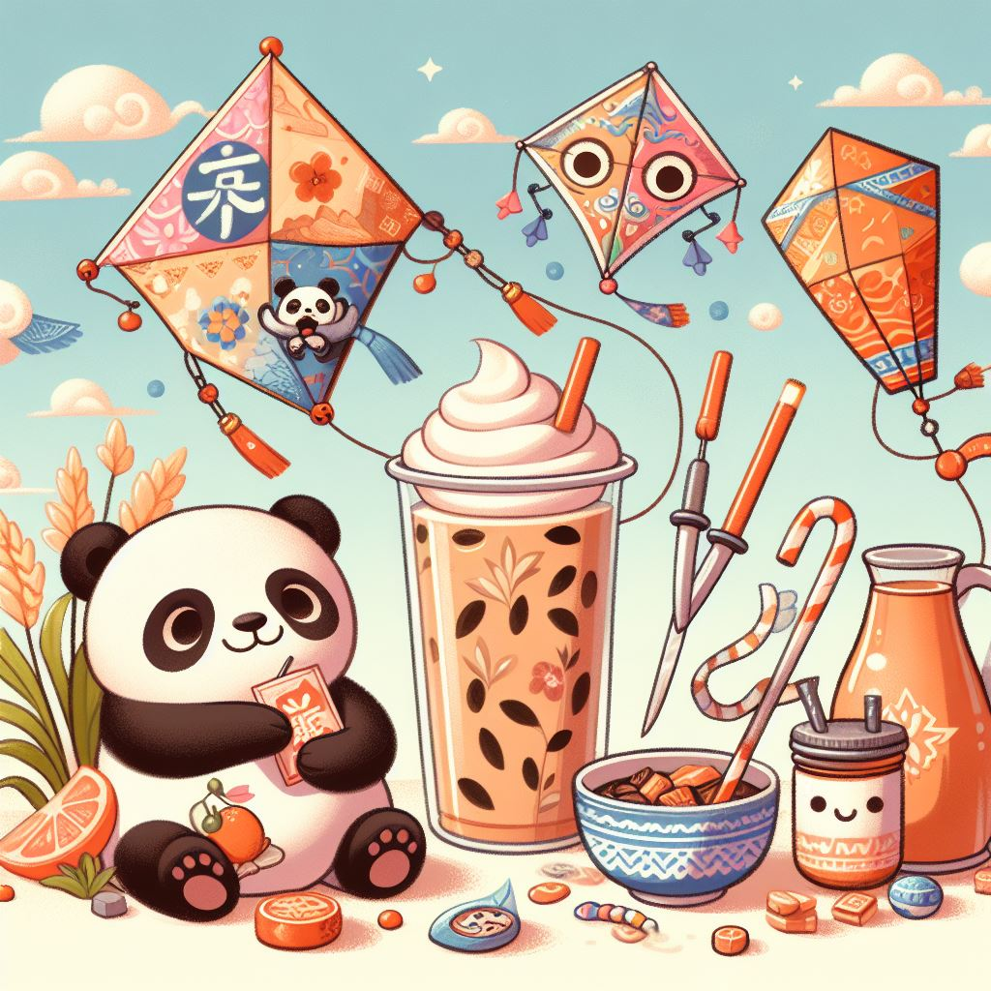
Session 10
翻译二班 Fri May 10
10:00-11:40 room 404
20 谭雅兰 Tán Yǎlán 20. Beverages: Milk Tea
61 吴梨萍 Wú Lípíng 61. Landscapes and Tourism: Four State-Level Cultural Relics
7 裴心弦 Féi Xīnxián 7. Animals: Panda Culture
51 杨子璇 Yáng Zǐxuán 51. Games: Kite Flying

Slide 5
Chinese milk tea culture
Thousands of years of Chinese history from a cup

Slide 6

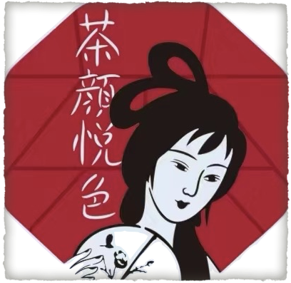







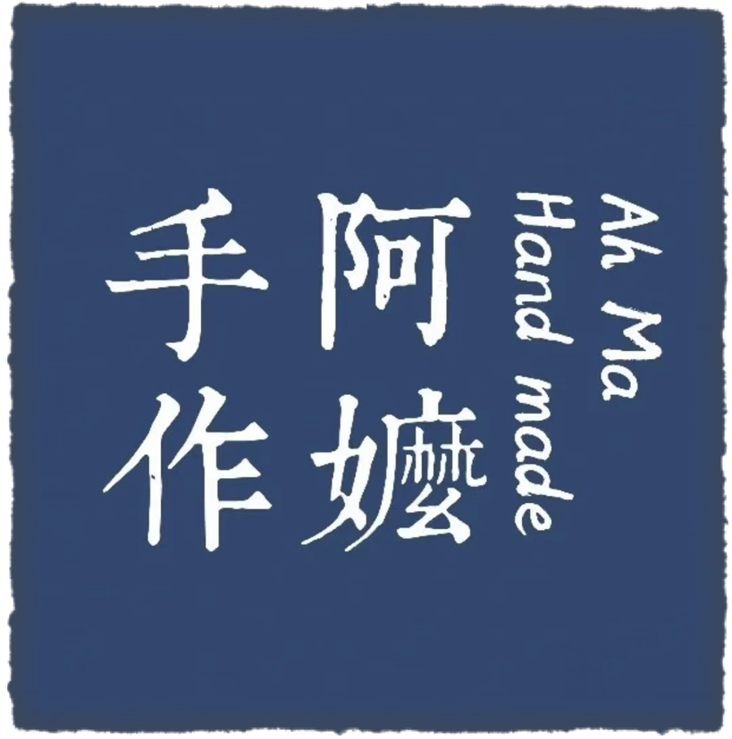






Slide 7
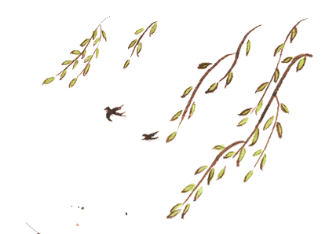
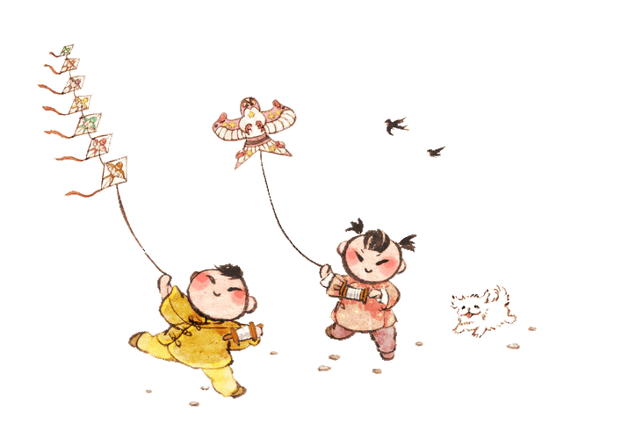

Games: Kite Flying
杨子璇

Slide 8




儿童散学归来早，
Children returned home early after school.
忙趁东风放纸鸢。
They got busy flying kites in east wind.

Slide 9
Animals：
Panda Culture
speaker : Pei Xinxian

Slide 10
Contents
03
05
Current situation
01
Actions and Contributions
Introduction
04
The importance of protecting giant pandas
02
Status and symbolism

Slide 11
Shall we abandon or keep
these traditional cultural phenomena?
And why?
http://menti.com 翻译1班: 3498 2030
翻译2班: 2808 5285

Slide 12
Feedback on today‘s session
http://menti.com 翻译1班: 6489 6888
翻译2班: 7689 8736

Slide 13
PREPARATION
FOR NEXT CLASS SUNDAY MAY 12
Please 1. learn the vocabulary, 2. read the texts and
3. answer the questions in our textbook on the following topics:
翻译一班：11 Session 11 MW Sat May 11 8:00-9:40 room 603
  11.1 148 陈昕舟 Chén Xīnzhōu ppt Traditional Crafts: Handcraft - Chinese Knots
  11.2 154 李静怡 Lǐ Jìngyí Traditional Cuisine: Four Distinct Regional Cuisines
翻译二班：11 Session 11 MW Sat May 11 10:00-11:40 room 404
  11.1 Session 11 Student presentations
    11.1.1 雷慧婷 4. Aesthetic ideals and social customs: Marriage-Accompanying Songs in Hunan
    11.1.2 喻鑫众 69. Language: Chinese Dialects
Please suggest a topic for your final exam paper!!!

