Slide 1
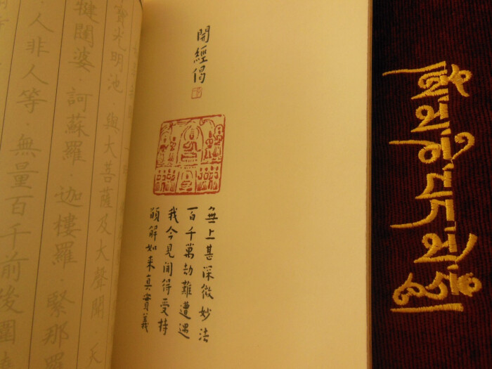
Early Representative Theories of Buddhist Scriptures Translation in China
中国早期代表性佛经翻译理论
by曾心媛、陈涵

Slide 2
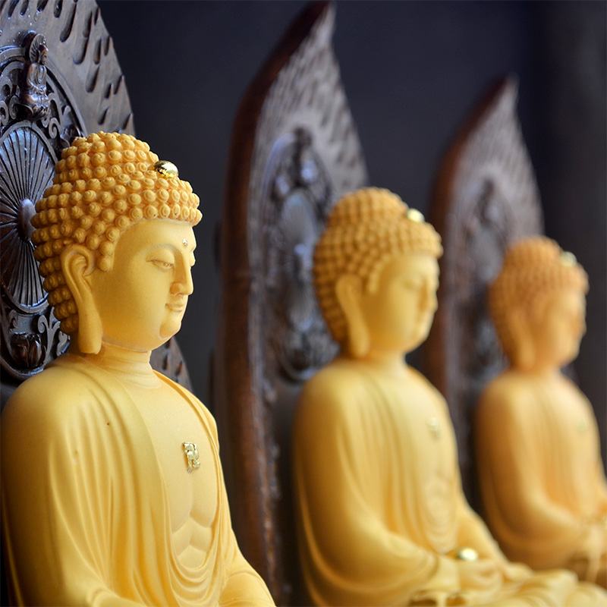
Contents
1. Background of Buddhist Scriptures Translation
2. Three Major Translation Theories of Buddhist Scriptures
3. The significance of Buddhist scriptures translation

Slide 3
1. Background of Buddhist Scriptures Translation
The first translation climax in China
Began from late Eastern Han Dynasty~the Northern Song Dynasty
A large number of outstanding translators of Buddhist scriptures emerged in this period.
Translation theories of Zhi Qian, Shi Daoan, and Yancong

Slide 4
2. Three Major Translation Theories of Buddhist Scriptures
（1）Zhi Qian“本旨论”——center on translations
（2）Shi Daoan“案本论”——center on original texts
（3）Yan Cong“译者论”——center on translators

Slide 5
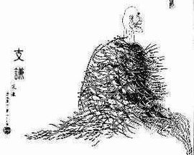
Zhi Qian
Zhi Qian, also known as Zhi Yue, is a Buddhist scripture translator during the Three Kingdoms period. He is the author of The Dhammapada Sequence(《法句经序》), which is said to be the first essay on translation in China.
本旨论：follow the main ideas of original texts without adding any adjunct words（“因循本旨,不加文饰”）
The translation can be inelegant, but it should be easy to understand and the language should be smooth.

Slide 6
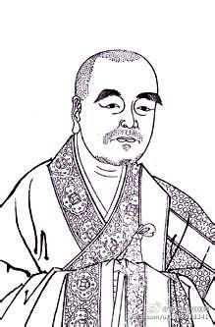
Shi Daoan
An eminent monk in the pre-Qin period of the Eastern Jin Dynasty. Liang Qichao, called him "the first builder of Chinese Buddhism".
案本论："Five Losses of Source Texts and Three Difficulties in Translation."（五失本,三不易）
Seeking truth from facts, carefully analyzing the original text, and the translation should reflect the style of the original one.

Slide 7
Five Losses
(1) change of word order
The Buddhist scriptures are in Sanskrit, and the word order is reversed to conform to that of Chinese.
(2) change of characteristics of Sanskrit
The language of scriptures are plain and simple while the Chinese are full of rhetorical flourishes.
(3),(4),(5) change of form of original texts
The Buddhist scriptures, elaborate and detailed, are tailored and the repetitive chants, considered wordy, are shortened in Chinese translation.

Slide 8
Three Difficulties
(1)The Buddha’s wisdom is expounded in the sutras, and its true revelation always goes along with the times. As times and fashions change, the antiquated elegant features have to be removed and adjusted to the present time.
(2) The enlightened and the unenlightened are separated by an immense gap, and yet the translator must seek to make the subtle and profound words from a millennium ago understandable to the common people.
(3) After the death of Buddha, his eldest disciple and others check the texts rigorously. Nowadays, it is not easy for ordinary people to translate the scriptures.

Slide 9
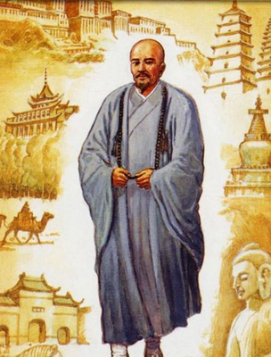
Yan Cong
An eminent monk in the Sui Dynasty.
译者论：Eight Prerequisites（八备）
The 1,2,5,6 articles lay emphasis on translators' morals and ethics.
A translator must love the truth sincerely and devoted to spreading the Buddhist faith and wisdom to others. He should be strict with himself, be tolerant towards others, and indifferent to fame and fortune.
In terms of the translator's skills.
A translator must study hard and constantly improve their language, writing, translation skills. Be erudite, proficient in Buddhist Scriptures, and familiar with Chinese culture.

Slide 10
3. The significance of Buddhist scriptures translation
The translation of Buddhist scriptures has a significant impact on China’s language and culture, and has played an important role in the enrichment of Chinese language and the changes in literary and language style.

Slide 11
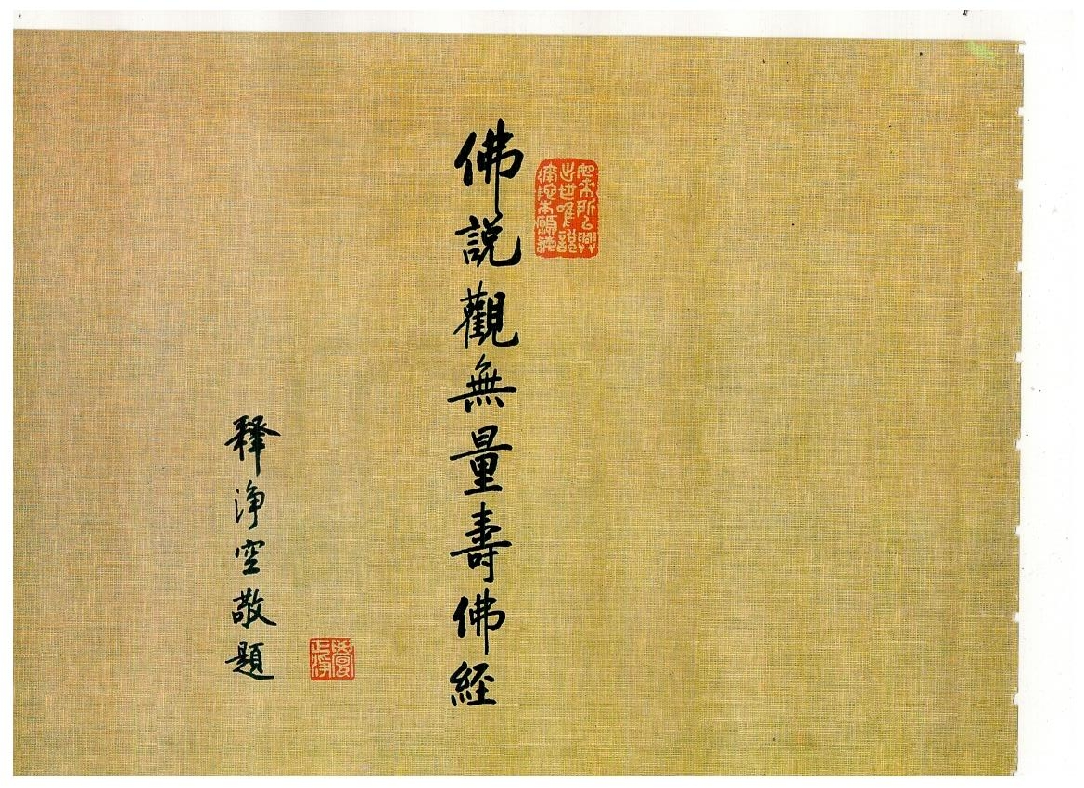
Thank you!

