Slide 1

Mobile Games
谷钰婷

Slide 2
CONTENTS
01
02
03
Development history
Current situation and trend
Social impact

Slide 3
01
Development history

Slide 4
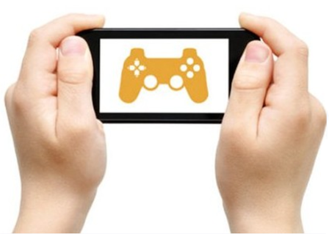
Development history
Mobile
Games
The birth of mobile games
Pre Android
Pre Tencent period
Post Tencent period

Slide 5
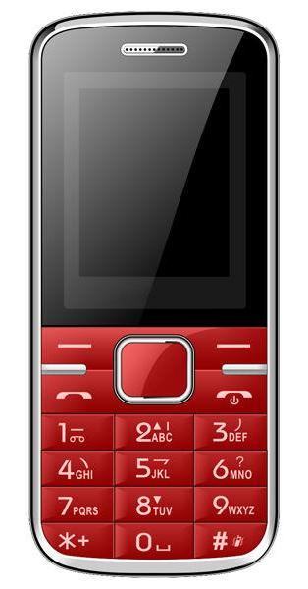
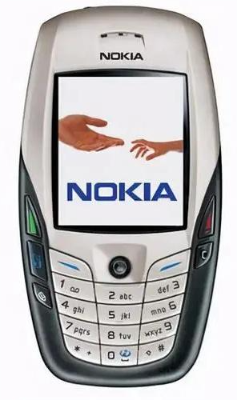
The birth of mobile games
Mobile
Games
In 1977, the Gluttonous Snake(贪吃蛇) launched by Nokia started the history of mobile games.
Early mobile phones
Notes:
很快就

Slide 6
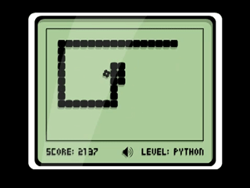
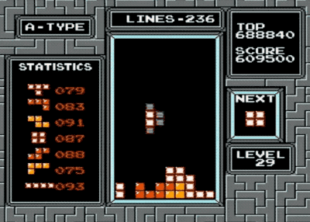
The birth of mobile games
Mobile
Games
Gluttonous Snake(贪吃蛇)
Tetris(俄罗斯方块)

Slide 7
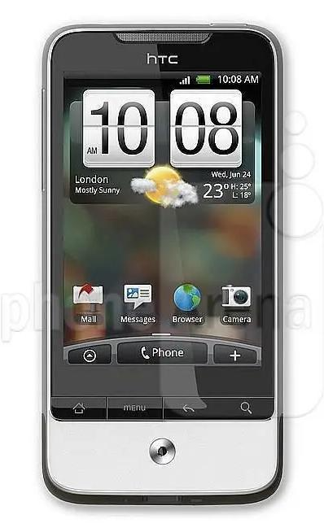
Pre Android
Mobile
Games
With the avdent of Android phones, mobile phones with touch screen became dominant in the mobile phone market
Early touch-screen phones

Slide 8
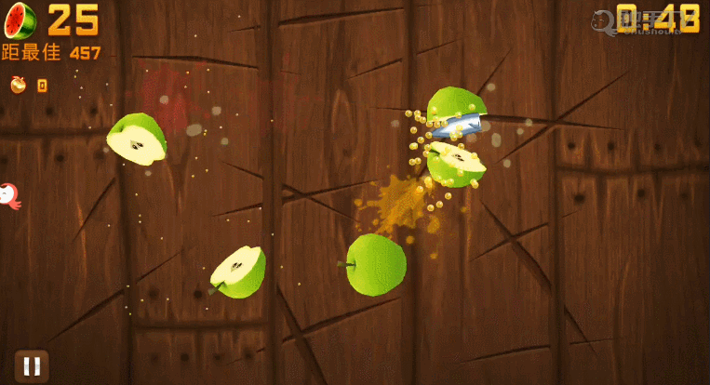
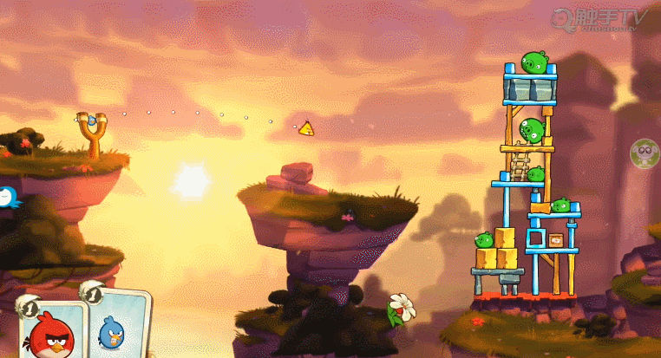
Pre Android
Mobile
Games
Fruit Ninja(水果忍者)
Angry Birds(愤怒的小鸟)

Slide 9
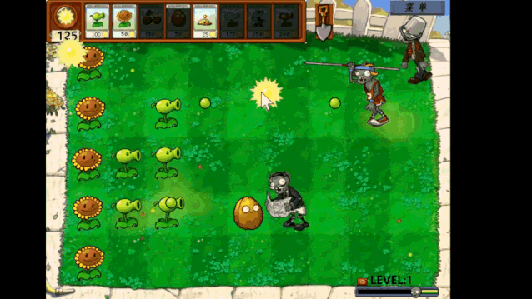
Pre Android
Mobile
Games
Plants vs. Zombies(植物大战僵尸)

Slide 10

Pre Tencent period
Mobile
Games
-The rise of domestic mobile games
In 2013, Tencent games became popular, surpassing the froreign games, and firmly ranked the top of Chinese mobile games.For a time, no game company could compete with Tencent.

Slide 11
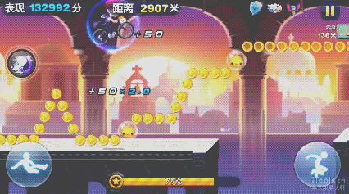
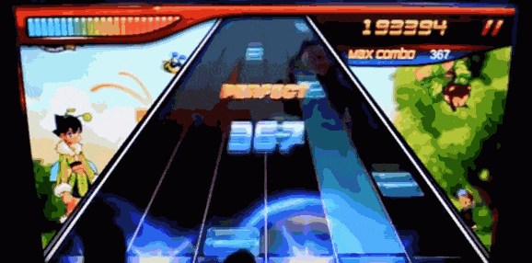
Pre Tencent period
-The rise of domestic mobile games
Mobile
Games
Tiantian Cool Running
(天天酷跑)
Rhythm Master(节奏大师)

Slide 12





Post Tencent period
Mobile
Games
-Bloom of mobile games
After 2018, Chinese mobile games developed rapidly. Various game companies have sprung up and various types of mobile games have come up. Both the picture quality and the game experience have made a qualitative leap.

Slide 13
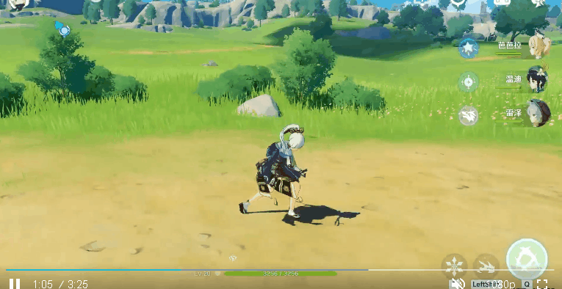

Post Tencent period
Mobile
Games
-Bloom of mobile games
RPG(Role Playing Games) 角色扮演游戏

Slide 14
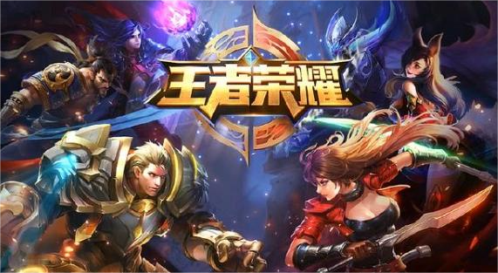
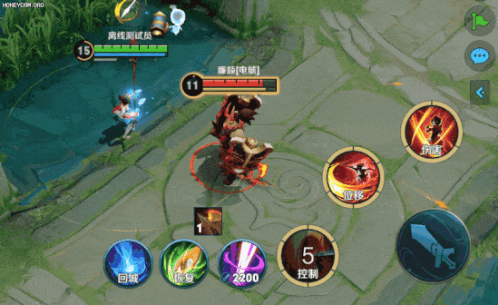
Post Tencent period
Mobile
Games
-Bloom of mobile games
MOBA（Multiplayer Online Battle Arena）
多人在线战术竞技游戏

