Slide 1
Chinese Classics
in World Literature
Reports on Specific Classics
汇报人：周皓熙

Slide 2
CONTENTS
1
3
Zhuangzi
Three Kingdoms
2
4
Strange Tales from Liaozhai
Outlaws of the Marsh

Slide 3
Zhuangzi
庄子
PART.01

Slide 4
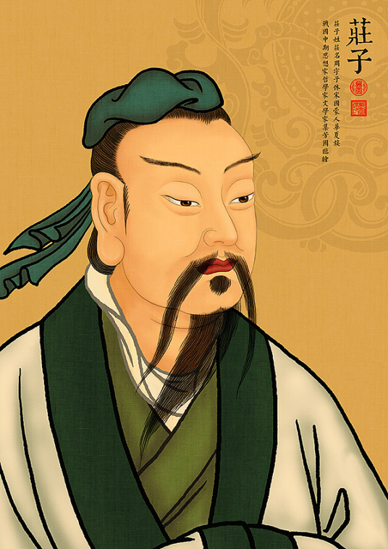
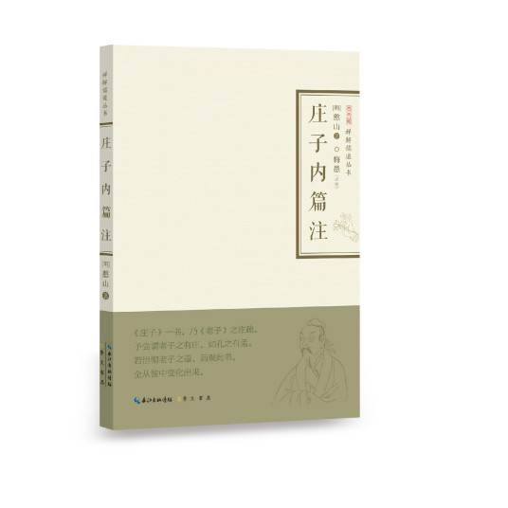
Zhuangzi
Written by the philosopher Zhuangzi and his students in the Warring States Period. also known as The Holy Canon of Nanhua is a Taoist classic proposing “Tao as the source of the world” “uniformity of things” “non-action in face of nature” and “absolute freedom
Zhuangzi
Philosopher in the Warring States Period
”

Slide 5
Western Studies on Zhuangzi
01
02
03
04
1881 First Version
By British sinologist Frederic Henry Balfour (1846—1909)
By
Herbert A. Giles，1845—1935
By
Burton D. Watson，1925—2017
By
James Legge (1815—1897)
The Divine Classic of Nan-hua, Being the Works of Chuang Tsze, Taoist Philosopher
Chuang Tzu: Mystic, Moralist, and Social Reformer。
The Complete Works of Chuang Tzu
Writings of Kwangtsze

Slide 6
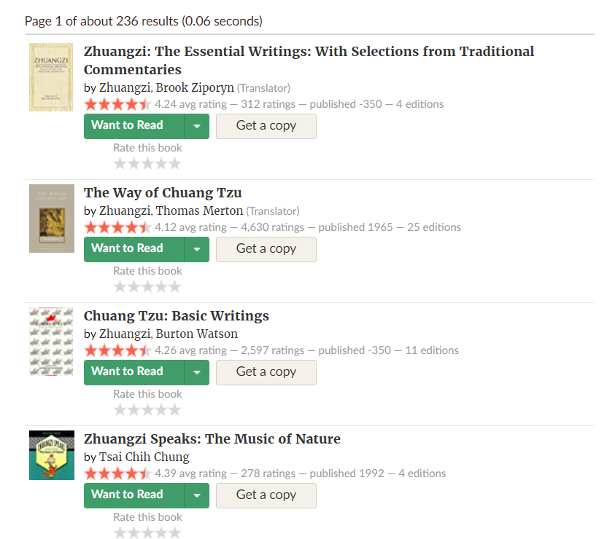
Ratings on Goodreads

Slide 7
Strange Tales from Liaozhai
PART.02

Slide 8
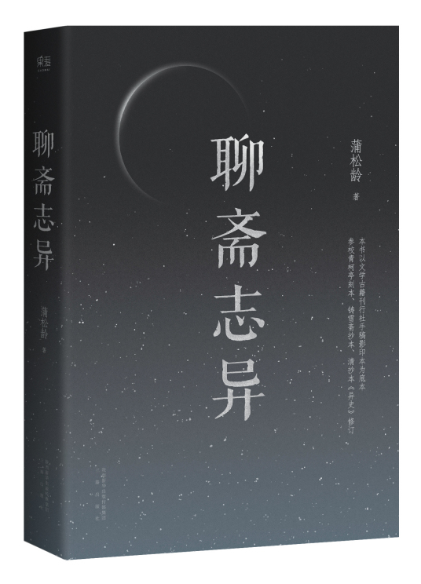
LiaoZhai
Written by Pu Songling in middle-Ming Dynasty(1662-1722)
Love Stories
Criticism on Feudalism and Officialdom
Criticism on the Keju (the Imperial Examination)
Satirical Allegories

Slide 9



Brief Introduction of the Translation History of LiaoZhai
01
02
03
First Version in 1880
By
Herbert A. Giles
From 1946
To
2014
A 216 Stories Version
133 stories were translated by Huang Youyi, and another 60 by Zhang Qingnian, Zhang Ciyun, and YangYi and 23 stories were translated by Denis C. Mair and Victor H. Mair
164 stories from the book under the title Strange Tales from a Chinese Studio
16 more English translations published both in China and abroad

Slide 10
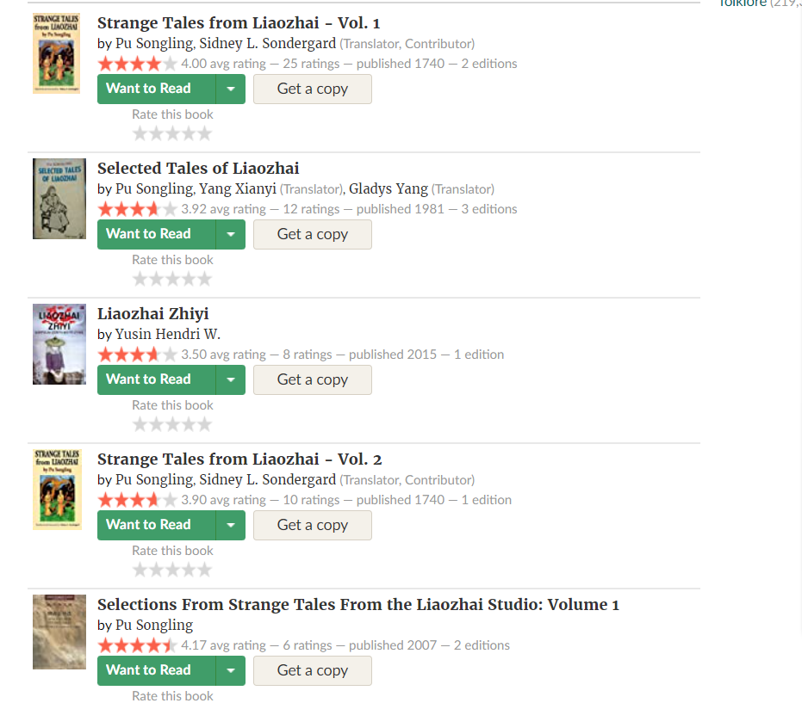
Ratings on Goodreads

Slide 11
Three Kingdoms
Full name was Popular Romance of the Three Kingdoms
PART.03

Slide 12
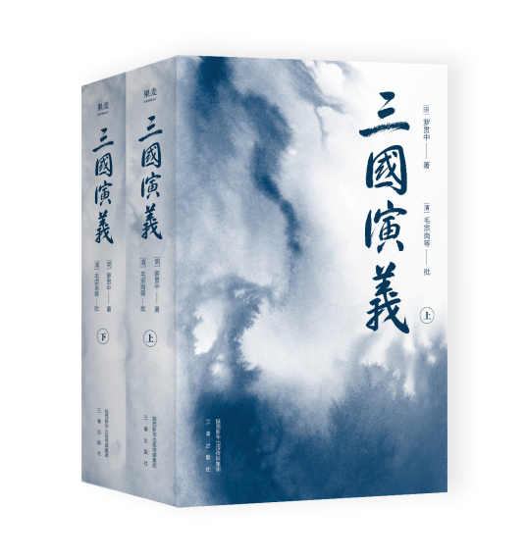
Three Kingdoms
Author:
Status
Luo Guanzhong
One of the Four Great Chinese Classical Novels
Translation
Library collections
The translations of Three Kingdoms cover nearly 60 languages
By 455 libraries outside main land of China

Slide 13
Western Studies on Zhuangzi
01
02
03
04
In 1820, Englishman P. P. Thomas (1782–1834)
In the late Qing Dynasty
By
British C. H. Blewitt-Taylor (1857-1938)
In 1925
First Full Translation
By
Moss Roberts (1937- )
The Death of the Celebrated Minister Tungcho in The Asiatic Journal
17 abridged English translations were published by 10 translators
Three Kingdoms
In 5 volumes
San Kuo, or Romance of the Three Kingdoms

Slide 14
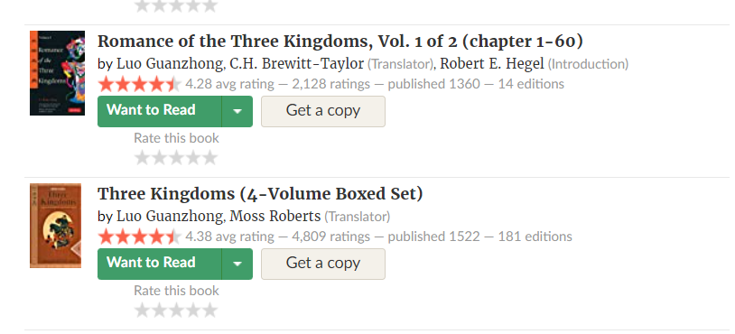
Ratings on Goodreads

Slide 15
Outlaws of the Marsh
Shinaian&Luoguanzhong
PART.04

Slide 16
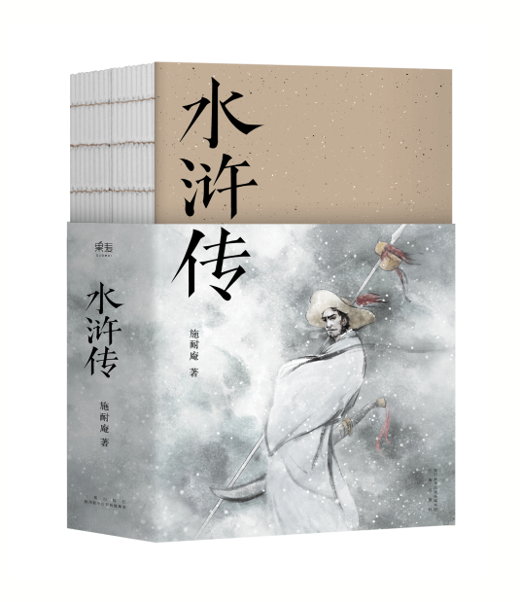

Outlaws of the Marsh
Shuihuzhuan, one of the best-known Chinese classic novels, recounts the doings of the 108 heroes
·Distinctive and prominent characters
·Vivid language
·Storytelling,

Slide 17
Four most famous versions of Shuihuzhuan
By Pearl S. Buck
In 1933
By J.H. Jackson
In 1937
By
Sidney Shapiro
In 1999
By John and Alex Dent-Young
1994-2002
All Men Are Brothers
Water Margin
Outlaws of the Marsh
The Marshes of Mount Liang。
01
02
03
04

Slide 18
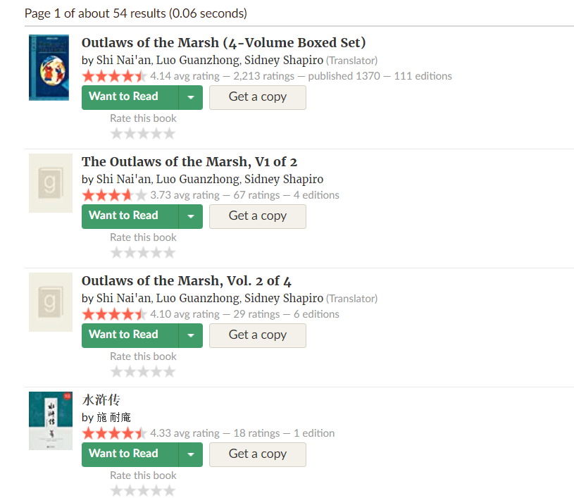
Ratings on Goodreads

Slide 19
Summaries
Thanks For Watching
Chinese Classics in World Lit.
汇报人：周皓熙 & Mahzad & Nizam & Sagara

