Slide 1
Book Burning in the Qin Dynasty 焚書坑儒

Slide 2
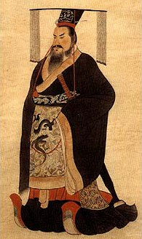
Qin Shi Huangdi 秦始皇
In order to understand the book burning we must understand Qin Shi Huangdi.

Slide 3
Qin Shi Huangdi 秦始皇
What do we know about him?
http://www.youtube.com/watch?v=1bZXxGv52t8

Slide 4
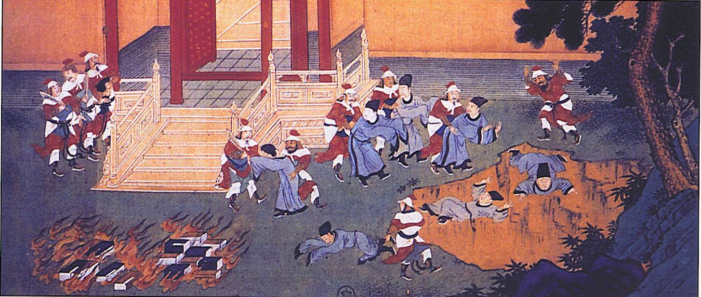
What Happened?

Slide 5
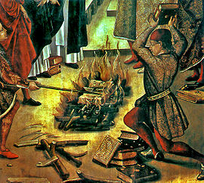
What Happened?
We must understand the political climate of the time to understand what happened.

Slide 6
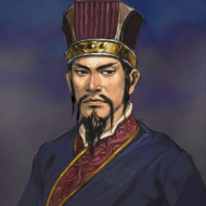
Li Si
Who is Li Si?

Slide 7
Legalism
What is legalism?
From the point of view of Legalism why does a policy of book burning make sense?

Slide 8
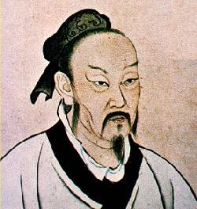
Confucianism
How do we define Confucianism?
How could Confucianism pose a problem for Qin Shi Huangdi?

Slide 9
Scholars could "use the past to criticize the present“- Li Si
Deference for the past.
“The feeling of commiseration is the beginning of humanity; the feeling of shame and dislike is the beginning of righteousness; the feeling of deference and compliance is the beginning of propriety; and the feeling of right or wrong is the beginning of wisdom. Men have these Four Beginnings just as they have their four limbs.” –Mencius
In other words, goodness is innate as opposed to the views of many legalists. (we are born evil)

Slide 10
Where does our information on the book burning come from?
Sima Qian
Historian from the Han dynasty.
What do we know about the relationship between the Han and Qin?

Slide 11
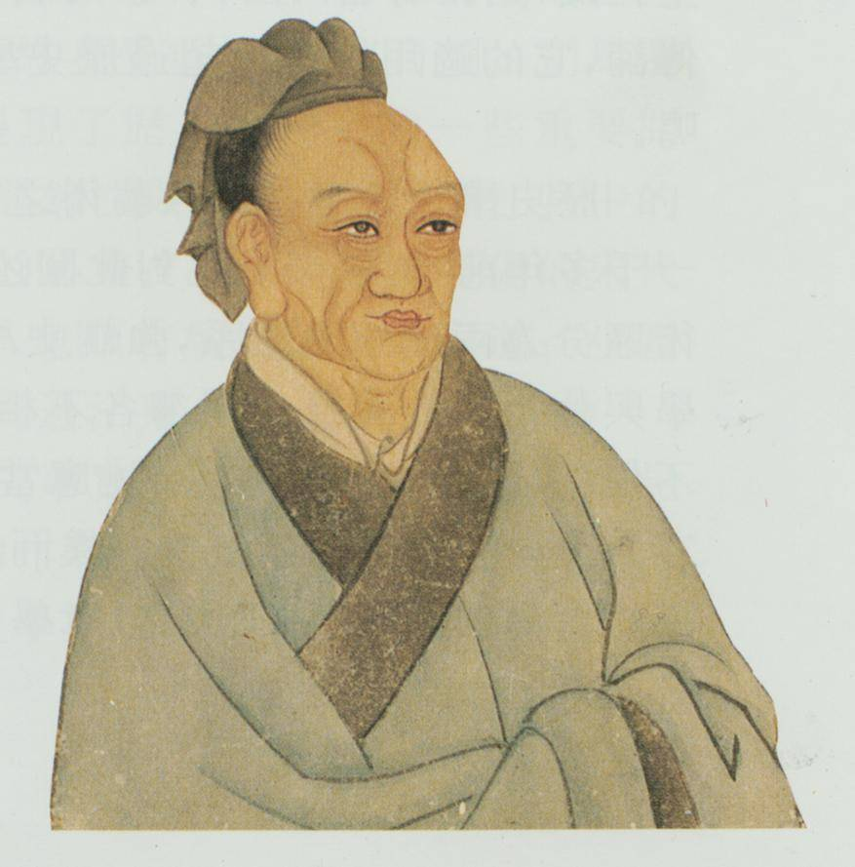
Sima Qian
What influence would Sima Qian being part of the Han empire have on his objectivity as a historian of the Qin dynasty?

