Slide 1
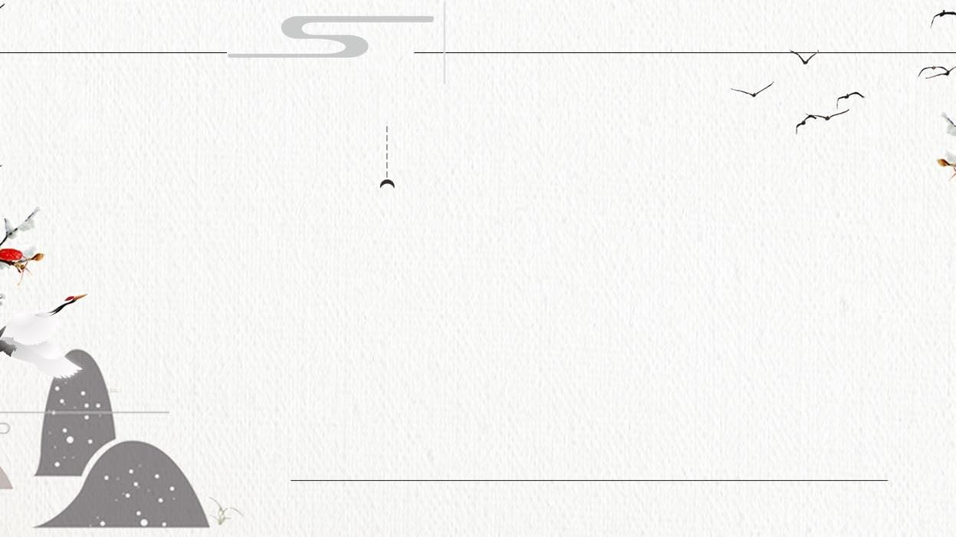
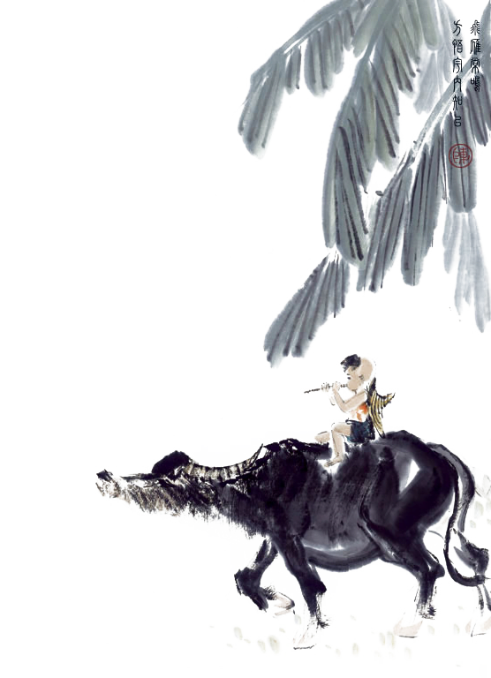



Literature of
Tang And Song Dynasties
Reporter：Xiang Shiqi

Slide 2



Catelogue
1.Tang Poetry
2.Song Ci
3.Classical Prose Movement

Slide 3


1
Tang Poetry

Slide 4


1
2
3
Pastoral
Romantic
Realistic

Slide 5
Pastoral school（田园派）
Pastoral poetry mainly describes natural and rural scenery and a quiet and isolated life so as to express the dissatisfaction with reality and longing for a quiet and peaceful life.
Representatives: Wang Wei, Meng Haoran

Slide 6
Romantic school（浪漫派）
Romantic school concentrated on the expression of personal feelings, chanting about the desire and pursuit of personal values for a free life. Romantic poetry is colorful with both fantastic imagination and unrestrcited style.
Representative: Li Bai

Slide 7
Realistic school（现实派）
The poetry of the realistic school has a melancholy style and mostly expresses feelings of sadness and compassion for the world by depicting the difficulties of their reaslitic life.
Representatives: Du Fu, Bai Ju Yi

Slide 8
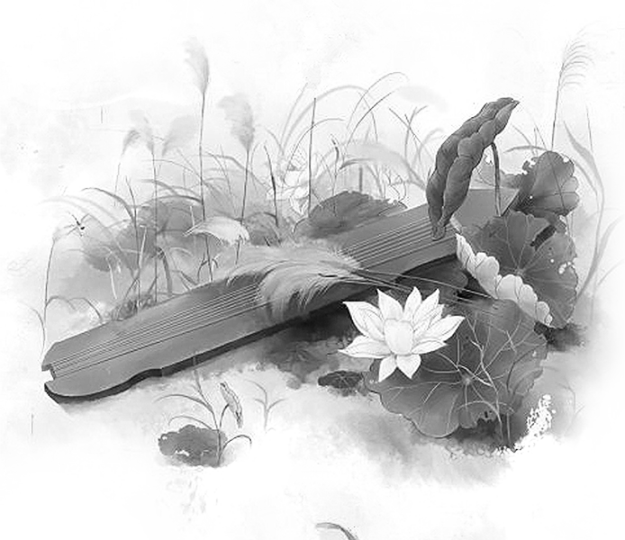
2
Song Ci

Slide 9

1
2
Plaintive
Unconstrained

Slide 10
Plantive school（婉约派）
In plantive poems there are themes about love and parting, written in a very graceful and gentle style.
Representatives: Li Qingzhao, Liu Yong, Yan Shu

Slide 11
Unconstrained school（豪放派）
Unconstrained poetry is characterised by a wide range of subjects, a straightforward and expressive approach, a grand and majestic style, a broad vision, a magnificent atmosphere, and it is not restricted to the rhythm of Ci poetry.
Representatives: Xin Qiji

Slide 12

3
Classical Prose Movement

Slide 13
1.Introduction
Chinese classical prose movement also known as Classical Prose Movement of the late Tang dynasty and the Song dynasty is a movement of writing revolution aimed to revive the ancient prose style.

Slide 14
2.Preposition
1. Advocate ancient prose style that had been popular since pre-Qin and Han dynasties and stood against the
pianwen or parallel （骈文） prose style.
2. Call for the revial of Confucianism（儒学）to stand against any other schools represented by Buddhism（佛教）and Taoism（道教）.

Slide 15

pianwen / parallel prose style
1. pay attention to antithesis (对偶）and rhythm.（声律）
2. every sentence usually use four or six words.
3. usually very ostentatious and use very empty rhetoric.
ancient prose style of the pre-Qin and Han dynasties
not restricted by formats including anthesis and rhythm

Slide 16



reversed the trend of formalism which had dominated Chinese literarure for a long time.
1
has a profound influence on the later schools of literature.
2
Milestone
3
Confucianism has become the dominant literature and philosophy of China for emphasis to it.

Slide 17
Thanks for your listening!

