Slide 1

Chinese Traditional Painting
presentor: Wang Yihan

Slide 2


Contents
History
Main Features
Tools and Materials
3 main themes
representatives

Slide 3

Chinese Painting: originated from the Neolithic Period
Chinese painting is one of the oldest continuous artistic traditions in the world, Chinese traditional painting dates back to the Neolithic Period about 6, 000 years ago. The colored pottery with painted animals, fish, deer and frogs excavated in the 1920’s indicate that during the Neolithic Period the Chinese had already started to use brushes to paint.

Slide 4
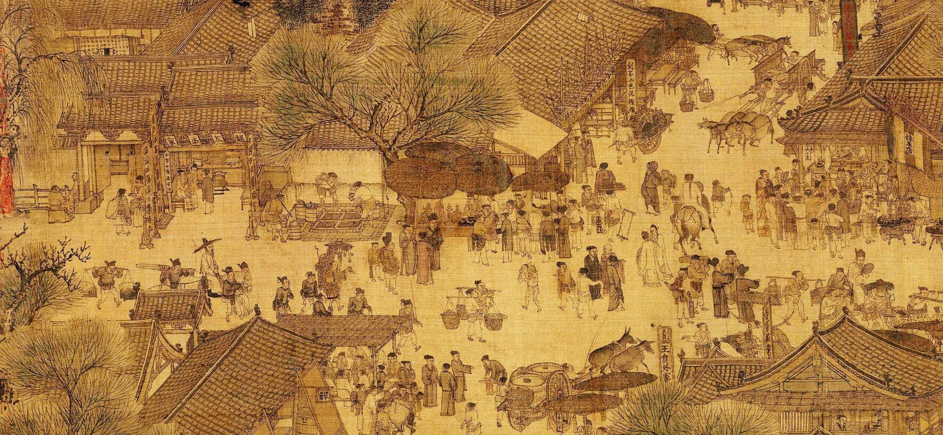
Different from Western paintings, a Chinese painting is not restricted by the focal point（聚焦点） in its perspective.
The artist may paint on a long and narrow piece of paper or silk all the scenes along the Yangtze River.
Along the River During the Qingming Festival
Zhang Zeduan Northern Song Dynasty

Slide 5
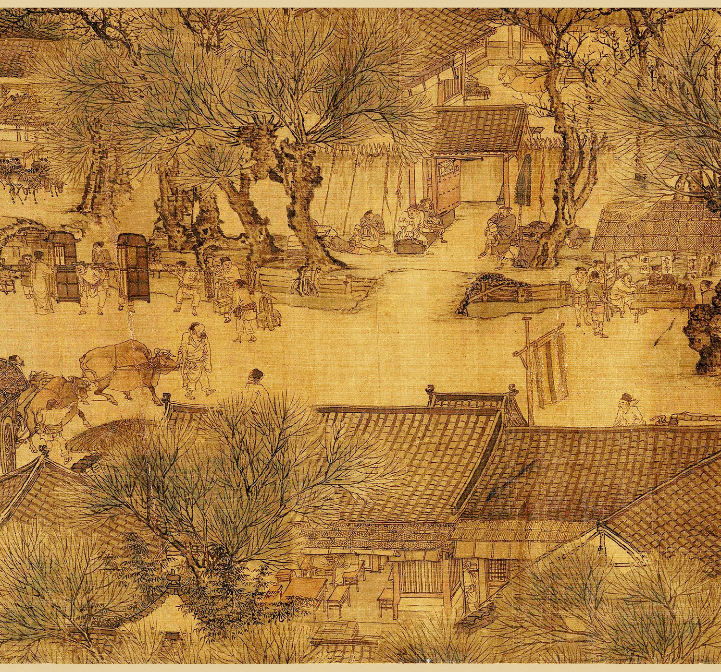
Why do the Chinese artists emphasize the shifting perspective?
They try to break away from the restriction of time and space, and include in their pictures both things which are far and things which are near. Also, the artists find that in life people view their surroundings from a mobile focal point. The shifting perspective enables the artists to express freely what he wants to.

Slide 6
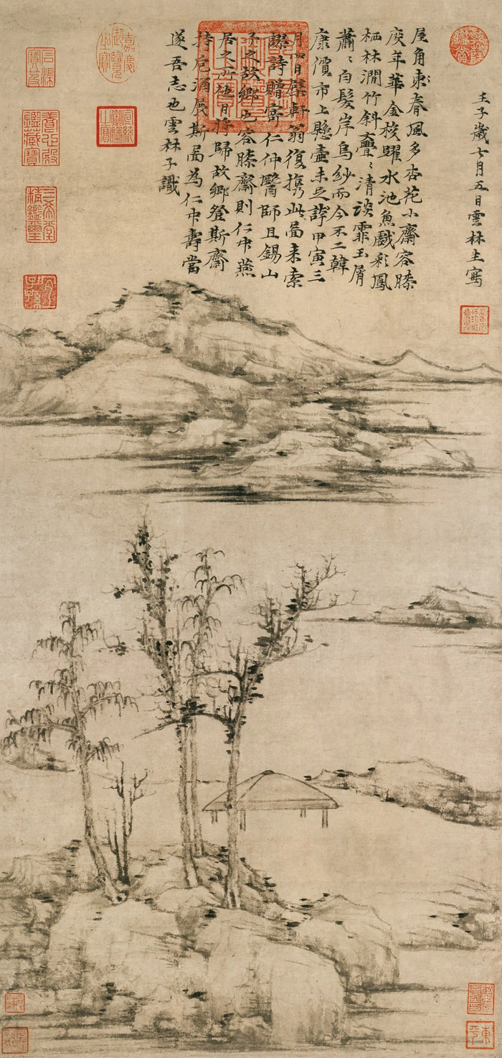
Chinese calligraphy and Chinese painting are closely related
Combination of poem, calligraphy, painting and signet Chinese painting shows the perfect union of poem, calligraphy, painting and signet.
Generally, Many Chinese painters are poets as well as calligraphers. He often adds a poem to it personally and stamps his various signets on the painting after he finishes it. The combination of the four makes the painting look more integrated, perfect and beautiful, which can bring the appreciator an aesthetic pleasure.

Slide 7
Tools for Chinese Painting
The artistic expression of Chinese painting differs from that of western painting because of its tools for painting. To draw a Chinese painting, a writing brush, ink stick, rice paper, and ink stone are necessary. Especially for rice paper ( Xuan paper), is the best tool for Chinese painting because it has a nice texture to allow the writing brush, wet with Chinese ink and held in a well-trained hand to move freely on it, making strokes varying from shade to light, from real to imaginative.
Materials for Chinese painting
Generally, Chinese painting is drawn on rice paper. But in the fans, porcelain, bowls and dishes you also find beautiful Chinese pictures when you shop in the tourist shopping streets or eat in some specialty restaurants. Besides, the Chinese pictures are also drawn on the silk, screens, and even on many ancient tombs' walls.

Slide 8
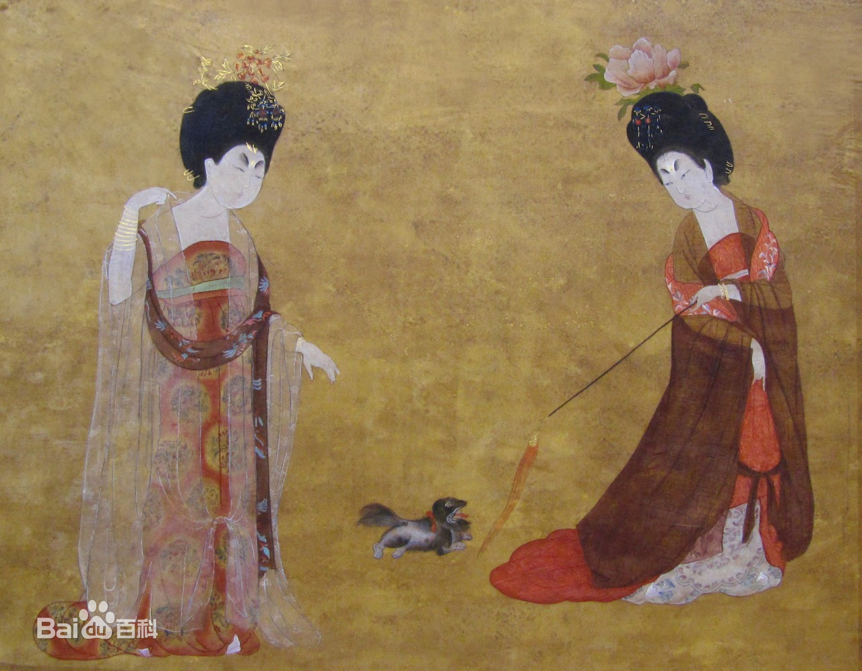
According to the means of expression, Chinese painting may be divided into 2 categories:
Meticulous - Gong-bi (工筆), often referred to as "court-style" painting, or "fine-line" painting.
This style of painting incorporates delicate Chinese calligraphy strokes and close attention to detail. Fine brushes are first used to create an outline of the subject, and then the artist goes back with softer brushes to apply layers of color washes until the desired effect is achieved.

Slide 9

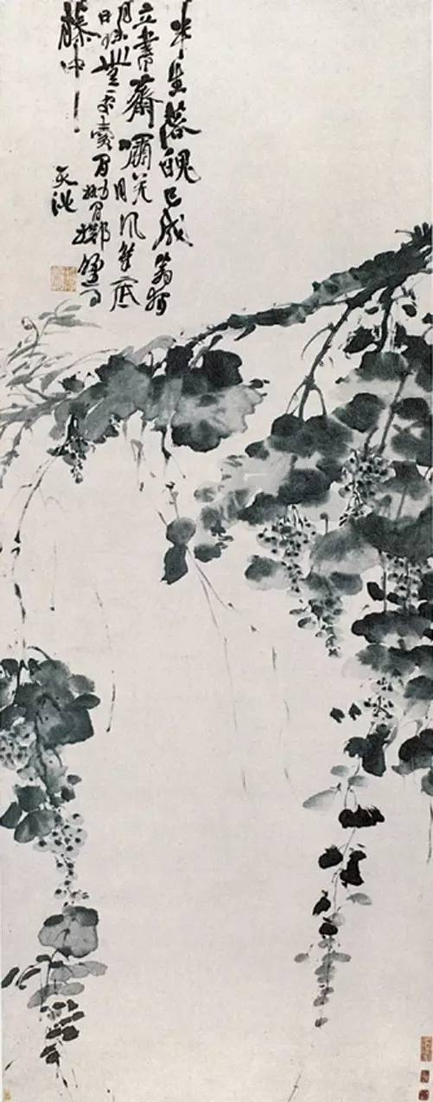
"xie yi" (写意) or freehand style.
This style emphasizes the interpretive aspect of brushwork and the shading of ink, and seeks to express the essence of the subject, rather than the details of its appearance. Only black ink and its shadings are used. Xie yi style has a freer, unrestrained look.

Slide 10
The history of Chinese painting can be compared to a symphony. The styles and traditions in figure, landscape, and bird-and-flower painting have formed themes that continue to blend to this day into a single piece of music. Painters through the ages have made up this “orchestra,” composing and performing many movements and variations within this tradition.

Slide 11
Figure Painting （人物画）
Nymph of the Luo River (洛神賦)
Gu Kaizhi顾恺之

Slide 12
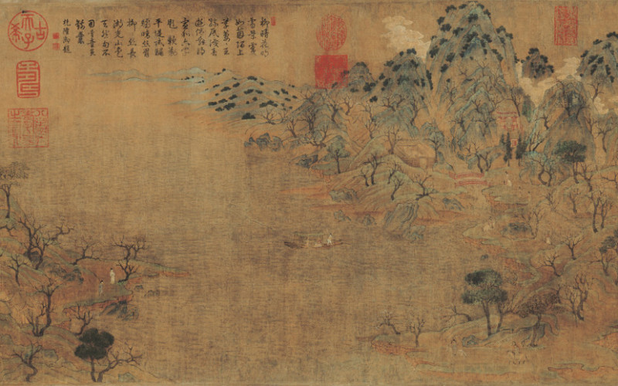
Landscape painting 山水画
Spring Excursion (游春图)
Zhan Ziqian Sui Dynasty

Slide 13
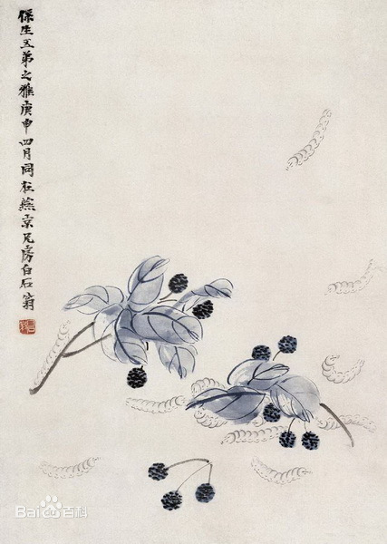
bird-and-flower painting
Qi Baishi (1863-1957) is a most celebrated contemporary Chinese artist. He was versatile, and his own criteria of his success placed poetry first, seal-carving second, calligraphy third and painting last.

Slide 14
Thanks for Watching

