Slide 1
Literature Society & Romanticism During May 4th Period
白润元 魏钰珈 生梦鑫

Slide 2
Literary Research Society

Slide 3
Introduction
1921 January 4th,in Beijing.1920-1932.
One of the societies established in May 4 th new literature movement .
Members:Zhou Zuoren,Zheng Zhenduo,Shen Yanbing,Guo Shaoyu,Zhu Xizu,Qu Shiying,Jiang Baili,Sun Fuyuan,Geng Jizhi,Wang Tongzhao,Ye Shaojun,Xu Dishan.
Purpose:to research and introduce world literature,to sort out and select old Chinese literature,to create new literature,art for life's sake(文学为人生).

Slide 4
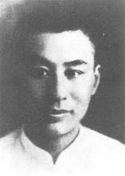
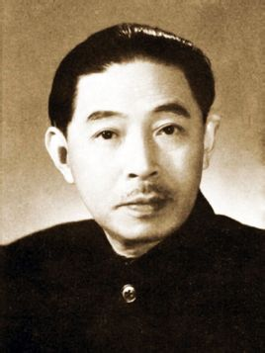
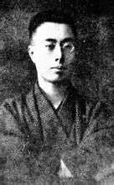
情景剧：A small cafe in Beijing
Main Topic:Ye Shentao's new novel Ni Huanzhi & Literary Realism
Basic Information:1923,Beijing,Ye Shengtao's house.
Members:Ye Shengtao,Zhou Zuoren,Shen Yanbing.
Ye Shengtao
Shen Yanbing
Zhou Zuoren

Slide 5
《倪焕之》
主人公倪焕之，是个热切追求新事物的青年。同辛亥革命失败后不少进步知识分子一样，他最初把救国的“一切的希望悬于教育”，真诚地期待着用自己的“理想教育”来洗涤尽社会的黑暗污浊。他还憧憬着一种建立在共同事业基础上的互助互爱的婚姻关系，爱慕和追求一个思想志趣和自己相似的女子金佩璋。然而，严酷的现实生活，破灭了倪焕之的许多不切实际的空想。不但在教育事业上多次碰壁，而且家庭生活也远违初衷。婚后的金佩璋，沉没于琐细的家庭事务中，对于前途、理想、教育、书本都不再有兴趣。这使倪焕之深深感到“有了一个妻子，但失去了一个恋人、一个同志”的寂寞和痛苦。
在革命者王乐山的影响下，作品主人公开始把视线从一个学校解脱出来，放眼“看社会大众”，投身于社会改造活动。“五卅”和大革命高潮期间，倪焕之更是参加了紧张的革命工作。在“四一二”反革命大屠杀后，倪焕之并未像王乐山那样坚持英勇斗争，却是脆弱地感到“太变幻了”，竟至悲观失望，纵酒痛哭，怀着“什么时候会见到光明”的疑问和希望死去。

Slide 6
Literary Realism
Literary realism is part of the realist art movement beginning with mid nineteenth-century French literature (Stendhal), and Russian literature (Alexander Pushkin) and extending to the late nineteenth and early twentieth century.
Literary realism, in contrast to idealism, attempts to represent familiar things as they are.Realist authors chose to depict everyday and banal activities and experiences, instead of using a romanticized or similarly stylized presentation.

Slide 7
Creation Society

Slide 8
Introduction
1921 June,in Tokyo.1921-1929.
One of the societies established in May 4 th new literature movement .
Members:Guo Moruo, Yu Dafu, Cheng Fangwu, Zhang Ziping, Tian Han, Feng Yuanjun
Publication :" Quarterly creation " , “Create Weekly" , “The Creation Journal", " Flooding ", “Cultural Criticism " and so on .
Purpose:They admire genius and gods, believing that literature is the art of self-expression，influenced by romanticism. Call on revolutionary literature.

Slide 9
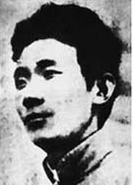
Members
郁达夫Yu Dafu：
沉淪 Sinking (1921)
日記九種Nine Diaries (1927)
過去 The Past (1927)
出奔 Flight (1935)

Slide 10
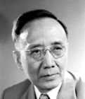
Members
郭沫若Guo Moruo
女神 The Goddesses
星空 Starry Sky
花瓶 The Vase
先驱 The Forerunner
复苏 Recovery
And more poems.
has exquisite style of writing, ornate language, and deep meaning scene.

Slide 11
Rebirth of the Goddesses
《女神之再生》
剧曲写共工与颛顼争帝，共工失败，怒而触不周山，天崩地裂，众女神们不再修补旧世界，而是要重新创造一个新鲜的太阳。
Gong Gong and Xuanxu are fighting for the crown. With shame and anger of failure, Gong Gong strikes the Buzhou Montain, making the sky collapse.Instead of repairing the world, the Goddesses created a new one.
http://202.194.48.102/englishonline/culture/ChineseCulture/Chineseliterature/rebirthofthegoddesses1.htm

Slide 12
Goddess
Just after the May Fourth Movement in China and Guo Moruo was much influenced by the great event.
The theme of "Rebirth of the Goddesses" comes from ancient Chinese mythology, as the author explains in a note at the end of the poem.
Guo Moruo’s "Goddess" is the representative of the hurricane spirit in “5.4” and the distinct artistry which is different from other vernacular poetry, thus "Goddess" has laid the foundation of romanticism for the new poetry. "Goddess" also marked the new poetry substituted for classical poetry. It created and utilized free style successfully. The new poetry came up to a new level.

Slide 13
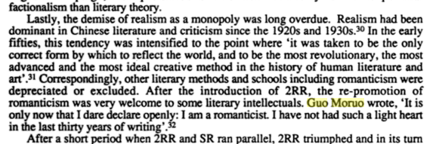

Slide 14
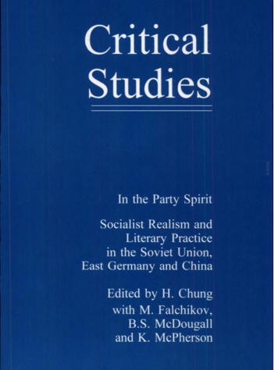
Critical Studies
In the Party Spirit: Socialist Realism and Literary Practice in the Soviet Union, East Germany and China
Edited by H.Chung with M.Falchikov,B.S.McDougall and K.McPherson

Slide 15
Crescent Moon Society

Slide 16
Crescent Moon Society
The Crescent Moon Society was a Chinese literary society founded by the poet Xu Zhimo in 1923, which operated until 1931. It was named after The Crescent Moon, a poem by Rabindranath Tagore.
In addition to Xu Zhimo, its other members included leading author and educator Hu Shi, poets Wen Yiduo and Chen Mengjia, writers Liang Shih-chiu and Shen Congwen, Rao Mengkan, and sociologist Pan Guangdan.
It engaged in running debates with the "art for politics' sake" (and Chinese Communist Party-driven) League of the Left-Wing Writers.[1]
The organisation dissolved shortly after the death of Xu Zhimo in November 1931.
-----wikipedia

Slide 17
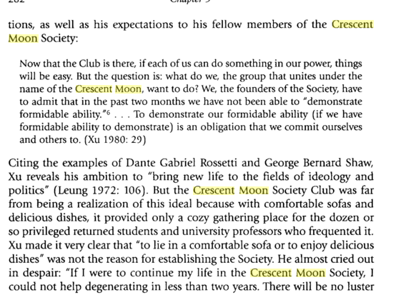
A Brief introduction to The Crescent Moon

Slide 18
情景剧：徐志摩家的客厅

Slide 19
徐志摩 再别康桥
Very quietly I take my leave
As quietly as I came here;
Quietly I wave good-bye
To the rosy clouds in the western sky.
The golden willows by the riverside
Are young brides in the setting sun;
Their reflections on the shimmering waves
Always linger in the depth of my heart.
The floating heart growing in the sludge
Sways leisurely under the water;
In the gentle waves of Cambridge
I would be a water plant!
That pool under the shade of elm trees
Holds not water but the rainbow from the sky;
Shattered to pieces among the duckweeds
Is the sediment of a rainbow-like dream?

Slide 20
徐志摩 再别康桥
To seek a dream? Just to pole a boat upstream
To where the green grass is more verdant;
Or to have the boat fully loaded with starlight
And sing aloud in the splendour of starlight.
But I cannot sing aloud
Quietness is my farewell music;
Even summer insects keep silence for me
Silent is Cambridge tonight!

Slide 21
Xu Zhimo
Free-thinking Chinese poet who strove to loosen Chinese poetry from its traditional forms and to reshape it under the influences of Western poetry and the vernacular Chinese language.
One of the most renowned romantic poets of 20th-century Chinese literature, he is known for his promotion of modern Chinese poetry, and has made tremendous contributions to modern Chinese literature.

Slide 22
《诗的格律》
“三美”
建筑美 Structrue
音乐美 Rhyme
绘画美 Image

Slide 23
Style
新格律派既有唯美主义倾向，也有浪漫主义倾向，又有古典主义倾向。有人认为新格律诗派类似法国19世纪中期的巴那斯派（即高蹈派）。
Aestheticism
Romanticism
法语：Le Classicisme 英语：Western classical

Slide 24
Romanticism
Romanticism (also the Romantic era or the Romantic period) was an artistic, literary, and intellectual movement that originated in Europe toward the end of the 18th century and in most areas was at its peak in the approximate period from 1800 to 1850. Romanticism was characterized by its emphasis on Emotion and Individualism as well as glorification of all the past and nature, preferring the medieval rather than the classical.

Slide 25
Romanticism in China
1 Ancient China has its own romanticism litrature
2. Western romanticism in 1920s

Slide 26
https://en.wikipedia.org/wiki/Romanticism
https://en.wikipedia.org/wiki/Crescent_Moon_Society
《Literary Societies Of Republican China》
Denton & Hockx
http://global.britannica.com/biography/Guo-Moruo
http://pan.baidu.com/share/link?shareid=1024572803&uk=774210168&app=zd
https://books.google.com.hk/books?id=dEgowpmwVb0C&pg=PA92&lpg=PA92&dq=guo+moruo+romantics&source=bl&ots=L9evmzoHZw&sig=gsew9PgLrEc9De5Yf5MyjnHFy9w&hl=zh-CN&sa=X&ved=0ahUKEwjz3IyBuObLAhVJNJQKHVP4A2kQ6AEIWzAJ#v=onepage&q=guo%20moruo%20romantics&f=false

Slide 27
Thank You

