Slide 1

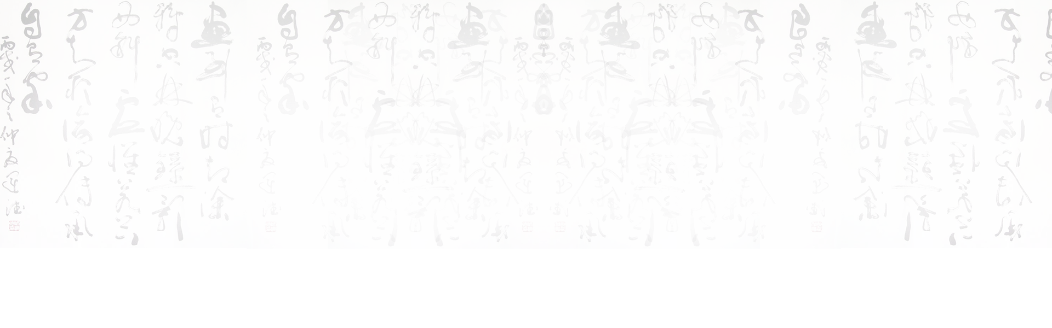
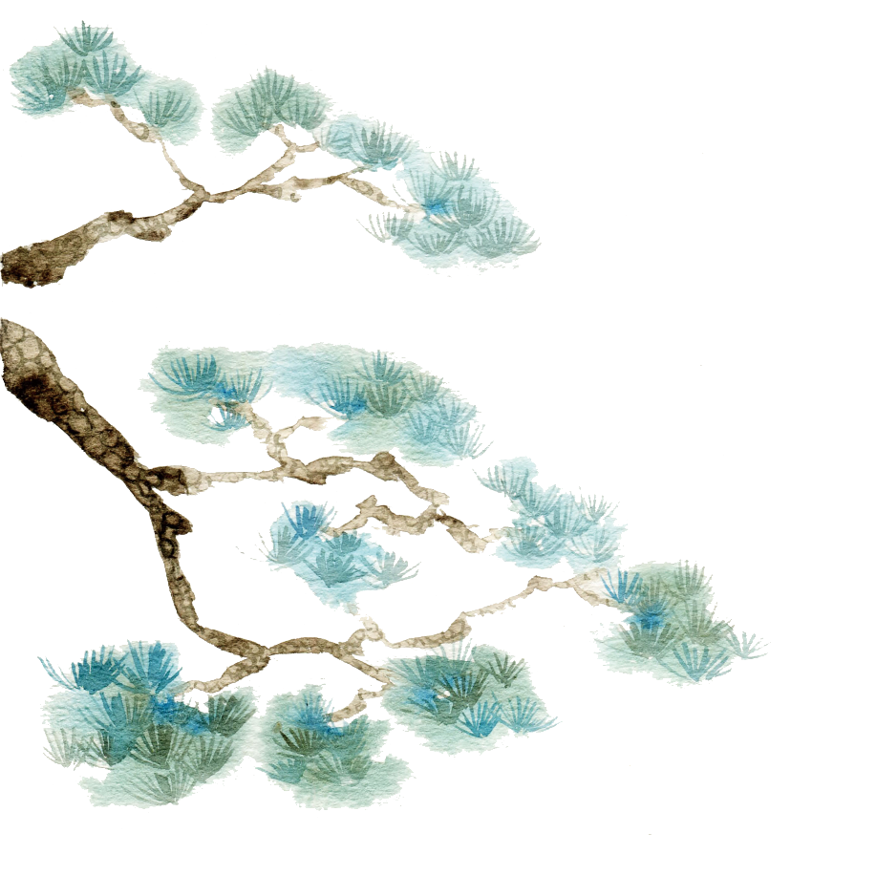

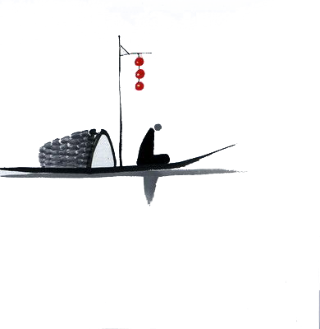
BY YUSHEN
Celadon
高明珠 Gao Mingzhu
陈静静 Chen Jingjing

Slide 2

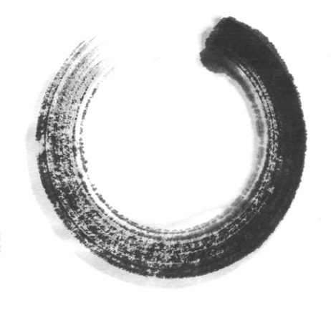

目
A brief introduction of celadon
录
CONTENTS
Longquan celadon
Translation difficulties and skills

Slide 3


PART 01
A brief introduction of celadon

Slide 4
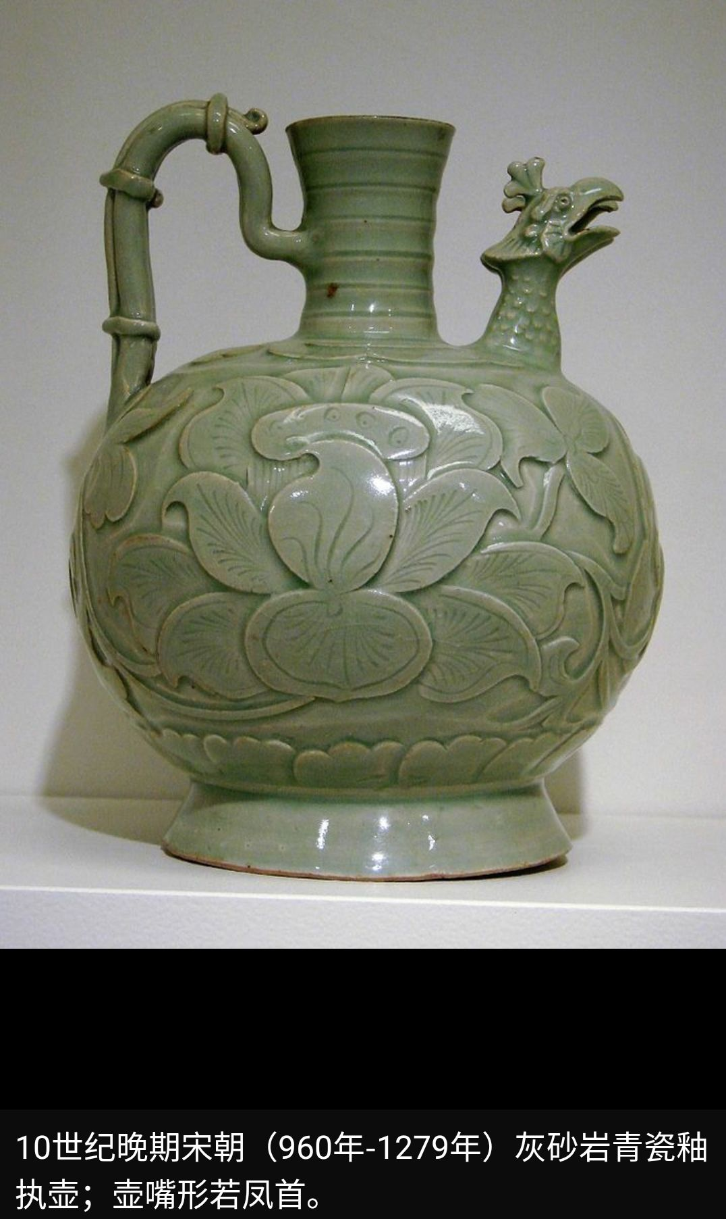
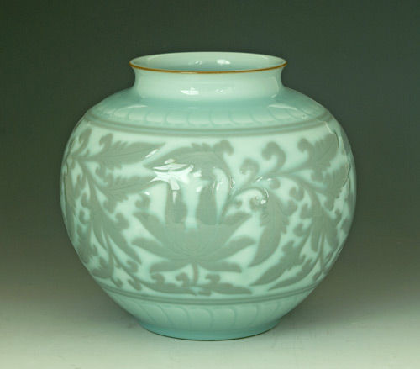
Celadon is a term for ceramics denoting both wares glazed in the jade green celadon color, also known as greenware (the term specialists tend to use) and a type of transparent glaze, often with small cracks, that was first used on greenware, but later used on other porcelains.

Slide 5


Shang and Zhou Dynasties
Three Kingdoms,Jin and Southern and Northern Dynasties
Eastern Han Dynasty
Greenwares are found in earthernware from the Shang dynasty onwards and was called primitive celadon.
The celadon firing technology in the Eastern Han Dynasty has reached a mature stage.
The celadon fired in the south and the north had their own characteristics.

Slide 6
PART 02
Longquan celadon

Slide 7
It reached its peak in the Southern Song Dynasty.
The ancient Longquan famous kiln was one of the five famous kilns of the Song Dynasty "Guan, Ge, Ru, Ding and Jun".
Longquan celadon began in the Southern Dynasty.
It flourished in the Northern Song Dynasty.
Longquan celadon
一
二

Slide 8
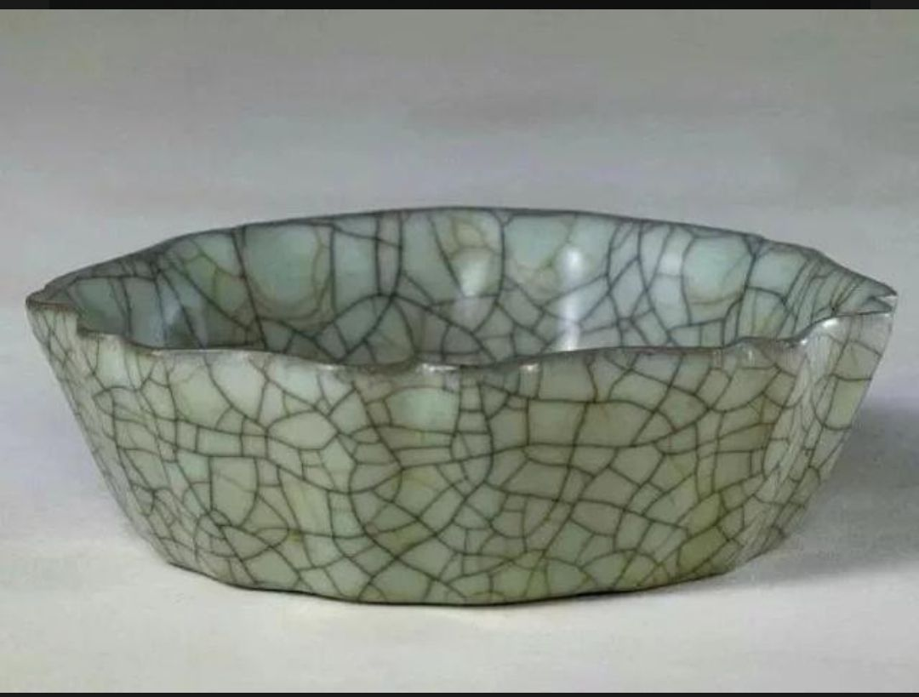
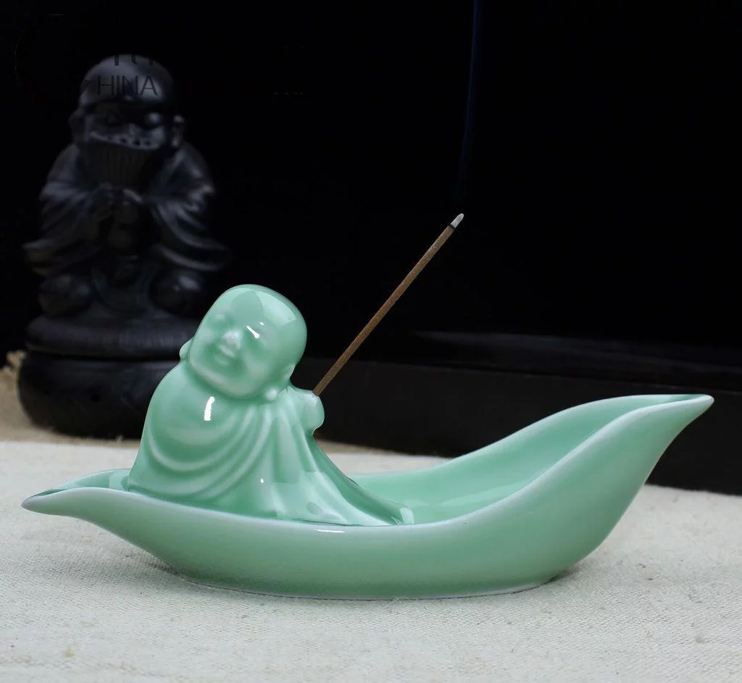



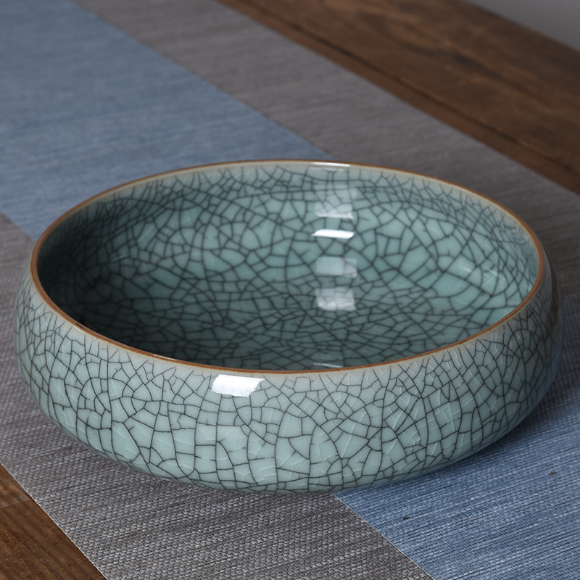
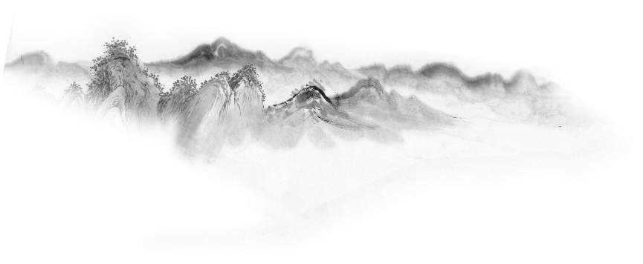
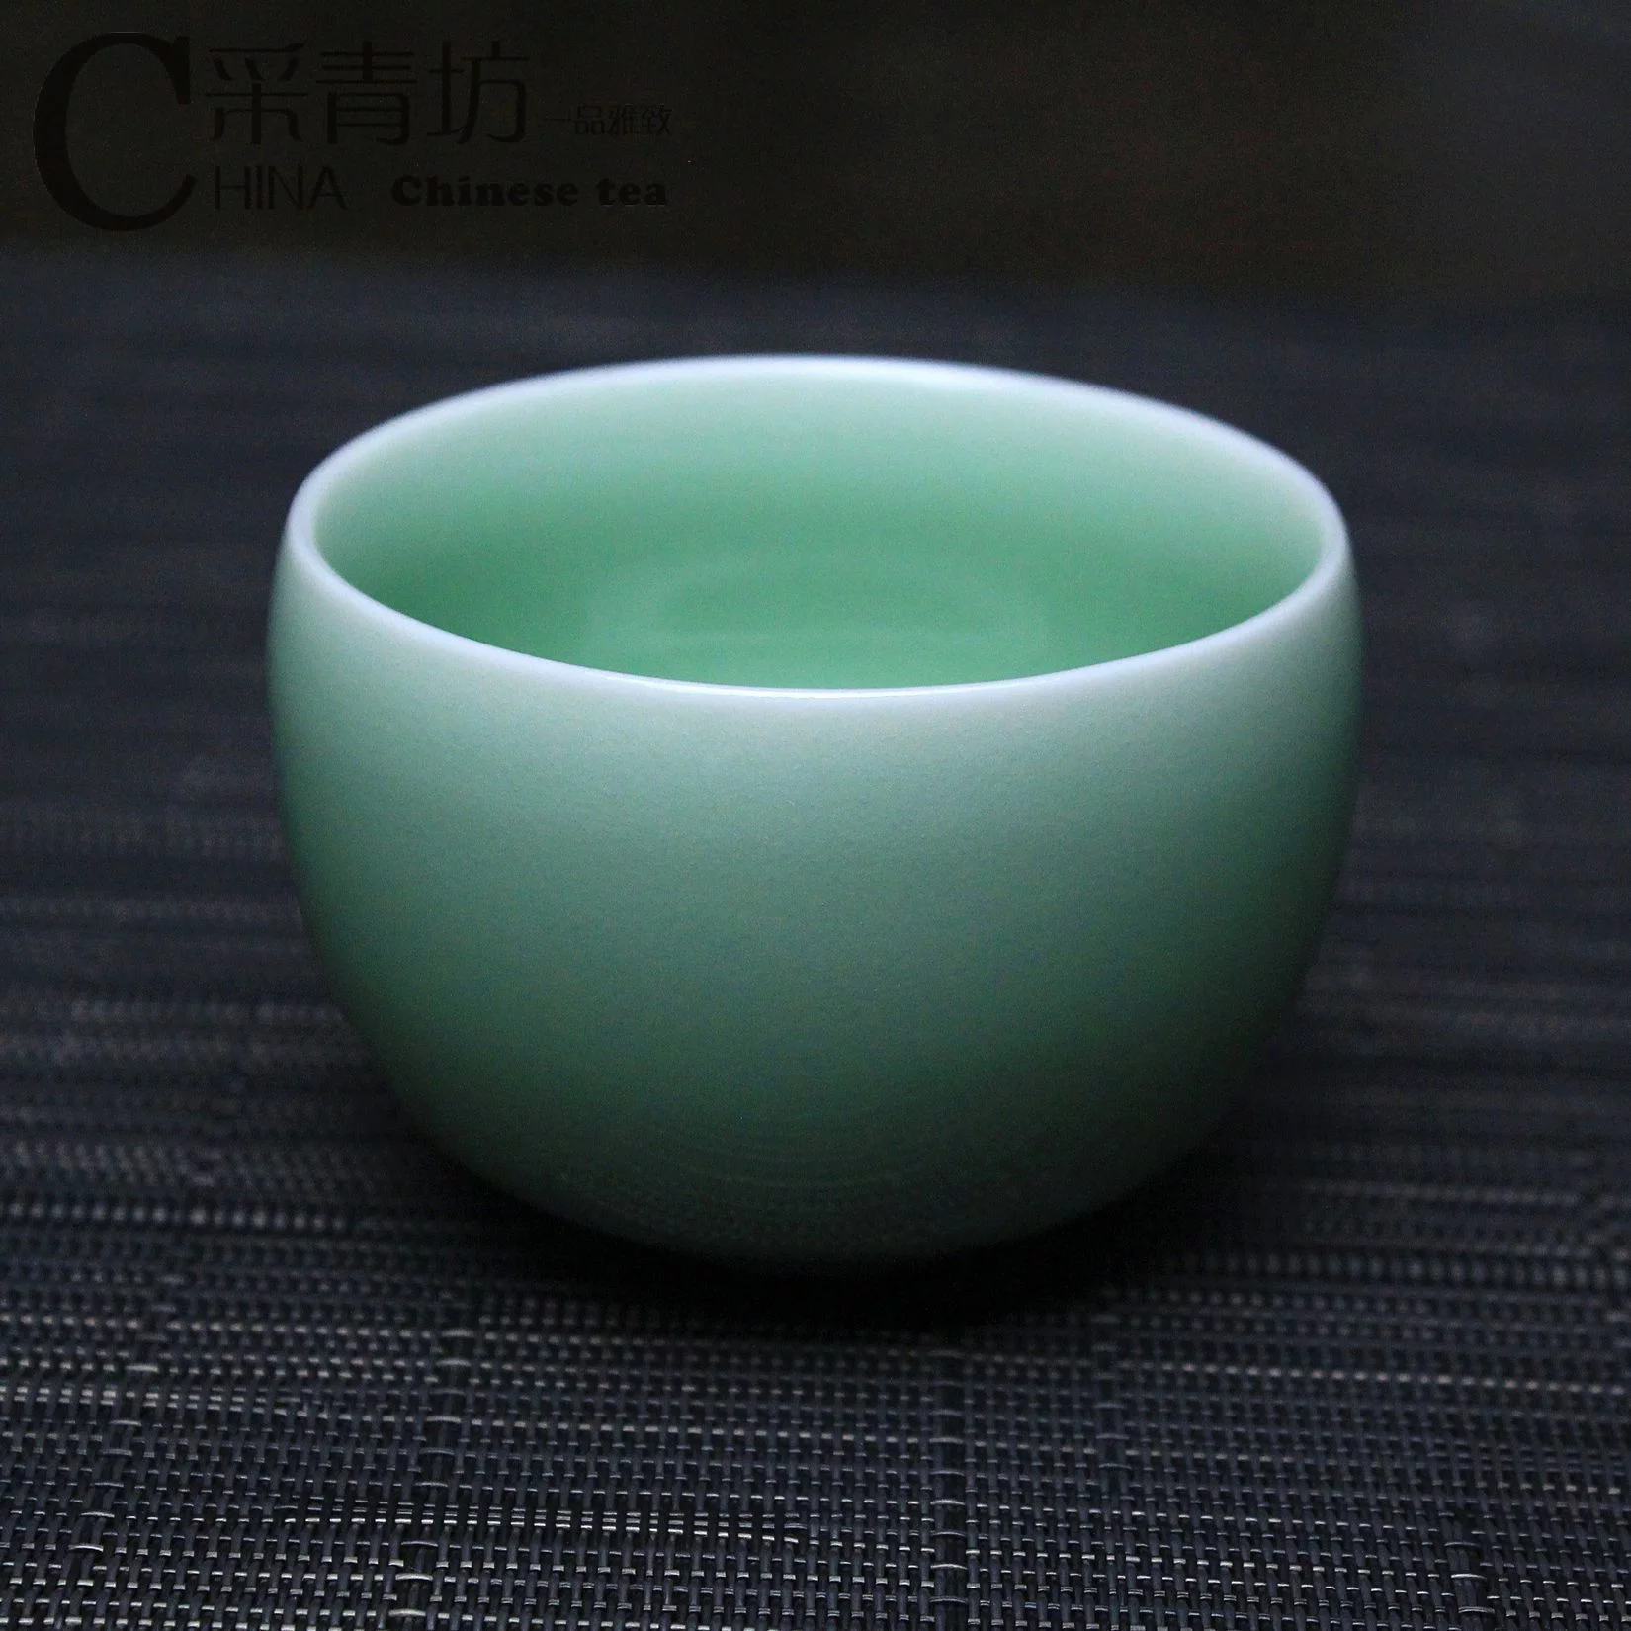
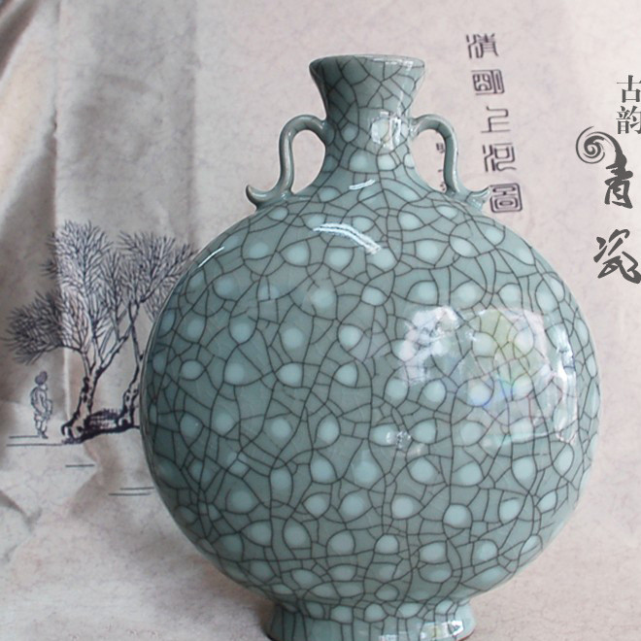
.
Di kiln
Ge kiln
.

Slide 9

“Ge kiln”
history
specialty
It appeared in the middle and late Southern Song Dynasty, together with the famous Guan, Ru, Ding, and Jun, they were called the five famous kilns in Song Dynasty.
The fetus is as thin as paper, and the glaze is as thick as jade. The glazed surface is covered with patterns, purple-mouthed iron feet, and the fetal color is gray and black.

Slide 10
“Di kiln”
specialty
history
It has white glaze green. The glaze colors are powder green and plum green.The glaze layer of the di kiln is rich, the glaze is blue, and the luster is soft, crystal, better than jade.
From the middle and late Southern Song Dynasty, especially in the Yuan Dynasty, a large number of works using exposed fetus appeared.

Slide 11
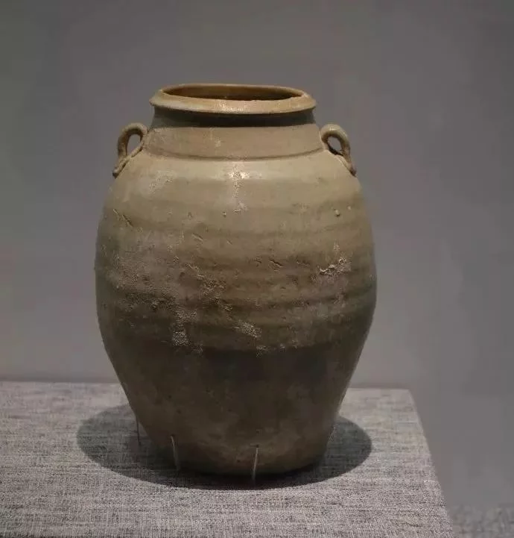
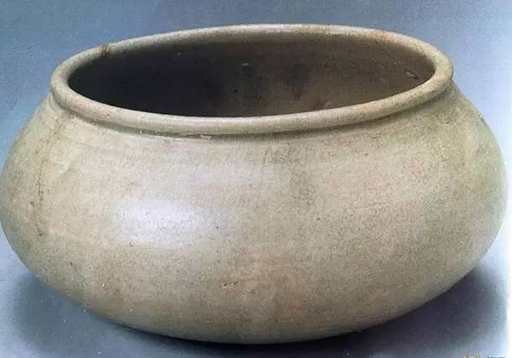
features of Longquan celadon in different periods
the Five Dynasties
light cyan glaze color
fetal bone gray-white
while a few gray-black
solid texture

Slide 12
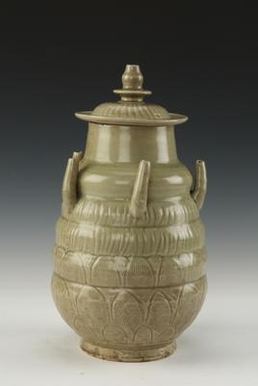
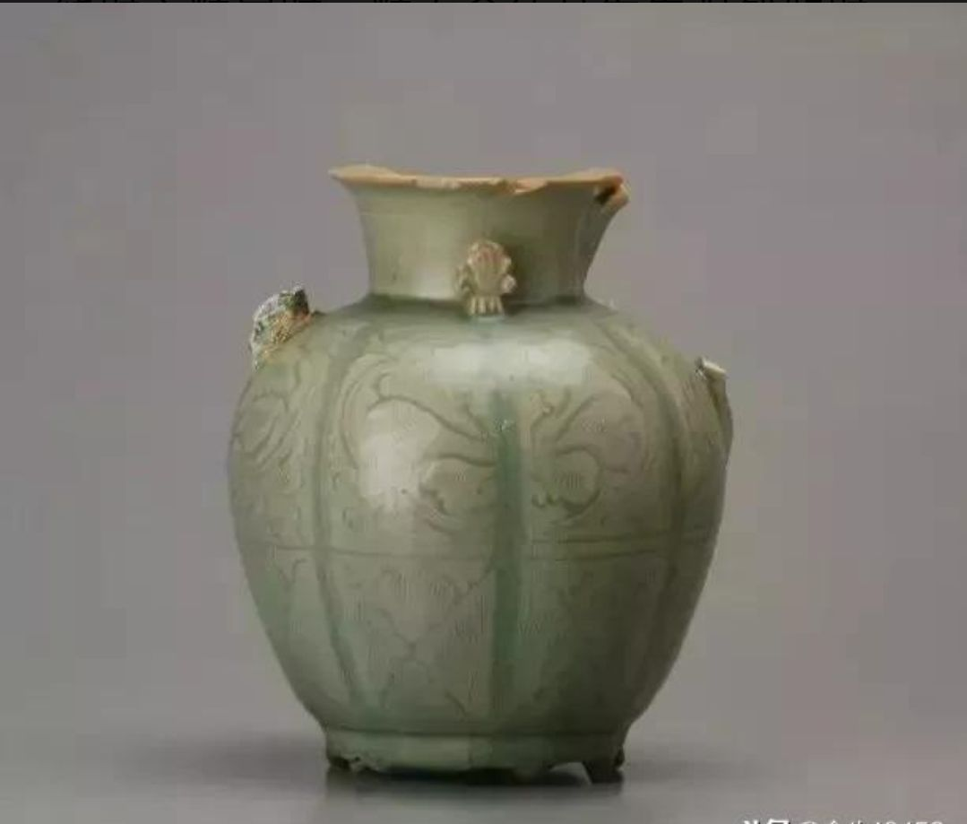
features of Longquan celadon in different periods
Patterns such as cluster flowers, waves, and burnt leaves appeared
the early Northern Song Dynasty

Slide 13
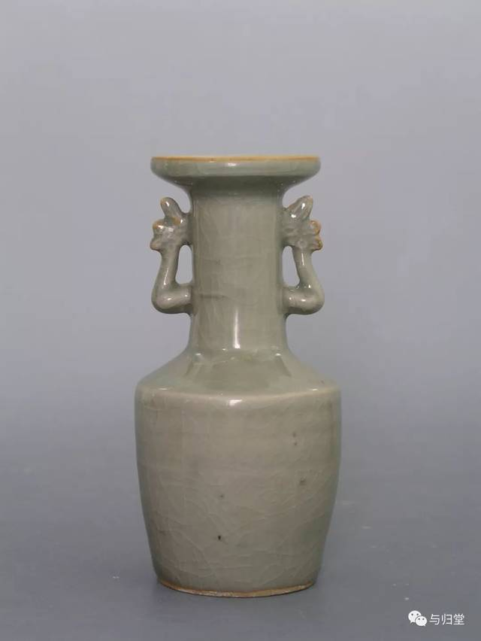
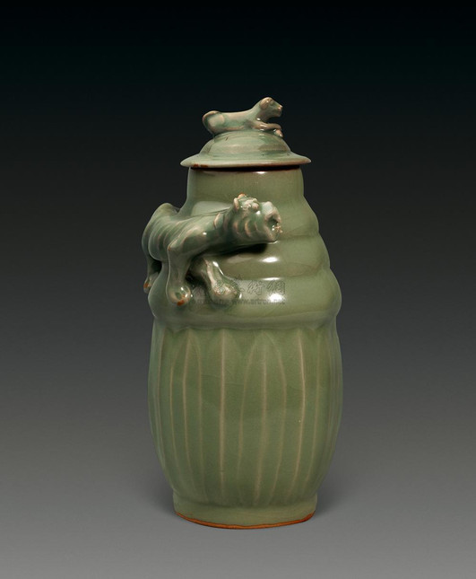
features of Longquan celadon in different periods
the Southern Song Dynasty
glaze color is like jade,
the shape is rich and varied,
the decoration is quite creative

Slide 14
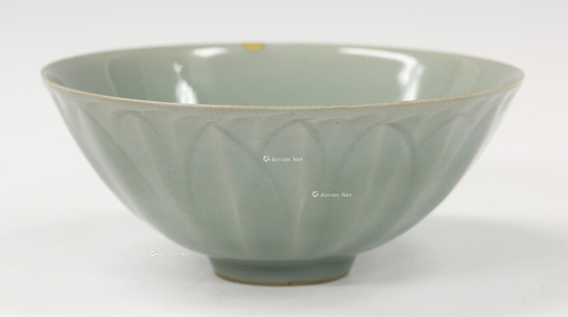
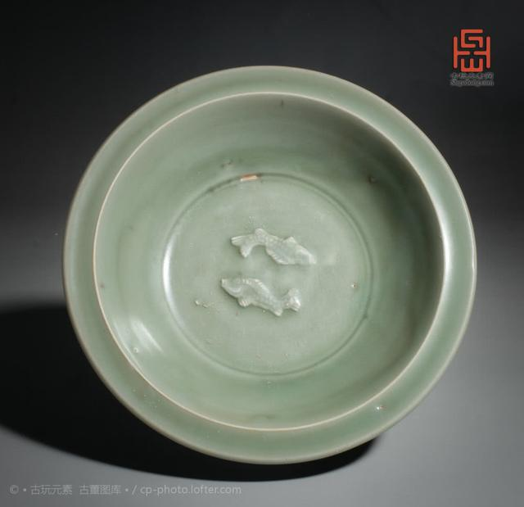
features of Longquan celadon in different periods
the Yuan Dynasty
light cyan glaze color
fetal bone gray-white
while a few gray-black
solid texture

Slide 15
PART 03
Translation difficulities and skills

Slide 16
translation of some kinds of celadons
transliteration and explanation
transliteration
二
一
龙泉窑，龙泉青瓷
Longquan kiln, Longquan celadon
尊式瓶
zun-shaped vase (a kind of vessel, means the bottom is smaller than the top

Slide 17
其中的白胎和朱砂胎青瓷釉层丰润，釉色青碧，光泽柔和，晶莹滋润，胜似翡翠，以梅子青，粉青，豆青等釉色最为珍贵。
translation of four-character words
..., the enam of layer of white and vermilion embryo is plump, smooth and green like jade.
三

Slide 18
BY YUSHEN
Thank you for your attention!

