Slide 1

翻译学导论 Introductory Course in Translation Studies
湖南师范大学外国学院21 级MA，平台课，周一，上课地点线上http://bit.ly/ZOOMCOURSE（以后外院大楼515 报告厅） 2021 年9 月26 日——2022 年1 月15 日19-20:20，老师：吴漠汀（Martin Woesler），助教TA：Yang Ye, Li Xichang, wiki TA: Zhu Renduo
吴漠汀特聘教授 Distinguished Professor Dr. Martin Woesler
湖南师范大学外国学院 Foreign Studies College, Hunan Normal University

Slide 2
Session 2 Weekly Survey 第二周 在线闻讯调查
Consent that your data (name, study no., study direction, email, technical data of your device, ip address etc., ) is stored for grading, and academic use (teaching and ANONYMIZED for research).
Consent that your contributions can be used by the teacher under his name.
Understanding of basic concepts – http://bit.ly/Eval-01
Awareness of data usage

Slide 3
Session 2 Weekly Survey 第二周 在线闻讯调查
Review: Homework
Outlook: Powerpoint topics
Outlook: Book projects => find group, suggest chapters

Slide 4
Review: Session 1 第一周
Session Overview 本节概览 (Organizational things)
Preparation:
1. WeChat group, rename yourself as „Wang Jianguo王建国 21级笔译“
2. Register on course wiki https://bit.ly/WIKIREG input your username and real name (PINYIN!!!), first time password “wikicaptcha”更多资源：打开维基网站，请点击登录、申请，然后输入用户名字和真实姓名（以拼音的方式，第一次登录密码是“wikicaptcha”）
3. Start Zoom https://bit.ly/ZOOMCOURSE (all students without visible face on camera will be blocked by student assistant)
4. Access our course website https://bit.ly/TS_INTRO

Slide 5
Session 1 第一周
Session Overview 本节概览 (Organizational things)
Preparation:
1. WeChat group, rename yourself as „Wang Jianguo王建国 20级笔译“
2. Register on course wiki https://bit.ly/WIKIREG input your username and real name (PINYIN!!!), first time password “wikicaptcha”更多资源：打开维基网站，请点击登录、申请，然后输入用户名字和真实姓名（以拼音的方式，第一次登录密码是“wikicaptcha”）
3. Start Zoom https://bit.ly/ZOOMCOURSE (all students without visible face on camera will be blocked by student assistant)
4. Access our course website http://bit.ly/TransStud

Slide 6
Session 1 第一周
Session Overview 本节概览 (Organizational things)
Self-introduction, student introductions (too many, so before presentation) 自我介绍，学生介绍 （学过口译麦恩慈大学、外交部、给总理、使馆、慕尼黑、翻译红楼梦、王蒙、韩寒等等。助教：郭露 Guo Lu ）
Contents, required textbooks, WeChat group 课程内容，课本，微信群
Review existing concepts (development from ethnocentrism to universalism), preview this semester‘s contents: 复习已有的概念，预习本学期的内容 What you will be able to do at the end of this semester 这学期结束时你能做到什么？
Jointly agree on commitment, use of classroom time, weight of grades 共同达成教室使用时间和成绩比重的协议

Slide 7
Self-Introduction 自我介绍
German China Association, President 德中協會主席
World Association of Chinese Studies, President 世界喊學研究會會長
Bochum, Peking, Harvard, Mainz/Germersheim, Witten, Harvard, Orem/USA, Rome, Peking Normal & Witten波鸿，北京，哈佛，美因茨/盖默斯海姆，威腾，哈佛，奥勒姆/美国，罗马，北师大&威腾
Essays (Western influence, social impact, cf.: blogs)文章（西方的影响，社会影响）
Early literary translations 早期文学翻译
Development of literature (Canonization, Categorization) 文学的发展（经典，分类）
Early Western reception of Dream of the Red Chamber 《红楼梦》在西方的早期反响
Translation workshop (volunteers?) 翻译工作坊（有志愿者可以找我报名？）

Slide 8
Unique Selling Points 独特的卖点
EU Expert Course – counts for Diploma Supplement (EU multilingualism, Sep 26 day of languages)
quality: based on experience in Germany (Bochum, Mainz/Germers-heim, UAL Munich, Witten), Italy (Rome III), the USA (Harvard, UVU) 质量：基于在德国、意大利、美国的经历
jointly agree on: weight of grades 共同协议：成绩的比重
jointly agree on: your oral presentation will be documented in a wiki article and will be published 共同协议：你的口头展示会被收录到维基文章中并被公开
fellowship: get help of others and help others 友谊：互帮互助
simple quizzes as reading response 对阅读反馈的简单测验

Slide 9
Session 1 第一次上课
Brainstorming
WeChat group: Please indicate real name
Material: Many texts. We will sort topics chronologically.
Homework for next session:
- Translate 1 sentence of a Manchu-Chinese translation study paper on Wiki
- Two students pick 1 topic for a 5-min. presentation (1 student gives presentation, the other prepares handout and puts in the group) for each session. The topic should be prepared by everybody (read handout or articles) before class (topic WeChat quiz) and prepared by 1 student for presentation.
Homework for later:
- Pick a topic for a book chapter on Translation studies (Exam paper, 5000 English characters) – find a group to write a book, submit book to press

Slide 10
Session Topics 本学期每周的题目
1 Sep 26 Introduction
2 Sep 29 Emergence I
3 Oct 13 Emergence II
4 Oct 20 History of Translation
5 Oct 27 Early understanding
6 Nov 3 Linguistics and Equivalence (Nida)
7 Nov 10 Translation Studies
8 Nov 17 Translation Theories
9 Nov 24 History of Chinese Translation Theories
10 Dec 1 Appropriateness Theory
11 Dec 8 Methods and Style
12 Dec 15 Theory and Practice
13 Dec 22 Decriptive Studies, Culture, Invisibility, Constructivism
14 Dec 29 East-West Comparison
15 Jan 5 Review in Preparation of final exam
16 Jan 12 Final Exam

Slide 11
About grades 关于成绩
Expectation for grades 对成绩的期许
=
Requirements from the curriculum课程要求

Slide 12
About grades
学期论文（结合学期所学，撰写一篇 以上汉字或单词的论文）成绩占70%。

Slide 13
How to find resources 怎麽能找到參考資料
百科百度（起點，要看文章用的參考資料）
https://www.gugexueshu.com/ (MLA標準)
CNKI
圖書館
tupian.baidu.com、ppt on baidu
Ishare? Douban? books.google.de?

Slide 14
Why Translation Studies?
She shook her head
She wiped away
the tears in her eyes
with her white cloth

Slide 15
The Translation Sequence
judgements‘‘
intentions‘‘
Au-
thor‘‘‘
READER
perceives
TRANS-LATOR
perceives
LITERATURE‘
ima-gines
Narrator‘‘
imagines
experiences‘‘
Symbol systems‘‘

Slide 16
Session 2 Emergence 第二周 起源
Interpretation theories and interpretation studies are as old as human languages, since interpretation practise is not just necessary between full fledged languages, but is practised as soon as two different individuals meet, like a grandmother and her grandchild. The first lay interpreters naturally reflected on their interpreting work and this was the start of theories and studies. As soon as written language was invented, critical reflection also started and with it translation theories and translation studies.
The first thoughts about transponing the meaning of one language into a similar one of another language were prescriptive with precepts and principles, sometimes exaggerated into dogma and people not adhering to them being tortured or murdered.

Slide 17
Lecture “Emergence I” Translation in antiquity.
1. Translation in ancient Egypt.
2. Translation in Assyria and Babylon.
3. Translation in ancient China and India.
4. Translation in the Roman Empire.

Slide 18
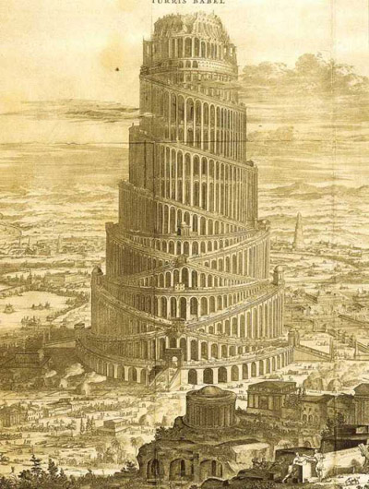
the Tower of Babel
But the Lord came down to see the city and the tower that the men were building.
The Lord said, “If as one people speaking the same language they have begun to do this, then nothing they plan to do will be impossible for them. Come, let us go down and confuse their language so they will not understand each other.”
(Genesis 11: 5-7)

Slide 19
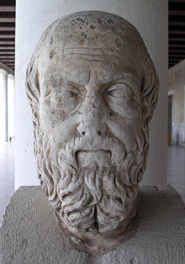
Translation in ancient Egypt
Now of the Egyptians there are seven classes, and of these one class is called that of the priests, and another that of the warriors, while the others are the cowherds, swineherds, shopkeepers, interpreters, and boatmen.
This is the number of the classes of the Egyptians, and their names are given them from the occupations which they follow.
(Herodotus Histories 2.164)

Slide 20
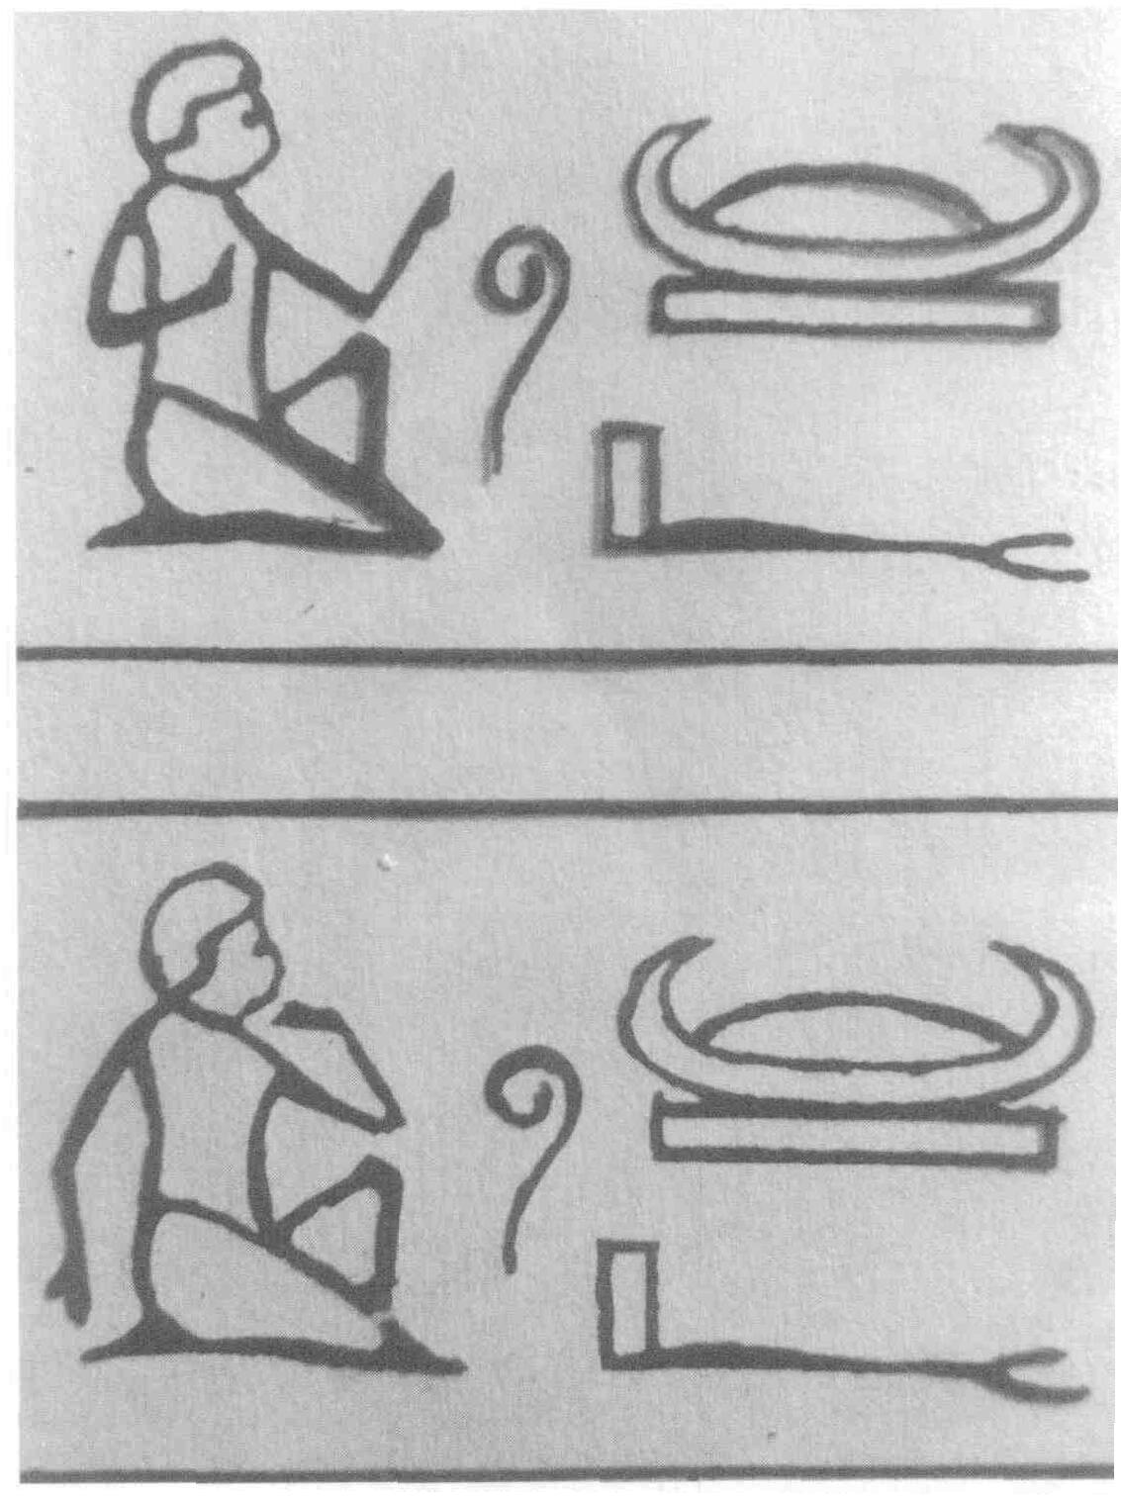
Translation in ancient Egypt
Egyptian hieroglyphic meaning “interpreting”

Slide 21
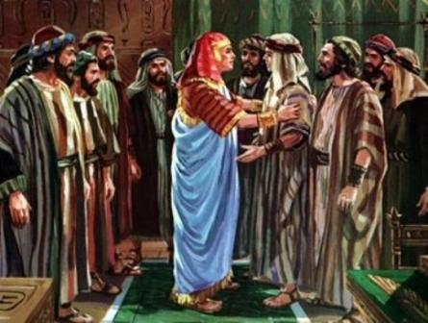
Translation in ancient Egypt
They did not know that Joseph understood them, for there was an interpreter between them. (Genesis 42)

Slide 22
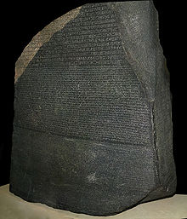
Translation in ancient Egypt
Rosetta Stone, bearing the first known bilingual text.

Slide 23
Translation in ancient Egypt
The inscription on the Rosetta Stone records a decree that was issued at Memphis in 196 BCE on behalf of King Ptolemy V.
The decree appears in three texts: ancient Egyptian hieroglyphs, Egyptian demotic script (used in everyday speech),
and ancient Greek.

Slide 24
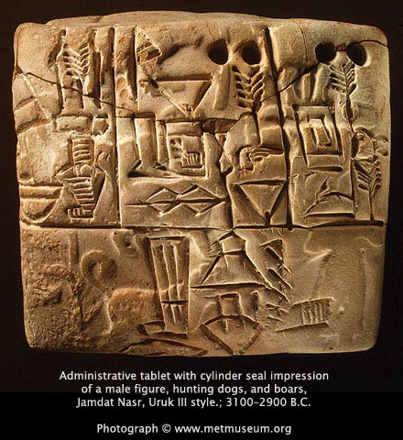
Translation in Assyria and Babylon
The Sumerian language of Mesopotamia (modern Iraq) is the earliest known written language
Sumerians wrote in cuneiform on clay tablets
bilingual cuneiform dictionaries of Sumerian and Akkadian (1800-1600 B.C.)

Slide 25
Translation in Assyria and Babylon
In ancient Assyria and Babylonia there was a regular board of interpreters working at court.
During the war the interpreters accompanied the king together with scribes and other officers.

Slide 26
Translation in ancient China and India.
The earliest translation activities in China date back to the Zhou dynasty (11th c.BC). Translation was carried out by government clerks.
"Translation is to replace one written language with another without changing the meaning for mutual understanding."
Jia Gongyan, an imperial scholar
(late Zhou dynasty)

Slide 27
Translation in ancient China
Year | Work | Author | Translator | Relevance
-1100 (周公居摄六年) | “道路悠远，山川岨深，音使不通，故重译而朝。” [not literature] | Report of the translation of talks of Yue Shang 越裳 to Duke Zhou 周公: “道路悠远，山川岨深，音使不通，故重译而朝。”, documented in: 《册府元龟·外臣部》 | Translator of Zhou Gong 周公
周 | 越人歌 第一篇诗歌翻译：越人歌（楚国和越国之间语言不通）P3-4 刘向书中对歌词的古越语记音用了三十二个汉字，如下： 滥兮抃、草滥予、昌枑泽予、昌州州、鍖州焉乎秦胥胥、缦予乎昭澶秦逾、渗惿随河湖（[汉]刘向．说苑校正．卷第十一．中华书局，1987．） | 楚译人把它译成“楚语”（即姚先生说的楚地汉语），用了五十四个汉字，“词采声调，宛然楚辞”： 今夕何夕兮，搴舟中流。 今日何日兮，得与王子同舟。 蒙羞被好兮，不訾诟耻。 心几烦而不绝兮，得知王子。 山有木兮木有枝，心悦君兮君不知。 | 刘向
秦汉时代 | 〈亡我祁连山〉匈奴诗歌 | 与北方匈奴打交道，他们使用的语言是阿尔泰语系，与汉语截然不同。P4 《西河旧事》中，翻译了一首古代匈奴的歌，这是古代匈奴留存下来的唯一文学作品，但是不知道译者是谁。 亡我祁连山， 使我六畜不蕃息。 失我燕支山， 使我嫁妇无颜色。P5 | Anonymous

Slide 28
Translation in ancient China and India
In the fifth century, translation of Buddhist scripture was officially organized on a large scale in China.
Dao An, Director of the State Translation School, advocated strict literal translation of the Buddhist scriptures, because he himself didn't know any Sanskrit.

Slide 29
Translation in ancient China and India
Indian Buddhist monk Kumarajiva (350-410) carried out a great reform of the principles and methods for the translation of Sanskrit sutras.
He applied a free translation approach to transfer the true essence of the Sanskrit Sutras.
He was the first person in the history of translation in China to suggest that translators should sign their names to the translated works.

Slide 30
Translation in ancient China and India
In the year 150, a Greek astrological text, written in Alexandria a hundred years earlier, was translated into Sanskrit.
In the classical period (100 -1000), translation activity in India was connected with the significant development of drama.

Slide 31
Translation in ancient China and India
Sanskrit plays started to allow characters who were not kings or brahmins to speak in Prakrit, an intermediate stage between Classical Sanskrit and the modern Indian languages derived from Sanskrit.
Prakrit speeches in plays were provided with glosses in Sanskrit.

Slide 32
Translation in ancient China and India
From the 7th century onwards, contacts with Arab traders resulted in the exchange of medical expertise between Indians and Arabs. Medical treatises were translated from Sanskrit into other languages both inside India and outside it.

Slide 33
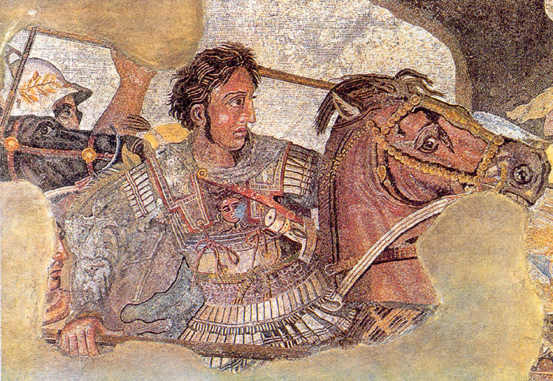
Translation in the Roman Empire
References to the services of military interpreters are found in Greek literature concerning Alexander the Great’s campaigns in Asia, which took him as far as India.

Slide 34
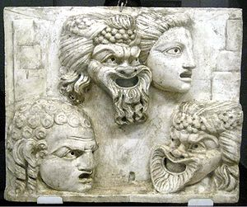
Translation in the Roman Empire
In the 3rd c. BC the popularity of Greek theatre among the Romans encouraged Latin authors to make free translations and adaptations of Greek plays.

Slide 35
Translation in the Roman Empire
Livius Andronicus (c. 285-204 BC) wrote a Latin version of the Odyssey (250 BC) and a number of plays commissioned for the Roman Games of 240 BC.

Slide 36
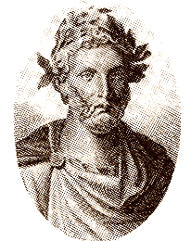
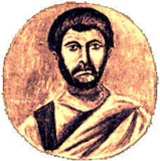
Translation in the Roman Empire
Plautus (d.184 BC) and Terence (?190-?159 BC) - the world's first commercial literary translators.

Slide 37
Translation in the Roman Empire
The Roman authors made free adaptations of the original Greek plays to suit the taste of the Roman audience.

Slide 38
Translation in the Roman Empire
In the century following Terence, the Greeks introduced rhetoric to Rome and translation began to be seen as a branch of rhetoric.

Slide 39
Translation in the Roman Empire
The greatest age of Roman literary translation began with a translation of Homer by Matius (about 100 BC) and lasted until the middle of the 1st c. AD.
This age set the tradition of treating translation as a literary apprenticeship.

Slide 40
Translation in the Roman Empire
Among the greatest names associated with the development of a truly Roman literature are the poets Catullus (87-57 BC) and Horace (65-8 BC) and the statesman, orator and philosopher Cicero (106-43 BC).

Slide 41
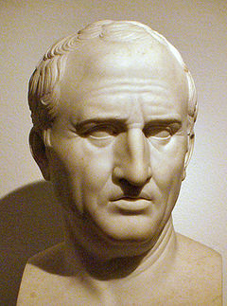
Translation in the Roman Empire
In De optimo genere oratum
(The Best Kind of Orator) Cicero makes two major points:
word-for-word translation is not suitable;
the translators should seek in their own languages expressions that make the translation sound as forceful and convincing as the original text.

Slide 42
Translation in the Roman Empire
Cicero's translations of Greek philosophers prepared the ground for most modern philosophical terminology.

Slide 43
Translation in the Roman Empire
‘De optimo genere oratorum’ (the Best Kind of Orator):
For I have translated into Latin two of the most eloquent and most noble speeches in Athenian literature, those two speeches in which Aeschines and Demosthenes oppose each other. And I have not translated like a mere hack, but in the manner of an orator, translating the same themes and their expression and sentence shapes in words consonant with our conventions.

Slide 44
Translation in the Roman Empire
In so doing I did not think it necessary to translate word for word, but I have kept the force and flavour of the passage. For I saw my duty not as counting out words for the reader, but as weighing them out. And this is the goal of my project: to give my countrymen an understanding of what they are to seek from those models who aim to be Attic in style, and of the formulas of speech they are to have recourse to.

Slide 45
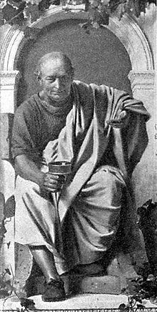
Translation in the Roman Empire
Horace criticizes the ‘faithful’ translator and follows the way of free interpretation of originals.

Slide 46
Translation in the Roman Empire
Horace supported Cicero’s recommendations for translators of orations, where the aim is not so much a literal transcription of the Greek words as a representation of the persuasiveness of source texts, which are transcriptions of delivered speeches.

Slide 47
Translation in the Roman Empire
From Horace, Satires, Epistles and Ars Poetica:
In ground open to all you will win private rights, if you do not linger along the easy and open pathway, if you do not seek to render word for word as a slavish translator.

Slide 48
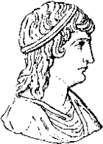
Translation in the Roman Empire
The way of free interpretation from the source language works in translation was accepted and further developed in the 2nd c. AD by Apuleius (c. 125 – c. 180), who would still more deliberately rearrange the ancient Greek originals altering them sometimes beyond recognition.

Slide 49
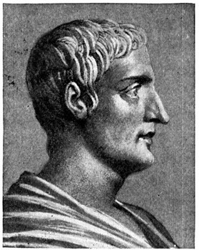
Translation in the Roman Empire
Quintilian
(?30-?96 AD)
Institutio Oratoria
(Education of an Orator)

Slide 50
Translation in the Roman Empire
Quintilian sees translation not only as a tool in the acquisition of a foreign language, but as a means of enriching the target language.
He systematizes much of what earlier writers had to say, making clear, for instance, the distinction between metaphrasis (word-for-word translation) and paraphrasis (phrase-by-phrase translation).

Slide 51
Translation in the Roman Empire
From Institute of Oratory; or Education of an Orator
From these [Greek] authors, and others worthy to be read, a stock of words, a variety of figures, and the art of composition must be acquired; and our minds must be directed to the imitation of all their excellences; for it cannot be doubted that a great portion of art consists in imitation, since, though to invent is first in order of time, and holds the first place in merit, yet it is of advantage to copy what has been invented with success. [ . . . ]

Slide 52
Translation in the Roman Empire
From Institute of Oratory; or Education of an Orator
We must, indeed, be either like or unlike those who excel and nature rarely forms one like, though imitation does so frequently. But the very circumstance that renders the study of all subjects so much more easy to us, than it was to those who had nothing to imitate, will prove a disadvantage to us, unless it be turned to account with caution and judgement.

Slide 53
Translation in the Roman Empire
From Institute of Oratory; or Education of an Orator
Undoubtedly, then, imitation is not sufficient of itself, if for no other reason than that it is the mark of an indolent nature to rest satisfied with what has been invented by others. For what would have been the case, if, in those times which were without any models, mankind had thought that they were not to execute or imagine anything but what they already knew? Assuredly nothing would have been invented. [ . . . ]

Slide 54
Translation in the Roman Empire
From Institute of Oratory; or Education of an Orator
It is dishonourable even to rest satisfied with simply equalling what we imitate. For what would have been the case, again, if no one had accomplished more than he whom he copied? [ . . . ] But if it is not allowable to add to what has preceded us, how can we ever hope to see a complete orator, when among those, whom we have hitherto recognised as the greatest, no one has been found in whom there is not something defective or censurable?

Slide 55
Translation in the Roman Empire
From Institute of Oratory; or Education of an Orator
Even those who do not aim at the highest excellence should rather try to excel, than merely follow, their predecessors; for he who makes it his object to get before another, will possibly, if he does not go by him, get abreast of him. But assuredly no one will come up with him in whose steps he thinks that he must tread, for he who follows another must of necessity always be behind him. [ . . . ]

Slide 56
Always here for you! 随时为你们服务
Professor Dr. Martin Woesler 吴漠汀 湖南师范大学特聘教授、 德国威藤-海德克大学教授，博士导师
Office / 办公室: 外国语学院
Phone / 电话: (150) 1138 8818 Email / 电子邮件: martin@woesler.de

Slide 57
Thank You

