Slide 1
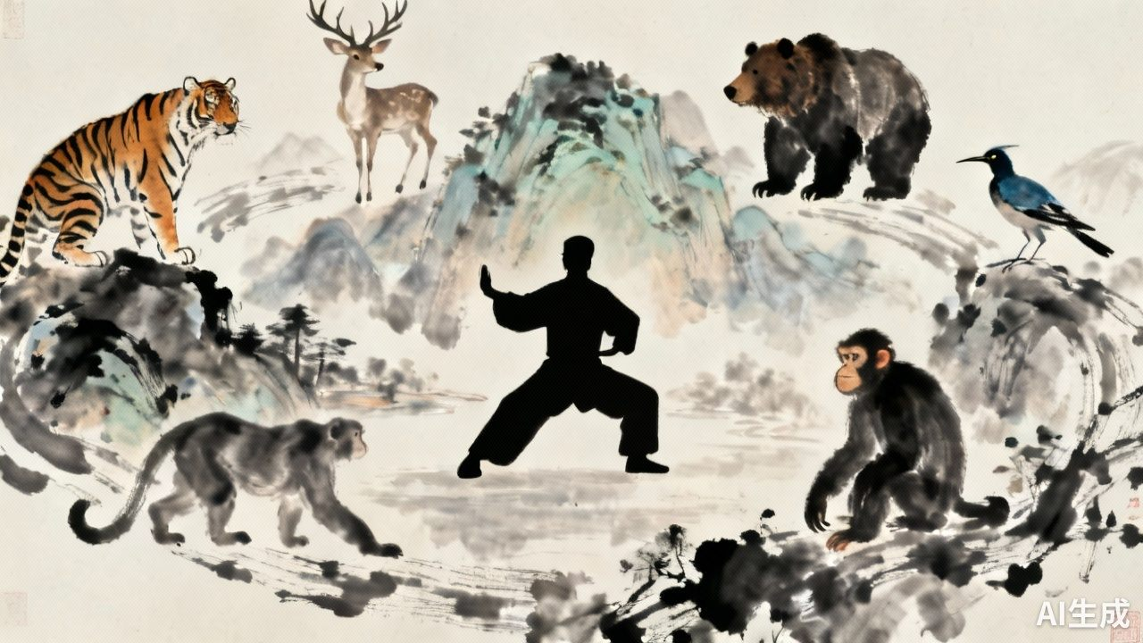
五
禽
戏
A Living Fossil of Chinese Wellness Culture
Frolics of the Five Animals
W U Q I N X I
五禽戏：中华养生文化的活化石
Lin Zhiyi
林芷怡
202570081746

Slide 2
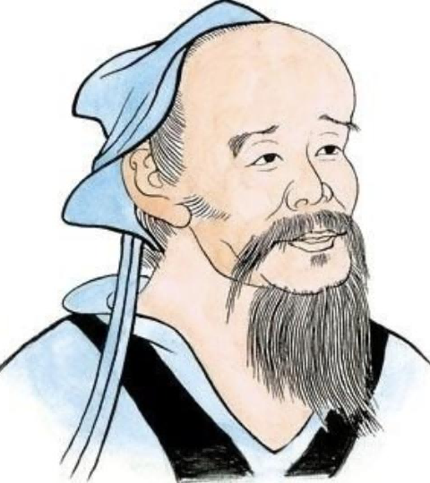
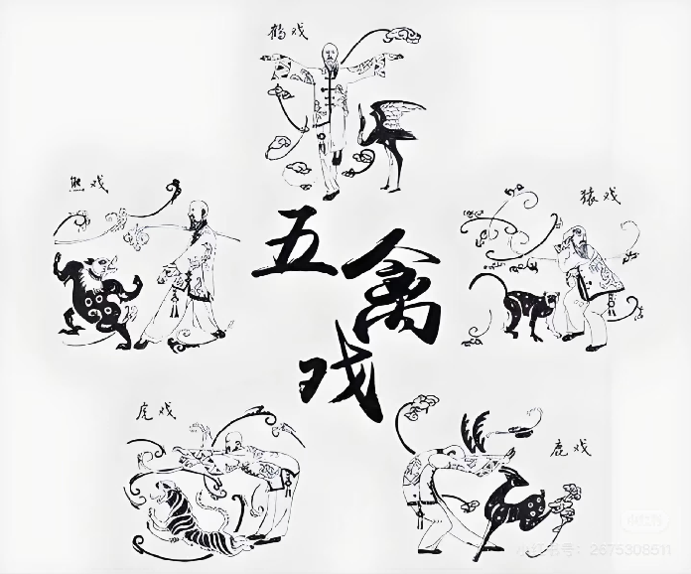
What is Wu Qin Xi?
何为五禽戏？
Origin: It was created by the famous physician
Hua Tuo in the Eastern Han Dynasty, with a history spanning nearly 1,800 years.
Core: It imitates the postures and movements of five animals: the tiger, deer, bear, ape, and bird.
It adheres to the health preservation concept of "external movement with internal tranquility, seeking tranquility amidst movement."
●
Origin: It was created by the famous physician Hua Tuo in the Eastern Han Dynasty, with a history spanning nearly 1,800 years.
Core: It imitates the postures and movements of five animals: the tiger, deer, bear, ape, and bird. It adheres to the health preservation concept of "external movement with internal tranquility, seeking tranquility amidst movement."
起源：东汉名医华佗创编，传承近1800年的导引养生
术。
●
核心：模仿虎、鹿、熊、猿、鸟五种动物的神态与动
作，遵循“外动内静，动中求静”的养生理念。

Slide 3
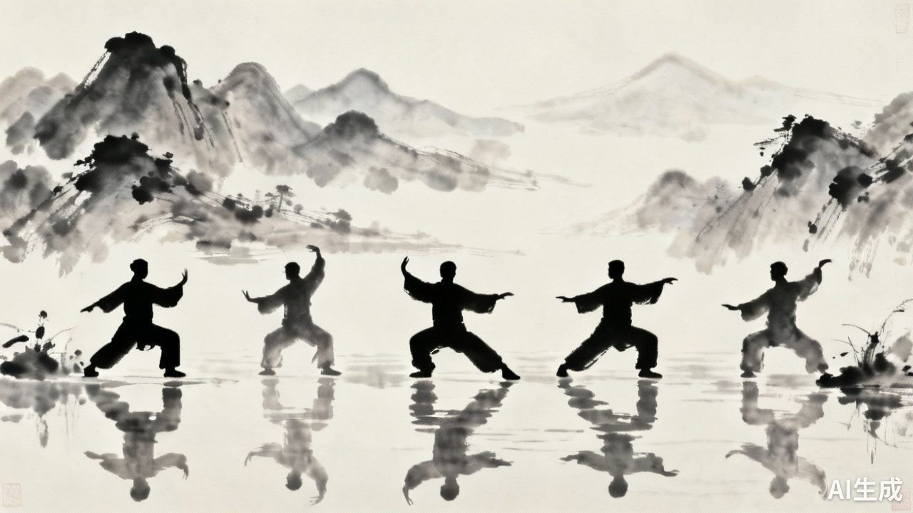
Core Philosophy :
“Unity of Man and Nature”
核心理念：“天人合一”
Harmonious unity between humans and nature, embodying the cosmic and life outlook of " following the natural way (Dao emulates nature)."
By imitating the movements of natural creatures, it achieves alignment between the rhythms of the human body and the laws of nature, thereby attaining physical and mental balance.

Slide 4
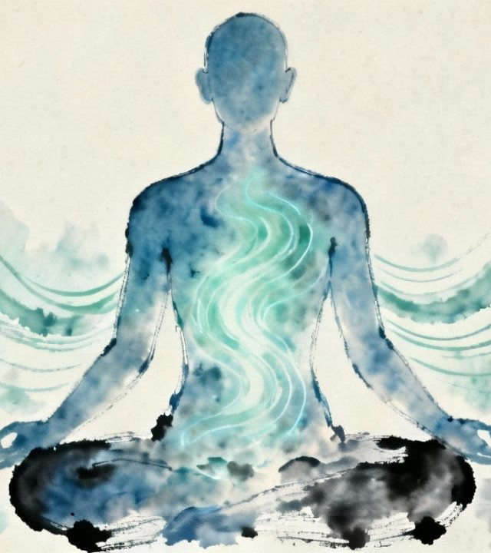
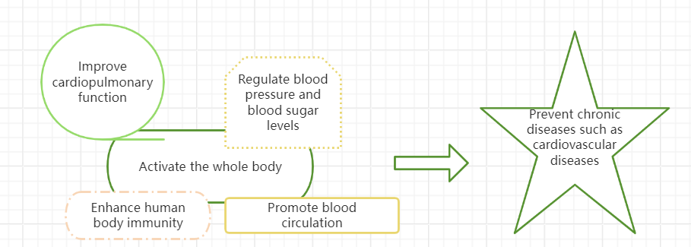
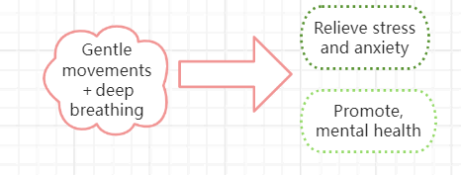
Medical Wisdom: "Preventive Healthcare"
Medical Wisdom:
“Preventive Healthcare”
医学智慧：“治未病”
By guiding and circulating qi and blood, as well as dredging meridians(疏通经络）, it strengthens physical constitution and embodies the proactive health management wisdom of "preventing diseases before they occur, and preventing the progression of existing diseases."(“未病先防、既病防变”)
五禽戏：中华养生文化的活化石

Slide 5
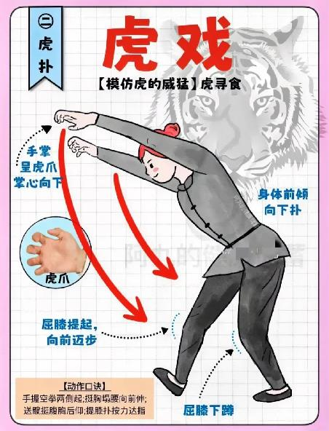
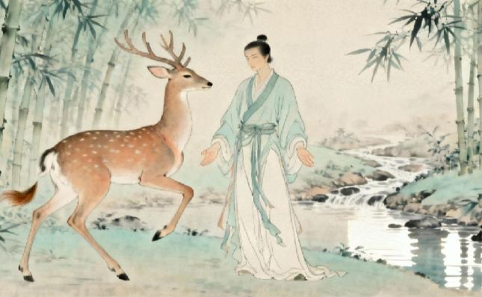
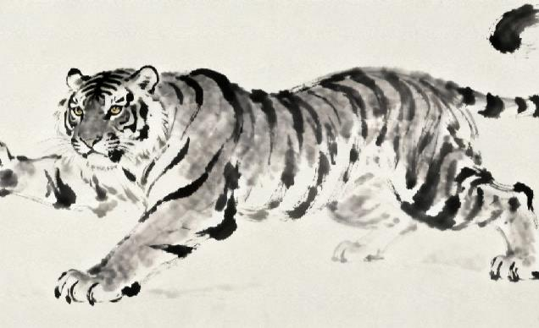
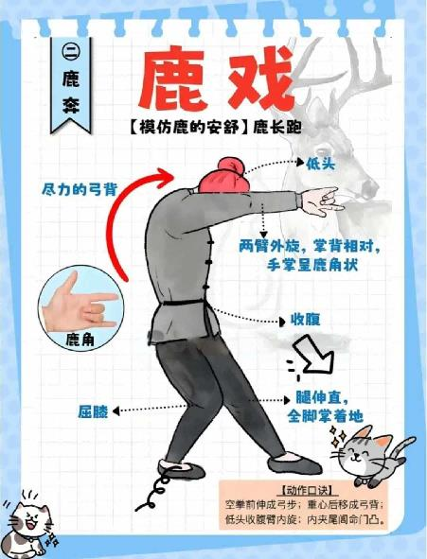
Aesthetic Connotation: Unity of Form and Spirit
美学底蕴：神形兼备
It imitates the majestic, vigorous, and coiled-up-for-action(蓄势待发）power of a tiger.
The movements predominantly feature pouncing, grasping, and pressing（扑、抓、按）, as exemplified by the move “Hungry Tiger Pouncing on Its Prey.”
It imitates the serene, graceful, and light-footed posture of a deer, as well as its tendency to engage in antler-clashing duels.
The movements mainly consist of lifting legs, running, turning the neck, and clashing antlers (提腿、奔跑、转颈、抵角).

Slide 6
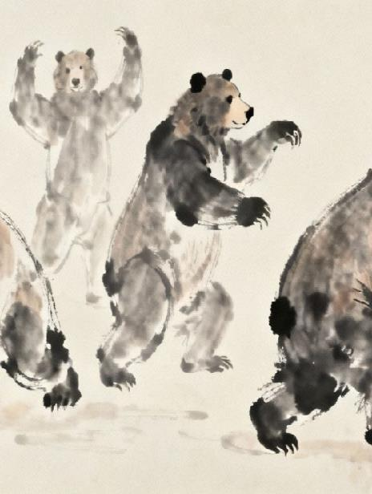
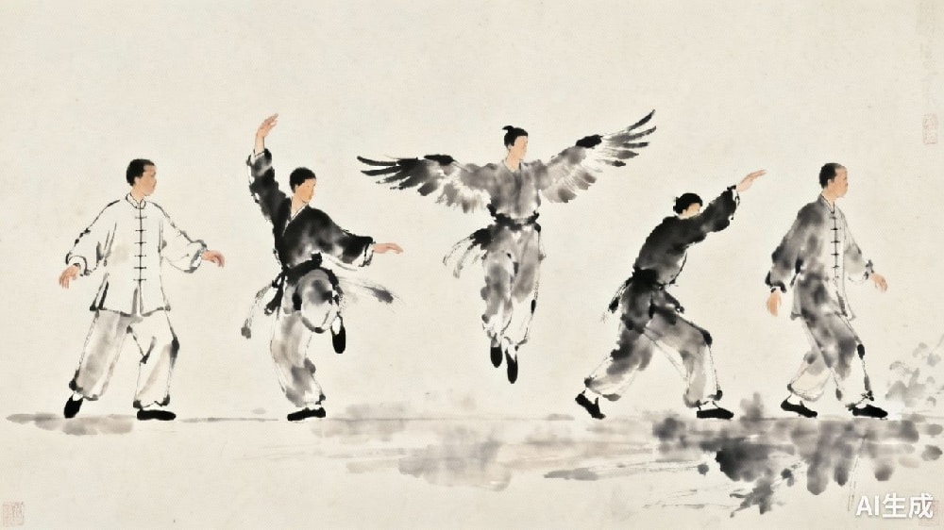
It imitates the bear's composed demeanor, robust and powerful essence concealed beneath its heavy and clumsy appearance.
The movements primarily focus on swaying, swinging, pushing, and leaning（晃、摆、推、靠）, with the core mimicking the bear's side-to-side body sway and the action of rubbing against trees to scratch an itch as it walks.
The Bird Play takes the crane as its prototype, imitating the stretched posture and breathing rhythm of birds during flight.
The movements mainly include those mimicking a crane spreading its wings, tucking its neck, and puffing out its chest（展翅、缩颈、挺胸）.

Slide 7
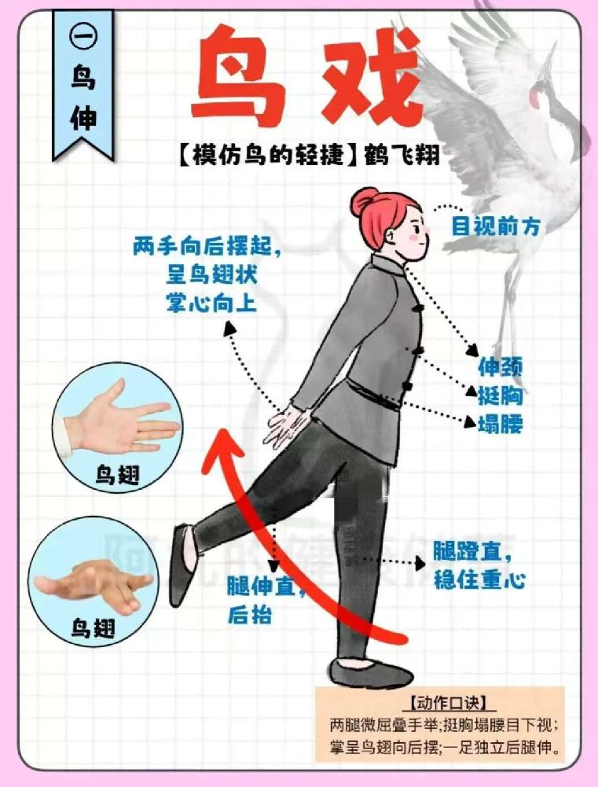
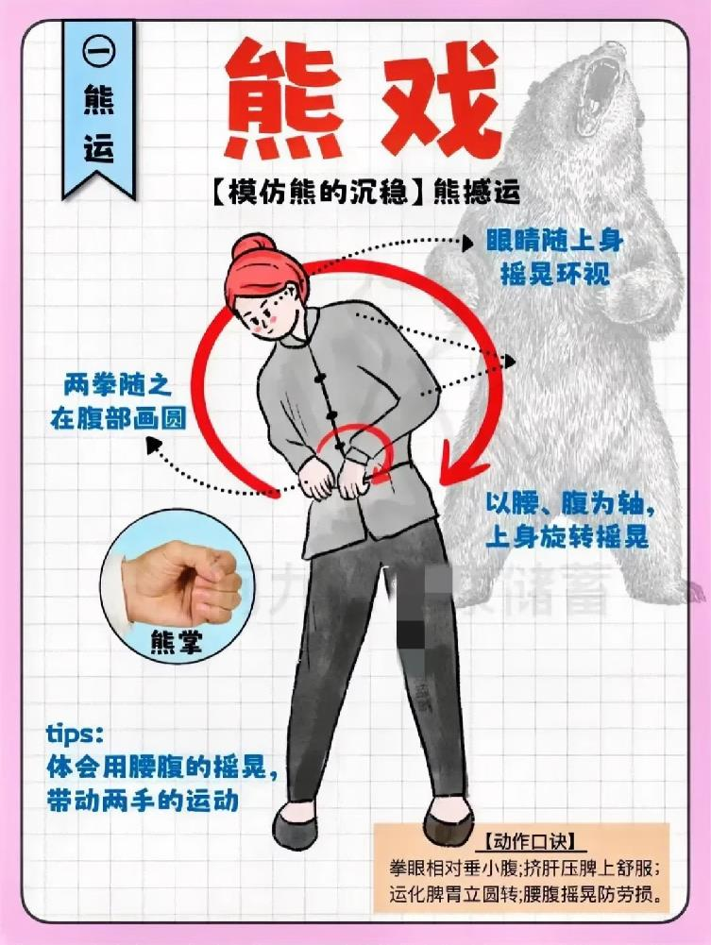

Slide 8
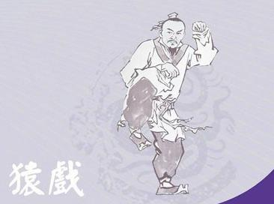
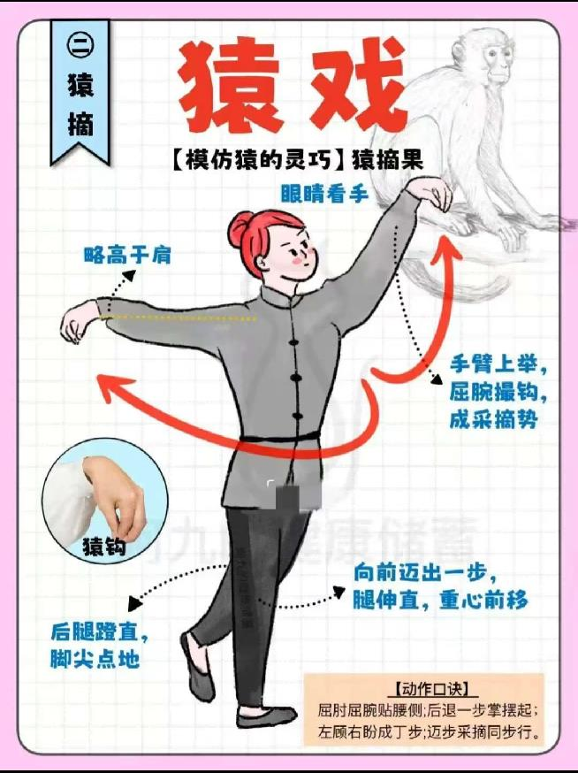
The Monkey Play is modeled on the agility and alertness of monkeys.
It involves imitating the movements of monkeys scratching their ears and cheeks, lightly leaping, or mimicking the actions of monkeys picking fruits.

Slide 9
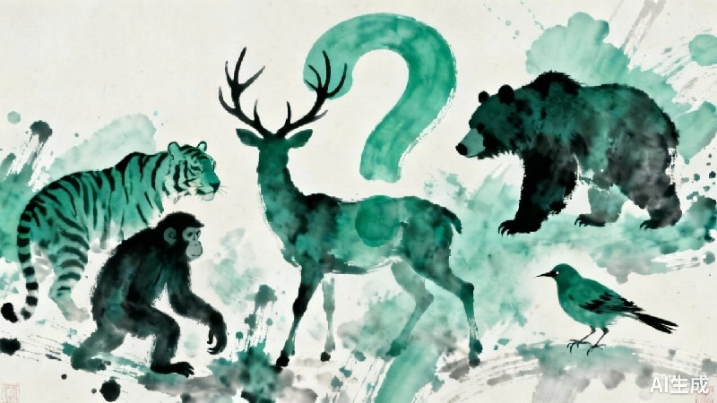
慧眼识禽戏
Guess the Wuqinxi Movements
Interaction Rules: I will present three images capturing key poses from the Wuqinxi.
After seeing each image, please identify which animal's movement it represents.
Those who answer correctly will receive small prizes.

Slide 10
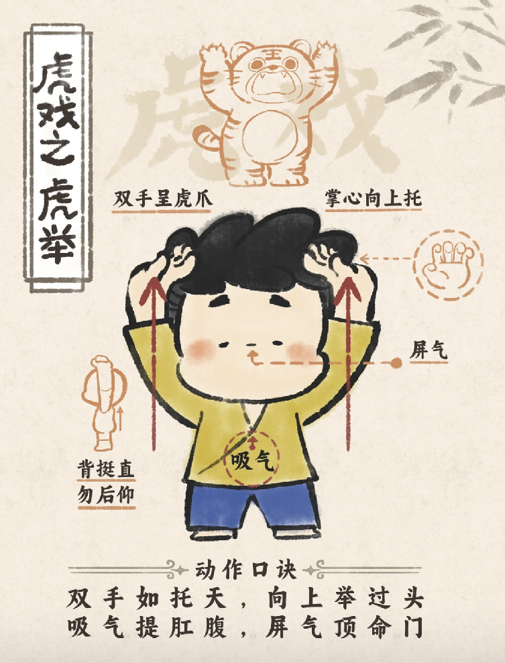
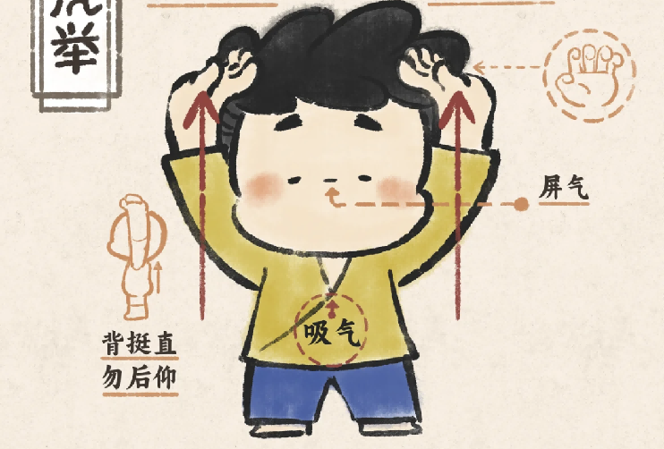
动作竞猜
提示：
展现力量与气势，壮筋骨、强腰肾。
答案：虎 (Tiger)
（虎举 ）

Slide 11
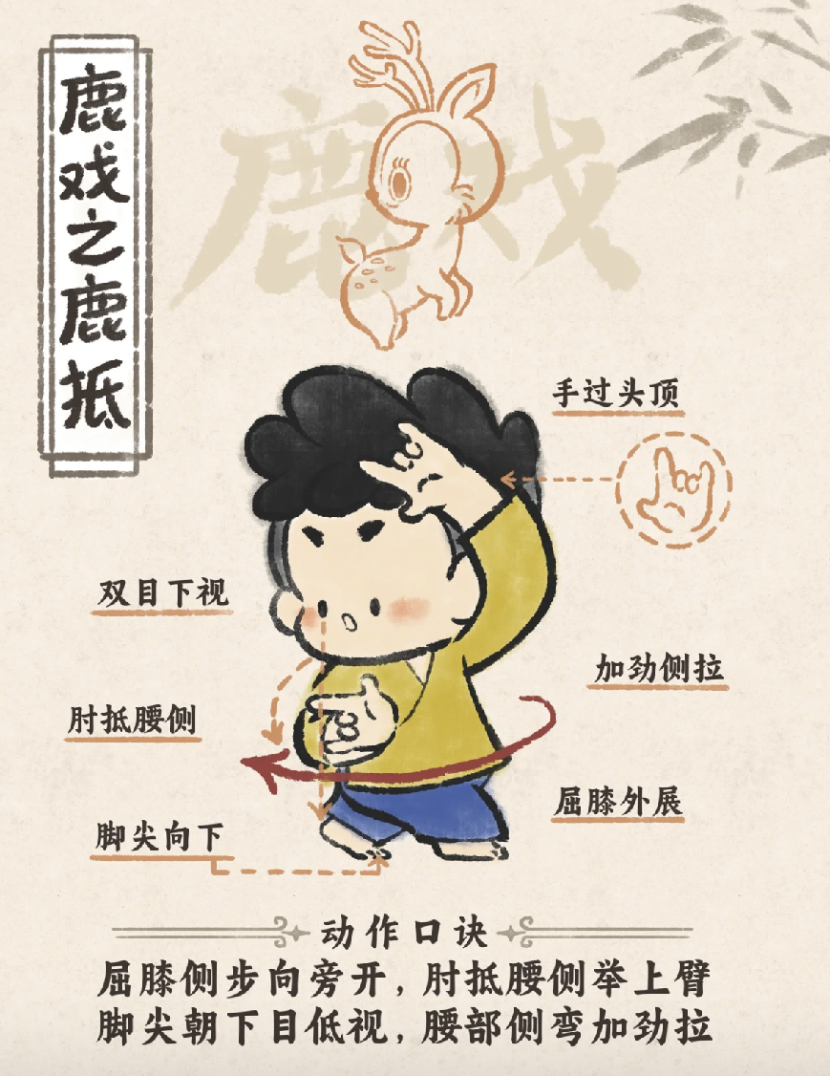
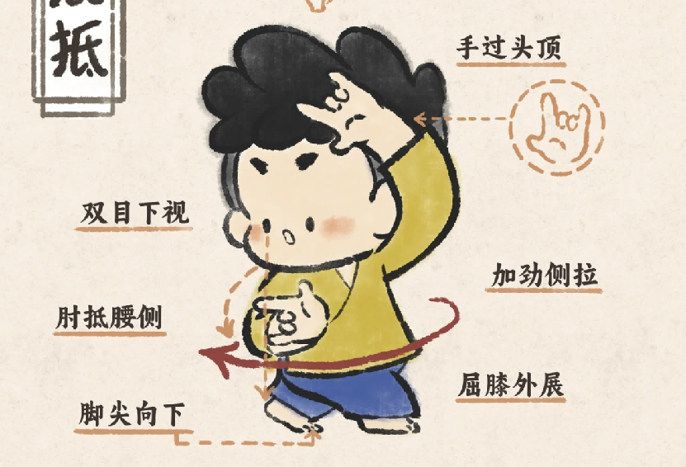
动作竞猜
提示：轻盈舒展，舒展筋脉、增强腰腿功能。
答案：鹿 (Deer)
（鹿抵 ）

Slide 12
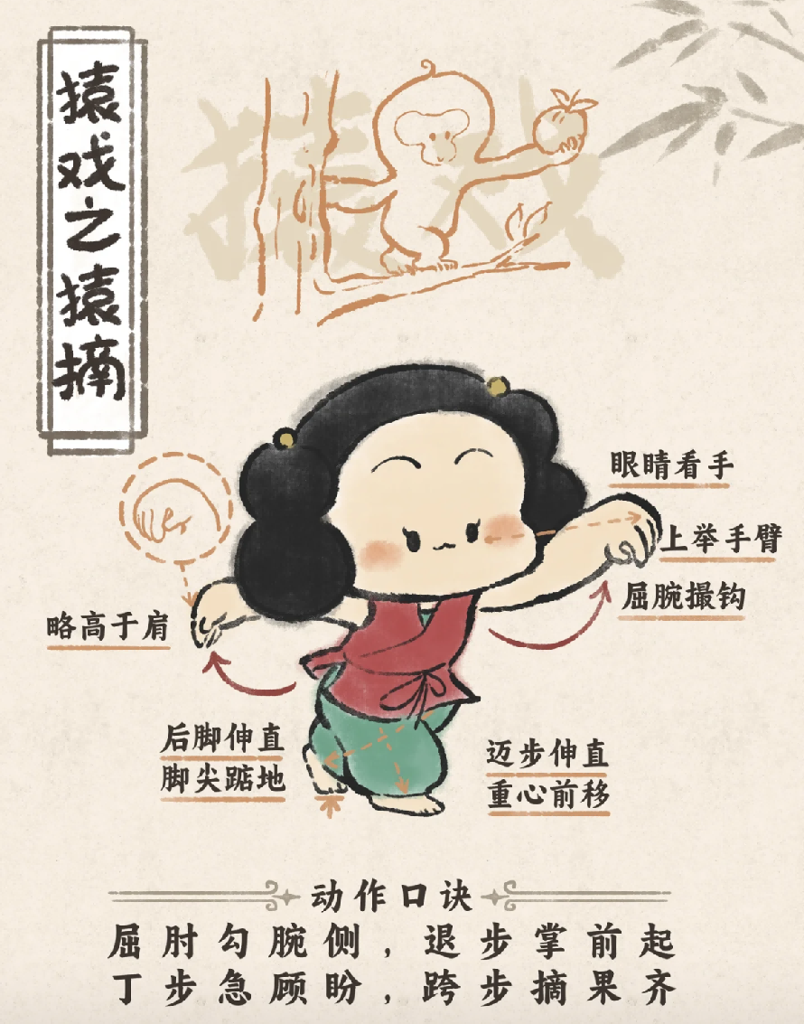
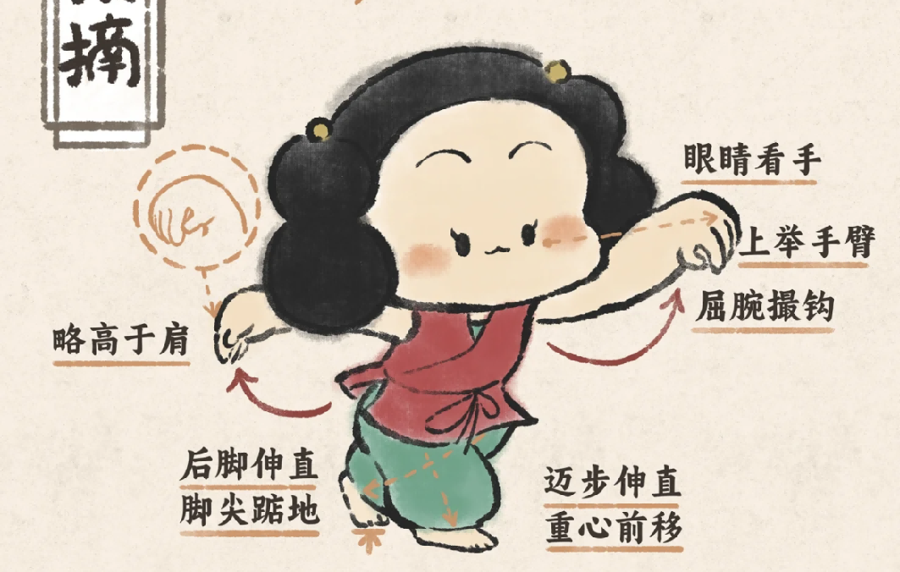
动作竞猜
提示：敏捷灵活，增强心肺功能、提升反应能力。
答案：猿 (Ape)
（猿摘）

Slide 13
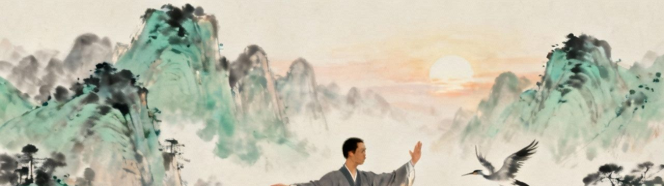
让我们一起动起来！
Let's Get Moving!
●
Key points for practice: Relax the mind, breathe naturally, and perform movements slowly and evenly.
练习要领：放松心、呼吸自然、动作缓慢均匀。

Slide 14

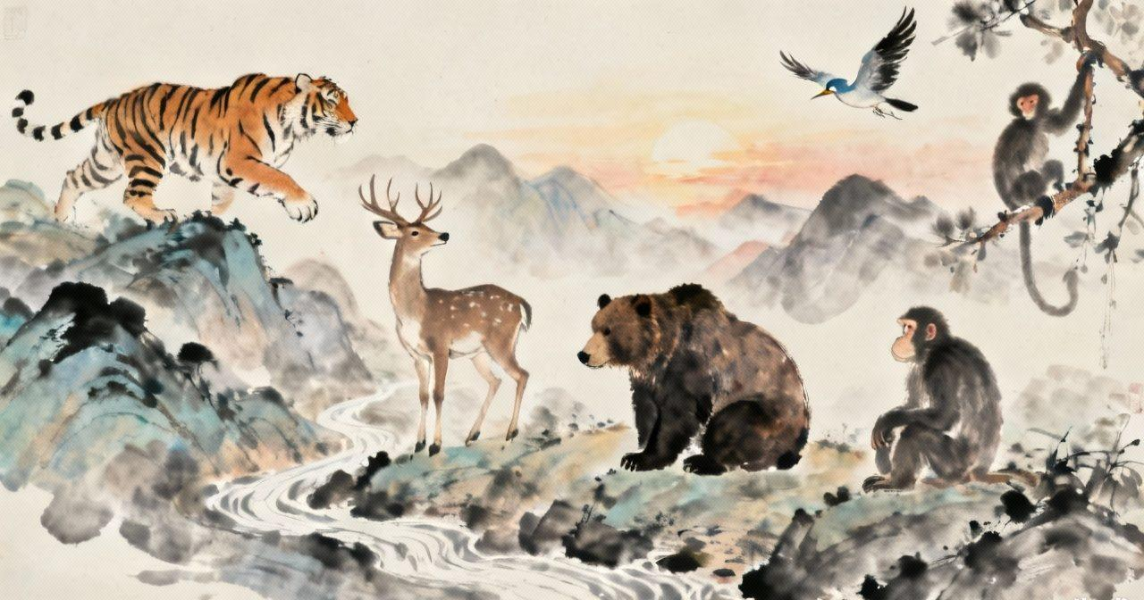
传承千年智慧，乐享健康生活
Inherit Millennia-Old Wisdom, Enjoy a Healthy Life.
Thank You!

