Slide 1
The Three Kingdoms
184 – 280 CE

Slide 2
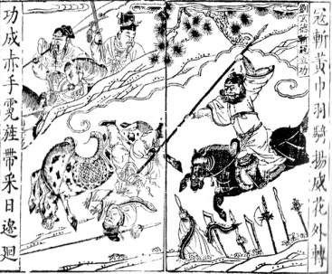
The Beginning of the End
Yellow Turban Rebellion
Caused by famine, floods, high taxes & corrupt government
No Mandate of Heaven
Zhang Jue Taoist Sect
Peasants, politicians, soldiers

Slide 3
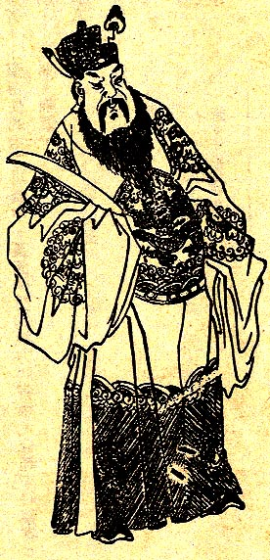
The Ten Eunuchs
Emperor Ling
189 CE
He Jin
Dong Zhuo
Emperor Xian

Slide 4
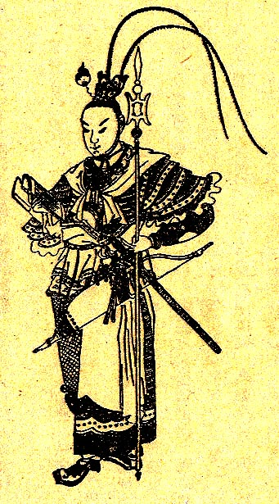
Allied Coalition
Capital moved from Luoyang to Chang’an
Luoyang burned
Internal strife
Lu Bu

Slide 5
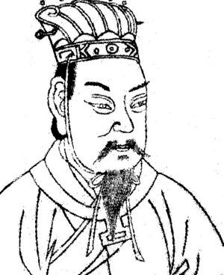
Cao Cao
Attempted to unify the Empire
Capital moved to Xuchang
Usurper of the throne
200 CE battle of Guandu
Pacifying the South

Slide 6
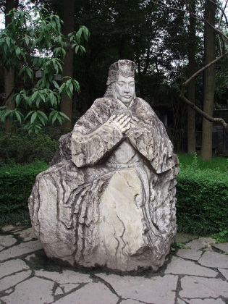
The Alliance
Liu Bei retreats from Changban
Alliance with Sun Quan
Exaggerated military numbers
Zhou Yu, commander of Alliance

Slide 7

Battle of Red Cliffs

Slide 8
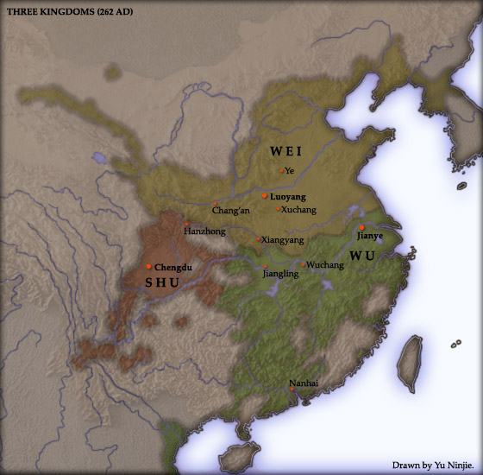
The Three Kingdoms
Shattered Alliance lead to separate kingdoms
Southern Wu, 222 CE (229 CE)
Sun Quan
Western Shu, 221 CE
Liu Bei
Northern Wei, 220 CE
Cao Pi

Slide 9
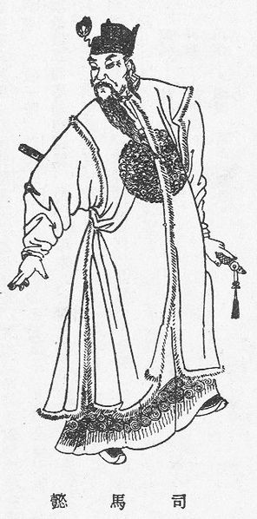
The Sima Family
Sima Yi serving the Wei
Cao Cao, Cao Pi, Cao Rui
Military advisor
After Cao Rui died, Sima Yi was granted governing powers
Coup d’etat

Slide 10
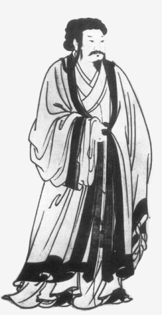
The Fall of Shu
Zhuge Liang passes away
Liu Shan lacking guidance
Corrupt eunuchs create chaos
263 CE, invasion from Wei
The Duke of Safety and Happiness

Slide 11
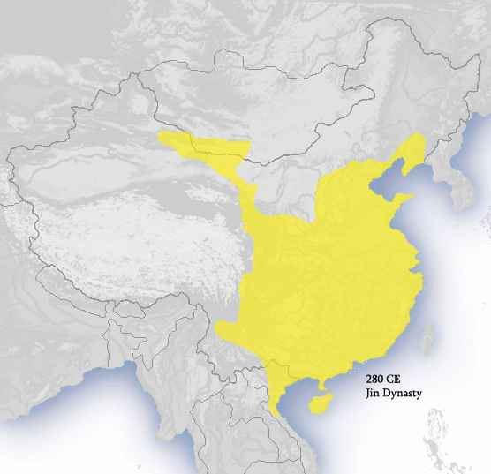
The Fall of Wei
Cao Huan attempts to assassinate Sima Zhao
Sima Yan grows tired of Cao family
Forces Cao Huan to abdicate throne
Overthrows Wei and creates Jin Dynasty
264 – 420 CE

Slide 12
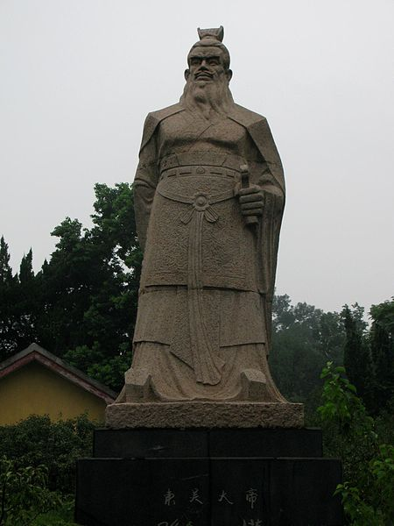
Fall of Wu
Sun Quan dies in 252 CE
Wu in gradual decline
Wei restricts Wu through civilian uprisings
Sun Hao becomes a tyrant Emperor
Kills and exiles his own court
279 CE, Jin Kingdom enters and defeats a weakened Wu

Slide 13
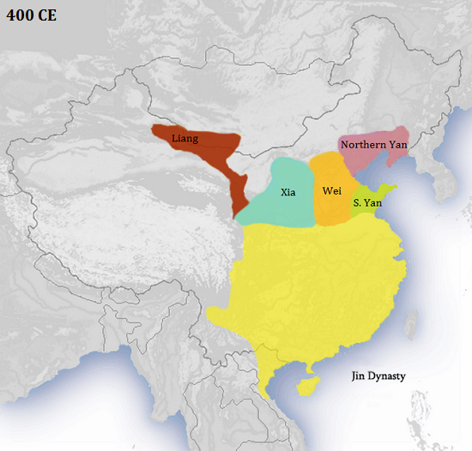
280 CE
The Three Kingdom era comes to an end
Jin Dynasty rules China until 420 CE

