Slide 1


National Flag
107.
National Symbols:
National Flag of the People’s Republic of China
邓蕊欣

Slide 2

directory
1
Introduction
2
Establishment process
3
Symbolism

Slide 3

National flag | A five-star red flag
Designer | Zeng Liansong曾连松
Design elements | Red and rectangular（length & height are three to two） Five yellow five pointed stars （decorated on the top left of the flag）
Design details | One star is larger, and its circumscribed circle diameter is three tenths of the flag height, which is on the left. The four stars are smaller, and their circumscribed circle diameter is one tenth of the flag height, and the ring is arched to the right of the big star.
A brief introduction of National Flag of the People's Republic of China
段落文本配图
此处可以添加副标题或说明文本

Slide 4
The national flag Selection Committee received 2992 national flag designs.
The first plenary session passed a motion to use the five-star red flag as the national flag.
The first national flag was first raised by Mao Zedong in Tiananmen Square.
On August 20,1949
On September 27,1949
On October 1,1949

Slide 5

Establishment
processment process
Solicit comments from the public
Collect drafts from all walks of life
Pass a resolution

Slide 6
On June 15,1949
The sixth group of the Preparatory Committee was designated to be responsible for the important task of formulating the national flag of new China.
On 4 July 1949
The sixth group held its first meeting to solicit the patterns of the national flag and the national emblem.
From July 14 to August 15
Newspapers published the notice of Chinese people's Political Consultative Conference asking for the design of the national flag.

Slide 7

Collect drafts from all walks of life
On August 20,1949, the national flag and national emblem Selection Committee received 2992 pieces of national flag patterns.
Guo Moruo, Chen Jiageng and other members of the preparatory committee also submitted their sample designs.
These designs were displayed in the temporary reading room.
The selection committee selected 38 draft plans and incorporated them into the reference materials for the design of the national flag.

Slide 8
Final resolution
On September 27,1949, the resolution on the capital, chronology, national anthem and national flag of the people's Republic of China, adopted at the first plenary session of the CPPCC National Committee.
“the national flag of the people's Republic of China is a five-star red earth flag,which symbolizes the great unity of the revolutionary people of China.”
段落文本配图
此处可以添加副标题或说明文本

Slide 9
Symbolism
The red flag of the people's Republic of China | Revolution
The five five pointed stars on the flag and their relationship | The great unity of the revolutionary people under the leadership of the Communist Party
Each of the four small Pentagram stars has a point facing the center of the big star | They are united around a center and are compact in form
Length and height are three to two, and five yellow pointed stars are on the top left of the flag | The revolutionary unity under the leadership of the Communist Party of China

Slide 10
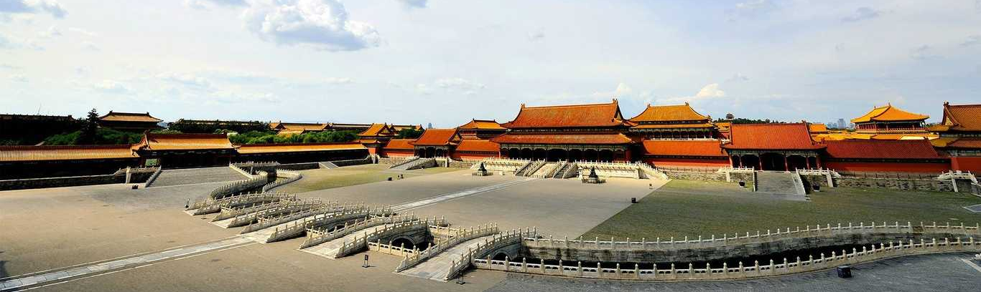
https://www.bilibili.com/video/BV1f44y147m4?p=1&share_medium=android&share_plat=android&share_session_id=82db3626-101a-4ccf-94db-d612e718ca4c&share_source=WEIXIN&share_tag=s_i&timestamp=1652584258&unique_k=CTWX6co
https://www.bilibili.com/video/BV1EY411a7EG?p=1&share_medium=android&share_plat=android&share_session_id=6d0aae7c-ef27-4f10-977a-addcf1cdfef8&share_source=WEIXIN&share_tag=s_i&timestamp=1652584372&unique_k=UYbt2Kr
https://www.bilibili.com/video/BV1Lb4y1n7C3?p=1&share_medium=android&share_plat=android&share_session_id=276b009e-b2cf-4bb9-90d4-fd8a53e1d784&share_source=WEIXIN&share_tag=s_i&timestamp=1652584468&unique_k=hPj4NDK

