Slide 1
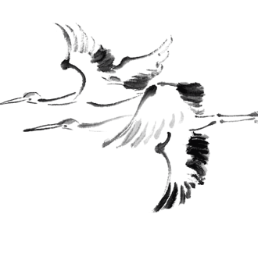
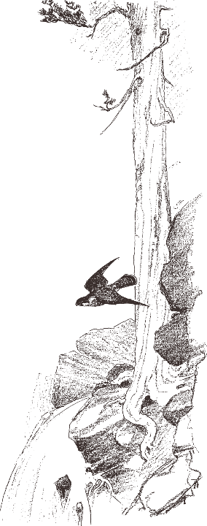
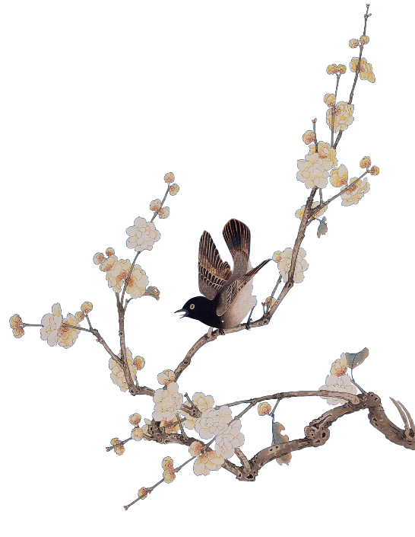
The Four Great Works of Chinese Classic Novels
——王亚娟
Notes:
版权声明：精品模板商业授权，请联系【锐旗设计】:https://9ppt.taobao.com，专业PPT老师为你解决所有PPT问题！

Slide 2


目
1.Water Margin
2.Romance of Three Kingdoms
录
3.Journey to the West
4.Dream of the Red Chamber

Slide 3





Water Margin

Slide 4
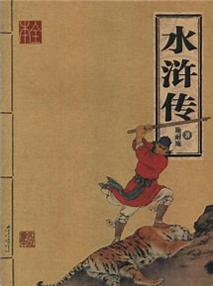
Water Margin
Water Margin, written by Shi Naian, is based on the peasant uprising led by Songjiang in the late Northern Song Dynasty. Through the process of the peasant uprising, it reveals the political corruption and the darkness of the society.

Slide 5
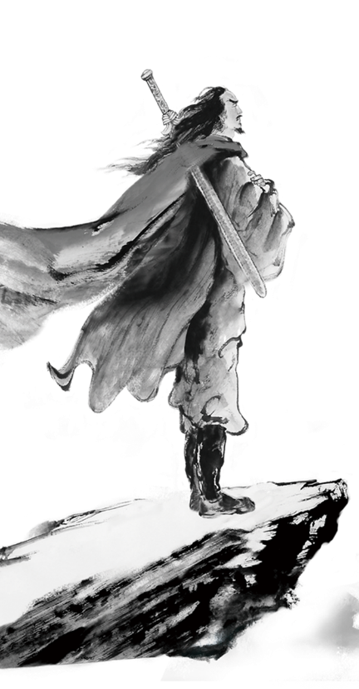
The first forty chapters of this book are about individual heroes, and then talks about the process of their great union in Liang Shan. From seventy chapters, it tells their defeat and submission to the court.
Zheng Zhenduo in his Studies in Chinese Literature uses an arc to describe the structure of Water Margin. The arc starts with“误走妖魔” (the first chapter), reaches the apex of “梁山英雄排座次”(chapter 71: the heroes’ ranking in the Liang Shan), and then gradually declines to the end of “魂聚蓼儿洼”(the last chapter).
.

Slide 6
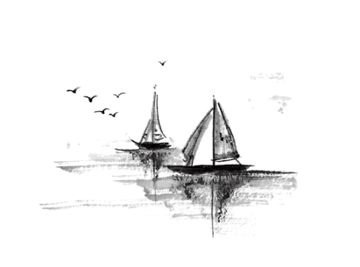


This book had a great influence on later generations, providing lessons for people’s struggle experiences after the Ming Dynasty. It is not only provide subjects for later novels and plays, but also opening the way for the creation of Chinese realistic literature.

Slide 7

Romance of the Three Kingdoms

Slide 8
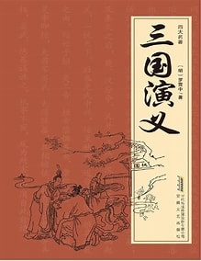
Romance of the Three Kingdoms
Romance of the Three Kingdoms, was written by Luo Guanzhong. The story begins with the Yellow Turbans Uprising and ends with the reunification of the Western Jin Dynasty. The story describes the political and military struggles during the period of the Three Kingdoms with the rise and fall of the three kingdoms of Wei, Shu and Wu.

Slide 9
The book can be divided into three parts: the first part (1-33) is about the turmoil at the end of the Han Dynasty and the rise of Cao Cao’s group; the second part (34-85) is about the growth of Liu Bei’s group and the formation of the Three Kingdoms; and the third part is about the decline of the Three Kingdoms which was unified by Sima, and the establishment of the Western Jin Dynasty.
The structure of Romance of the Three Kingdoms is described by scholar Mao Zonggang as “a tree with different branches”, that is, the plot is arranged not in a single line but in multiple alternating lines. With the three parties of Wei, Shu and Wu as the core, all the conflicts leading to the evolution of events are alternately advanced.

Slide 10
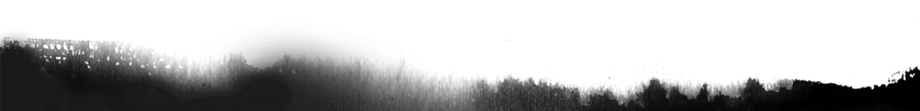
The author has created a large number of characters with distinctive personalities, such as Liu Bei, who loves the people like son, and Zhuge Liang, who has amazing wisdom. This book shows the distinctive idea of “supporting Liu and opposing Cao” and the benevolent ideology of Confucianism, as well as the people’s desire for a bright ruler and a stable society.
Romance of the Three Kingdoms pioneered Chinese historical romance novels and led to the creation of romance novels during the Ming and Qing dynasties , for example, Romance of Sui and Tang Dynasties, The Life of Yue Fei and Records of the States in the Eastern Zhou Dynasty were written in this period.

Slide 11

Journey to the West

Slide 12
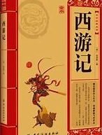
Journey to the West
Journey to the West, written by Wu Chengen, is a classical mythological novel. It tells the story of the Tang Monk’s journey to get the scriptures and expresses the idea of praising virtue and punishing vice.

Slide 13
The first seven chapters tell the Havoc in Heaven of Sun Wukong, 8 to 12 chapters tell the origin of getting scriptures, and the latter part tells the story of Sun Wukong’s conversion to Buddhism, protecting the Tang Monk to get the scriptures, accompanied by Sand Monk, Zhu Bajie and White Dragon Horse.
One of features of Journey to the West is that it uses imagination and exaggeration to break through the limitations of time and space, life and death, and human and god, creating a fantasy world. It praises the spirit of the four teachers and prentices who are indomitable and not afraid of hardships. This book also conveys the author’s dissatisfaction and satire of reality. As the scholar Li Zhuowu commented, the gods and demons in Journey to the West are depicted very much like people in the world, and the author uses them to reflect reality.

Slide 14
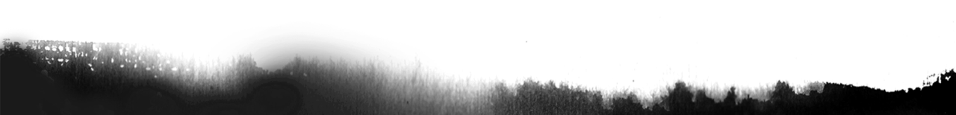
Journey to the West pioneered a new type of long chapter novel about gods and demons, and thereafter, the Ming Dynasty saw the culmination of writing this kind of novels. The combination of satire and criticism in this book also influenced the development of satirical novels.

Slide 15

Dream of the Red Chamber

Slide 16
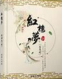
Dream of the Red Chamber
Dream of the Red Chamber, also known as the Story of the Stone, written by Cao Xueqin, is the pyramid of classical Chinese novel. Mao Zedong called it “the encyclopedia of Chinese feudal society” and praised it as “the fifth great invention of China”. The book focuses on the love between Lin Daiyu and Jia Baoyu, exposing the corruption of the feudal ruling class and revealing the inevitable collapse of feudal society.

Slide 17

The first five chapters are the prologue; chapters 6-55 are the heyday of the Jia family; chapters 66-104 are the period when the four families, represented by the Jia family, turn from prosperity to decline; and chapters 105-120 are the period of complete decay.
The conflicts between landlords and peasants; between noble rulers and servants; between feudal guardians and feudal rebels; and within feudal rulers are expressed in Dream of the Red Chamber. Through the struggle between the feudal rebels represented by Jia Baoyu and the feudal guardians, it attacks the hypocrisy of feudal morality, glorifies the newborn rebellious spirit, It expresses the author’s progressive social thought and new democratic ideology, which is a main line throughout the book and represents a new height of thought.

Slide 18

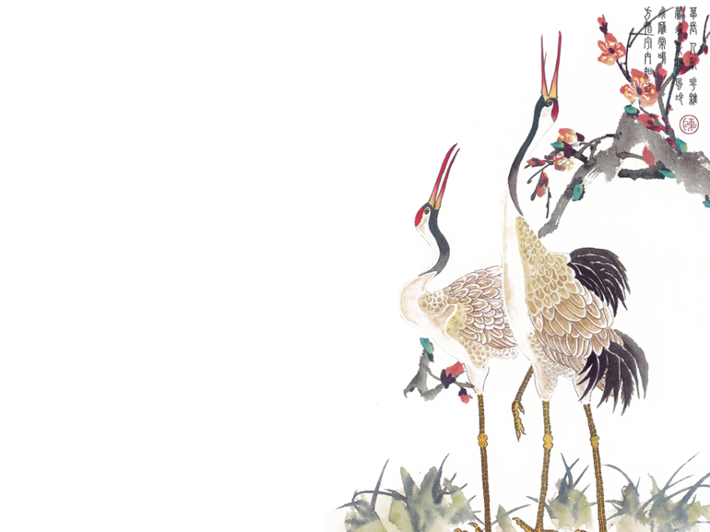
Dream of the Red Chamber has its literary and artistic value. The book makes extensive use of rhetorical techniques such as metaphor, metonymy, pun and exaggeration; at the same time, the author often express the personalities of the characters by using poems. Redology, which specializes in the study of Dream of the Red Chamber, also illustrates to the intellectual and artistic achievements of this book.

Slide 19
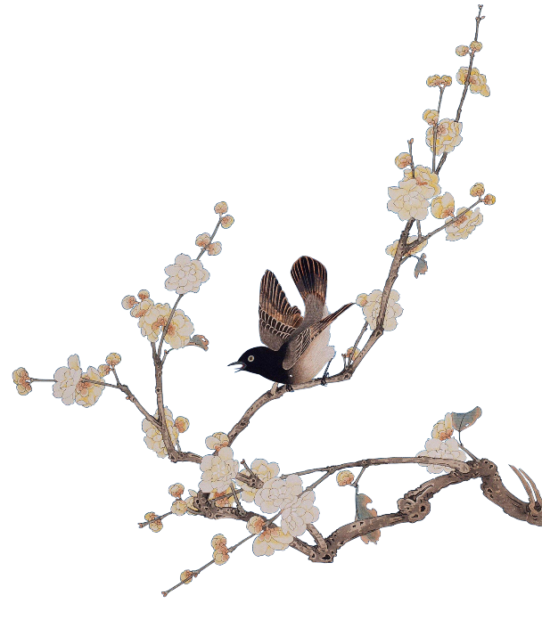
Thanks!

