Slide 1
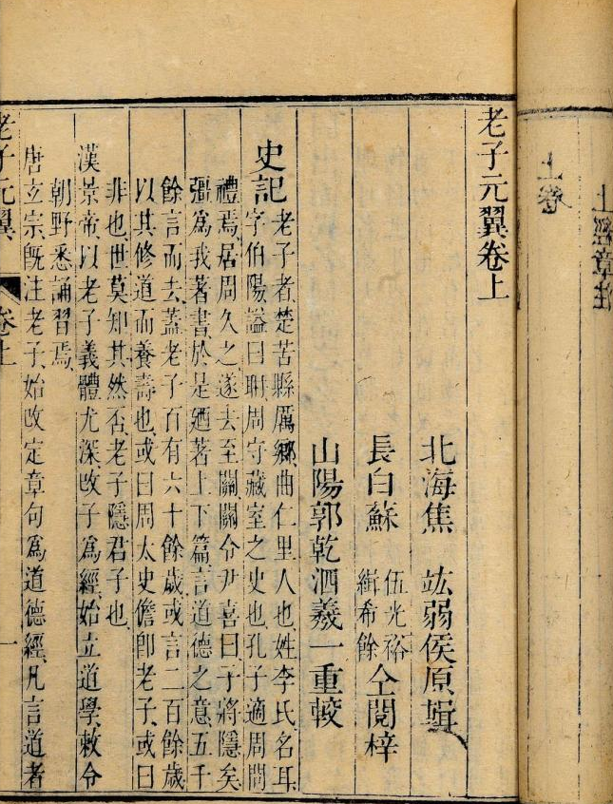
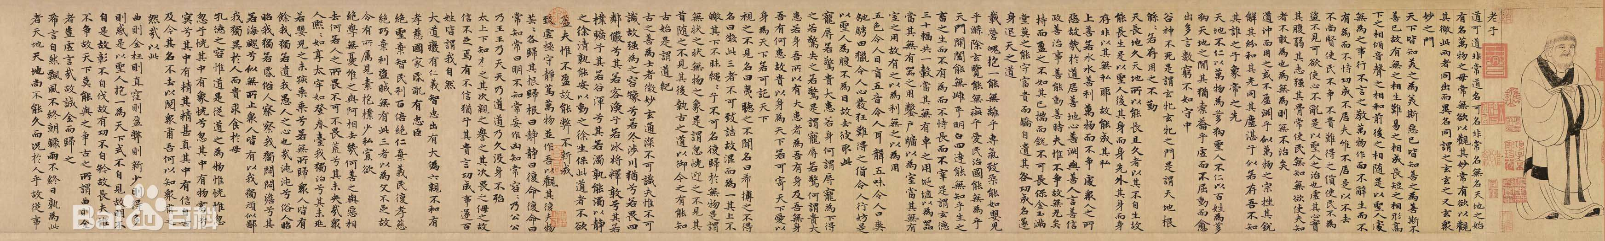
The Tao gives birth to one, one to two, two to three, three to everything.
道生一一生二二生三三生万物
Almost the same
Background，
Methods，
Worldview,
Techniques.
all things are equal

Slide 2
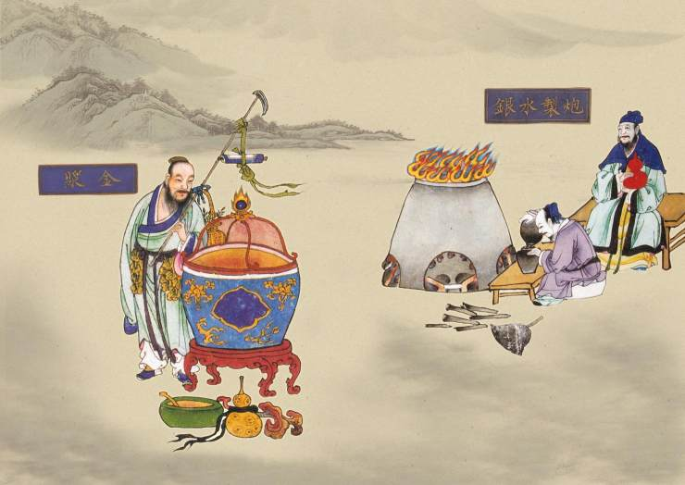
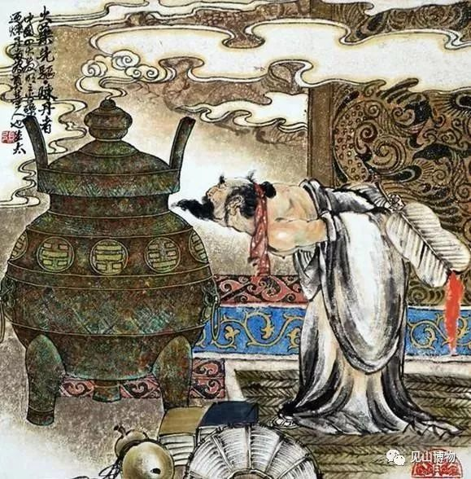
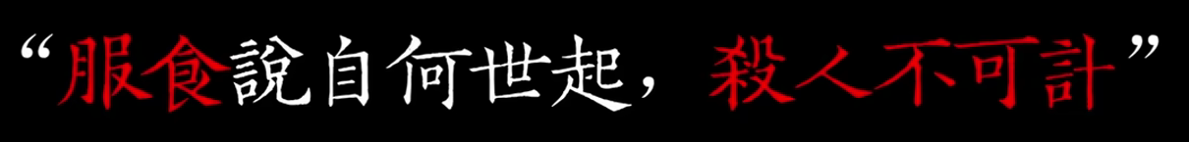
Reevaluating
Round 1
“Elixirs were nowhere to be found, so why not make them on our own?”

Slide 3
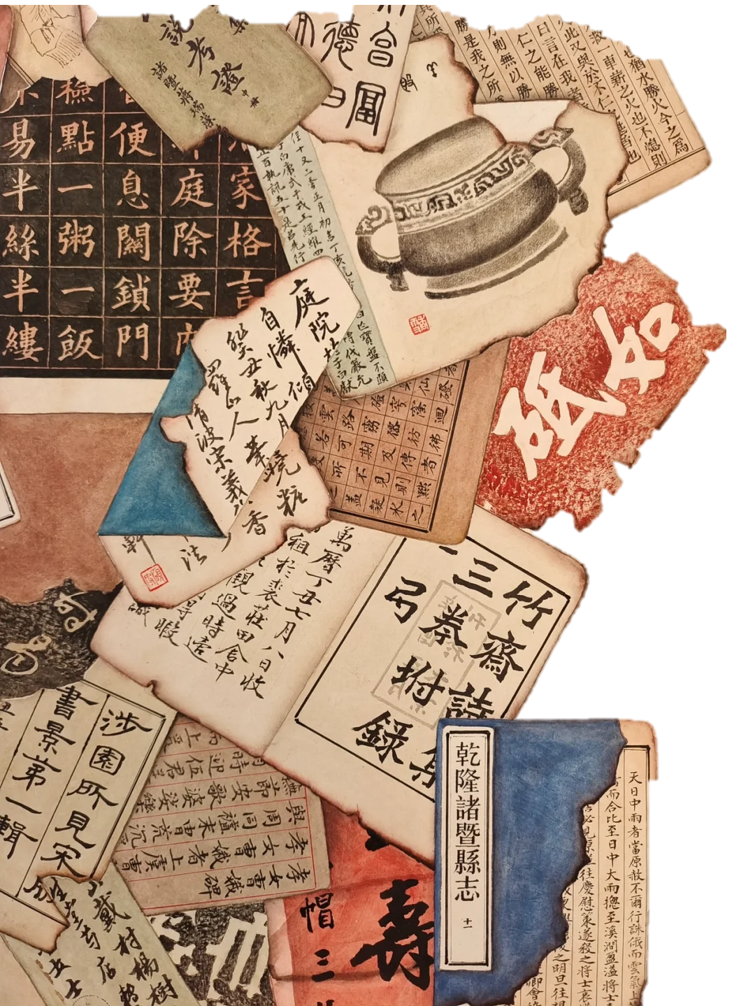
Reevaluating
Round 2
“What went wrong must be the tools or the ingredients! We can’t produce immortal pills! But humans are created by heaven and earth, and the human body is the best tool, and Qi is the best ingredient. Isn’t cultivating Neidan(inner alchemy) better!”

Slide 4
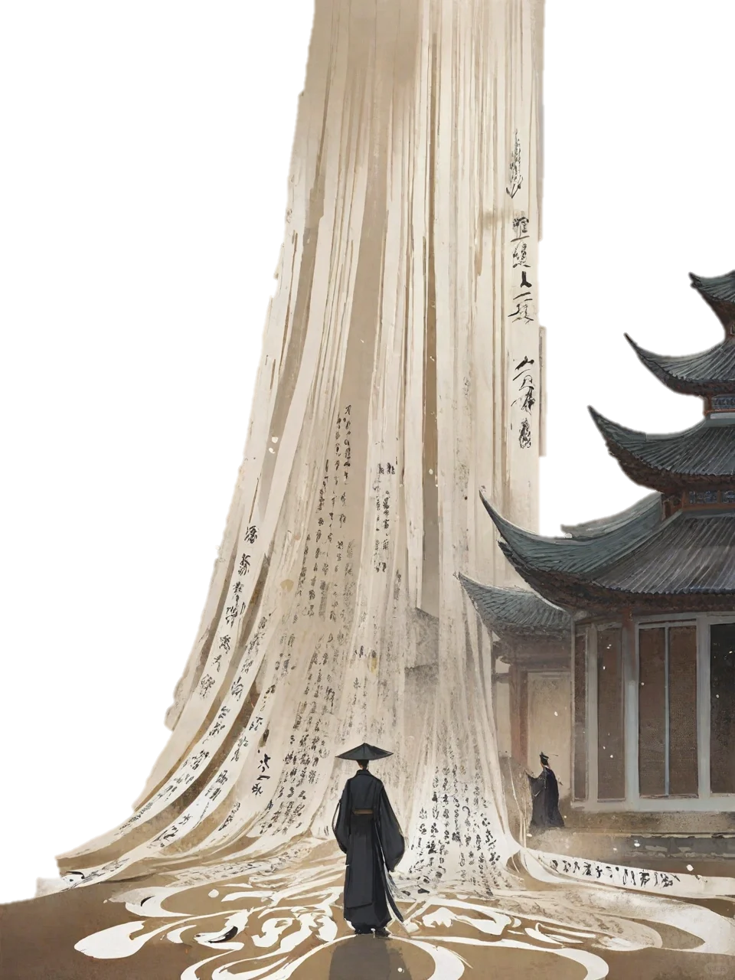
1.筑基-Foundation Building
2.炼精化气-Refining Essence and Transforming Qi
3.炼气化神-Refining Qi and Transmuting Spirit
4.炼神还虚-Refining Spirit and Returning to Emptiness
5.炼虚分道·Refining Empties and Diverging Paths

Slide 5
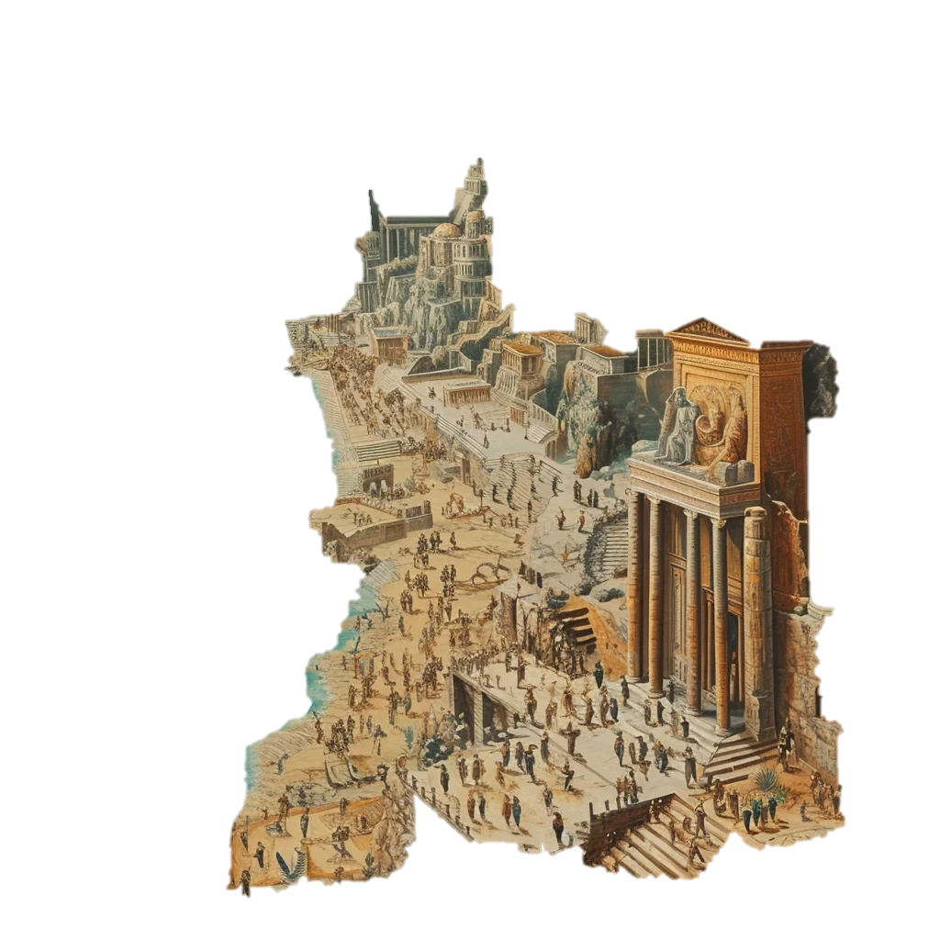
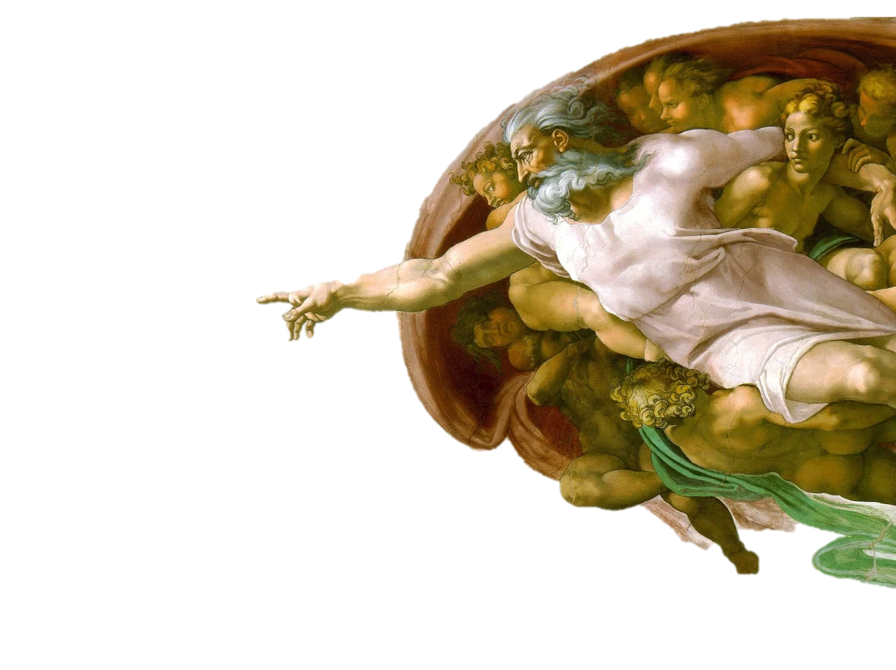
Comparision
Western mythology：Inherited by blood.
God's power comes from the bloodline.
VS
Chinese mythology：it has completely failed to develop a genealogy of gods and immortals with a single god as the main deity, developed through bloodlines. Nor does it have a single god who holds the fate of all beings and tests their goodness and purity.

Slide 6
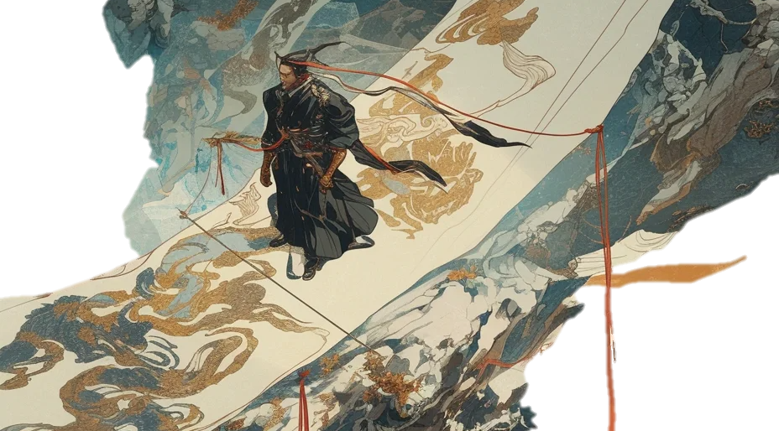
The Chinese deities are unique in their pursuit of the Great Way and their faith in taking care of all beings.
Chinese culture as the only ancient culture passed down, its pursuit of the Great Way has never changed.

Slide 7
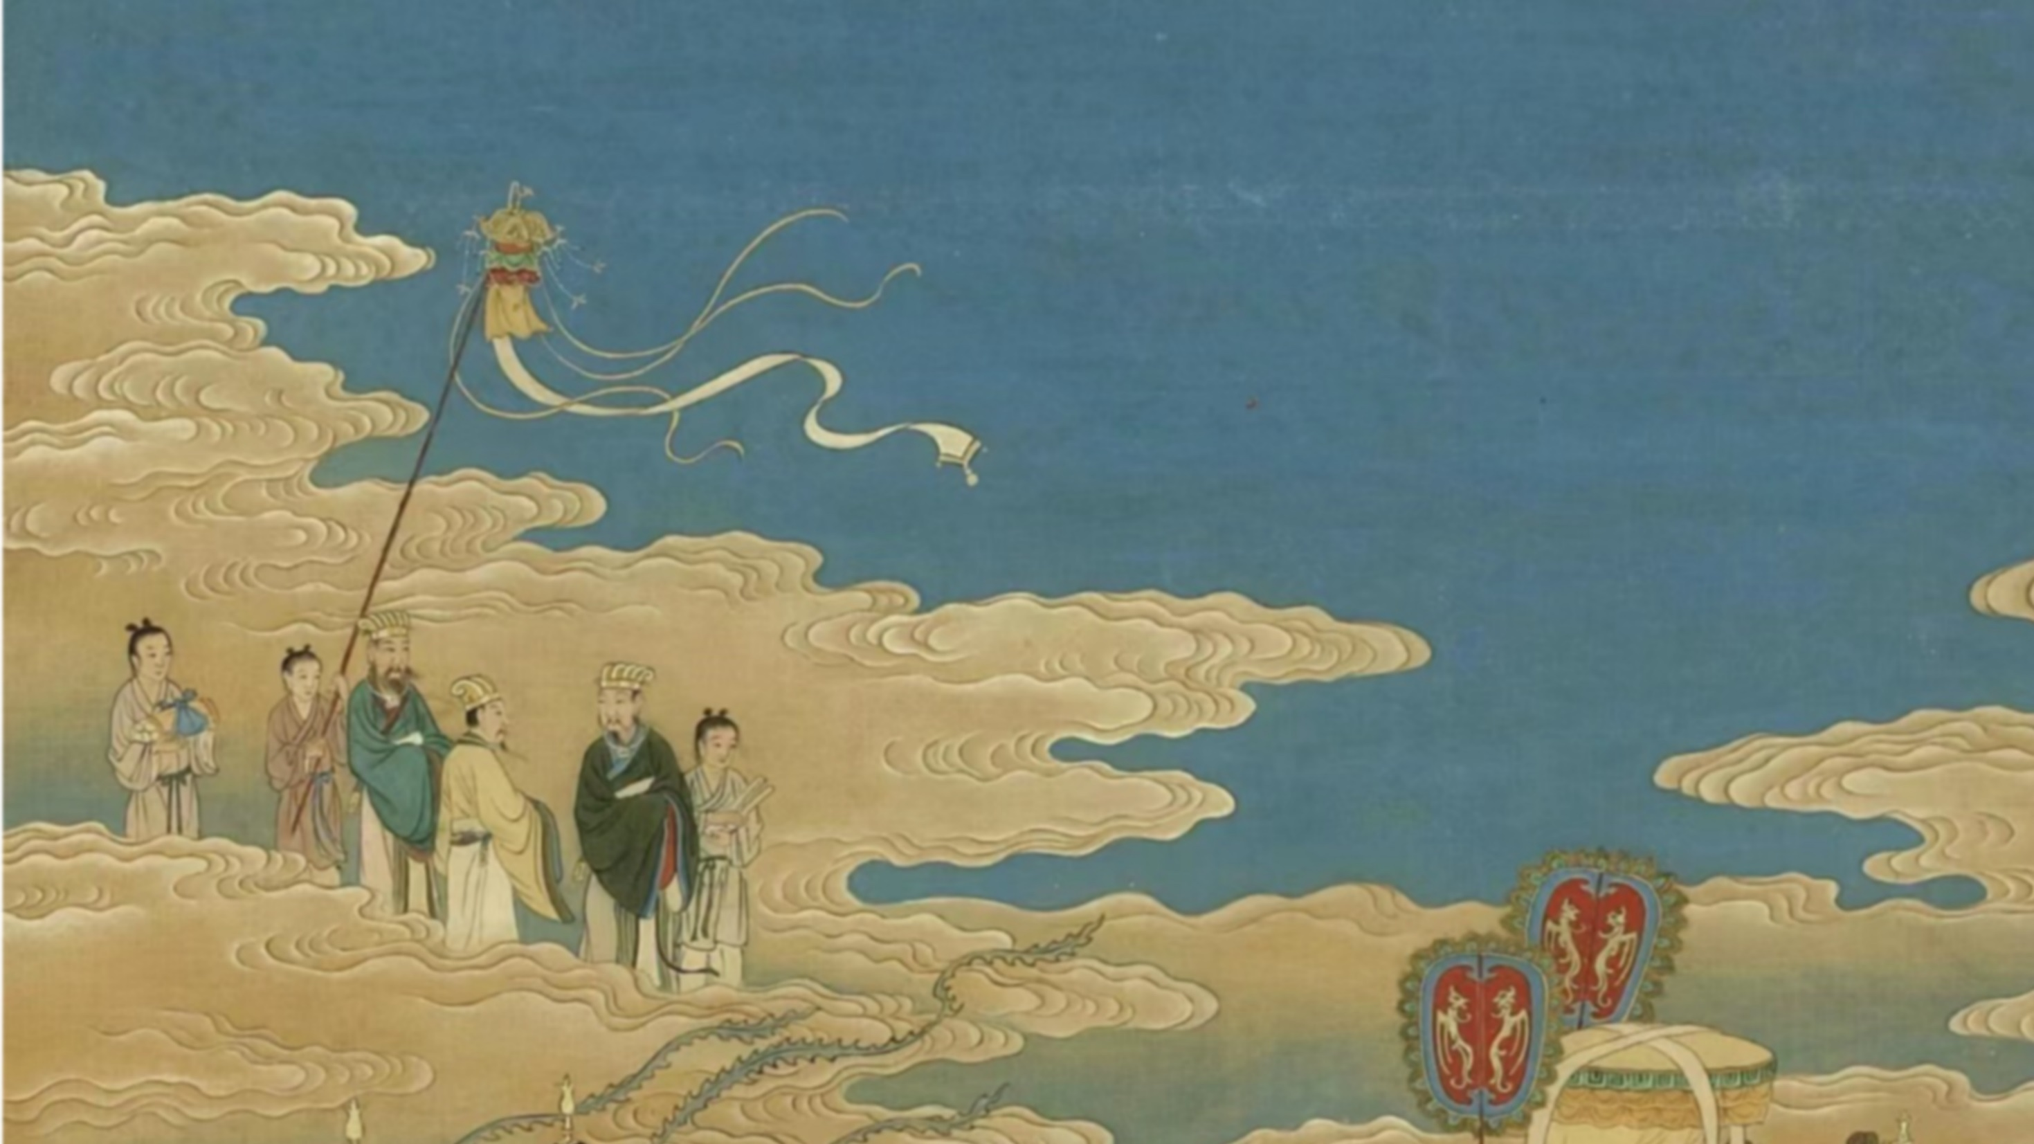
THANK YOU ！

