Slide 1




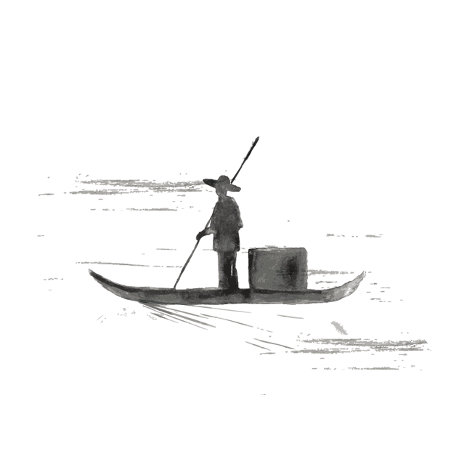
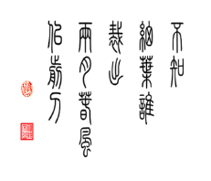
Ancient Literature-Classical Liteature
By Yang Ziwei（杨紫微）

Slide 2

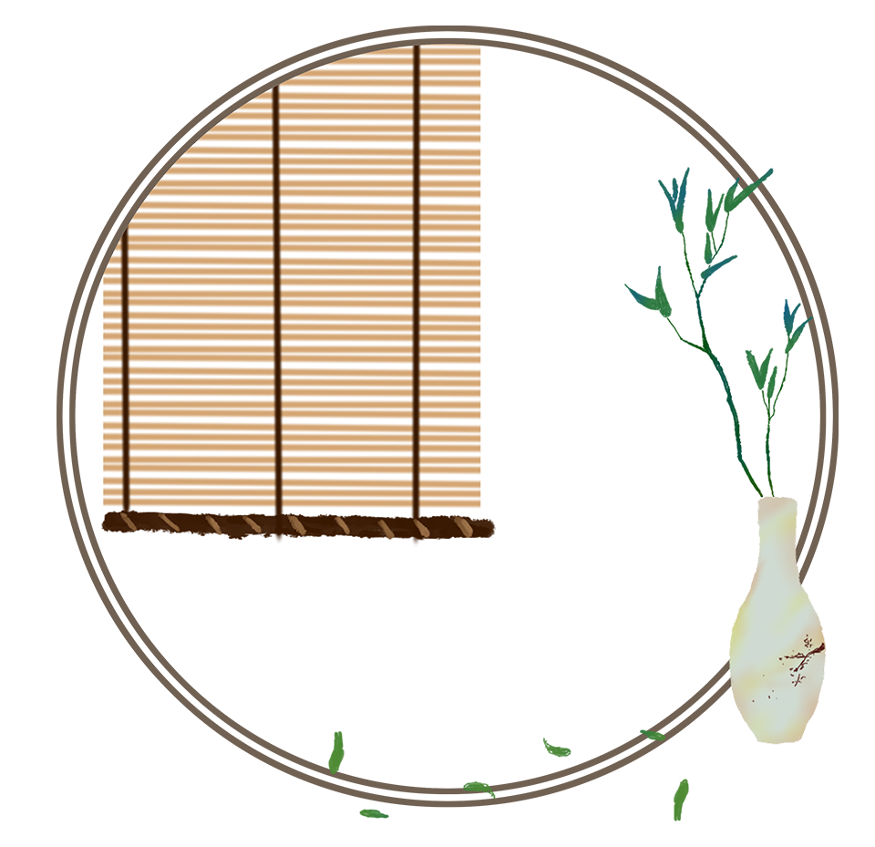
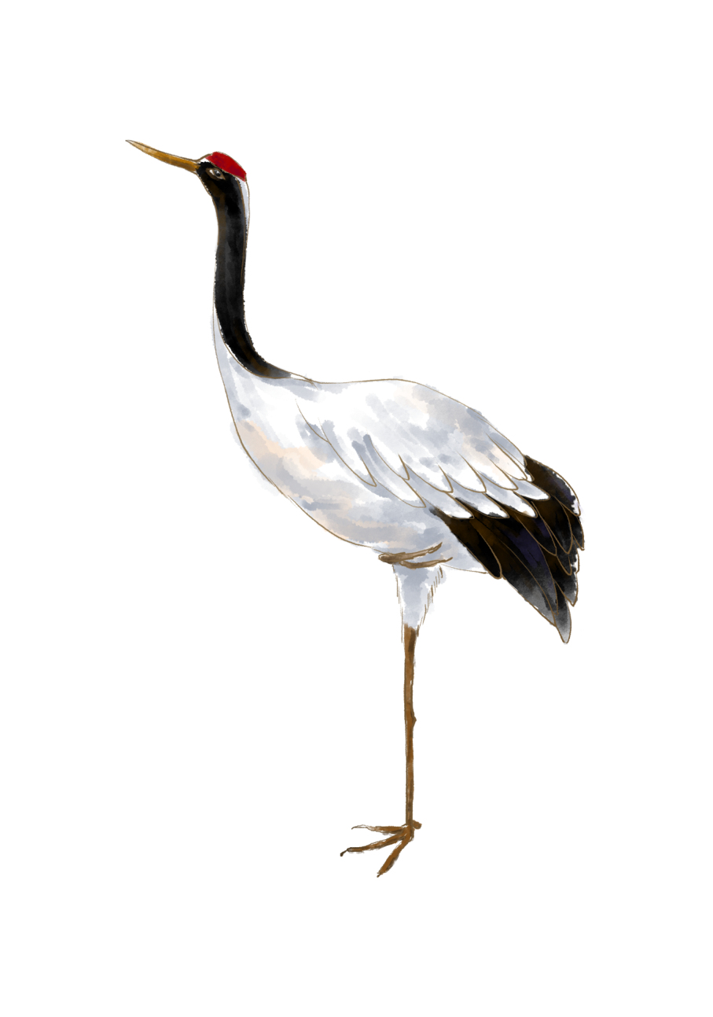
壹
贰
叁
肆
伍
定 义 与 表 现 形 式
先秦两汉文学
魏晋南北朝文学
唐宋文学
元明清文学
目录

Slide 3

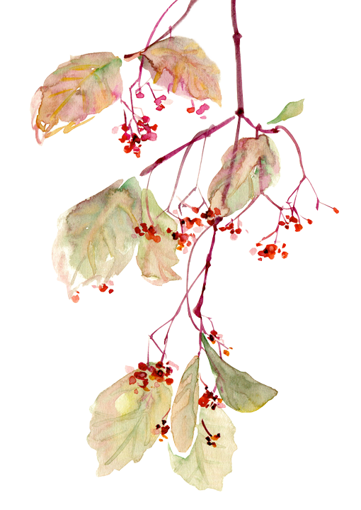
壹

Slide 4
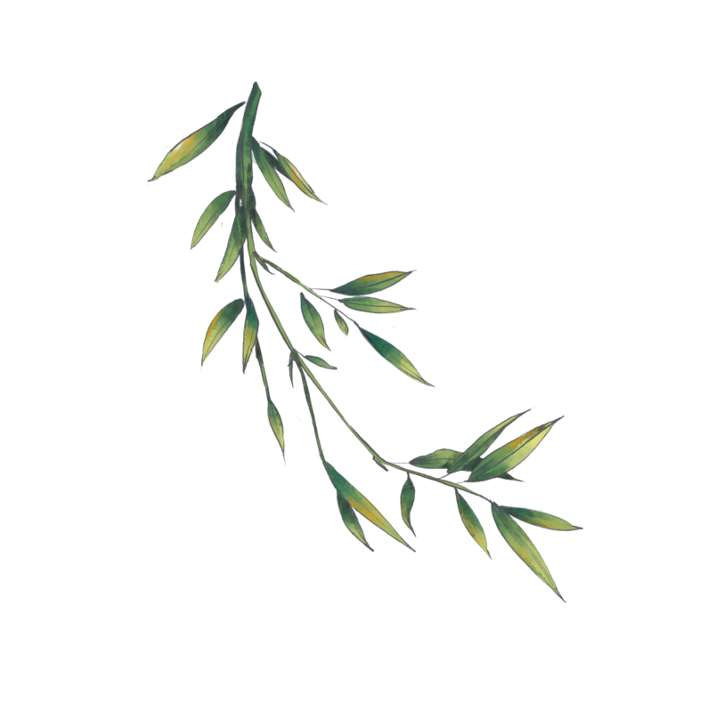
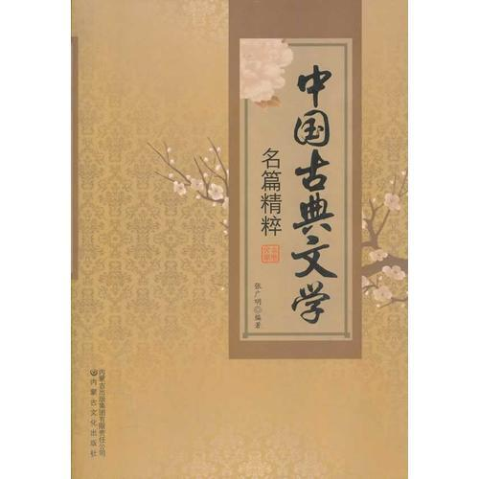
Definition and Manifestations
Chinese classical literature refers to Chinese literature of a period of around 3,000 years between the beginning of Chinese history and the Opium War of 1840.
According to literary history, it can be divided into six periods: pre-Qin literature; Qin and Han literature; Wei, Jin, Southern and Northern Dynasties; Sui, Tang and Five Dynasties; Song and Yuan literature; and Ming and Qing literature.
The representative forms of literary works include poems, Lyrics, Songs, Fu, prose, novels, etc. Chinese classical literature is one of the most precious cultural heritages of the Chinese nation.

Slide 5
贰

Slide 6
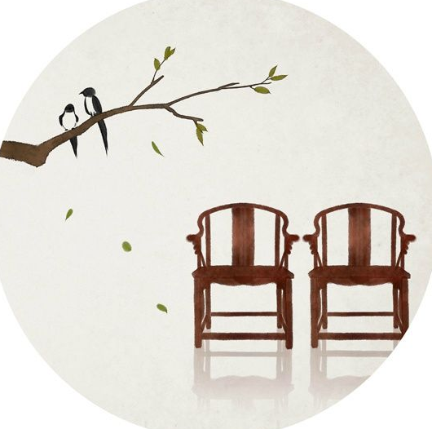
Literature of Pre-Qin and Han Dynasties
Classical literature bean during the transitional period of Chinese history from slavery society to feudal society. During the pre-Qin period, masterpieces includes The Book of Songs and “Li Sao” or “A Lament”.
The Book of Songs is the first collection of poetry in China. Compiled in the Spring and Autumn Period, it is probably about 500 years from the early Western Zhou Dynasty to the middle of the Spring and Autumn Period. There are 305 works in total, representing the highest achievement of poetry creation more than 2,500 years ago. The works in the "Book of Songs" are all composed of music, which belong to the three major parts of "Wind", "Elegance" and "Song"（风、雅、颂）. The wind is the tune of music, and the national wind is the meaning of the music of various states. There are 160 articles in total. "Wind" and "Elegance" are works reflecting the social life during the political decline of the Zhou Dynasty.

Slide 7
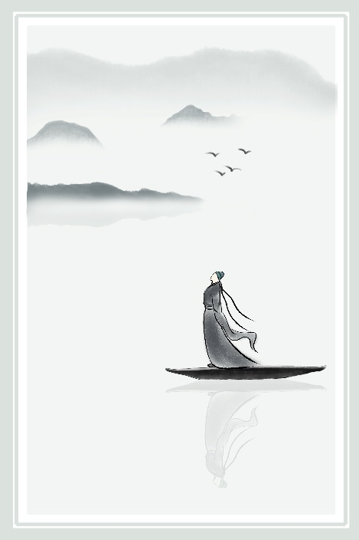
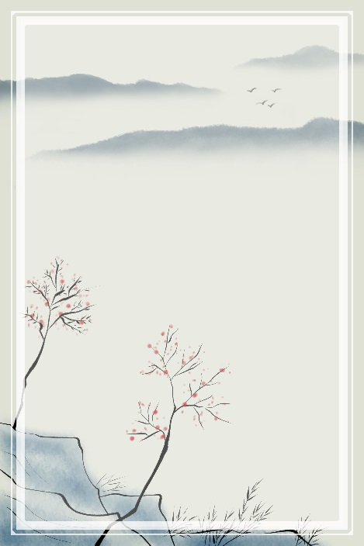
A Lament
“Li Sao" is the representative work of Qu Yuan (about 340-277 BC). It is the longest lyric poem in ancient China, with 373 sentences and 2490 words. This is a masterpiece of romanticism. In this poem, the poet bursts out with lofty ideals and fiery feelings, bursting out with extraordinary brilliance.
Qu Yuan as a great patriotic poet, his works express the poet's nostalgia for the motherland and love for the people.

Slide 8
Pre-Qin Prose and Fu In the Han Dynasty
Pre-Qin prose can be mainly divided into historical prose(历史散文) and Zhuzi prose(诸子散文). Generally speaking, historical prose is mainly narrative, and the prose of Zhuzi is mainly reasoning.
The Spring and Autumn Annals is the earliest chronicle of the Warring States compiled by Confucius. It records the major events of various countries during the 242 years from the first year of Lu Yin (722 BC) to the fourteenth year of Ai Gong (480 BC).
The prose of Zhuzi can be divided into three periods: the first period is the late Spring and Autumn period and the early Warring States period, the second period is the middle period of the Warring States period, and the third period is the end of the Warring States period.
古
韵
风
采

Slide 9
In the Han Dynasty(206 BC-220 AD), Sima Qian, a well-known writer and historian, wrote Records of the Historian, an outstanding historical work with discriptions of emperors, kings, generals, ministers of states, and peasant rebels. The book provides precious biographical records of various kinds of people who lived during the 3,000 years from the Legendary Yellow Emperor to Emperor Wudi of the Han Dynasty.
In the latter period of the Eastern Han Dynasty, Jian’an Literature (196-220) is famous and characterized by the discriptions of wars, rebellions and people’s sufferings then.

Slide 10
叁

Slide 11
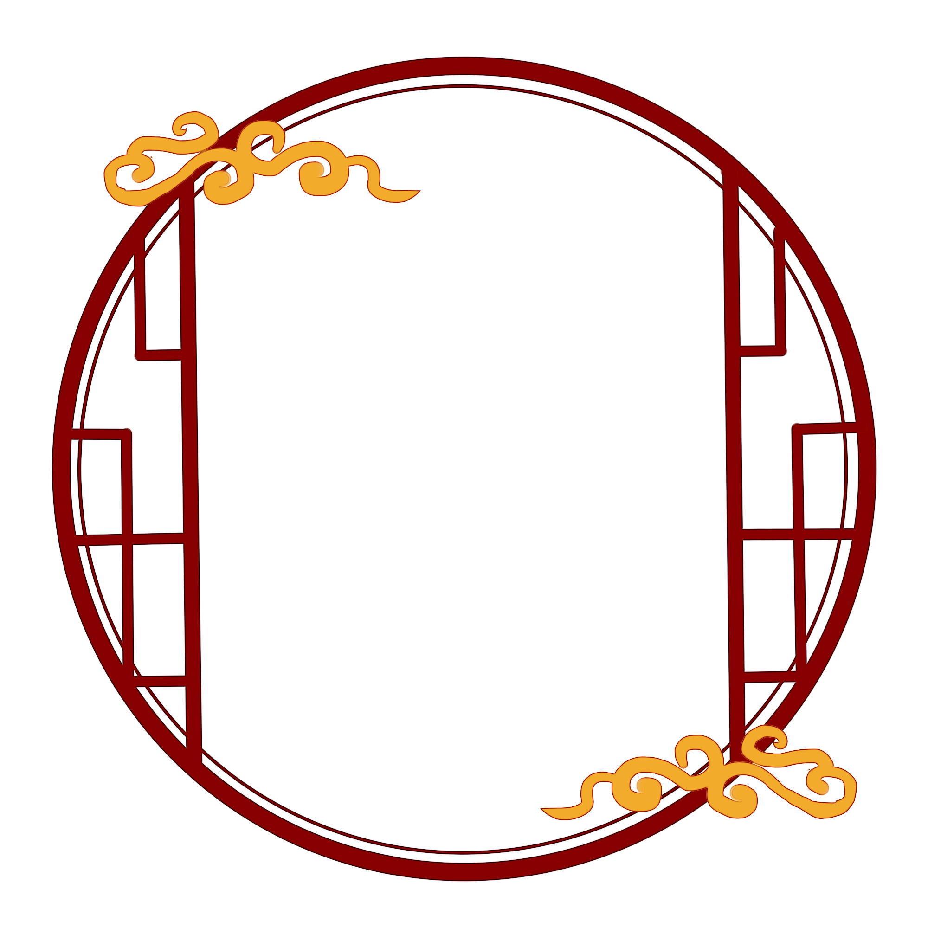
Literature of Wei, Jin, Southern and Northern Dynasties
"Seven writers of Jian’an literature" refers to the late Han writers Kong Rong, Chen Lin, Wang Can, Xu Gan, Ruan Yu, Ying Jue, Liu Zhen, and Wang Can's literary achievement is the highest. Cao Cao and his sons Cao Pi and Cao Zhi are the outstanding respresentatives. Tao Yuanming, a Jin poet, is particularly renowned for his idylic poetry.
“The Ballad of Mulan” is a good example of the folk songs in the Northern dynasty.

Slide 12
肆

Slide 13
Literature of Tang and Song Dynasties
"Four Heroes of the Early Tang Dynasty": Wang Bo, Yang Jiong, Lu Zhaolin, Luo Binwang.
The Tang Dynasty is known as the golde age of classical poetry, which resulted from the economic development and social stability. The Complete Tang Poetry contains about 50,000 poems by more than 2,000 poets, including such great names as Li Bai, Du Fu and Bai Juyi. Han Yu and Liu Zongyuan, famous poets and essayists, led a movement for reforms in literary form and style.
There are basically two types of ancient poetry in the Tang Dynasty: five-character and seven-character. There are also two types of modern poetry, one is called quatrains(绝句) and the other is called rhythmic poetry（律诗）. Quatrains and verses have five and seven characters respectively. Therefore, there are basically six basic forms of Tang poetry: five-character ancient style poems, seven-character ancient style poems, five-character quatrains, seven-character quatrains, five-character rhythm poems, and seven-character rhythm poems.

Slide 14
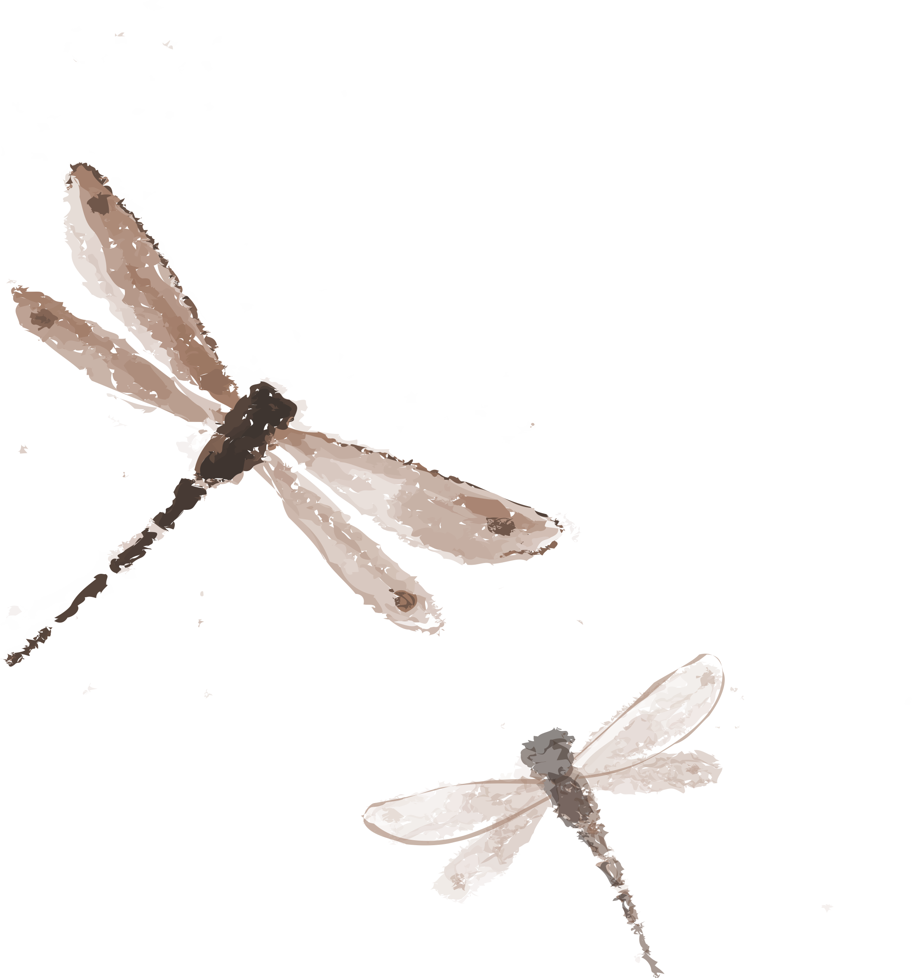
Song Lyrics is a kind of ancient Chinese poetry which is a type of poetry with lines of irregular length and set to music. It began in the Liang Dynasty, formed in the Tang Dynasty and flourished in the Song Dynasty. Song Lyrics can be roughly classified into graceful and bold schools.The former is represented by Liu Yong and Li Qingzhao, the latter is Su Shi and Xin Qiji.
Lyrics can be roughly divided into small tone (within 58 characters), medium tone (59-90 characters) and long tone (more than 91 characters, the longest word is 240 characters).
“The Eight Great Masters of Tang and Song Dynasties”, also known as “the Eight Great Masters of Ancient Prose of Tang and Song Dynasties”, is the collective name of eight prose writers of Han Yu, Liu Zongyuan in Tang Dynasty and Su Shi, Su Xun, Su Zhe, Ouyang Xiu, Wang Anshi and Zeng Gong in Song Dynasty.

Slide 15
伍

Slide 16
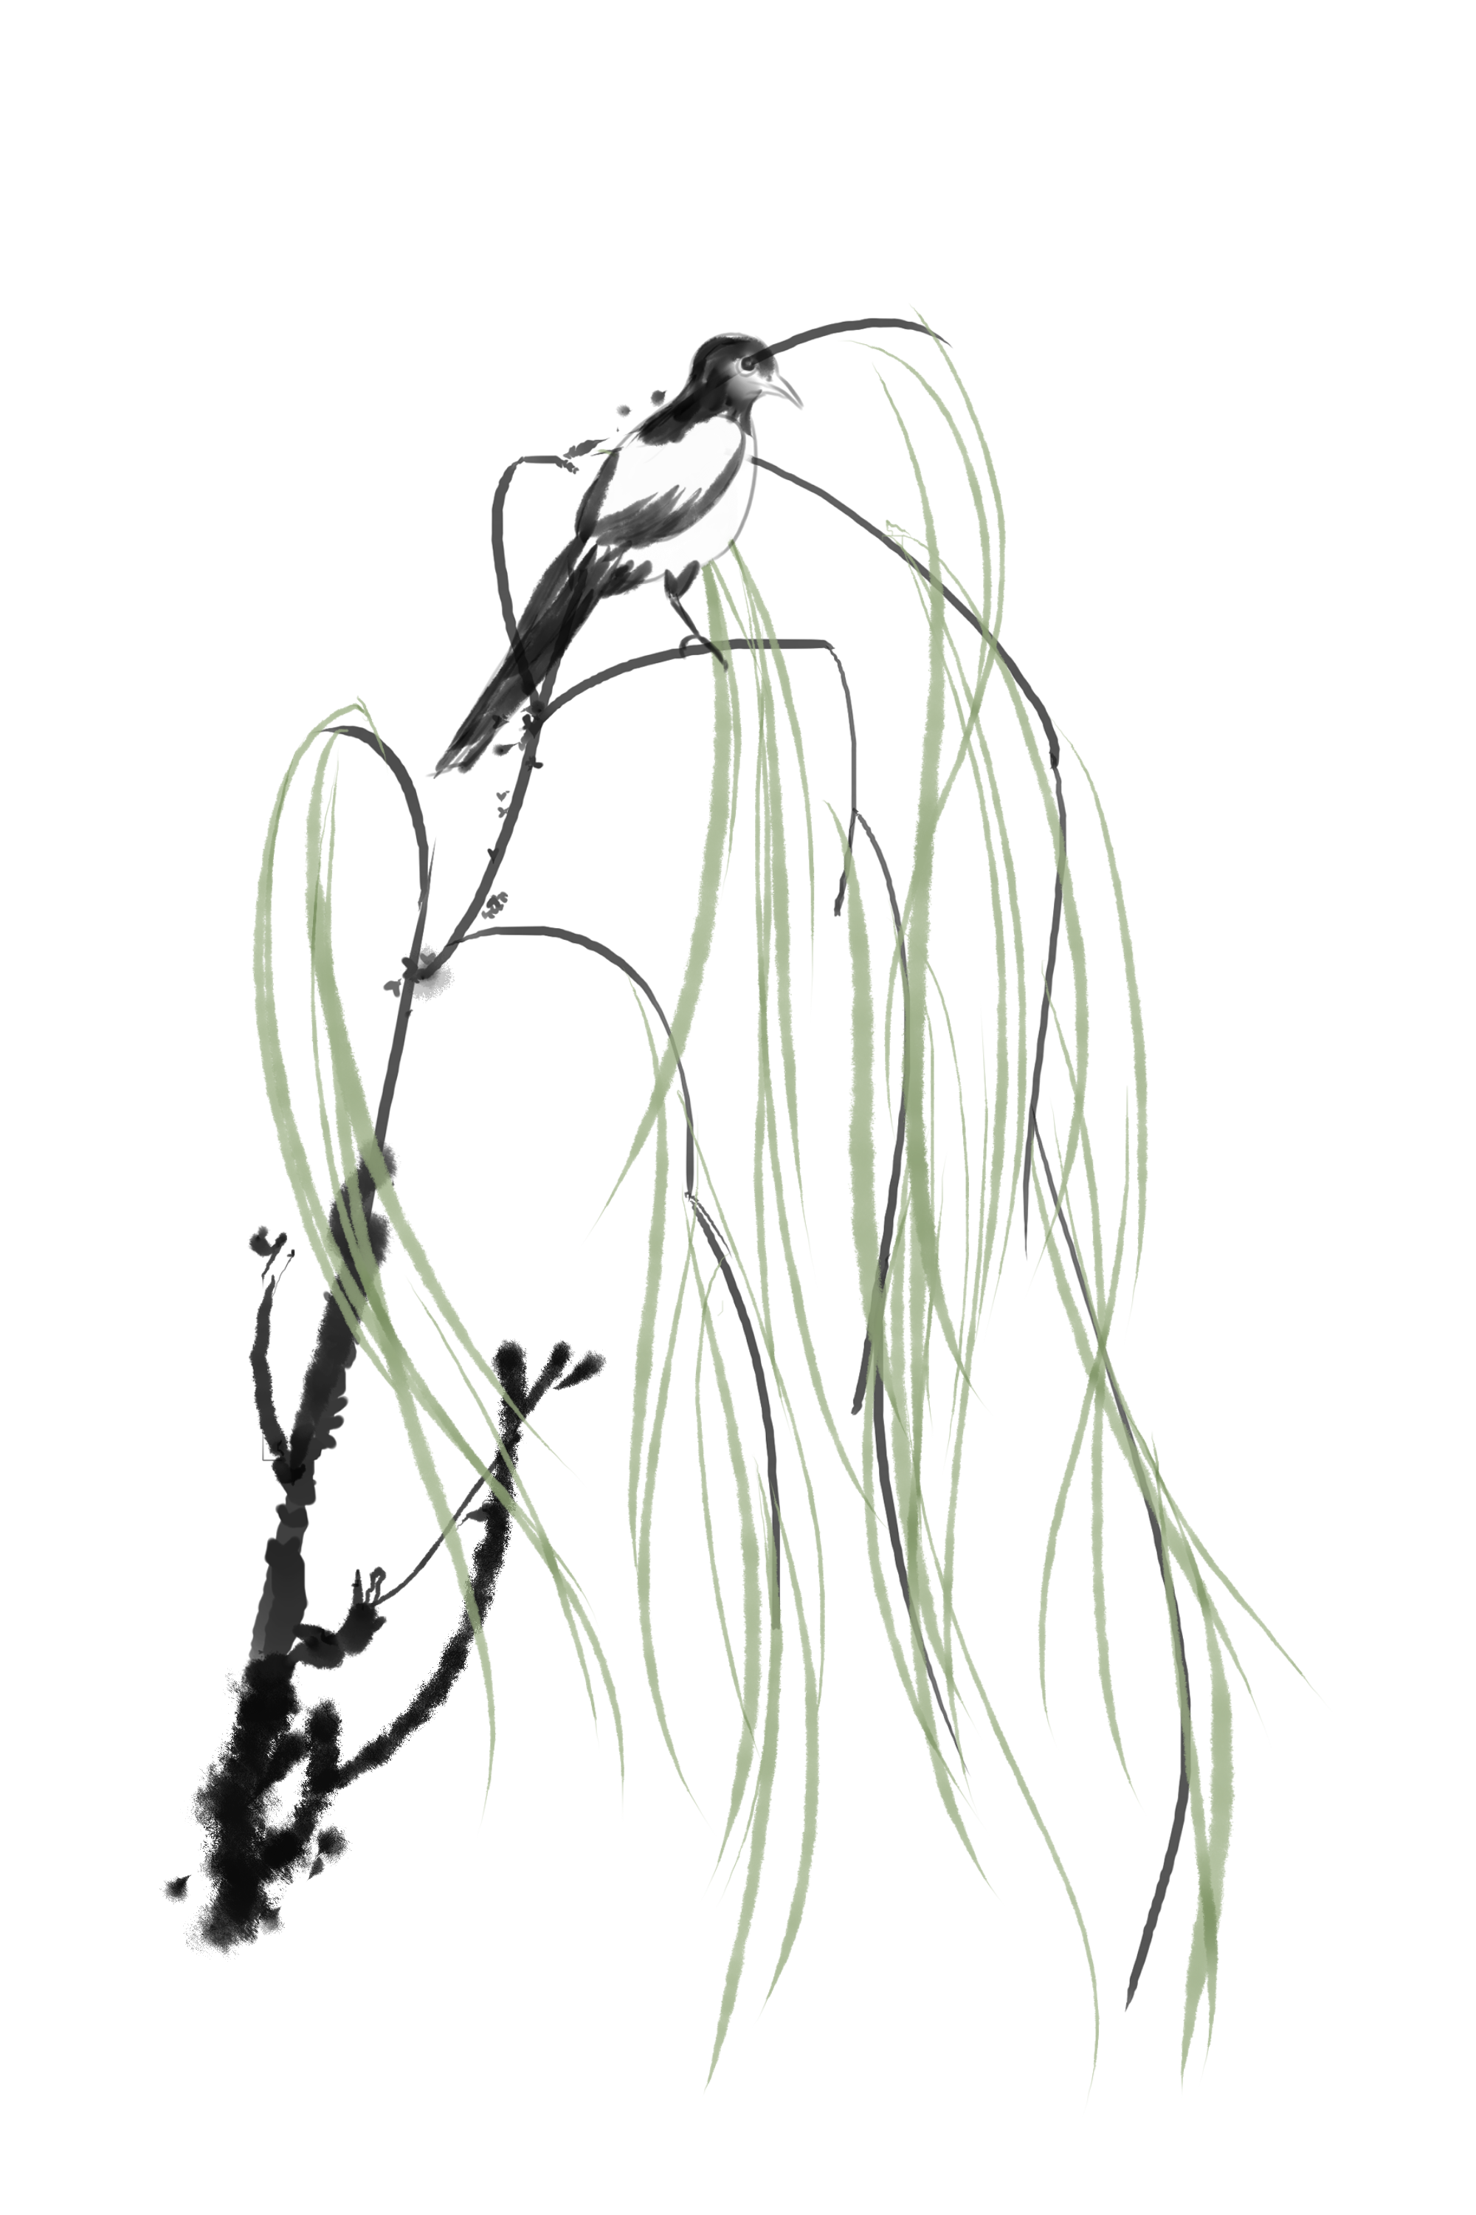
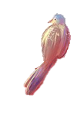
Literature of Yuan, Ming and Qing Dynasties
Yuanqu, also known as sandwich(夹心), is a literary form popular in the Yuan Dynasty, including Zaju and Sanqu, and sometimes refers to Zaju. The dramatic activities of the Yuan Dynasty actually formed two theatrical circles.
The northern theater circle is centered on Dadu, including most of the area north of the Yangtze River. The southern theater circle is centered on Hangzhou, including Wenzhou and other southeastern regions.
Famous playwrights: Guan Hanqing, Wang Shifu, Bai Pu and Ma Zhiyuan.
Works: Snow in Midsummer, The Western Chamber, The Orphan of Zhao.

Slide 17
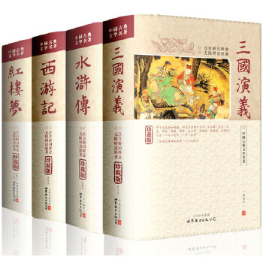
The Ming and Qing Dynasties are a prosperous period in the history of Chinese fiction. The novels written by literati in the Ming Dynasty mainly fall into two categories: vernacular short stories and novels.
Fiction and drama in the Ming（1368-1644） and Qing dynasties（1636-1911）represent their best genres in claasical Chinese literature. Among the famous plays of the Ming Dynasty are The Tale of the Lute by Gao Ming and The Peony Pavilion by Tang Xianzu. Well-known Qing plays are The Peach Blossom Fan by KOng Shangren and The Palace of Eternal Youth by Hong Sheng.
Fiction writing matured in the Ming dynasty. Masterpieces include The Romance of the 3 Kingdoms by Luo Guanzhong, Outlaws of the Marsh by Shi Nai’an, Journey to the West by Wu Cheng’en and Jin Ping Mei by Xiaoxiao Sheng. Momumental works of the Qing dynasty are A Dream of Red Mansions by Cao Xueqin, Scholars, a satirical novel by Wu Jingzi and Strange Tales from the Carefree Studio by Pu Songling.

Slide 18
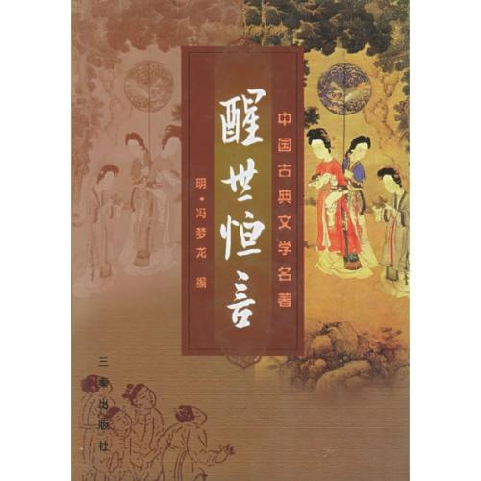
Thank you

