Slide 1
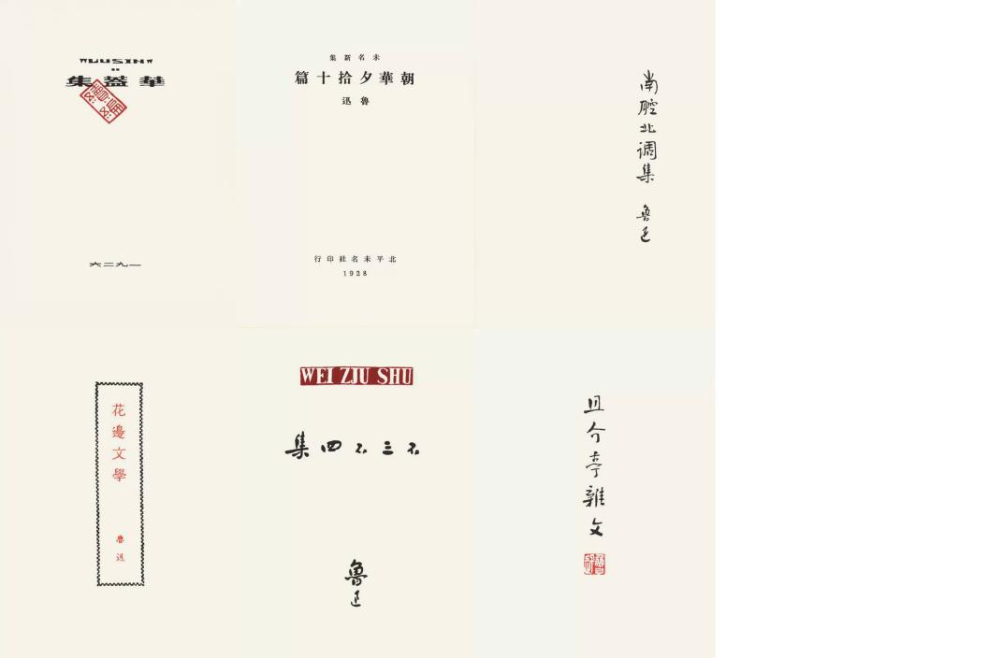
鲁迅 ：骄傲的牛
——谈作家的社会责任

Slide 2
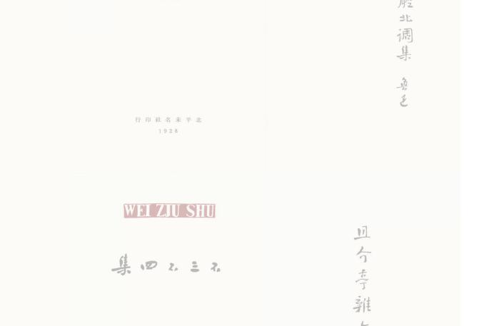
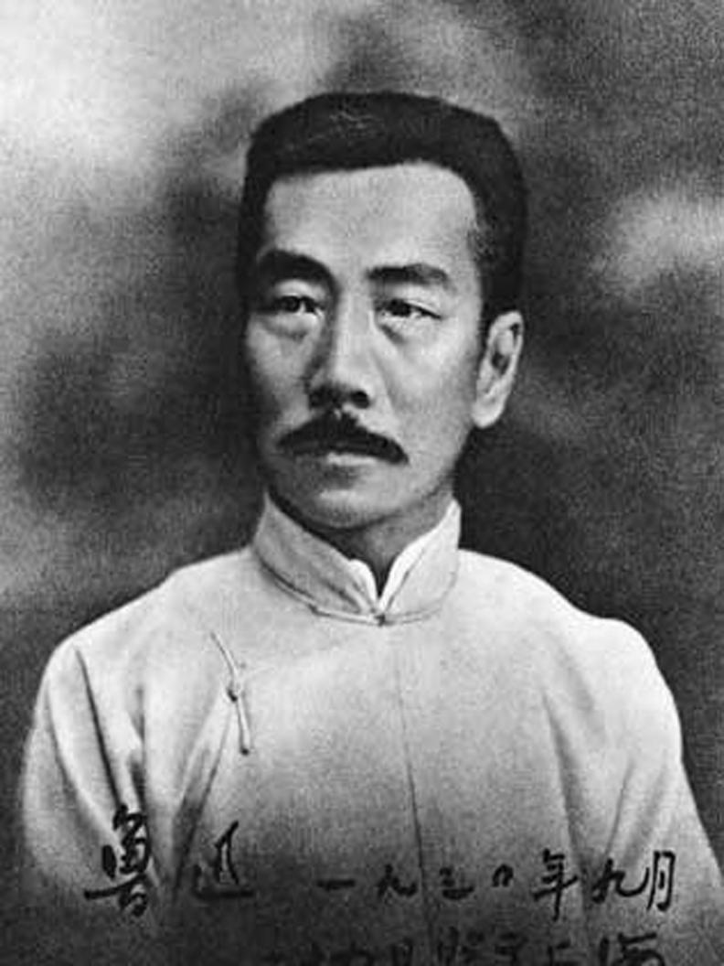
A brief introduction of Lu Xun
Lu Xun, born in Shaoxing County in Zhejiang Province on September 25,1881, was one of the Chinese greatest thinkers and man of letter in the 20th. e wrote a number of literary classics, including “The True Story of Ah Q” “A Madman's Diary”and ”Medicine”, which exposed the ugly side of human nature and emancipated people's minds.
When he was alive, his works stood out like a lighthouse, providing a guiding light for perplexed Chinese youths who were passionate about China's future. Lu Xun's works have been translated into such languages as English, Russian, German, and Korean and distributed throughout the world.

Slide 3
“His works do not belong only to one nation, but are of global value.''
---------Feng Tie, a Chinese scholar now living in Germany

Slide 4
关于“骄傲的牛”（Lu Xun’ s proud ox）
Fierce-browed, I coolly defy a thousand pointing fingers; headbowed, like a willing ox I serve the children.
横眉冷对千夫指，俯首甘为孺子牛。
I like a cow, who ate the grass and squeezed out of the milk, and the blood.”
我好像一只牛，吃的是草，挤出来的是牛奶，是血。

Slide 5
戏剧时间（dramatic time）
第一幕
时间：In 1902
地点：in a Japanese medical school's class
人物：Lu Xun and his classmates

Slide 6
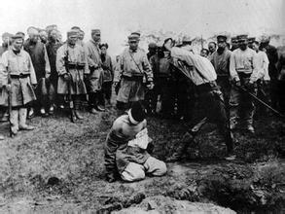

Slide 7
戏剧时间（dramatic time）
第二幕
时间：In 1902
地点：in Lu Xun's residence in Japan
人物：Lu Xun

Slide 8
鲁迅的社会责任 （LuXun’ s study for society）
（一）鲁迅的翻译作品和社会责任
Lu Xun first is the translator, followed by the writer.
Lu Xun has translated nearly a hundred writers and more than 200 works.
The most important part is the translation of Russian literature works which has a priority in Lu Xun’s translation work.

Slide 9
鲁迅的社会责任 （LuXun’ s study for society）
（一）鲁迅的翻译作品和社会责任
Lu Xun saw the “the oppressed ’s kind soul, sad, struggle.”
鲁迅看见了被压迫者的善良的灵魂，的心酸，的挣扎。

Slide 10
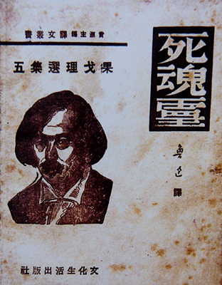
鲁迅的社会责任 （LuXun’ s study for society）
（一）鲁迅的翻译作品和社会责任
The representative work ：
Gogol’s “dead soul”
（果戈里《死魂灵》）

Slide 11
鲁迅的社会责任（LuXun’ s study for society）
（二）鲁迅与女师大（What Lu Xun did when he was in BNU）
In the autumn of 1924,
The female students of Beijing Women's Normal University
&the female principal Yang Yinyu.
Yang Yinyu forced 3 students to drop out,and soon forceed another 9 students to drop out.
In May 27th
Lu Xun published a declaration on the Beijing News , firmly supporting the female students of BNU.
Then , Lu Xun was fired by the government.

Slide 12
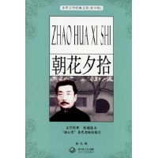
鲁迅的社会责任 （LuXun’ s study for society）
（二）鲁迅与女师大（What Lu Xun did when he was in BNU）
The agitation caused a series of arguments between Lu Xun and the "modern critics" who standed for the bad government. The controversy triggered a lot of Lu Xun's thinking, he produced a series of works to speaking for the students, like:
《朝花夕拾》
《野草》
《彷徨》(after half)
《华盖集》
《华盖集续编》

Slide 13
鲁迅的社会责任 （LuXun’ s study for society）
（二）鲁迅与女师大（What Lu Xun did when he was in BNU）
现在的所谓谁者，大抵不过是送国，也何尝想到子孙。这贤母良妻主义也不在例外，急进者虽然引以为病，而事实上又何尝有这么一回事；所有的，不过是“寡妇主义”罢了。 ——《寡妇主义》
真的猛士，敢于直面惨淡的人生，敢于正视淋漓的鲜血。这是怎样的哀痛者和幸福者？然而造化又常常为庸人设计，以时间的流驶，来洗涤旧迹，仅使留下淡红的血色和微漠的悲哀。
——《记念刘和珍君》
After May 4th ,
Lu Xun became a warrior and made social responsibility his aim for his whole life.

Slide 14
鲁迅的社会责任 （LuXun’ s study for society）
（三）鲁迅作品中的女性角色（women characters under Lu Xun’s works）
《我之节烈观》 My Views on Chastity
“National character”

Slide 15
鲁迅的社会责任 （LuXun’ s study for society）
（三）鲁迅作品中的女性角色（women characters under Lu Xun’s works）
Women characters
《伤逝》 Sadness
《明天》 Tomorrow
《祝福》 New Year Sacrifice
《离婚》 Divorce

Slide 16
鲁迅的社会责任 （LuXun’ s study for society）
（四）鲁迅与青年作家（ Lu Xun's help to young writers ）
鲁迅和萧红
Lu Xun regarded Xiao Hong as his daughter.
Xiao Hong was a frequent visitor to Lu Xun's home, and they were as close as a family.
As a result of Lu Xun's help, Xiao Hong broke into the literary world of Shanghai.

Slide 17
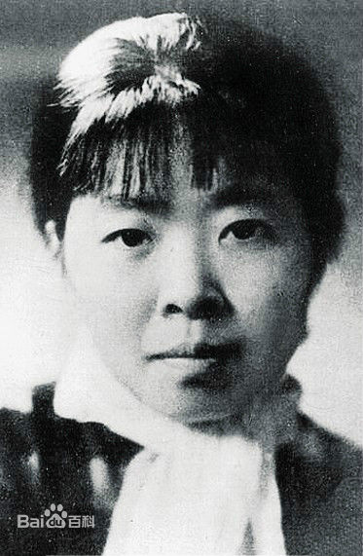
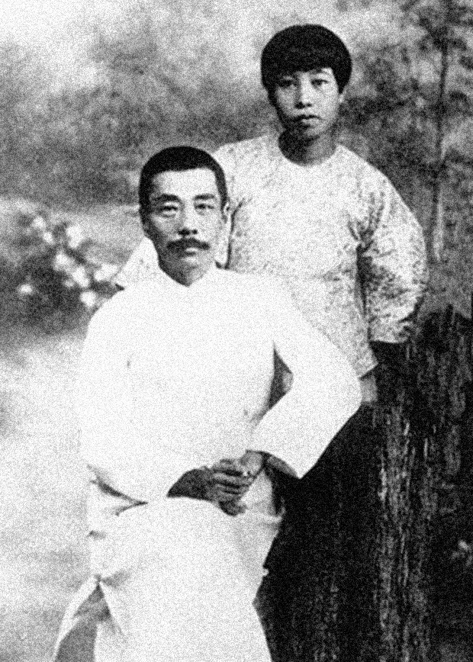
萧红个人照
萧红与鲁迅

Slide 18
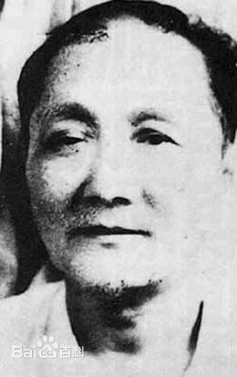
鲁迅的社会责任 （LuXun’ s study for society）
（四）鲁迅与青年作家（ Lu Xun's help to young writers ）
鲁迅和宫白羽
Gong Baiyu（宫白羽）, whose real name is Wan Xuan, is a great master of Chinese swordsman fictions.

Slide 19
鲁迅的社会责任 （LuXun’ s study for society）
（四）鲁迅与青年作家（ Lu Xun's help to young writers ）
Gong Baiyu communicated with Lu Xun by letters. In the letter he confided about his anguish and talked about his own plans and determination. He also attached his two short stories 《厘捐局》and《两个铜元》to the letter and request for correction of Lu Xun.
Lu Xun didn’t only encourage him to work hard, but also was willing to recommend his two novel to《晨报》 in his reply.

Slide 20
鲁迅的社会责任 （LuXun’ s study for society）
（四）鲁迅与青年作家（ Lu Xun's help to young writers ）
Gong Baiyu once had a meeting with Lu Xun at Lu Xun's home.
Gong Baiyu got a lot of advice from Lu Xun in his early start.
He felt very grateful and published 《话柄》, in which there were the letters from Lu Xun.

Slide 21
鲁迅的社会责任 （LuXun’ s study for society）
（四）鲁迅与青年作家（ Lu Xun's help to young writers ）
Gong Baiyu thought he failed to live up to Lu Xun’s expectations so he cut off communication with Lu Xun.
In 1955, when editing 《鲁迅全集》, a writer put the 7 letters in total from Lu Xun to Gong Baiyu in the book.

Slide 22
延伸了解：
纪录片《先生鲁迅》
..\先生鲁迅(四)-国语高清.qsv

Slide 23
总结（conclusion）：
Lu Xun, this name is always in our mind , not just because of the vivid descriptions of characters,but also highlights himself by his thought and his duty for the whole society.

Slide 24
小组成员(team members)
吴烨
陈思伊
杨紫涵
郑琪础新

