Slide 1
Chinese Courtyard Houses
Traditional Charm and Cultural Depth
Guo Cili

Slide 2
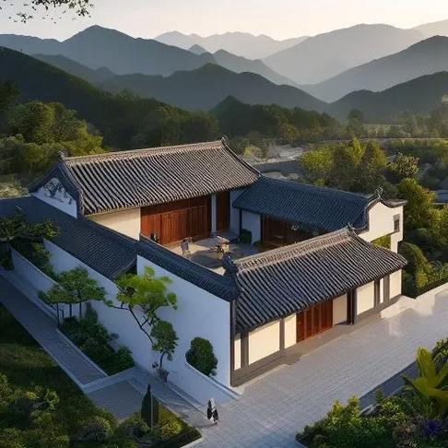
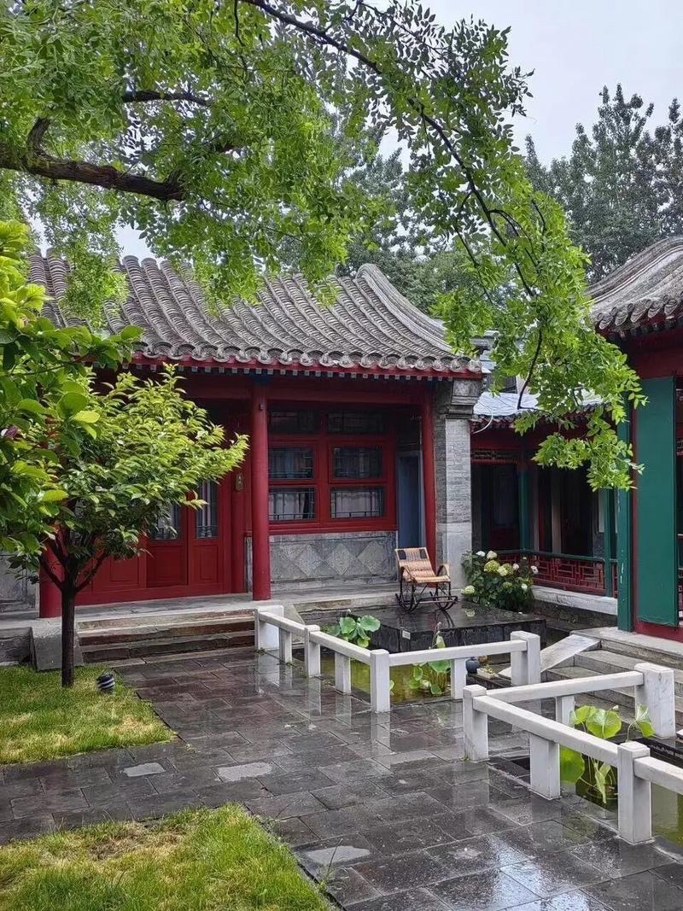
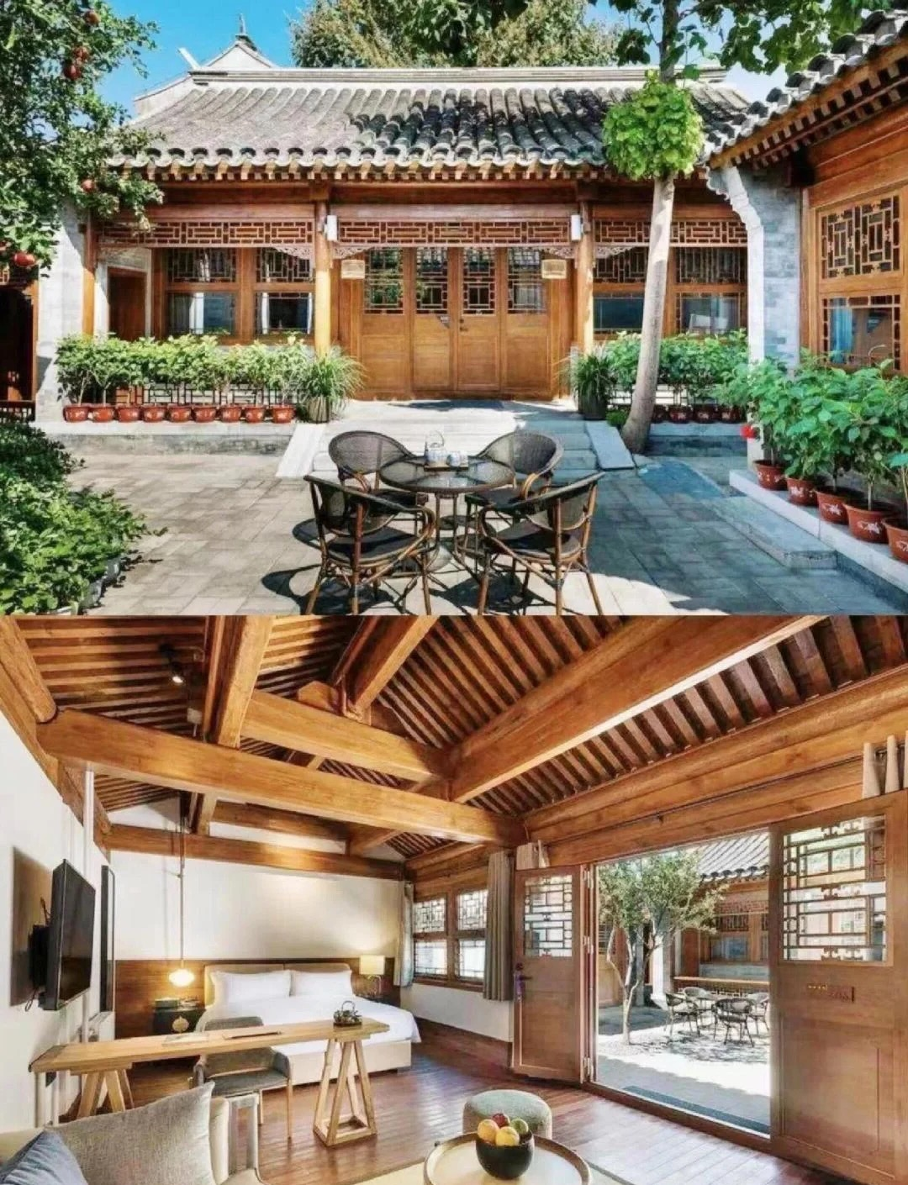
Architectural Features of Chinese Courtyard Houses
Symmetry and Layout
Central courtyard
Four-sided buildings
Craftsmanship
Wooden carvings
Roof design
Privacy and Unity
Enclosed structure
Family bonds

Slide 3
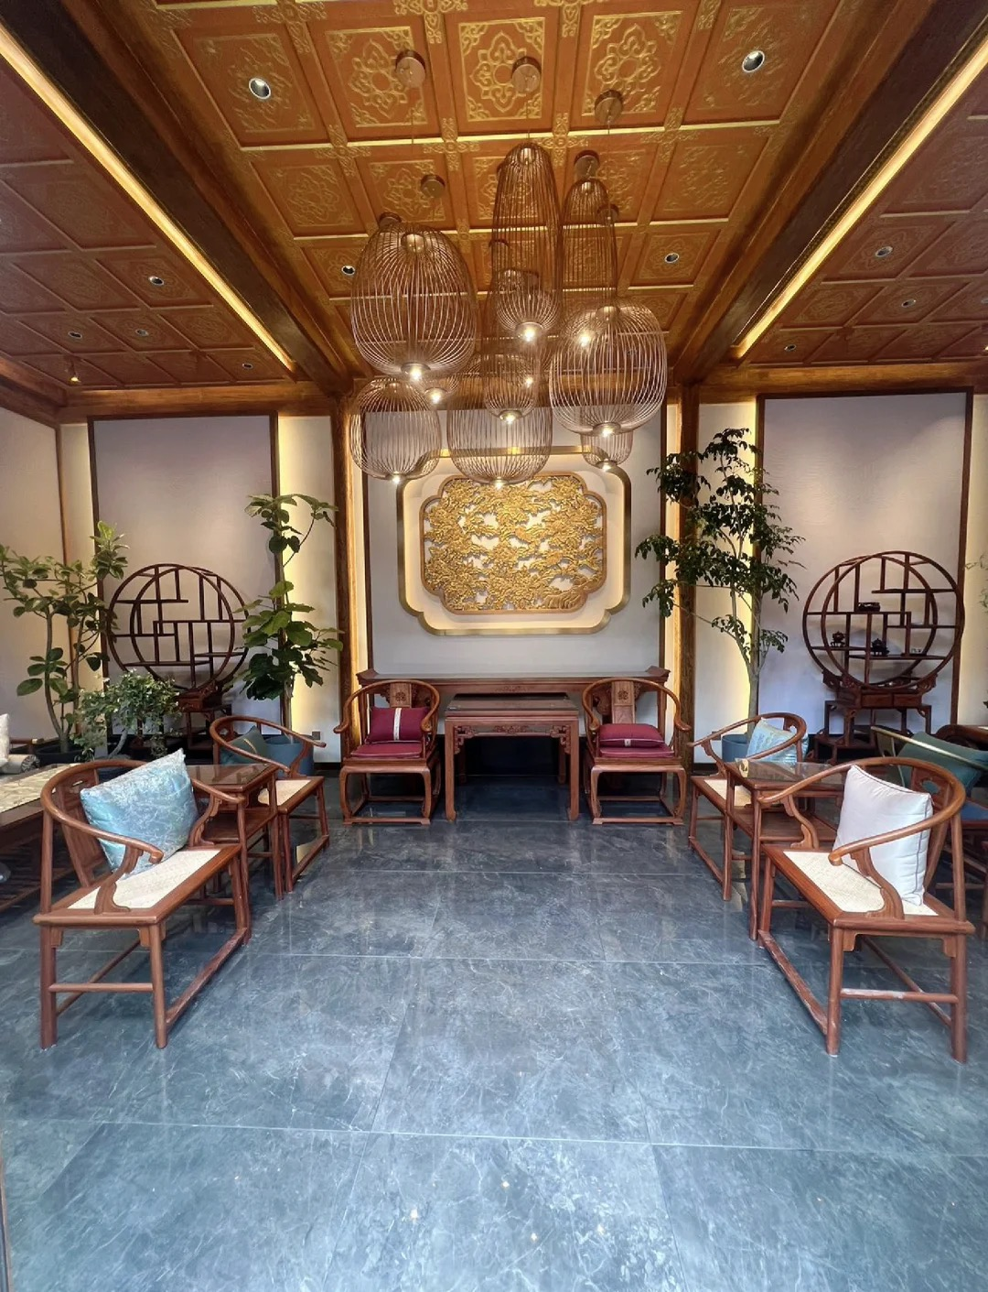
Cultural Significance
Family Hierarchy
Respect for elders
Harmonious living
Social Interactions
Gathering space
Confucian values
Symbol of Prosperity
Wealth and status
Intricate details

Slide 4
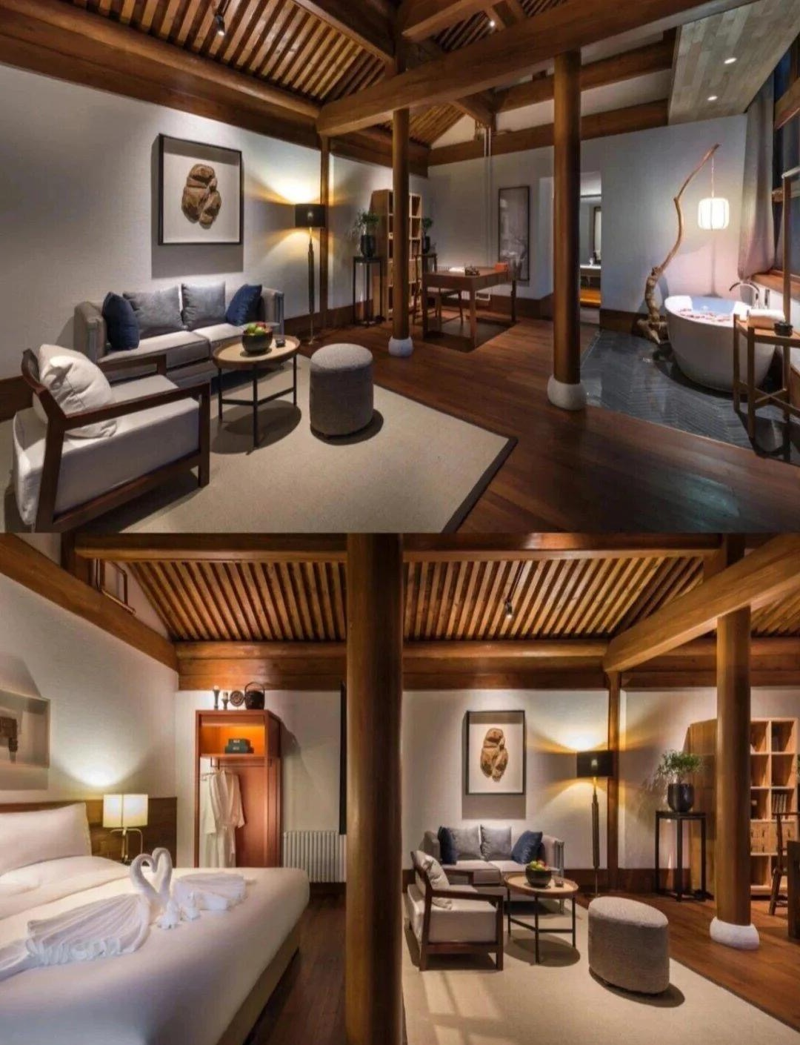
Modern Chinese Courtyard Houses
Preservation Efforts
Government
support
Community involvement
New Uses
Cultural
centers
Tourist
attractions
Cultural Exchange
Global
interest
Modern
inspiration

Slide 5
Thanks for your attention！
Guo Cili

