Slide 1
Exploring the cultural treasures of Chinese dialects
姓名：李秉洁

Slide 2
CONTENTS
01.
What is it？
02.
The types Of it
03.
Its Current situation and development
04.
Interaction

Slide 3
丨Part 1丨
Let’s recognize it

Slide 4

01.
Introduction
⬇In Chinese people, Topolect is a political science concept, actually it is the "local language". Also known as "Vernacular", "vernacular"（白话）, or "dialect", it refers to the language of a region that is distinct from the standard language, regardless of the kinship between the languages.
⬇It divides languages into family, group, branch and language according to their kinship (pronunciation, vocabulary and grammar), and under the language is dialect. Considering the special situation of China, "Chinese dialects" translated into English is "Varieties of Chinese".

Slide 5
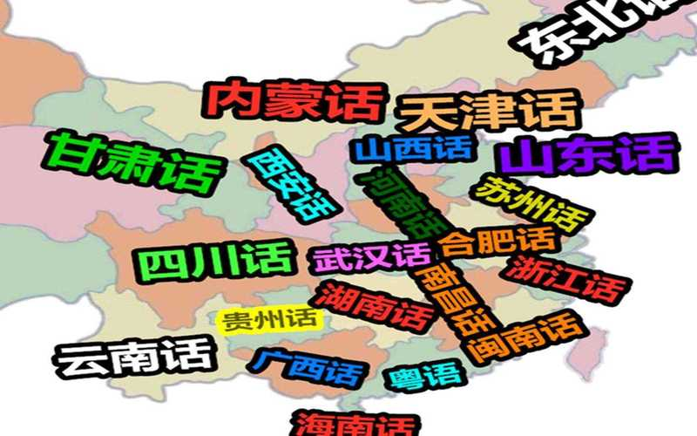


01.
Introduction
During the development of the Han Chinese society, there have been different degrees of differentiation and unity, so that Chinese gradually produced dialects.
The differences between different types of speech in modern Chinese are manifested in phonetics, vocabulary and grammar, especially in phonetics.

Slide 6
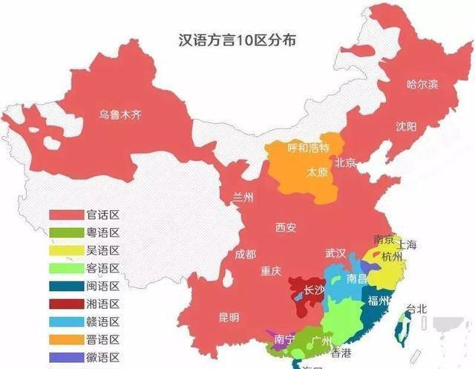
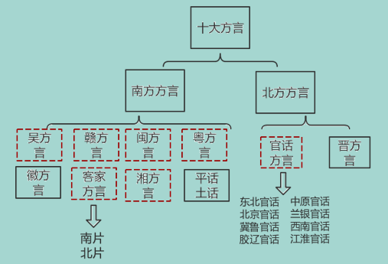
01.
introduction

Slide 7
丨Part 2丨
The type of it

Slide 8


02.
Mandarin dialects
It is the most widely distributed language in the Chinese language, and the user population accounts for about 75% of the total Han population.
好风胧月清明夜，碧砌红轩刺史家。独绕回廊行复歇，遥听弦管暗看花。
清明节的夜晚，清风习习，月色朦胧。碧玉做的栏杆，红砖砌成的墙，是刺史的府宅。
在回旋的走廊中独自徘徊，引吭高歌。听着远处传来的弦乐，默默的欣赏着花。
Among them, the most widely used mandarin dialects can be divided into eight sub-dialects: Northeast Mandarin, Beijing Mandarin, Jilu Mandarin, Jiao-Liao Mandarin, Zhongyuan Mandarin, Lanyin Mandarin, Jianghuai Mandarin and Southwest Mandarin.

Slide 9
02.
Mandarin dialects
Mandarin dialects characteristics:
⬇Large internal differences
⬇ Close to Mandarin
好风胧月清明夜，碧砌红轩刺史家。独绕回廊行复歇，遥听弦管暗看花。
⬇ Relatively simple tone
清明节的夜晚，清风习习，月色朦胧。碧玉做的栏杆，红砖砌成的墙，是刺史的府宅。
在回旋的走廊中独自徘徊，引吭高歌。听着远处传来的弦乐，默默的欣赏着花。
⬇ Ancient Chinese is rich in vocabulary
⬇ There are many local characteristic words
⬇ Special grammatical phenomena

Slide 10
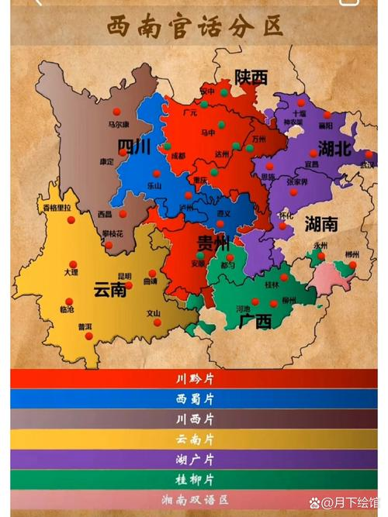

02.
Mandarin dialects
Southwest Mandarin
Immigration is the main factor of the formation of Southwest Mandarin.
the Chinese dialects in and around the southwest, the whole tone is assigned to a certain tone or four tone values similar to Chengdu, Wuhan, Chongqing, Changde, Guiyang, Kunming, Guilin.
With 270 million speakers, Southwest Mandarin is the most widely used dialect with the largest population

Slide 11

02.
Mandarin dialects
Its phonetic system is also the simplest in Mandarin dialect. In addition to the common characteristics of Mandarin dialect, such as clear dullness, differentiation of j q x from g k h/z c s, sending -m vowels into -n or -ng, and no sharp group opposition, Southwest Mandarin has indiscriminate and warped tongue sounds (some regions only read the Middle Chinese pronunciation zi-, ci-, si- as warped tongue; There are also a few areas that strictly distinguish between flat and upturned tongues, as in Beijing Dialect), between fu and hu (even f and hu are reversed), between n and l in some areas (most have n and l opposites), and between ing and in, eng and en (eng after b, p, m, f).
吃饭（chifan）--七饭（qifan）
湖南（hunan）--弗兰（fulan）
What’s the Meaning of “huolanxin” in English?
你吃饭没有
我不知道
今天天气真好
Unreliable

Slide 12
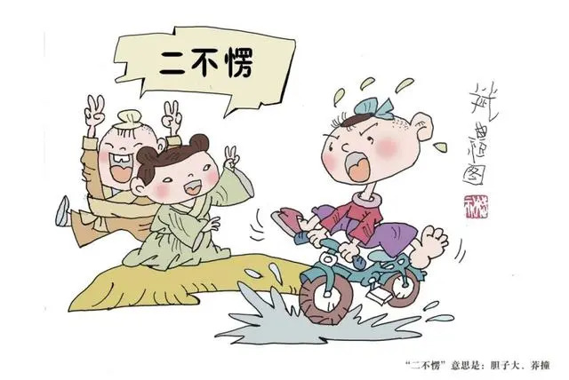
02.
Jin dialects
⬇Most Jin dialects have five tones, while in some areas there are six, seven or four tones, and there are extremely complex tone sandhi phenomena.
两人一起走叫‘厮跟上’；家里穷困叫‘家寒’”
数字一到十

Slide 13

02.
Wu dialects
Wu dialect has voiced consonants. In Middle Chinese, all voiced initial consonants still retain the voiced phoneme. For example, the initial consonants of "dòng", "tòng" and "dòng" are t, tʰ and d respectively. In Mandarin, the initial consonant of "dòng" is assimilated to a voiceless apical stop t.
陆先生让我来看看你
顺便给你带了一点点心过来
谢谢陆先生，也谢谢你
“眼瞎”指“瞎”、“离世”指“死”

Slide 14

02.
Min dialects
The Min dialects retain the contrast between voiced and voiceless sounds. For instance, the pronunciations of “da（大）” and “da（达）" are different. This contrast no longer exists in modern Mandarin.
你吃饭了吗
今天天气真好
快点快点
早餐

Slide 15

02.
Hakka dialects
The Hakka dialect retains many phonetic features of ancient Chinese, such as the absence of dental-labial sounds and retroflex sounds, a large number of monosyllabic words, and the retention of many tones. Therefore, linguists call it an "ancient fossil" of ancient Chinese and the Central Plains phonology.
你找女朋友了吗？
无”指“没有”、“箸”指“筷子”

Slide 16
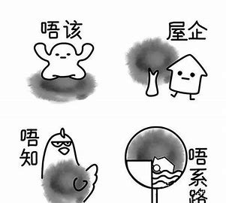
02.
Cantonese dialects
⬇The Cantonese dialect has a complete system of nine tones and six intonations, which perfectly retains the features of ancient Chinese. It has a wide range of sounds and is particularly melodious and rhyming when reciting ancient poetry.
“食（吃）”、“行（走）”、“走（跑）”、“着（穿）”、“面（脸）”、“饮（喝）”、“俾（给）”、“斟（倒）”、“怒（骂）”、“晓（知道）”、“翼（翅膀）”、“晏（迟）”、“滚水（开水）”、“倾偈（交谈）”、“下昼（下午）”、“趁虚（赶集）”

Slide 17

02.
Xiang dialects
The initial consonant system of Xiang dialect is relatively complex, and some dialects retain voiced initial consonants, such as "b", "d", "g", etc. in Old Xiang dialect.
吃饭没有
今天我们去烈士公园吧
奶奶，我要吃臭豆腐

Slide 18

02.
Gan dialects
An important characteristic of Gan dialect is the ancient voiced initial consonant being voiceless. Nowadays, when encountering stop and affricate sounds, it is pronounced as aspirated voiceless in most areas
“日头（太阳）”、“月光（月亮）”、“霍闪（闪电）”
“崽（儿子）”、“洋泥（水泥）”

Slide 19

02.
Hui dialects
In the Hui dialect, the ancient voiced initial consonants have been cleared in most areas, and today most characters that read the stop and affricate initial consonants are aspirated
“先”即“先生”，“造化”为“幸运”之义
“不曾”表示“没”、“没有”，“一堆”表示“一起”、“一块儿”

Slide 20

02.
Pinghua dialects
After the ancient voiced initials of Pinghua dialect are cleared, plosives and affricates generally do not carry air,
你吃饭了没有；
我要去读书了；
今天天气真好；
“帝”表示“到”、“在”、“被”、“把”等义

Slide 21
丨Part 3丨
The Current situation and development

Slide 22
03.
Current situation
Decline in usage: With the popularization and promotion of Mandarin, the frequency of the use of Chinese dialects has shown a significant decline on the whole. Due to the lack of adequate contact and use opportunities, many young people have poor ability to master and use their hometown dialects, resulting in an obvious intergenerational break in the transmission of dialects.
Obstruction of cultural inheritance: Dialect is an important carrier of regional culture, the decrease of its use frequency directly affects the inheritance of local culture. Many folk arts and traditional customs closely related to dialects are also facing the dilemma of no successor, and the uniqueness and diversity of local culture are gradually weakening

Slide 23
03.
Current situation
Changes in the family environment:The family is an important place for the transmission of dialects, but nowadays the language use environment within many families has changed. In order to better adapt their children to modern society, parents often choose to use Mandarin in family communication, resulting in a lack of dialect language environment and learning opportunities for children.
Weak language awareness:Some dialect users have insufficient understanding of the value and significance of dialects, and lack the awareness of protecting and inheriting dialects. They believe that the use of dialects will affect the learning and promotion of Mandarin, so as to actively reduce the use of dialects in daily life.

Slide 24

03.
development
Dialect is the treasure of regional culture, carrying the local sounds and feelings. We should cherish and protect dialects to make them shine in the tide of The Times. It is expected that dialects, like smart notes, will play a multi-cultural movement and leave a rich spiritual treasure for the later generations.

Slide 25
丨Part 4丨
Interaction

Slide 26


04.
Interaction

Slide 27
Thanks for your listening!

