Slide 1

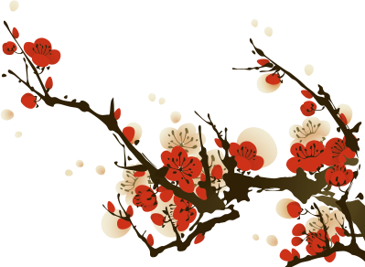



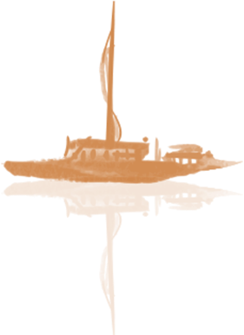
Exploring the Essence
Of Hui Culture
Liu Jianan
2025.5.23

Slide 2
Overview of Hui Culture​
01
Contents
The Key Elements of Hui Culture
02
​Hui Culture and the Development of Language Culture
03

Slide 3
01
PART
Overview of Hui Culture

Slide 4
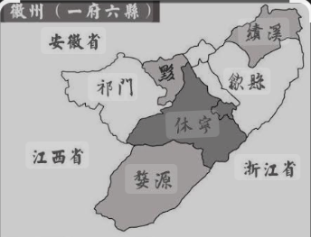
Geographical Scope and Cultural Genes
01
The ancient Huizhou region, nestled in the transitional zone between the Huangshan Mountains and the Yangtze River Delta, developed a harmonious philosophy of "unity between humans and nature" through its unique mountain-water geography.​

Slide 5
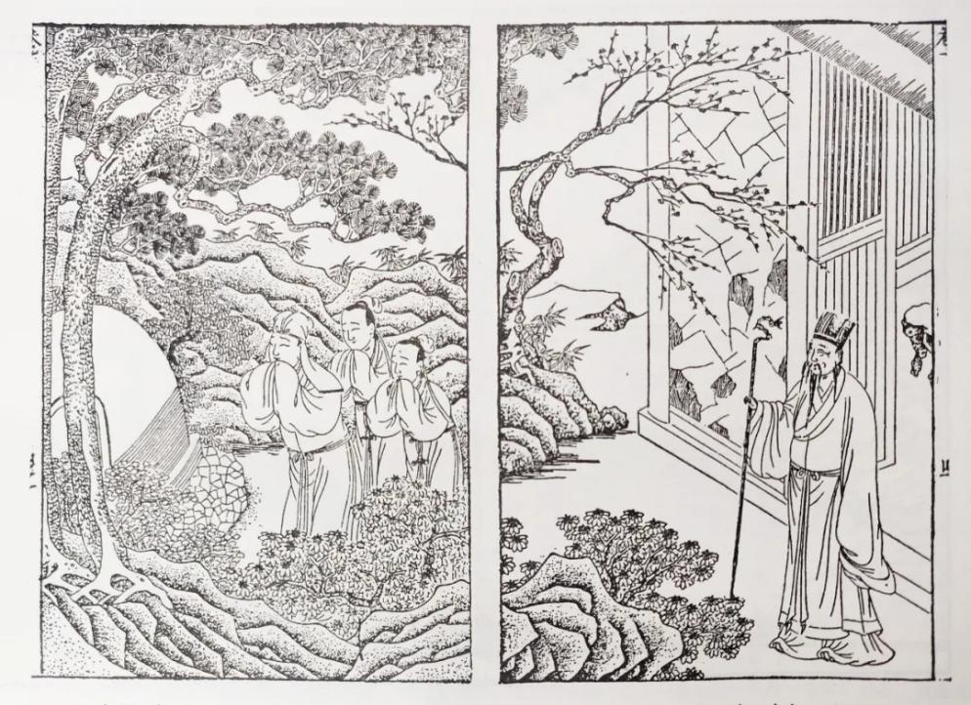
Geographical Scope and Cultural Genes
02
Huizhou Culture is a fusion product of Central Plains culture and Shan-Yue (mountain Yue) culture. Four waves of migration from the Central Plains (from the Eastern Han to the Northern Song Dynasty) brought advanced technologies, shaping a cultural gene characterized by "equal emphasis on farming and scholarship, and the integration of commerce and Confucianism." This cultural gene is deeply rooted in the lives of the Huizhou people, influencing their behavior and values.

Slide 6
02
PART
The Key Elements of Hui Culture

Slide 7
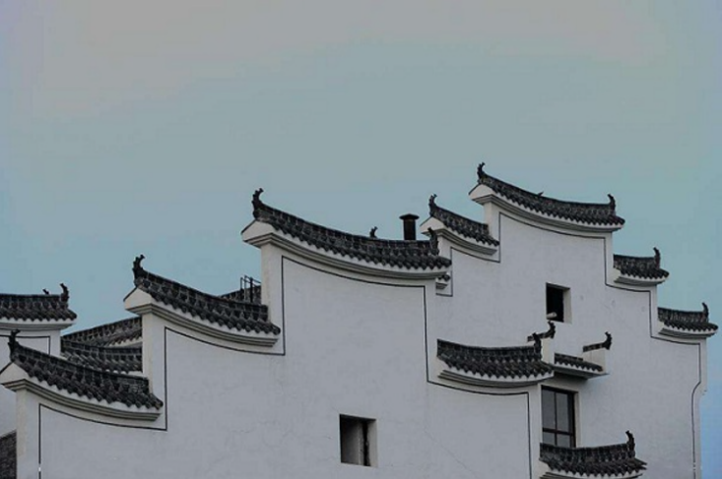
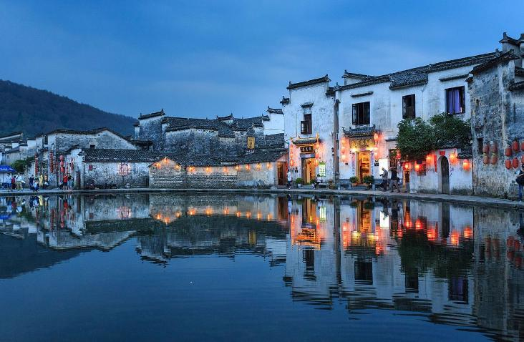
1、Hui-style Architecture
Technical Features: Built with brick, wood, and stone, Huizhou-style architecture features horse-head walls (马头墙) for fire prevention and security, as well as skywells (天井) designed under the concept of "four waters returning to the hall" (四水归堂), symbolizing the accumulation of wealth.
Cultural Significance: Beyond its practical functions, Huizhou architecture carries profound cultural meaning, reflecting the values and aesthetic tastes of the Huizhou people.

Slide 8
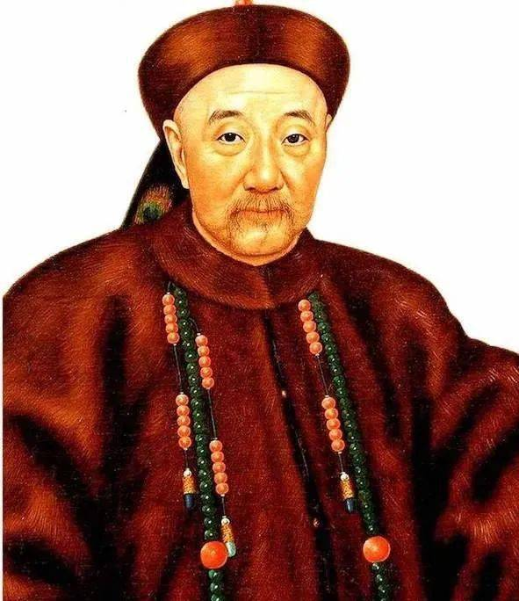
2、Hui Merchants
During the Ming Dynasty, the state monopoly on the salt trade enabled Huizhou merchants to amass enormous wealth, establishing a commercial network so extensive that it was said "no town could thrive without Huizhou merchants." The rise of Huizhou merchants not only brought economic prosperity but also catalyzed the flourishing development of Huizhou culture.

Slide 9
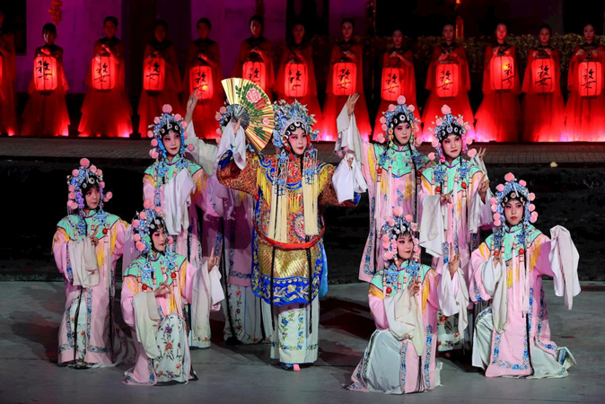
3、Hui Opera
The Formation of Hui Opera and Peking Opera
Huizhou Opera and Peking Opera:
The Four Great Huizhou Troupes (Sanqing, Sixi, Chuntai, and Hechun) brought Huizhou Opera to Beijing, where it merged with Hantune (汉调) to form Peking Opera. Representative works include Drowning the Seven Armies (水淹七军) and The Drunken Concubine (贵妃醉酒). The performance style and artistic techniques of Huizhou Opera profoundly influenced the formation and evolution of Peking Opera.

Slide 10
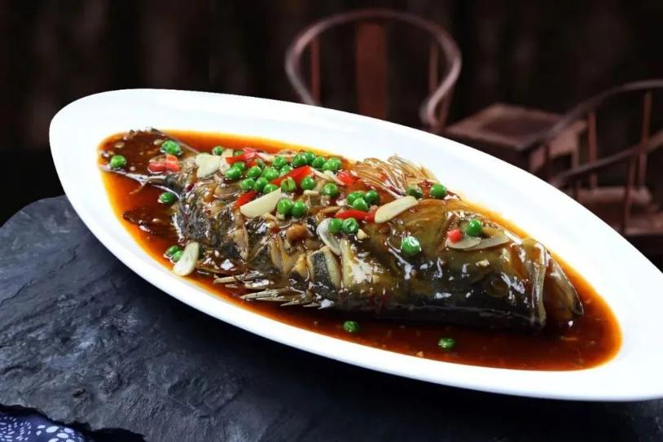
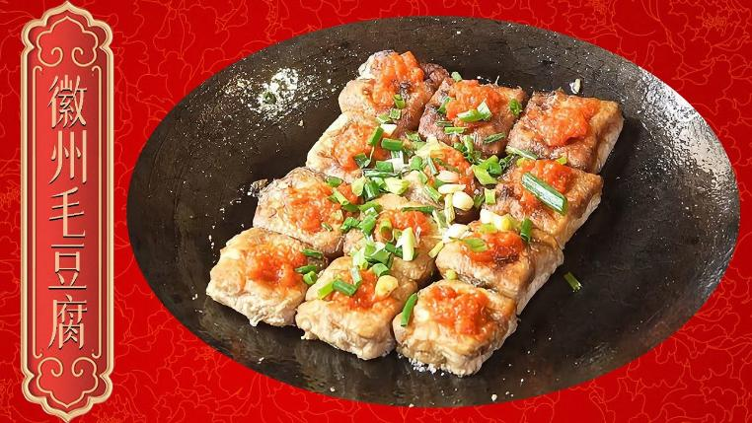
4、Hui Cuisine
Hui Cuisine Culture: Hui cuisine is known for its emphasis on rich flavors and precise heat control. Signature dishes include stinky mandarin fish (prepared through salting and fermentation) and fermented tofu (naturally mold-ripened), both of which reflect the concept of "food and medicine sharing the same origin." The cooking techniques and culinary traditions of Hui cuisine showcase the wisdom and creativity of the Huizhou people.

Slide 11
03
PART
Hui Culture and the Development of Language Culture

Slide 12
Culture-Tourism Synergy and Global Promotion
Integration of World Cultural Heritage and Cultural Tourism
International Exchange and Cultural Transmission
Themed Hui culture routes encompass visits to ancient villages, traditional tea ceremonies, and hands-on intangible cultural heritage experiences.
The Hui Studies Forum has been incorporated into the Belt and Road Initiative’s cultural cooperation projects, and Hui Opera troupes regularly tour overseas to share this art form with global audiences.
Intangible Cultural Heritage Projects and Preservation Measures
Digital Preservation and Innovation
The Palace Museum’s Craftsmanship Workstation promotes the integration of traditional techniques with modern design.
3D scanning technology is used to restore intricate details of ancient architecture.

Slide 13
​​Thank you for your listening！

