Slide 1
The Economy and Society of China
China is changing every day.

Slide 2
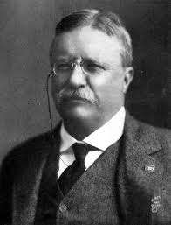
Early Chinese Trade
China limited their trade during the Ming Dynasty.
Theodore Roosevelt, in 1903, helped with negotiations with China to open up Manchurian cities to trade.

Slide 3
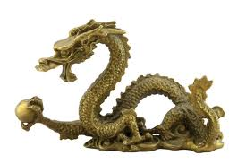
China’s Society
China’s approximate population, as of July 2012, is 1,343,239,923
China’s large and growing population has a lot to do with it’s economy.
The ethnic groups in China are: Han Chinese 91.5%, Zhuang, Manchu, Hui, Miao, Uighur, Tujia, Yi, Mongol, Tibetan, Buyi, Dong, Yao, Korean, and other nationalities 8.5% according to the 2000 census.
http://www.youtube.com/watch?v=Y7_p79ywS7E

Slide 4
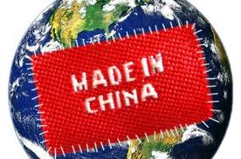
Chinese Economy
The wealth and resources of a country or region, especially in terms of the production and consumption of goods and services.
In 2004, China’s economy grew by 9%
Video: http://www.youtube.com/watch?v=2uuaVXpFwIs

Slide 5
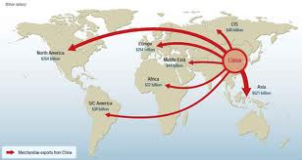
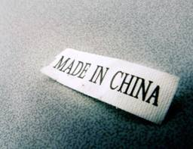
In 2010, China became the world’s largest exporter. It also became the second largest economy, after the U.S., passing Japan in 2001.
$1.904 trillion (2011 est.) in Exports
$1.743 trillion (2011 est.) in Imports
Notes:
Everyone name a few things you can think of that are manufactured in China.

Slide 6
Sources
http://www.theodoreroosevelt.org/life/NobelStickessay.htm
http://news.nationalgeographic.com/news/2005/05/0516_050516_chinaeco.html

